Slide 1
Group 1

Slide 2
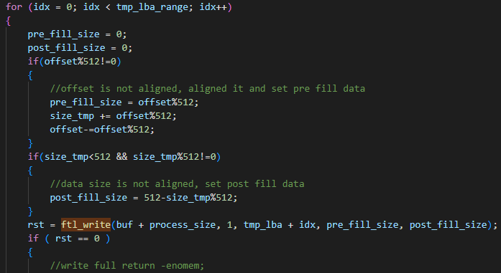
ssd_do_write

Slide 3

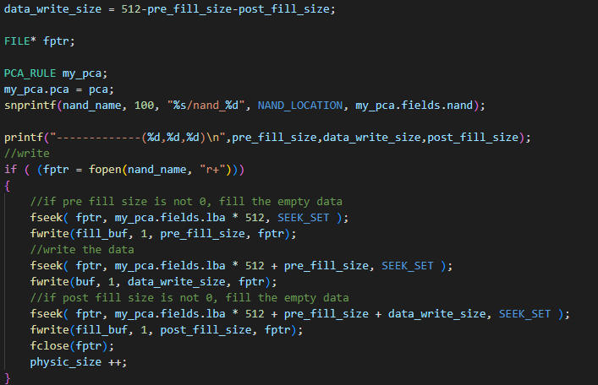
Ftl_write
Nand_write

Slide 4
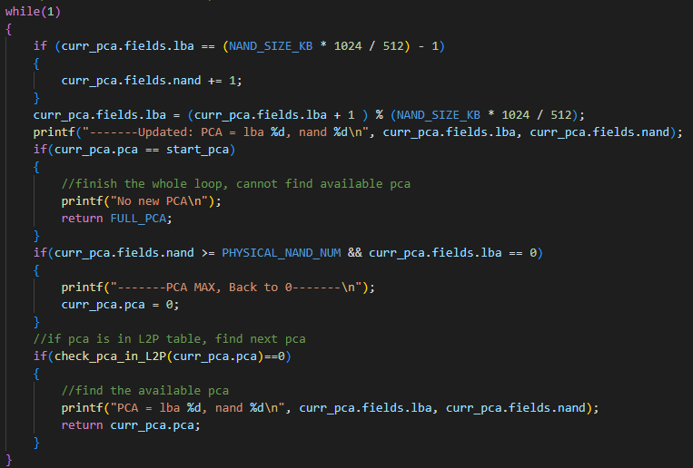
Get_next_pca

Slide 5
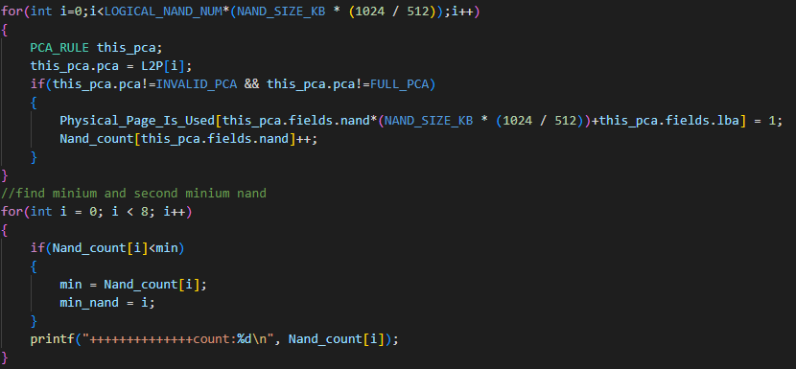
Ftl_gc

Slide 6

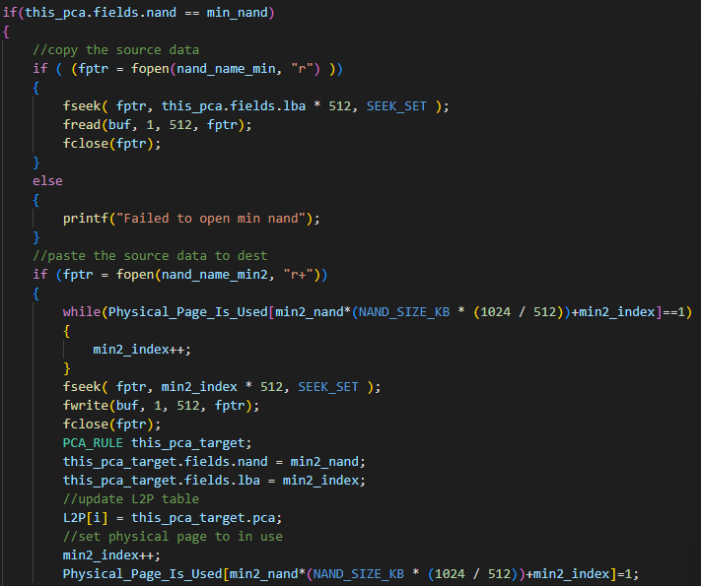

Ftl_gc

