Slide 1
React.js

Slide 2
Bagian 3: Routing

Slide 3
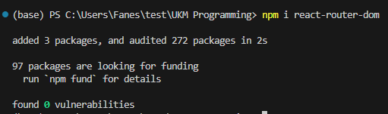
Instalasi
Jalankan sintaks: npm install react-router-dom

Slide 4
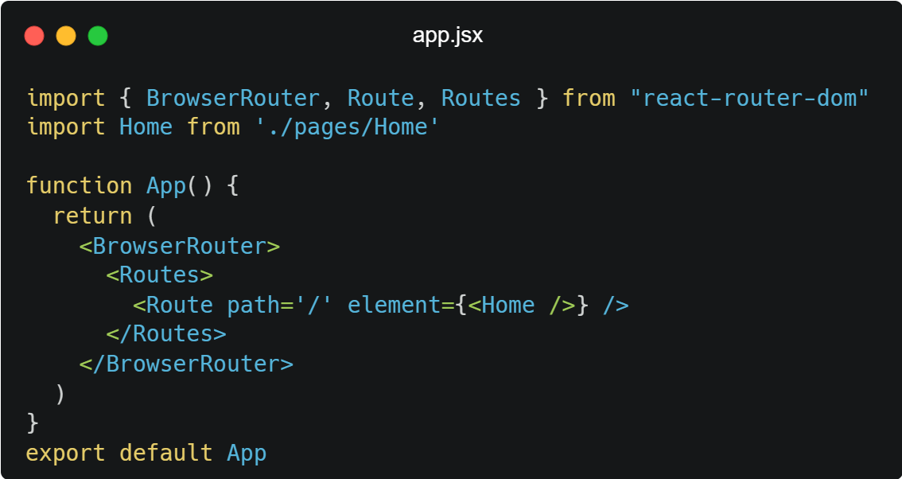
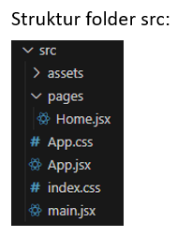
Setup Router

Slide 5
Bagian 4: Advance API Filtering

Slide 6
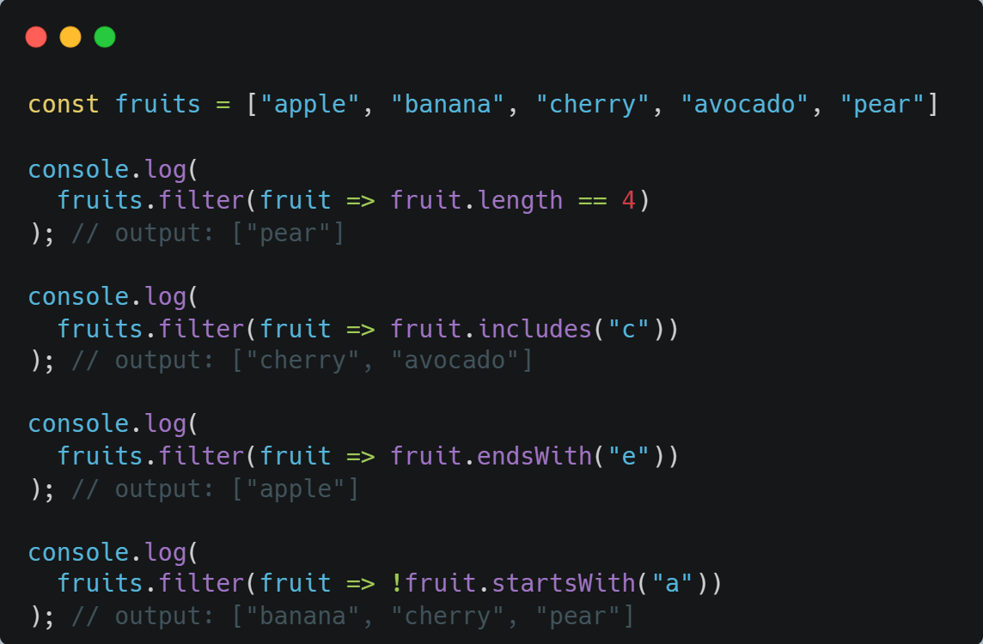
Array Filtering
.filter()

Slide 7
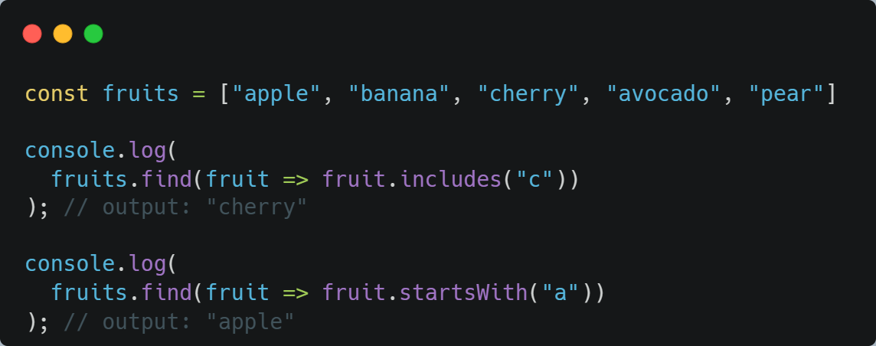
Array Filtering
.find()

Slide 8
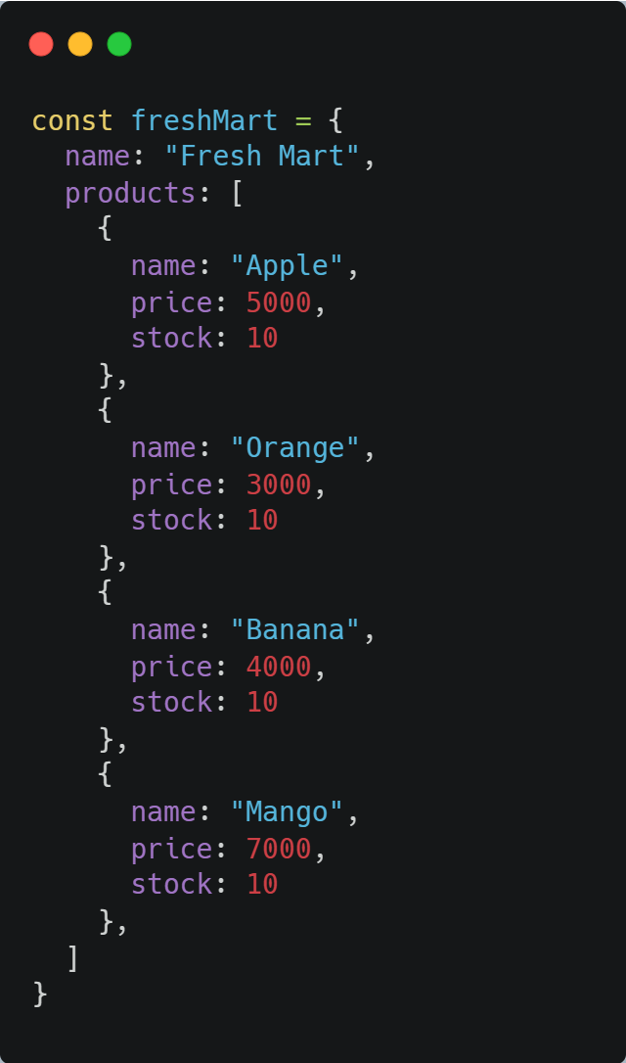
Object Filtering

Slide 9
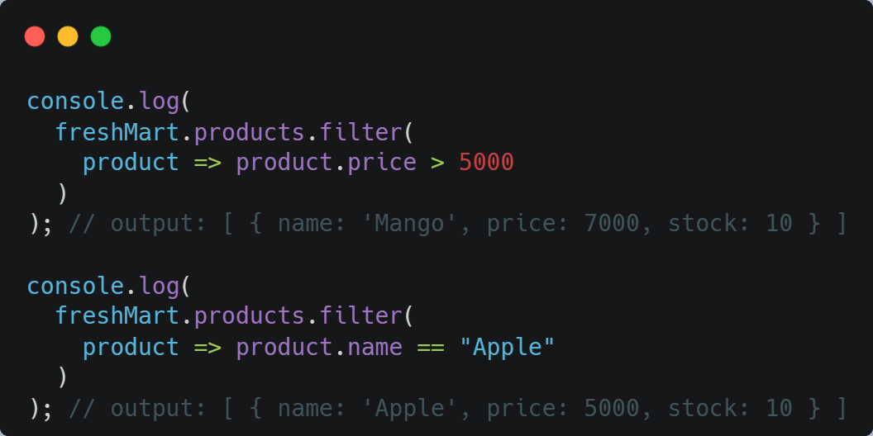
Object Filtering
.filter()

Slide 10
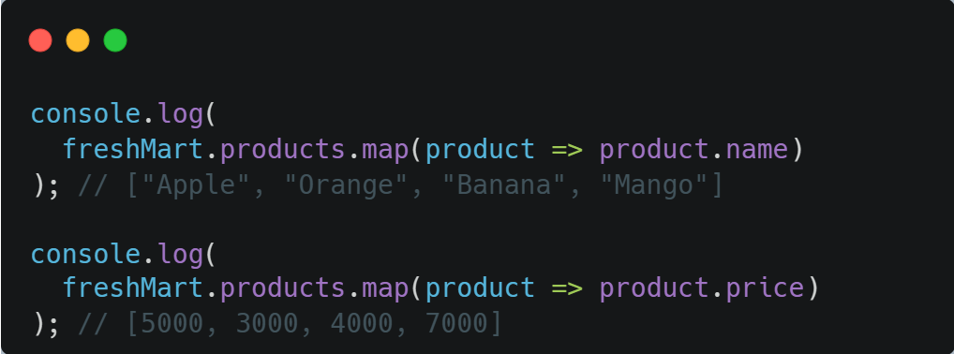
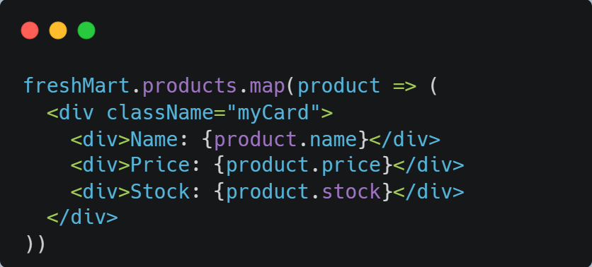
Object Filtering
.map()

Slide 11
Thank You

