Slide 1

AI-Powered Solution to Detect Manufacturing Equipment Issues using AWS
For HMGICS Job Competency Test – Cloud Engineer
Bintang Pradana

Slide 2

Problem Statement and Requirements
A manufacturing company wants to build an AI-powered solution to detect quality issues early from production line equipment data and automatically generate management reports. The requirements are as follows:
IoT sensor data from factory equipment (temperature, vibration, current, etc.) is collected and stored via Kinesis Firehose → S3.
SageMaker is used to train and deploy an Anomaly Detection model on this sensor data. The model should classify normal vs abnormal signals or predict anomaly probability.
Based on the inference results from SageMaker (e.g., “Anomaly detected with 85% probability”), AWS Bedrock should be used to:
Generate a human-readable management report.
Suggest potential root causes (e.g., “High likelihood of bearing wear”).
Provide recommended actions (e.g., “Add lubrication, check replacement schedule”)Final results should be stored in DynamoDB, and accessible through API Gateway + Lambda for the management dashboard.

Slide 3
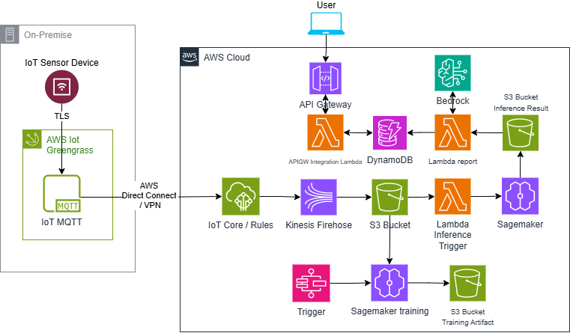
Solution Architecture Overview
Loose-Coupled Design The design loosely coupled for faster inference Sagemaker process and scalability
Data Ingestion with IoT Core
IoT Core collects and ingests data from connected devices, enabling seamless real-time data streaming.
AWS Greengrass with AWS Direct Connect
Using AWS Greengrass and Direct Connect for end-to-end secure private connection between edge device to AWS cloud.
Sagemaker for Training and Inference
AWS Sagemaker will classify the data ingested from IoT device to define the abnormality
Generative AI reporting
Report generated using AWS Bedrock to provide recommendation in the report and can be accessed by users via API.
github repo: https://github.com/BintangPradana/DetectAnomalyEquipmentAI

Slide 4

Data Flow Explanation
Data Ingestion from IoT
Data originates from IoT devices and is securely transmitted to AWS cloud via AWS Greengrass on the edge device. The connection between on-prem and AWS cloud will go through AWS Direct connect for secure and low latency data transfer.
Data Storage in Cloud
Incoming data is handled by IoT Core and the rules will route to Kinesis Firehose. From the Firehose the data will be stored in S3 bucket for inference or future training.
AI Inference for Classification
S3 events will trigger Lambda to run Sagemaker batch transform inference and the result will be stored in the S3 bucket.
AI Training
The training is using data coming from the IoT input S3 bucket that already been labeled. The training artefact output stored in S3 bucket.
Output Report and API
Another lambda will process AI inference classification output S3 bucket and call Bedrock API to perform analysis using GenAI and store the output into DynamoDB. This DynamoDB data later can be accessed via API gateway.

Slide 5

Security and Cost Optimization Considerations
Security Measures
Security includes IAM roles
Data encryption at rest and transit
Strict network firewall controls to safeguard resources.
End-to-end private connection using
Cost Optimization Strategies
The Sagemaker inference is event-based batch inference. Using event-based instead of always-on endpoint will save Sagemaker running cost.
Using larger batch files will save inference cost API call.
Evaluate the requirements of low latency connection between on-prem and cloud. AWS Direct connect can be substituted with VPN site-to-site connection.

Slide 6

Realtime vs Batch Processing Comparison
Realtime Processing Benefits
Realtime processing delivers low latency insights enabling immediate decision-making despite higher costs.
Batch Processing Advantages
Batch processing supports large-scale analytics with cost efficiency and simpler architecture for periodic reports.
In this design we propose batch processing for lower cost and simpler architecture.

Slide 7
Conclusion
Scalable AI Report Generation
Loosely coupled design for faster inference Sagemaker process and scalability
Security and Cost Efficiency
The system ensures secure data handling while optimizing costs for operational efficiency in IoT analytics.
Balanced Processing Needs
It balances complex processing demands with efficient operational management for reliable IoT insights.

