Slide 1
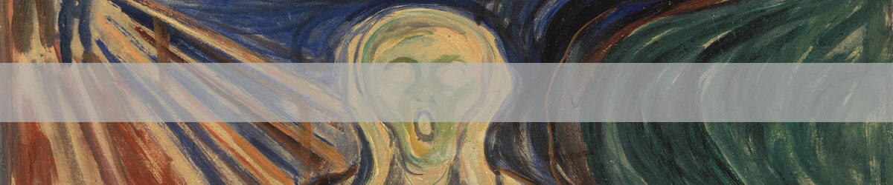
Predicting Artists Based on Their Paintings with Deep Learning
ArtNet
Binu Kandagedon
Galvanize Data Science
Final Project

Slide 2
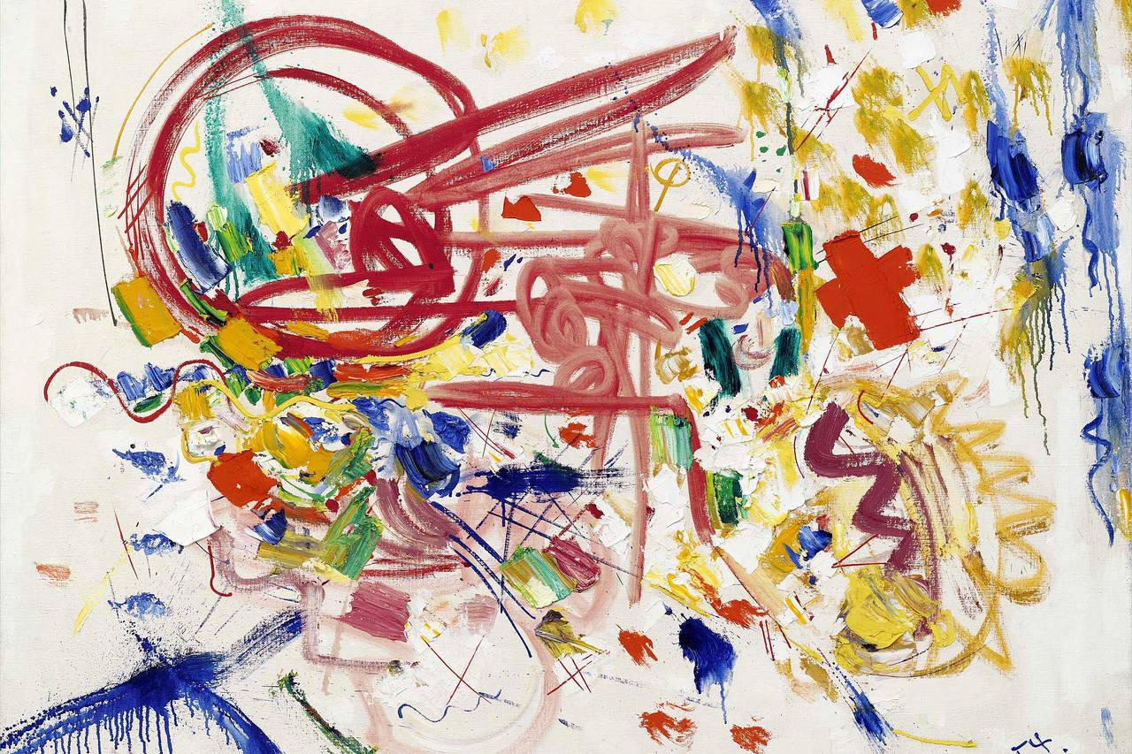
Why ArtNet ?
Childhood passion
Learn artists and their paintings

Slide 3
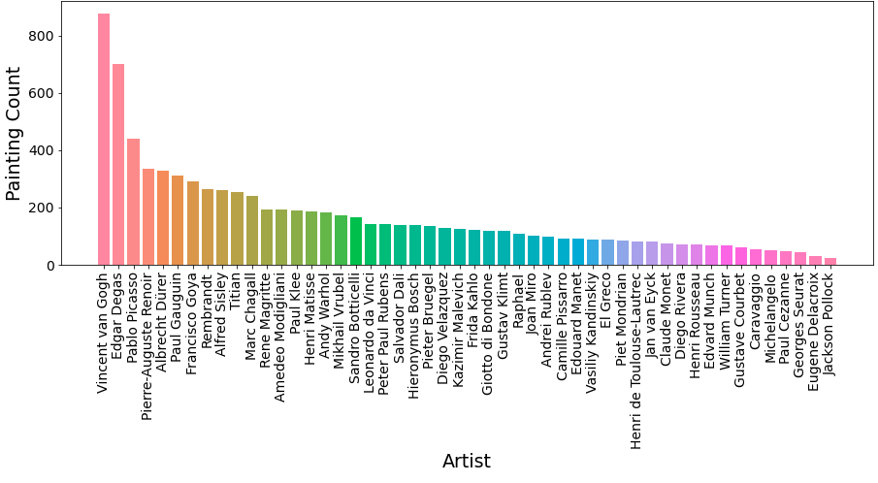
Data pre-processing
Data set is about 50 different artists and their paintings.
Can be found in (https://www.kaggle.com/ikarus777/best-artworks-of-all-time)
Unevenly distributed throughout each artist (It is important that under-represented classes get as much as attention as other classes when building the model.
Artists with more than 200 paintings

Slide 4
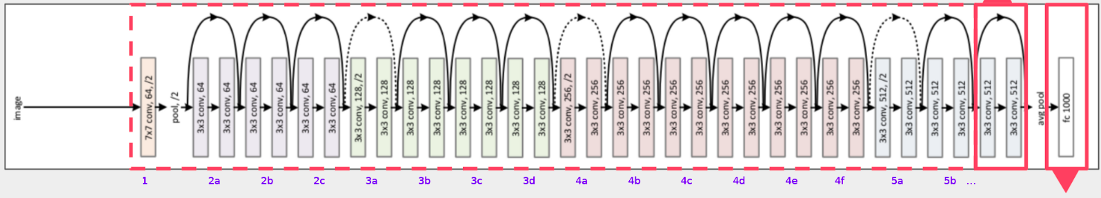
Why Transfer learning ?
Small data set (average about 200 paintings per artist)
Save time and computational power
Why ResNet50 ?
    48 x Convolution layers, 1 x max pooling, 1 x average pooling
    ResNet uses skip connection. Adding output from an earlier layer to a recent layer.
    Useful because neural network wont stop learning.

Slide 5
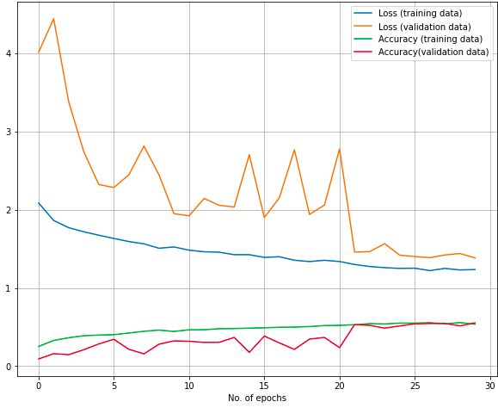
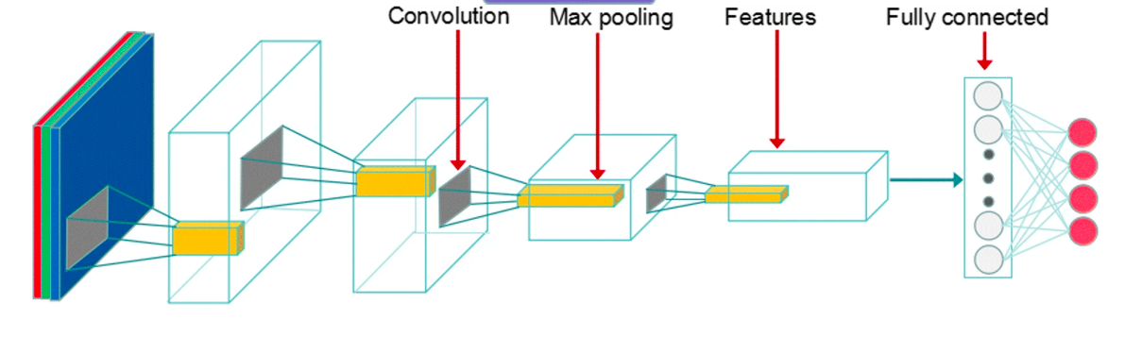
First Model
Got the pre-trained model without the classification layers at the top,
Froze all the other layers.
Added three fully connected layers (512, 16 and output layer)
Accuracy 55% on validation data set.
Still learning, fine tuning?

Slide 6
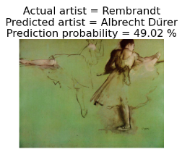
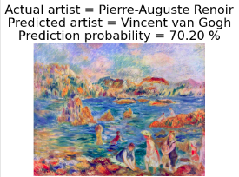
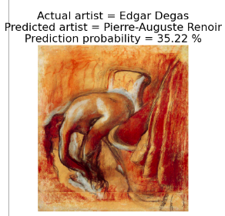
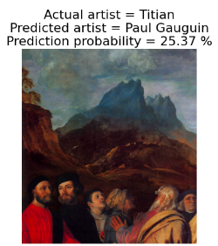
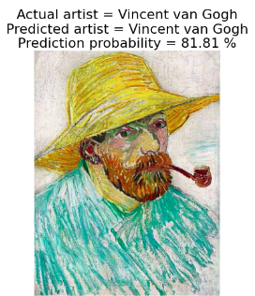
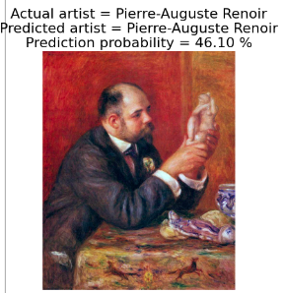
Some predictions from first model

Slide 7
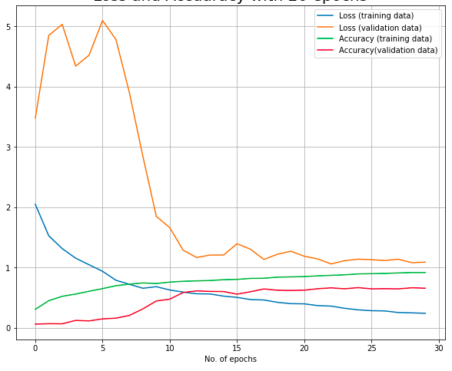
Fine tuning
Only froze first 40 layers.
After 30 epochs 65% accuracy on validation data set.
Over-fitting/plateauing out the accuracy of validation data set? Reducing learning rate and making more layers trainable

Slide 8
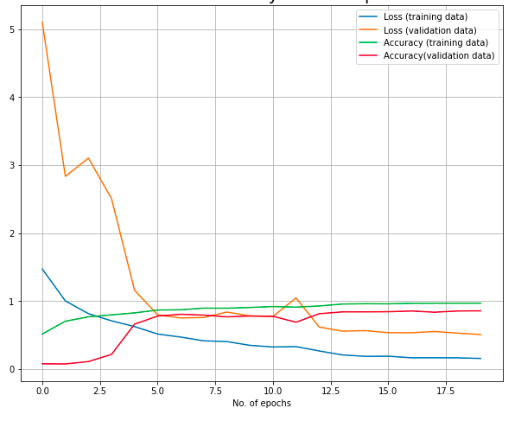
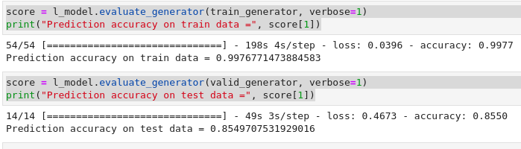
Surprised fine tuning
Made all the other layers trainable (trainable parameter went up to 74 millions)
Reducing the learning rate from 0.001 to 0.0001 because larger model can easily over-fit
85% accuracy just about 20 epochs.

Slide 9
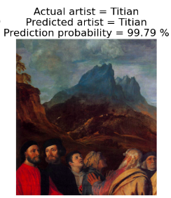
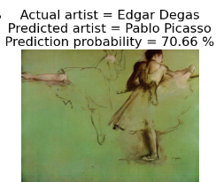
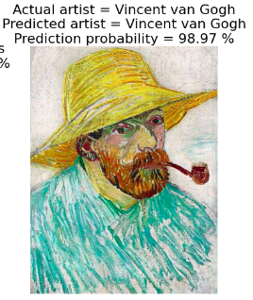
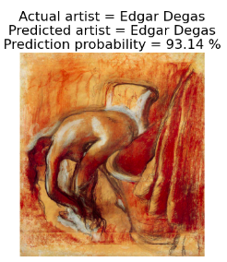
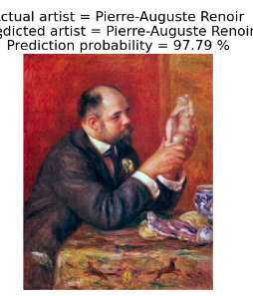
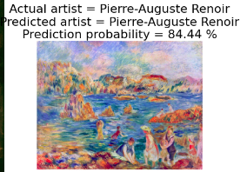
Model comparison
Final Model First Model
Final Model First Model

Slide 10
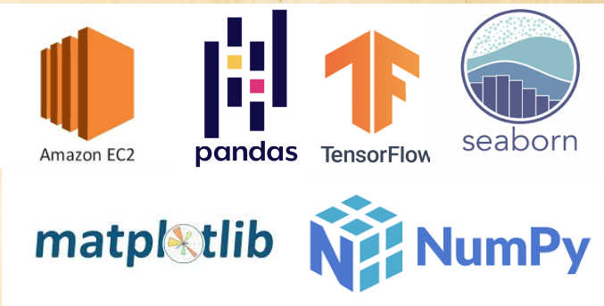
Tools
github: https://github.com/BinuBims
Linkedin: https://www.linkedin.com/in/binu-kandagedon-0abb5a204/
Thank You
Binu kandagedon
github: https://github.com/BinuBims
Linkedin: https://www.linkedin.com/in/binubims

