Slide 1
Bank Dataset Case Study
Created by :
Binu Shaw

Slide 2
Abstract
Banking Dataset where we provided applicant’s data.
We visualized Bank Dataset with proper graphs.
We implemented EDA Modules to understand basics of risk analytics in banking and financial services.
We analysed Dataset why applicant’s defaulting their loan.

Slide 3
Problem Solving Method
Data Cleaning
Univariate analysis
Data Analysis
Bivariate analysis
Data Merging
Data Understanding

Slide 4
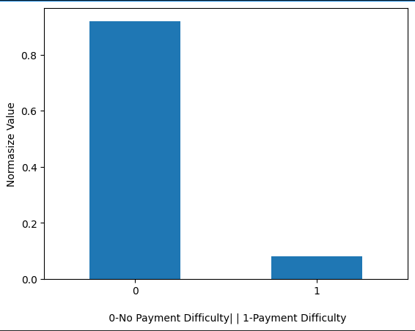
Analysis
Every 11 out of 1 applicant had payment difficulty

Slide 5
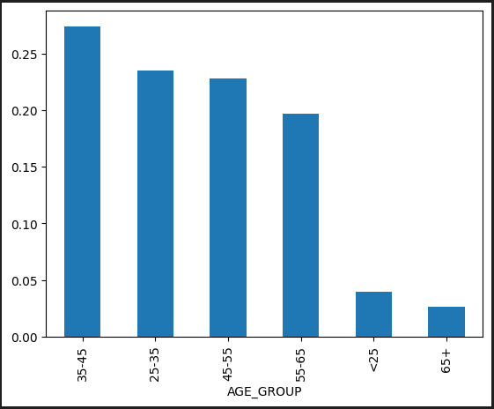
Analysis
Almost 35-65 age group applying for loan but 35-45 age is higher(27%) than others

Slide 6
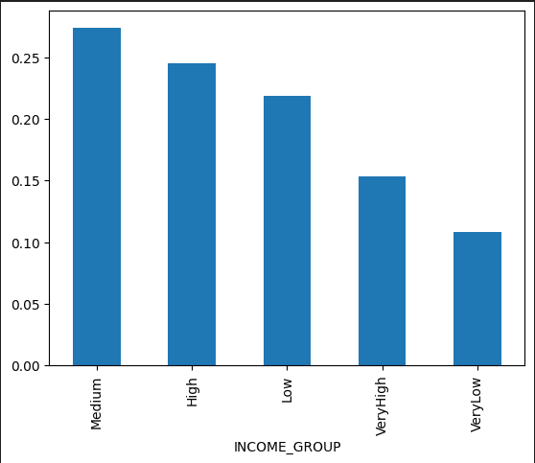
Analysis
Medium income group took more loan than others

Slide 7
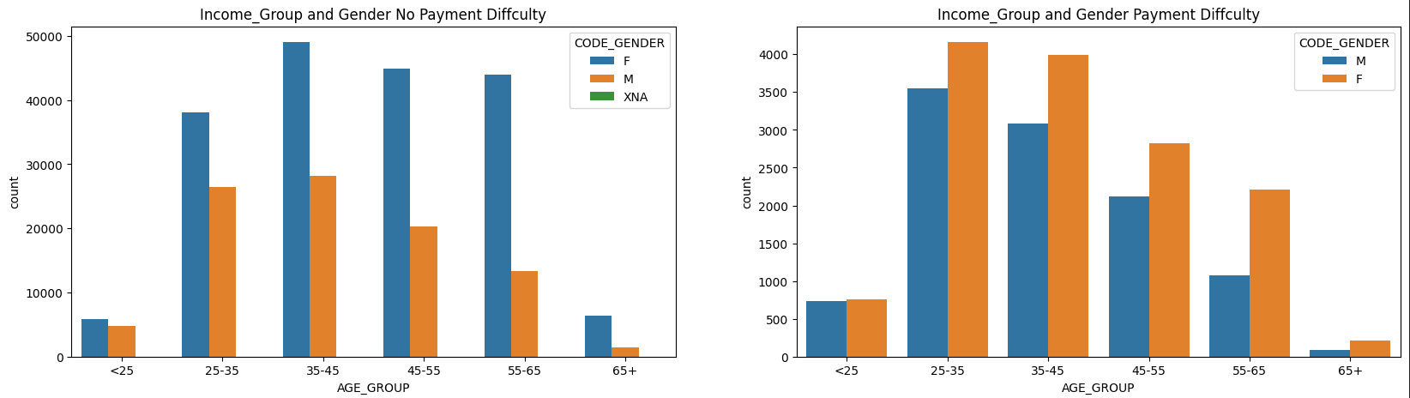
Analysis
Woman took more loan also had more payment difficulties while paying loans

Slide 8
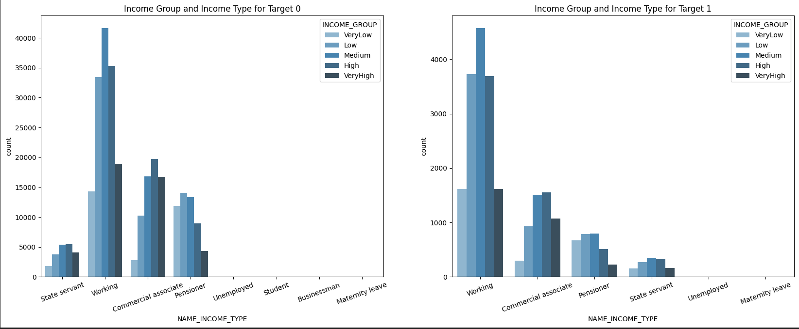
Analysis
Out Of Every Income Group Medium Working Income Group Took more loans and they also got difficulties while payment

Slide 9
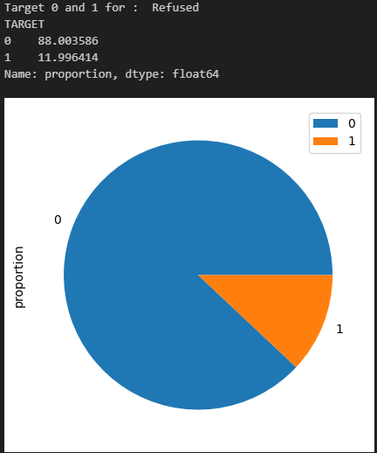
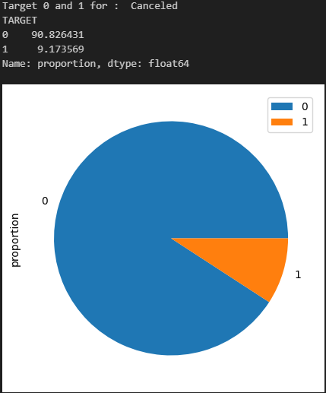
Analysis
Previously who were denied their loan request, got approved now.

Slide 10
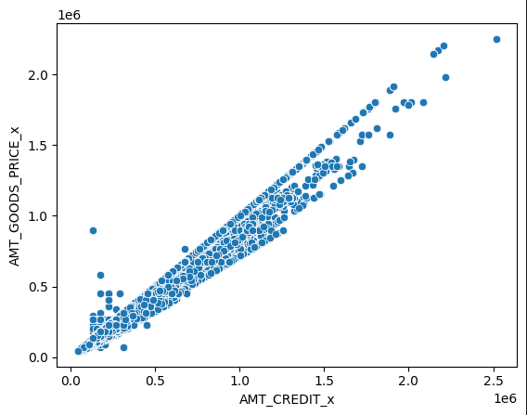
Analysis
Around 252946 Applicant’s income were less than 100000.

Slide 11
Conclusion
Female applicant’s whose income very low had payment difficulties than others.
Applicant’s who were working and income type low had payment difficulties than others.
Almost 7.5% applicant's who previously approved has payment difficulties now.
Applicant's who previously refused or cancelled now approved.

