Slide 1
Responsible, Open Science Citizenship
CODATA/RDA Research Data Science Summer School
Thursday/Friday, Kigali, October 2018
Louise Bezuidenhout
University of Oxford

Slide 2
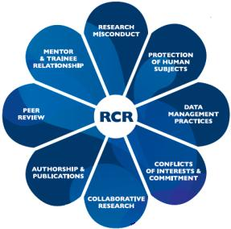

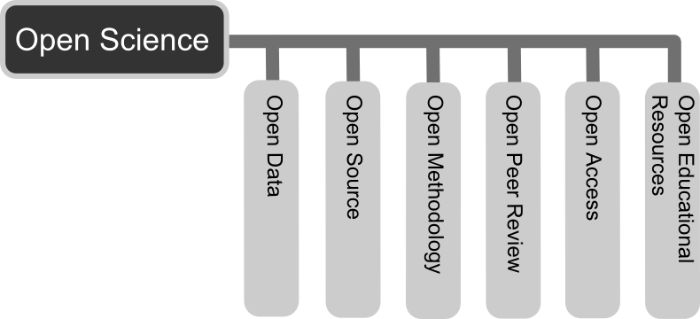

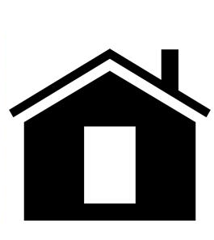
How to be a responsible and open data scientist
Doing responsible and open data science research
Tools for responsible and open data science
Create
Document
Use
Share
Preserve
Store

Slide 3
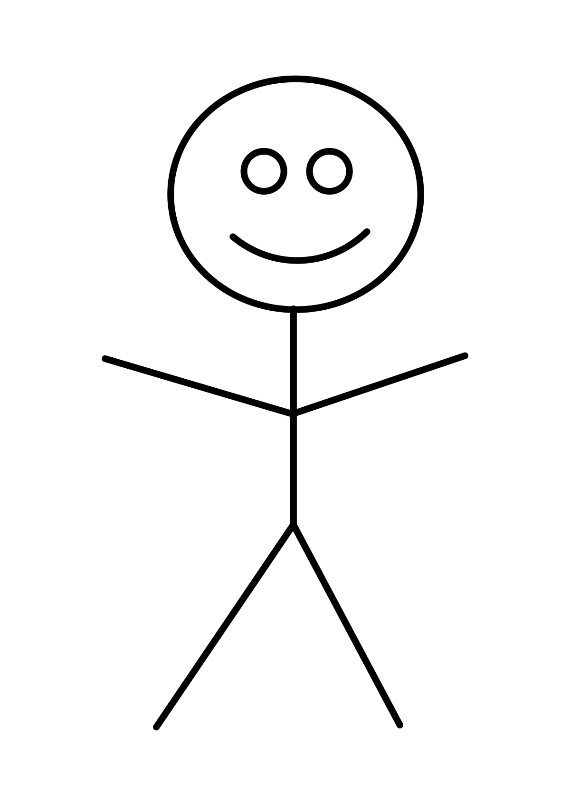
RESPONSIBLE, OPEN (DATA) SCIENCE CITIZENSHIP
Data science
Practical skills
Data management
Norms and values (FAIR)
Practical tools - RDM
Authorship
ORCID
Journals and licensing
Data use
- Finding and using data
- Data re-use and attribution
Ethics and responsibility
Multiple responsibilities
Norms and values

Slide 4
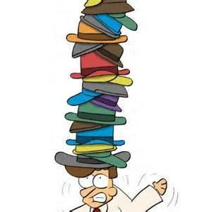
ETHICAL CHALLENGES OF BEING A RESPONSIBLE, OPEN DATA SCIENTIST
Data producer
Data user and/or collaborator
Author
Employee
Teacher/mentor
Recipient of public funds
Citizen/legally-obligated individual
Openness, sharing, justice, beneficence
Notes:
What we can see from the answers is that scientists wear many hats – these all come with different responsibilities

Slide 5
ETHICAL CHALLENGES OF RESPONSIBLE, OPEN (DATA) SCIENCE CITIZENSHIP
Data management
Non-transparency
Irreproducibility
Waste of trust/resources
OD
Data science
Biases in analysis
FOSS vs commercial
Data use
Inappropriate data use,
Attribution, theft etc
Commercialization issues
Authorship
Predatory publishing
OA
Inappropriate authorship
Theft
Ethics and responsibility
Harms to society
Present and future

Slide 6
BEING A RESPONSIBLE, OPEN (DATA) SCIENTIST AT HOME
Create
Document
Use
Share
Preserve
Store
Institutional cultures
Promotion criteria
Incentivization schemes
Cultural specificities
Institutional support
Facilities
Traditions
Resources
Time
Money
Infrastructure
Copyright, ownership and agency
IP
Career pressures
Time
Being scooped

Slide 7
PERSONAL CONCERNS
Lack of awareness and training
Cultural inertia and misinformation
Challenging the establishment
Following status quo
Lack of reward
Publication bias towards novel findings
Resources
Fear – of being scooped, scrutinized, reduced scientific quality, risk to reputation

Slide 8
EXPERIENCING CHALLENGES IS NORMAL
Group discussion
What specific challenges do you anticipate encountering when you return home in terms of your data work?
Using your hand-out sheets, go through the categories of RDM and RCR and think about challenges you will experience
Discuss these specific, or general challenges in your groups
Will this affect your ability to be responsible and open?

Slide 9
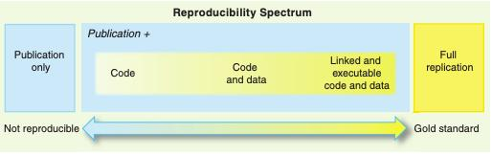
Working openly, responsibly and reproducibly ...
”Your primary collaborator is yourself 6 months from now, and your past self doesn’t answer emails" (Russ Poldrack)
Peng 2011

Slide 10
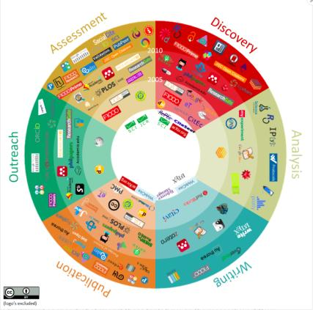
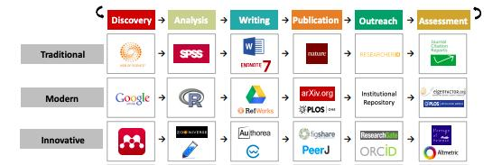
Resources to consider
https://figshare.com/articles/101_Innovations_in_Scholarly_Communication_the_Changing_Research_Workflow/1286826

Slide 11

Some Useful Resources to Consider

Slide 12
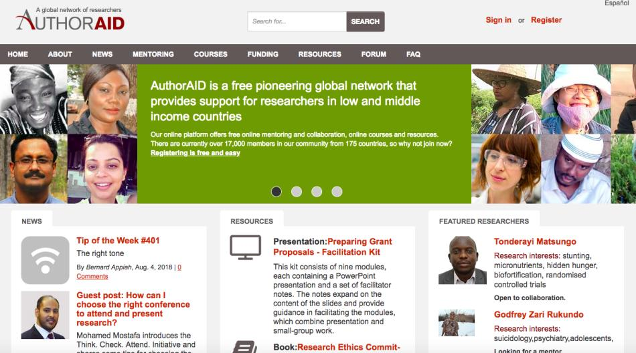

Slide 13
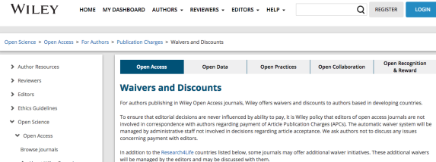
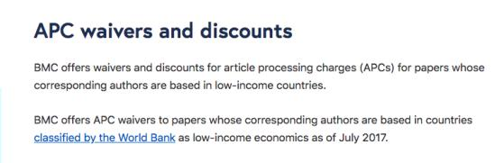
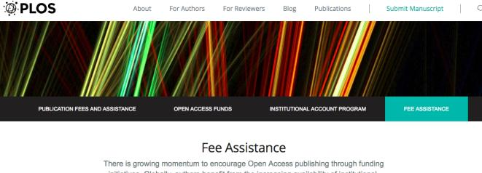
APC waivers

Slide 14
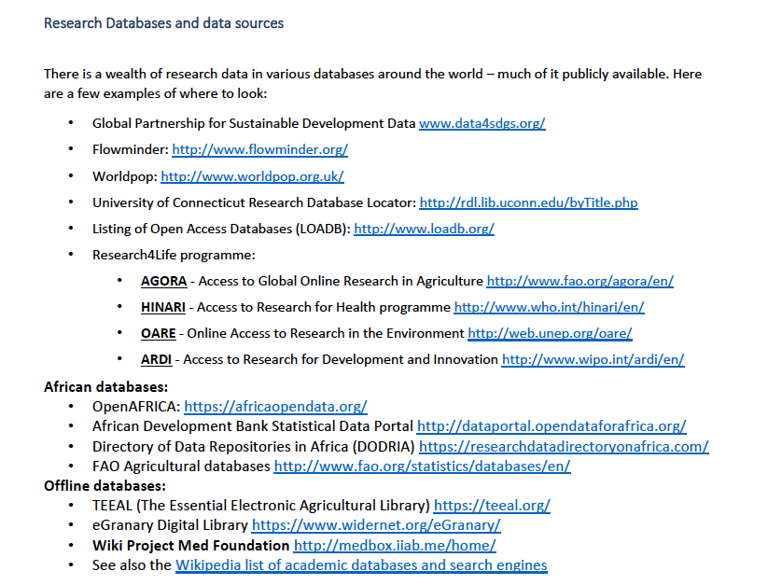
Access to resources
Thanks to Andy Nobes, INASP

Slide 15
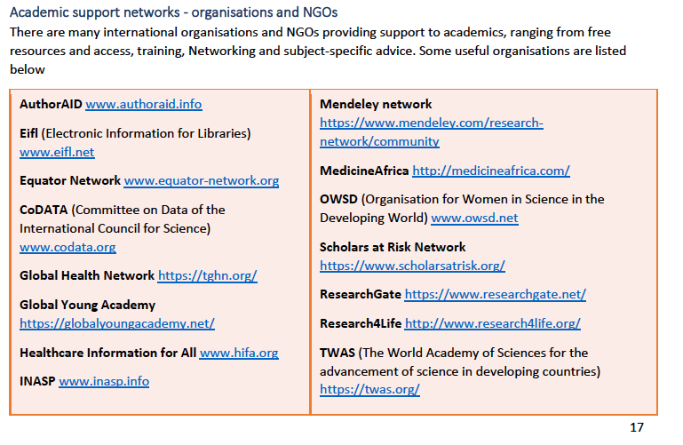
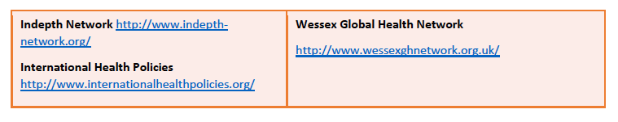
Support Networks
Thanks to Andy Nobes, INASP

Slide 16
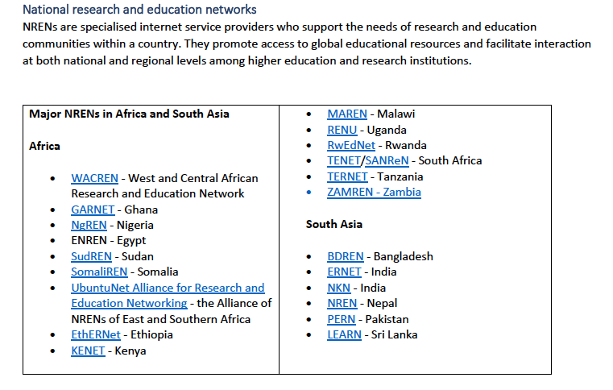
Support Networks
Thanks to Andy Nobes, INASP

Slide 17
EXPERIENCING CHALLENGES IS NORMAL
Group discussion
What tools and assistance can you utilize to address some of the problems you have listed?
Using your hand-out sheets, go through the categories of RDM and RCR and think about how to overcome some of the challenges you have listed
Discuss these specific, or general solutions in your groups
How will these resources enhance your ability to be responsible and open?

Slide 18
Thinking about next week: Impact of Digital Sciences
technology affects communication, collaboration and knowledge exchange within scientific, work and home settings.
people adapt to the rapid social changes brought by innovation and need to be assisted to use those innovations more productively and safely.
need to consider the ways in which new technologies can be designed and developed to be more responsive to societal acceptability and desirability.
Notes:
Some of the concrete outcomes we pursue in our work incl, improved design and resp develop – so in addition to design might be issues such as user education, policy and regulation of tech

Slide 19
Individual Activities … Global Impact
Being a responsible and open science citizen involves more than just making sure that your own data practices are ethical
Being part of the data community comes with responsibilities to the scientific community, public and future
Not just about responsible and critical use of data, also about scrutinizing evolving systems
Notes:
Systems perpetuate
Findings influence cultural understandings of who we are and how we understand our lives

Slide 20
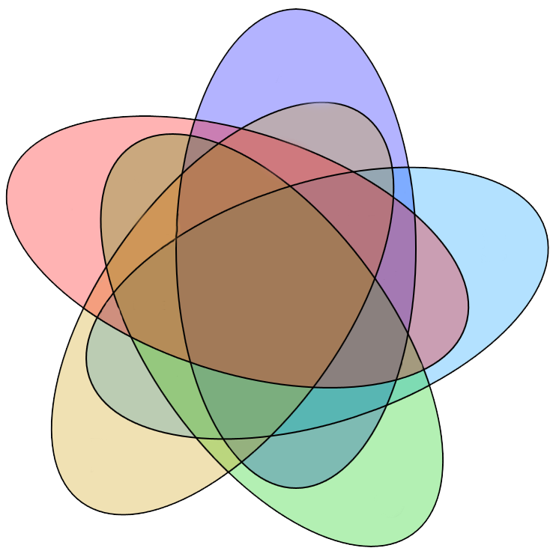
Extending Citizenship Responsibilities
Encourage development of open storage facilities
Institutional repositories, centralized departmental sharing
Physical
environment
Engage with public on data-related issues
Use expertise to engage with common concerns and misconceptions
Contribute to public skill development
Cultural
enviro
Work
culture
Open and
responsible
research
practices
Improve openness and responsibility in your work environment
Advocate for RDM practices
Engage colleagues in discussions on RCR, RDM, FAIR
Encourage data dissemination beyond disciplines
Scrutinize data and platforms currently in use for biases
and re-use data
Carefully scrutinize your own code and design for biases
Flag up platforms are exclusionary
Biases in algorithms etc
Advocate for improving community resources
Online
environment
Advocate for development of data regulatory frameworks
- Encourage development of data policies at institutional and policy level
Bureaucratic
enviro
Notes:
Of particular interest to this group, of course, is the online environment
While it is often tempting to think of the online environment as a neutral and international space, it is important to recognize the limitations of such thought
The cultural assumptions that are embedded into algorithms, the security criteria designed to safeguard sets of data, the design choices that underpin the design of platforms – these all have the potential to marginalize, stigmatize or override groups of users and it is very important that we pay attention to these issues when we design, use or scrutinize online platforms
Design choices are therefore not only important for efficiency, but also for the ethical functioning of the online environment
Furthermore, these choices have long-term implications as they shape in real time a highly dynamic space with limitless potential

Slide 21
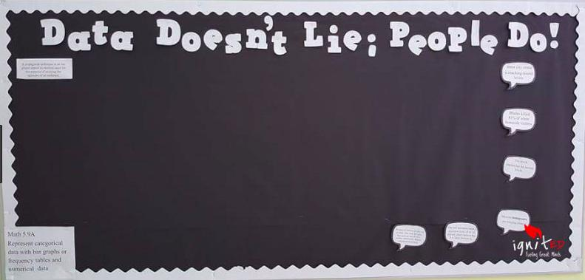

Infraethics ...

Slide 22
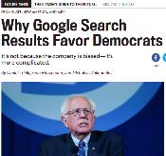
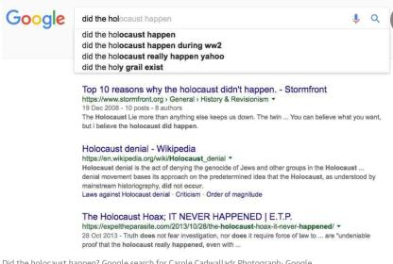
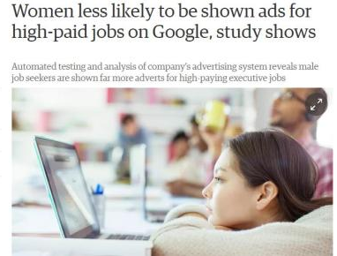
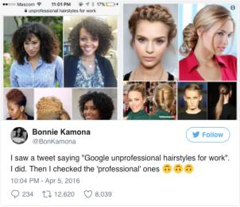
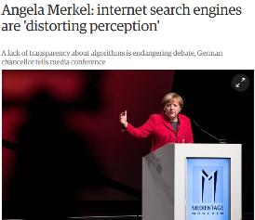
Current Challenges
Notes:
Offensive but also impact on cultural development
Selectively filtering the information we have available changes our ability to form opinions and contrast infromation
UnBias – user experience of alg driven internet platforms

Slide 23
Bias
= unjustified and/or unintended deviation in the distribution of algorithm outputs, with respect to one or more of its parameter dimensions
= inclination or prejudice for or against one person or group, especially in a way considered to be unfair.
Discrimination
= unequal treatment of persons on the basis of ‘protected characteristics’ such as race, sexual identity etc.
Notes:
Will orient more to the second definition as that’s what debate around controversies attend to and questions given by discussion organisers

Slide 24
“Algorithms are inescapably value-laden. Operational parameters are specified by developers and configured by users with desired outcomes in mind that privilege some values and interests over others…[O]peration within accepted parameters does not guarantee ethically acceptable behaviour… for example, profiling algorithms that discriminate against marginalised populations”
(Mittelstadt, Allo, Taddeo, Wachter, Floridi, 2016)
Notes:
Key points = a series of questions and challenges presented by these issues
Data or choice of what data to include as relevant – choice to include race or proxies for race etc.
Where we have humans developing the tech, there will be existence of values and with values potential for bias. Incr aware of unconscious bias so alsohave to consider this

Slide 25
What causes bias?
…. among the major factors the contribute to bias in the results that [systems] produce is because there is bias in the data. So you actually have to look at the data as far as the performance is concerned, to make sure you have a representative sample of the population you are trying to model.
Notes:
Not just in terms of demographics, but also in terms of culture and ethics

Slide 26
we have to think about how to rebalance the data so that that discrimination is not propagated through the algorithms. How does one come up with a fair set of data, which can actually challenge the biases that might naturally be there …

Slide 27
CHALLENGE FOR NEXT WEEK
Group discussion
Over the course of next week, reflect on the tools that you are going to be taught. Think about:
How you can safeguard beneficial outcomes of your activities in data gathering, infrastructure building and data dissemination?
How can you discuss these issues with your colleagues and peers?
How can you scrutinize the systems/datasets you will work with to make sure that biases do not creep into your research systems?
How can responsible and open science citizen strengthen these activities?

Slide 28


Thank you!
Please feel free to contact me with any further questions!
Louise.Bezuidenhout@insis.ox.ac.uk

