Slide 1
The Study of an Information-Theory-Based Hydrologic Model Diagnosis Approach
Baoxiang Pan
2013.11.3

Slide 2
Structure
Background
Questions and Objectives
Data & Method
Schedule

Slide 3
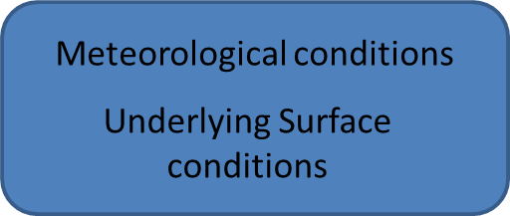
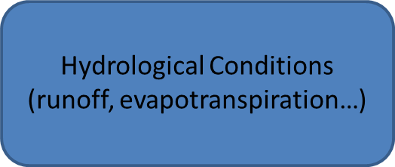
Background
Hydrologic Mechanism
Hydrologic Model

Slide 4
Hydrologic Model Diagnosis
Mechanism → Models
Distinguish the deficiencies either from structures or parameters
Distinguish the counterpart of different models
Limitation of models
Amelioration of models

Slide 5
Traditional Model Diagnosis Methods
Methods | Focus | idea
GLUE (Beven, 1992) | Parameter | Empirical Bayesian
Bayesian Stochastic Inference (Thiemann,2001; Kavetski,2006; etc. ) | Parameter & Structure | Bayesian
Precipitation Multiplier (Kavetski,2006 ) | Input | Bayesian
Process-based approach (Yilmaz, 2008) | Structure
Self-organzing maps (Gupta, Herbst, 2009 ) | Structure | Self-organzing maps
Temporal Clustering (de Vos & Rientjes, 2009) | Structure | Temporal Clustering
Uncertainty comes from the combination of input, parameters and structure.
The single-handed investigation of one or two of them may cause the double/treble-vision problem.

Slide 6
An information-theory-based model diagnosis method
Try to measure the definite information content of the variables and the relations between each other.

Slide 7
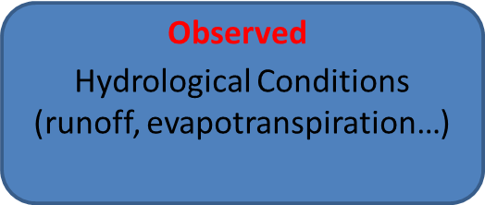
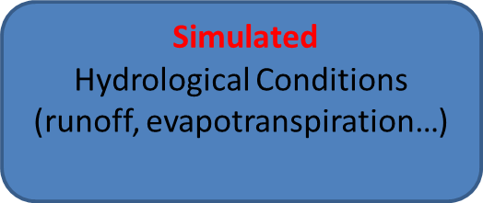
An information-theory-based model diagnosis method
Mutual information of input & observed data I(I;O) | Information content available from input
Entropy of observed data H(O) | Information content required for simulation
Mutual information of observed & simulated data I(O;S) | Information content used by the model
H(O)-I(I;O)=aleatory uncertainty
I(I;O)-I(O;S)=epistemic uncertainty

Slide 8
Beautiful, but, is it trustworthy?

Slide 9
Integrated concerns
Are H(O)-I(I;O), I(I;O)-I(O;S) able to catch the idea of information content we need? How?
How to test and verify this framework?
The comparison between this framework and the former works based on Bayesian inference.
How could this framework be used to evaluate and ameliorate hydrologic models?

Slide 10
Technology and skill concerns
How to calculate the entropy and mutual information?
What if H(O)-I(I;O) is negative?

Slide 11
Objective
Build this framework
Make comparison and understand it
Try to use it

Slide 12

Data
Classification | Data
Meteorological data | EP,P
Hydrological data | Runoff
Location | Ganjiang Catchment, further divided into 12 sub basins.
Time Scale | Monthly data

Slide 13

Method
7 monthly water balance models (DWBM, TPWM, etc.)are introduced in this project.
Parameters calibration and model simulation of the monthly runoff process
Calculate the H(O), I(I;O),I(O;S)
Compare with other evaluating indicators and method, extensions
Make conclusions

Slide 14
Schedule

Slide 15
Thank you！
Wish for questions and suggestions !

