Slide 1
Watershed Model Uncertainty Analysis Based on Information Entropy and Mutual Information
Baoxiang Pan
2013.12.2

Slide 2
OUTLINE
Background
Theoretical Derivation
Application
Discussion
Extensive Attempts

Slide 3
Background
Model uncertainty
Classical model evaluation criterions and methods
Two Weltanschauungs upon complex system

Slide 4
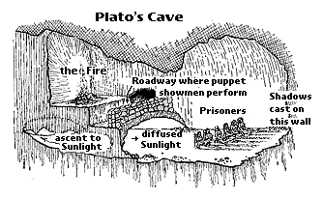
Model Uncertainty
parameters
structure
input
simulation uncertainty
classification | source
Aleatory uncertainty (independent of model) | Input
 | Immanent uncertainty of hydro system (?)
Epistemic uncertainty （related to model) | Structure
 | Parameters
 | State variables?

Slide 5
Quantization of Uncertainty
Objective functions | examples
Least Squares | Nash-Sutcliffe Coefficient
Maximum Likelihood | Heteroscedastic Maximum Likelihood Estimator
Correlation coefficient | Minimize the bias with y=x
Mutual information | Maximize I(Obser; Simulation)
1, Focus on performance, not mechanism.
2, A benchmark is required.
Note: The emphasis here is directed towards the streamflow. For water quality models, we can refer to the review paper by Beck (1987).

Slide 6
Classical Uncertainty Research Methods
Methods | Focus | idea
GLUE (Beven, 1992) | Parameter | Empirical Bayesian
Bayesian Stochastic Inference (Thiemann,2001; Kavetski,2006; etc. ) | Parameter & Structure | Bayesian
Precipitation Multiplier (Kavetski,2006 ) | Input | Bayesian
Process-based approach (Yilmaz, 2008) | Structure
Self-organzing maps (Gupta, Herbst, 2009 ) | Structure | Self-organzing maps
Temporal Clustering (de Vos & Rientjes, 2009) | Structure | Temporal Clustering
Uncertainty comes from the combination of input, parameters and structure.
The single-handed investigation of one or two of them may cause the double/treble-vision problem.

Slide 7
Two Weltanschauungs
Focus on the objects. The whole system is viewed as the combination of a sequence of objects, whose behavior may change with time.
Focus on the information flow, the way an electronic engineer takes when observing the signal processing system.
Harold Abelson et al. Structure and Interpretation of Computer Programming. Beijing: China Machine Press, 2004.2:53

Slide 8
Model uncertainty analysis based on information entropy and mutual information

Slide 9
Theoretical Framework Construction
The value of a definition/term lies in its ability to capture our intuition/perception of a certain object.

Slide 10
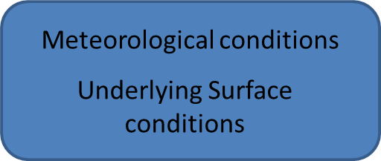
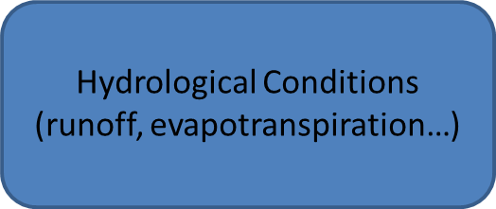
Hydrologic Process
Hydro-process
Observe
Code of observed data
Code of input data
Mechanism
performance
Model
Code of simulated data
I(Input; Observe)
Hydro-process
Observe
Average information
content: H(Observe)
Mechanism
Average information
content: H(Input)
Information Relativity
I(Simulation; Observe)
Average information
content: H(Simulation)
Model
I(Input; Simulation)

Slide 11
Data Processing Inequality
Data Processing Inequality
Form | If：X→Y→Z ， Then：I(Y;Z)≥I(X;Z) I(X;Y) ≥I(X;Z)
Application | Assume：Simulation→Input→Observation ， Then： I(Input;Simulation)≥I(Simulation;Observation) I(Input;Observation) ≥I(Simulation;Observation)
 | Since：Input→Observation→Observation， Then： I(Observation; Observation)≥I(Input; Observation) Since I(Observation; Observation)=H(Observation), H(Observation) ≥I(Input; Observation)
EXPLANATION:
1, X→Y→Z ↔ P(x,y,z)=P(x)P(x|y)P(z|y) ↔P(z|x,y)=P(z|y)
2, X→Y→Z ↔ Z→Y→X
2, Z=g(Y) → P(z|x,y)=P(z|y) → X→Y→Z
3, No super data processing method (No super model)

Slide 12
The application of Data Processing Inequality
H(Observation)≥I(Input;Observation)≥I(Simulation;Observation)
Definition
Aleatory Uncertainty | H(Observation)-I(Input;Observation)=H(Observation|Input)
Epistemic Uncertainty | I(Input;Observation)-I(Simulation;Observation)

Slide 13
Did the definition capture our intuition/perception of the certain objects?
Definition
Aleatory Uncertainty | H(Observation)-I(Input;Observation)=H(Observation|Input)
Epistemic Uncertainty | I(Input;Observation)-I(Simulation;Observation)
Theoretical Evaluation of the framework
Strong point | The simulation uncertainty is clearly divided into two parts, according to whether they are related with the model.
Strong & Weak Point | The relativity between variables are depicted in a robust way.
Weak point | No benchmark
 | valid in distinguishing relativity but not systematic bias

Slide 14
Application
Empirical Verification
I(Input; Observe)
Hydro-process
emulation
Average information
content: H(Observe)
Mechanism
Average information
content: H(Input)
Information Relativity
I(Simulation; Observe)
Average information
content: H(Simulation)
Model
I(Input; Simulation)

Slide 15
Empirical Verification
“Data”
6 month-scale water balance models
Data
19 sub basins of Ganjiang Watershed with monthly P,EP,Q data at the average length of about 20 years.
Methodology
Optimization method: PSO(particle swarm optimization)
Algorithm for calculating information contents.
Interpolation
Non-interpolation: Leonenko Method

Slide 16
Technological Route
Optimize using the objective function of NSC.
Calculate the epistemic uncertainty of the simulation.
Optimize using the objective function of epistemic uncertainty.
Calculate the NSC of the simulation.

Slide 17
A brief introduction of water balance models
Since there are 3 unknown variables as underlined above, we need to replenish two other functions to make the model run.
Additional Functions
Coupled water and energy balance equation ( Budyko)
Soil water replenish function

Slide 18
Models
Dynamic Water Balance Model (DWBM)
Two Parameter Water Balance Model (TPWM)
Vandewiele Model (Van-Model)
ABCD Model (ABCD)
Three Parameter Water Balance Model(TRPWBM)
Thornthwarite-Mather Model (TMM)

Slide 19
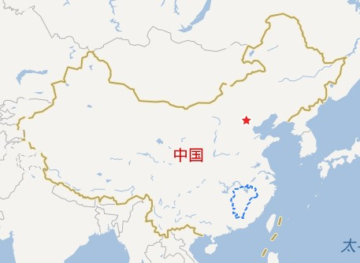
Catchment Information
No. | Subcatchment | Area (km²) | Period
Ganjiang | Basin
1 | Ruijing(瑞金) | 911 | 1963-81
2 | Mazhou(麻州) | 1758 | 1964-87
3 | Yangxinjiang(羊信江) | 569 | 1963-87
4 | Ningdou(宁都) | 2372 | 1963-87
5 | Hanlingqiao(翰林桥) | 2689 | 1963-87
6 | Fengkenkou(枫坑口) | 3679 | 1963-87
7 | Yaoxiaba(窑下坝) | 1935 | 1964-87
8 | Tiantou(田头) | 3209 | 1960-87
9 | Chuzhou(滁州) | 289 | 1965-87
10 | Lingken(林坑) | 994 | 1964-87
11 | Mukou(木口) | 1690 | 1963-87
12 | Shangshalan(上沙兰) | 5257 | 1963-87
13 | Saitang(塞塘) | 3073 | 1963-87
14 | Xintian(新田) | 3533 | 1962-87
15 | Hezhou(鹤洲) | 374 | 1963-87
16 | Maozhou(茅洲) | 3110 | 1965-87
17 | Niutousan(牛头山) | 2710 | 1960-87
18 | Yifeng(宜丰) | 519 | 1964-87
19 | Dutou(杜头) | 435 | 1963-87

Slide 20
 | Model Performance ( NSC)
Catchment number | DWBM | TPWM | Van-Model | ABCD | TRPWBM | TMM
1 2 3 4 5 6 7 8 9 10 11 12 13 14 15 16 17 18 19 | 0.916 0.854 0.858 0.896 0.886 0.928 0.873 0.754 0.848 0.795 0.894 0.887 0.884 0.901 0.89 0.906 0.886 0.883 0.909 | 0.918 0.922 0.896 0.93 0.931 0.912 0.925 0.75 0.906 0.869 0.934 0.918 0.907 0.919 0.91 0.905 0.895 0.895 0.926 | 0.891 0.777 0.810 0.810 0.827 0.891 0.854 0.674 0.728 0.666 0.913 0.844 0.884 0.889 0.875 0.834 0.843 0.906 0.911 | 0.861 0.835 0.769 0.871 0.849 0.863 0.823 0.629 0.840 0.790 0.806 0.826 0.816 0.848 0.842 0.845 0.841 0.856 0.864 | 0.914 0.931 0.898 0.931 0.929 0.932 0.929 0.807 0.903 0.867 0.935 0.923 0.917 0.917 0.913 0.927 0.902 0.920 0.933 | -0.083 -0.058 0.026 -0.104 -0.101 0.023 0.061 -0.008 0.148 -0.009 0.208 -0.037 -0.037 0.051 -0.038 -0.111 0.042 0.025 0.002

Slide 21
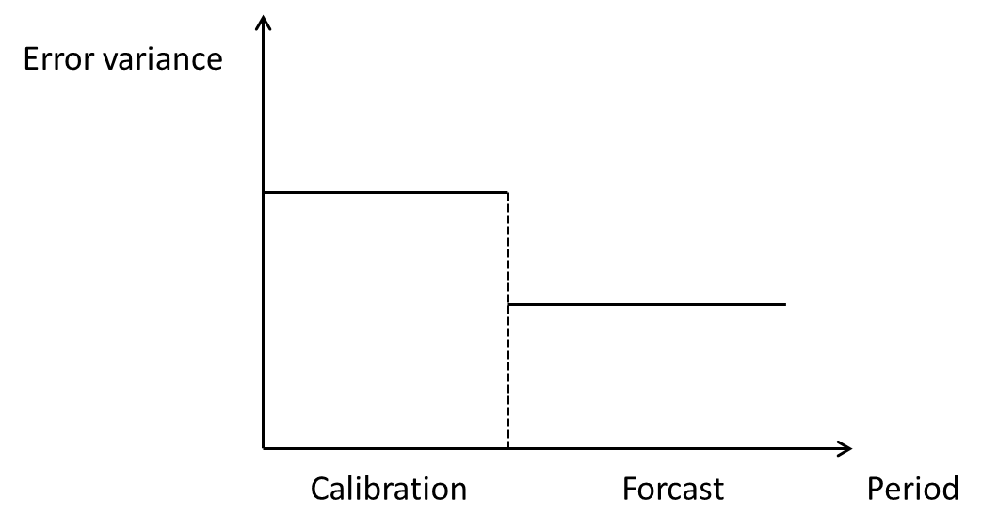
They are working too well.
The error variance of forecasted flows is much larger than the error variance of the flows simulated during calibration.[Sage and Melsa,1971].

Slide 22
Information Content Calculation
Discrete entropy & Differential entropy
Plug-in Method
Theoretical basis: AEP
Determination of histogram width
Non-Plug-in Method
Leonenko Method

Slide 23
Discrete entropy & Differential entropy
For continual random variable X~F(X),
divide the domain of X into uniform intervals with length of ∆. Define:
Thus:

Slide 24
When the degree of accuracy is fixed to ∆, the differential entropy and the corresponding discrete entropy differs by a constant log∆.
Notes:
在精确到n位的意义下，h(X)+n是为了描述X所需的平均比特数(即熵).

Slide 25
Plug-in Method

Slide 26
Asymptotic equipartition property(AEP)

Slide 27
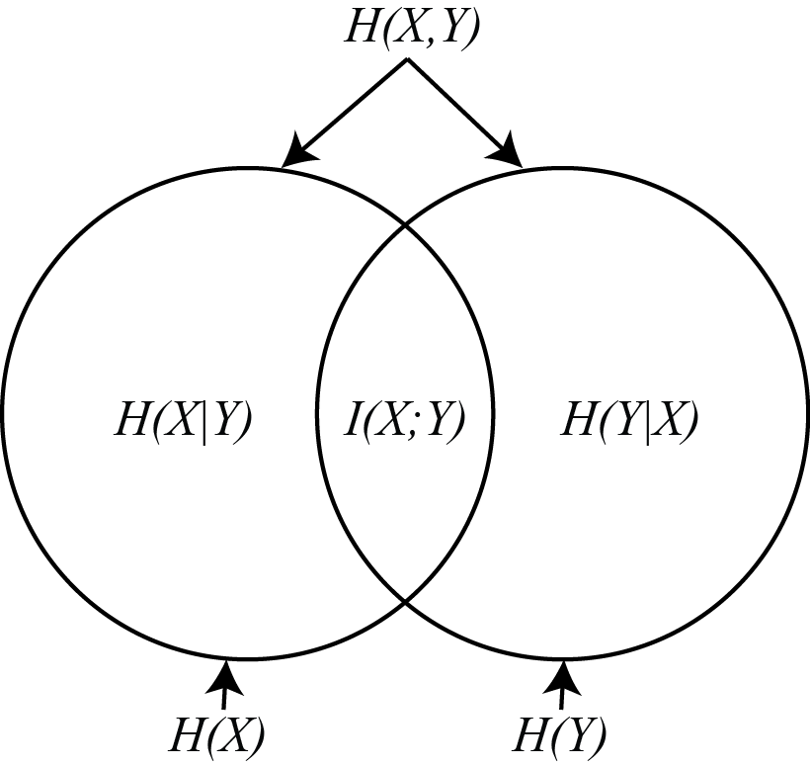
Since:
And
We have:

Slide 29
Histogram Method
Determine the division of the histogram.
Equal gap of Random Variable
Equal gap of Probability
Determine the width of the histogram.
Scott’s error theory
Consideration | Disadvantage | Mathematical description
Larger width | Rough description of p.d.f. | bias
Thinner width | few samples in a single histogram | variance
Co-consideration |  | Intergrated Mean Square Error

Slide 30
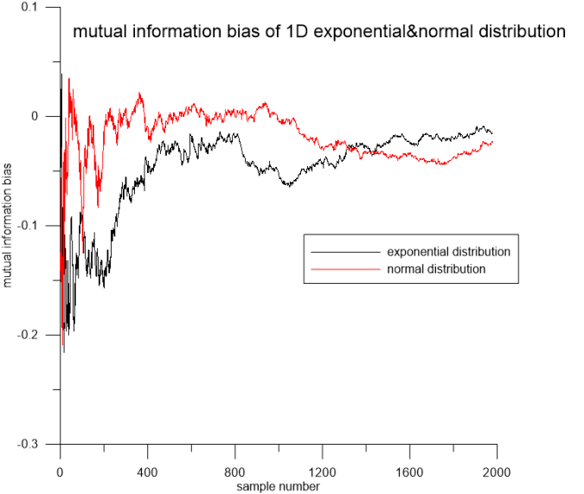
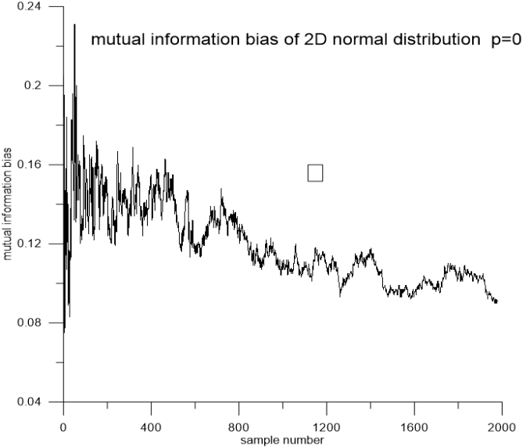
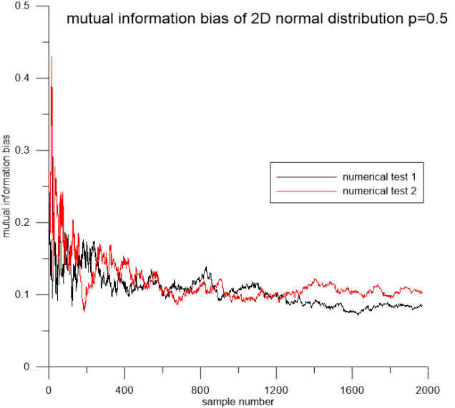
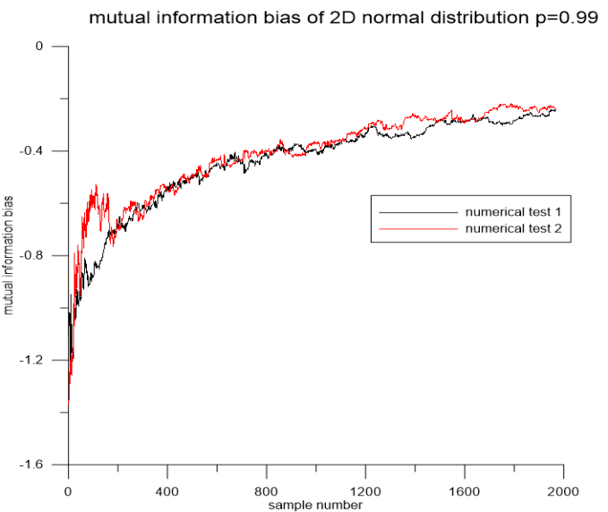
Numerical Test

Slide 31
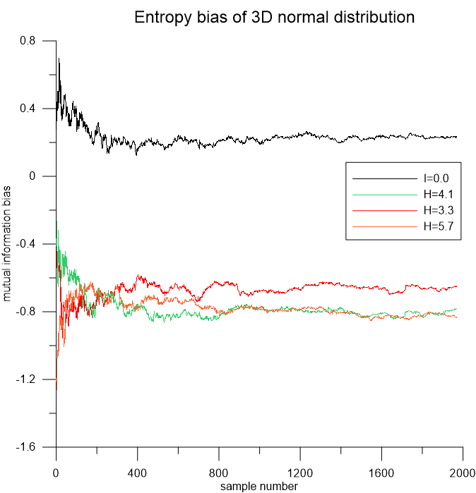

Slide 32
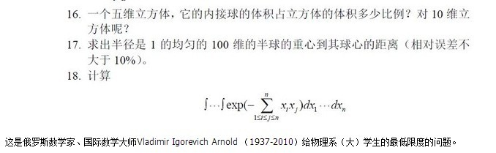
Dimension Disaster
As dimension increases, the sample required increases exponentially, otherwise we will form a more “distributed “ p.d.f. than the real situation, which causes a much larger entropy calculated compared with the real number.

Slide 33
Non-plug-in Method

Slide 34
Leonenko Method

Slide 35
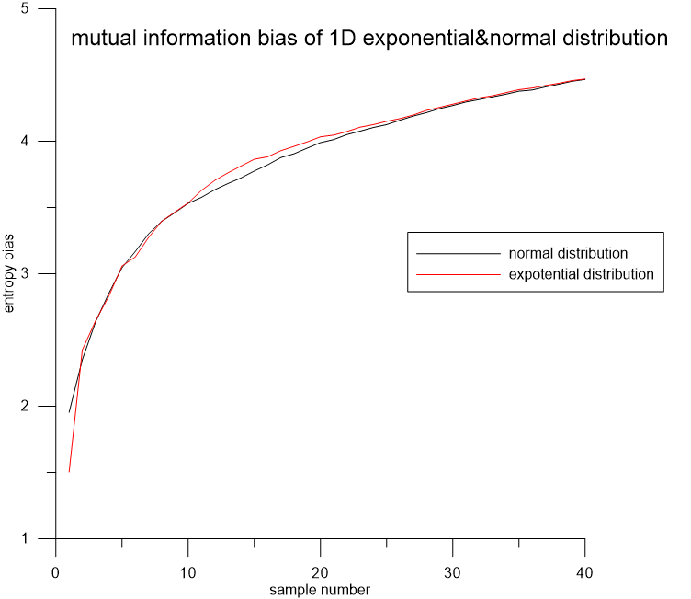
Numerical Test

Slide 36
Extraction of Consistent Series
M-K Method

Slide 37
Results
Result of full year data Plug-in Method
 | Subbasin8 |  |  | Subbasin16 |  |  | subbasin19
 | AU | EP | SCE | AU | EP | SCE | AU | EP | SCE
DWBM | 0.706 | 3.934 | 0.754 | 1.466 | 2.948 | 0.906 | 1.892 | 0.083 | 0.909
TPWM | 0.706 | 3.884 | 0.75 | 1.466 | 2.853 | 0.905 | 1.892 | 0.035 | 0.926
Van-Model | 2.259 | 0.132 | 0.728 | 1.466 | 2.925 | 0.834 | 1.892 | 0.019 | 0.911
TRPWBM | 0.706 | 3.89 | 0.807 | 1.466 | 2.872 | 0.927 | 1.892 | 0.085 | 0.933
TMM | 0.706 | 4.292 | -0.008 | 1.466 | 3.541 | -0.111 | 1.892 | 0.729 | 0.002

Slide 38
Discussion
Logic Consideration
Scientific Consideration
Technical Consideration

Slide 39
Logic Consideration——Iteration Curse
I(Input; Observe)
Hydro-process
emulation
Average information
content: H(Observe)
Mechanism
Average information
content: H(Input)
Information Relativity
I(Simulation; Observe)
Average information
content: H(Simulation)
Model
Does Simulation→Input→Observation form a Markov Chain?
State Variable

Slide 40
Scientific Consideration
No benchmark
Correlation does not mean function relation
The consistence requirement

Slide 41
Technical Consideration
Too much calculation
Calculation Inaccuracy
The entropy calculation for daily precipitation which is described using Chapman Dirac impulse function.

Slide 42
Two Ways To Fly Over the Iteration Curse

Slide 43
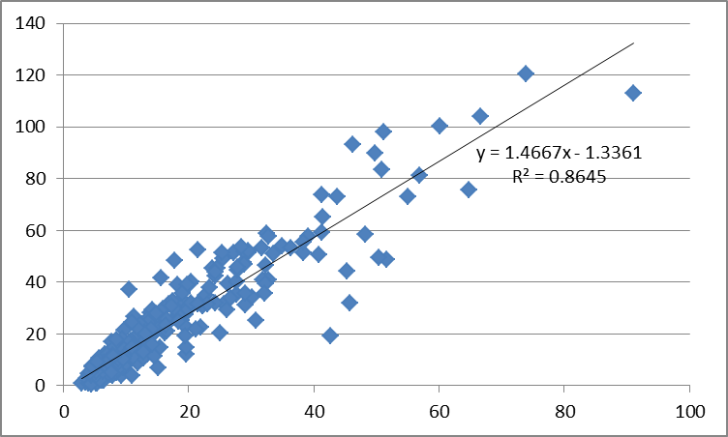
I. Reconstruct the Framework
Maxmize I( Input, State variable; Observation)

Slide 44
II. Construct the Probability Description of Hydro-mechanism Stochastic Soil Moisture Model

Slide 45
Reverberation of Plato’s Cave
I(Input; Observe)
Hydro-process
emulation
Average information
content: H(Observe)
Mechanism
Average information
content: H(Input)
Information Relativity
I(Simulation; Observe)
Average information
content: H(Simulation)
Model
THIS IS A MIRROR
Hydro-process
emulation
Average information
content: H(Observe)
Mechanism
Average information
content: H(Input)
Information Relativity
I(Simulation; Observe)
Average information
content: H(Simulation)
Model
I(Input; Simulation)

Slide 46
H(Simulation)≥I(Input;Simulation)≥I(Simulation;Observation)
Definition
State Uncertainty | H(Simulation)-I(Input;Simulation)
Reflection of Epistemic Uncertainty | I(Input;Simulation)-I(Simulation;Observation)

Slide 47
Stochastic Soil Moisture Model
The probability description of soil moisture water balance equation can be written as follows:
Where:
Thus：
Do series expansion at(s,t) ：
where

Slide 48
We have：
The stable distribution differential equation：

Slide 49
Compound Poisson Process
Where {Yi,i≥1} are independent stochastic series submitted to the same distribution as Y. {N(t),t≥0} are Poisson Process.
Rainfall Description in SSMM
Symbol | Probability | Representation
N(t) | Poisson Process | Rainfall frequency
Yi | Exponential Distribution | Rainfall depth per precipitation
X(t) | Compound Poisson Process | Rainfall depth during time t

Slide 50
Two Perspectives
Based on Stochastic Process
Based on Stable Distribution
Entropy rate:

Slide 51
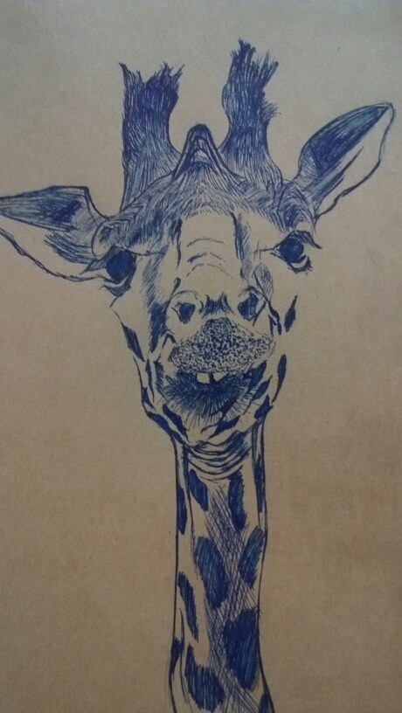
Wish for criticism.

Slide 52
Leonenko方法会严重低估互信息，说明其并不适用于高维高相关数据

Slide 53
随机不确定性较小，说明数据质量较好，模型有可能达到较高精度；
Leonenko方法对内在维数非常敏感，现有降维方法难以满足需求
ISOMAP方法和SVM方法对水文数据的信息量有一定的识别能力

