Slide 1
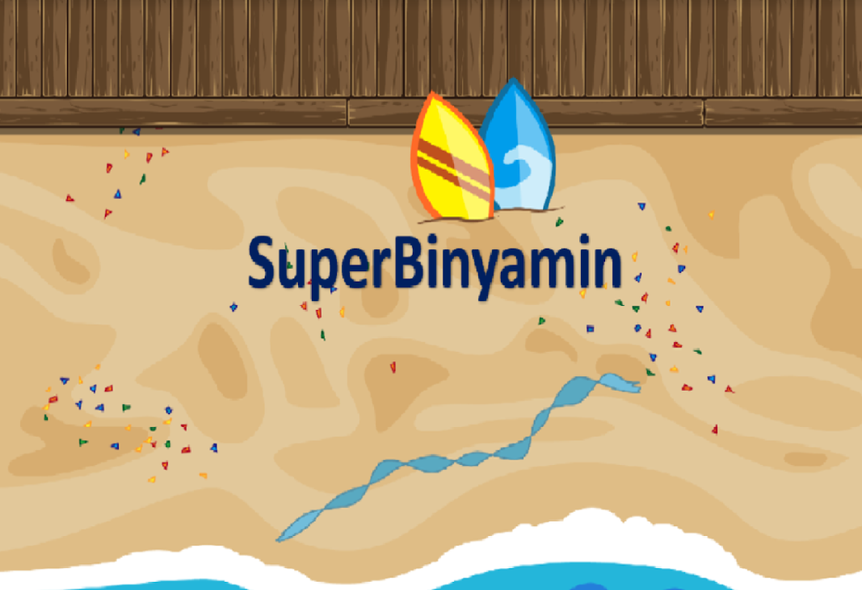

Slide 2
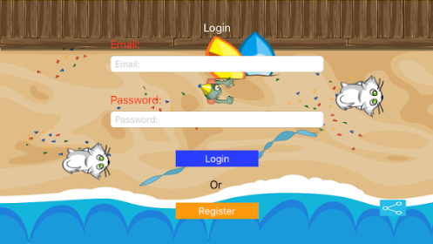
The main screen serves as the login screen.
And if it's the user's first experience with the app, then a registration is required
Moreover, the app enables it’s user’s to share the app with their friends.

Slide 3
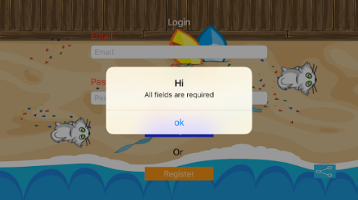
If the user did not fill in all the fields, then the app will subsequently alert him.

Slide 4
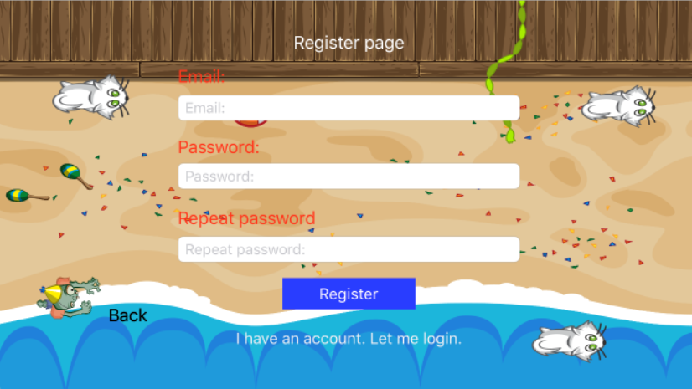
If it’s the user’s first time experience with the app, then a registration form is required from him to fill in.

Slide 5
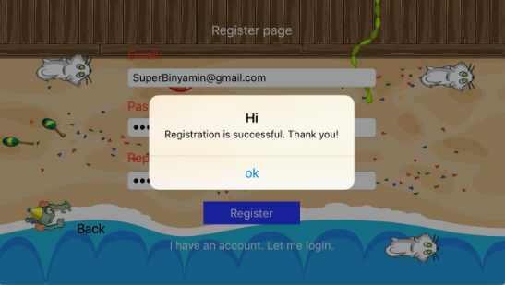
When the user has successfully
registered/logged in,
he will then recieve
a indication that he has successfully
managed to enter the app.

Slide 6
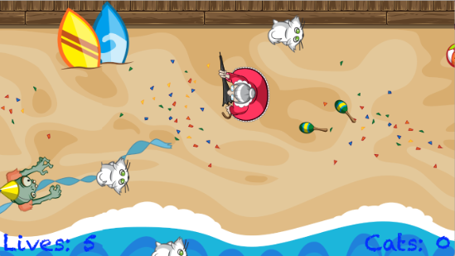
Here is the beginning of the game.

Slide 7
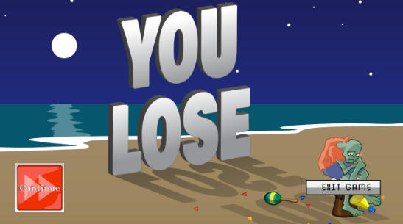
When the user has lost the game, he can either restart the game, or he can just quit and he will be led back to the login screen.

Slide 8
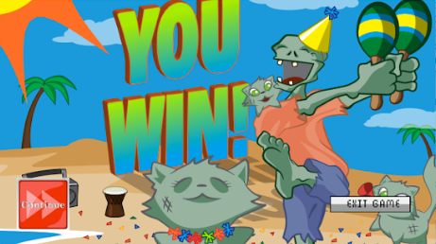
When the user has successfully won the game, he can either restart the game or he can end it and go back the login screen.

Slide 9
Good Luck!

