Slide 1
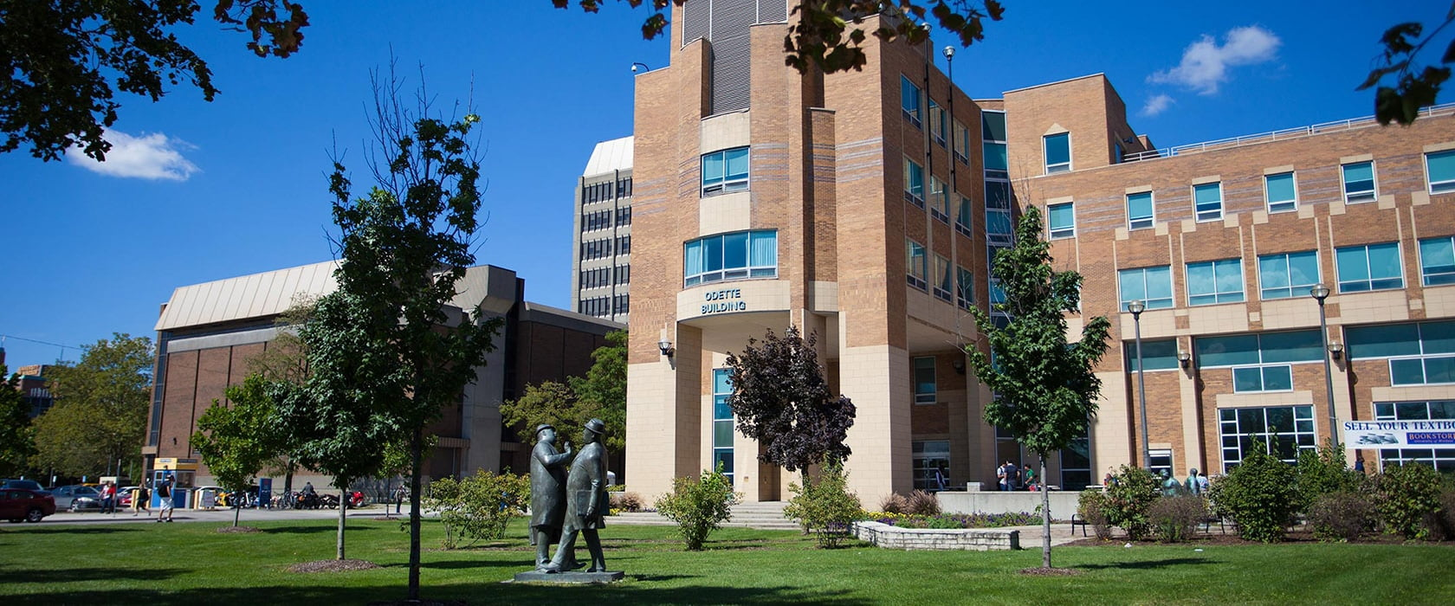
THE CUSTOMER STATUS UPDATE
FINAL PRESENTATION
BINZ BABY JOSEPH
JASLEEN KAUR AHLUWALIA
RIFAH TASFIA AMIN
SPARSH JINDAL
PRESENTERS OF GROUP 6:

Slide 2
PROBLEM STATEMENT
HOW CAN ODETTE SCHOOL OF BUSINESS BE SUCCESSFUL IN THE FT 100 RANKING?
WHAT FACTORS ARE DRIVING THE CHANGES IN THE FT 100 RANKING OVER THE YEARS ?

Slide 3
Our journey at a glimpse
DATA COLLECTION
DATA PROCESSING AND CLEANING
APPROACHES TO DATA ANALYSIS
ANALYSIS
INSIGHTS FROM DESCRIPTIVE STATISTICS

Slide 4
DATA COLLECTION
QUANTITATIVE DATA COLLECTION
QUALITATIVE DATA COLLECTION

Slide 5
Quantitative DATA COLLECTION
FINANCIAL TIMES
Data Collection Span: The dataset encompasses information from the period of 2018 to 2023, providing a comprehensive view of the relevant metrics over five years.
Data Exclusion Note: Due to detected inconsistencies, the 2018 dataset was deemed unreliable for analytical purposes and was consequently excluded to maintain the integrity of the analysis.
Methodological Update: The analysis utilized the 2023 FT (Financial Times) methodology as a benchmark, ensuring that the metrics remain current and relevant. This approach facilitated a consistent comparison with the data from previous years.

Slide 6
The data was collected and studied to understand the areas that were significant and unique to the performance of the top 5 universities in the dataset.
ALUMNI NETWORK: These universities held alumnus very dearly and kept them engaged with various re-unions, galas, mentoring opportunities etc. to establish and maintain the connect they had with students, which has now resulted in a well-knit alumni network.
DELIVERY OF CAREER DEVELOPMENT SERVICES: It was observed that the delivery of career services by the top universities was more comprehensive and holistic aiming at global employability for both currently enrolled students as well as the alumni, indicating that the universities are focusing on longer term relationship establishment and global recognition
Qualitative DATA COLLECTION

Slide 7
DATA CLEANING AND PROCESSING
Handling Missing Values
Anomaly Detection and Correction

Slide 8
INSIGHTS FROM THE DESCRIPTIVE STATS

Slide 9
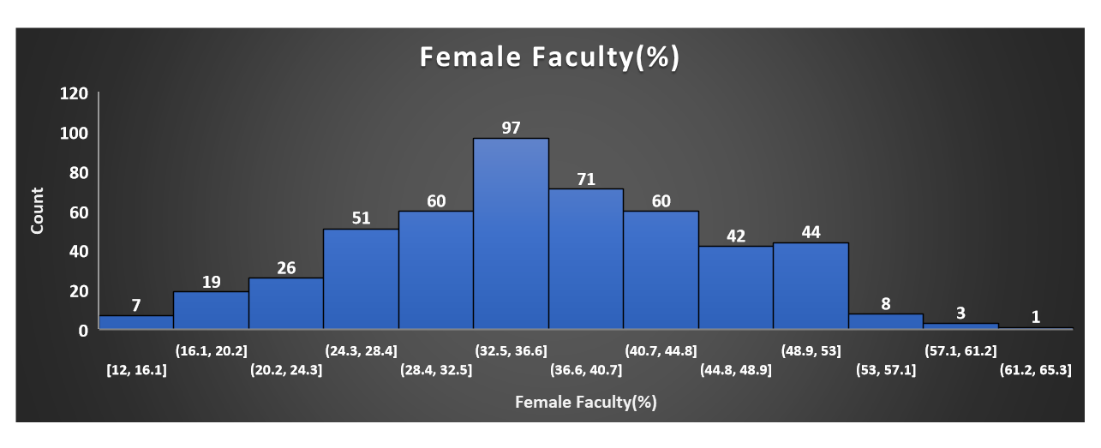

Slide 10
The analysis of descriptive statistics reveals a notable trend: The distribution displayed by the graph suggests a normal curve, with the preponderance of universities featuring a female faculty composition in the range of 30-35%.

Slide 11
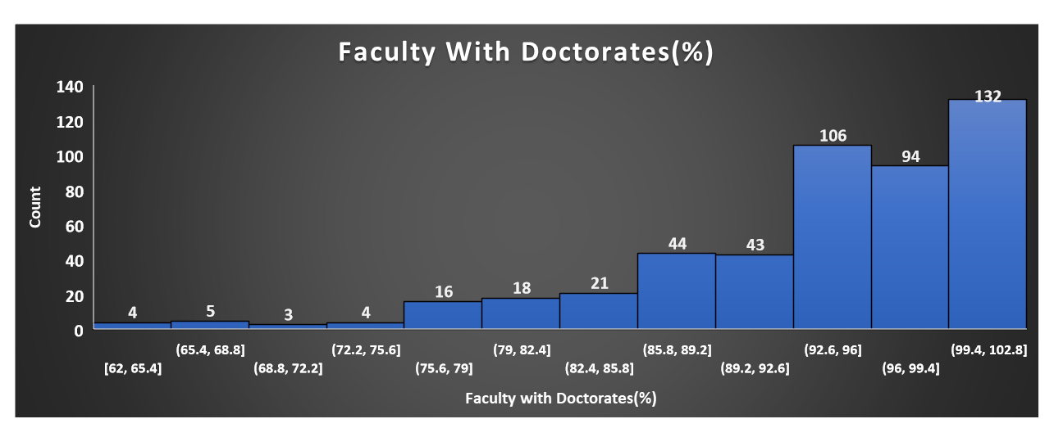

Slide 12
The analysis of descriptive statistics reveals a trend: The graph exhibits a right side clustering, signifying that a predominant number of universities employ a doctoral-educated faculty within the field of education.

Slide 13
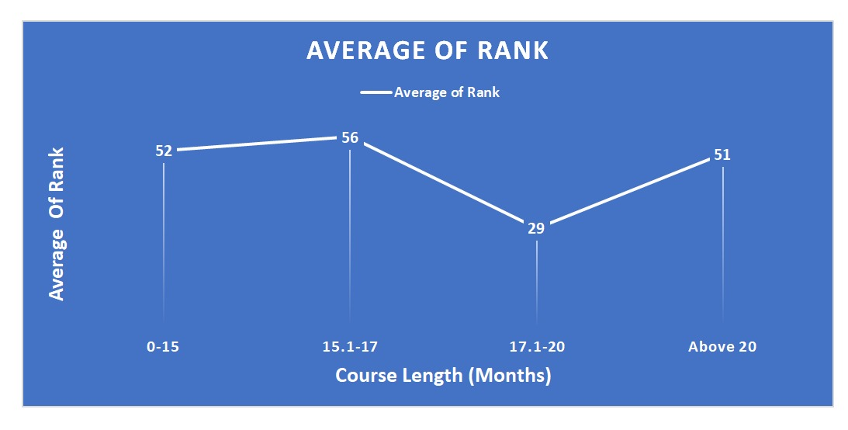

Slide 14
The line chart reveals that courses lasting 17.1-20 months reach the highest mean ranking, implying that such a timeframe may be most effective according to the assessed criteria. The observed pattern emphasizes the importance of duration in achieving optimal educational or programmatic success, with lengthier courses not automatically guaranteeing improved ranks.

Slide 15

ANALYSIS X OUR APPORACH

Slide 16
OUR APPROACH TO ANALYSIS:
NORMAL PREDICTION MODEL
CAUSAL APPROACH MODEL
a. SHORT-TERM
b. LONG-TERM
THE TRIPLE SWORD ANALYSIS

Slide 17
NORMAL PREDICTION MODEL (Regression analysis)
1
ACCURACY= 84%
BAYESIAN LINEAR REGRESSION
ACCURACY= 86%
RANDOM FOREST REGRESSION

Slide 18



LET’S IMAGINE
HENCE, CORREALTION ≠ CAUSATION

Slide 19






SHORT TERM CAUSAL APPROACH
2
In a short-term causal approach, we focus on what has happened recently and how those immediate events or factors might be responsible for the current situation. It helps us understand the 'why' behind something that has just occurred, like the poor condition of your garden today."
TO DETERMINE DRIVING FORCES

Slide 20
Short Term Change Effects (1yr change)
Attributes | Parameter
Weighted salary (US$) | -0.0008
Career progress rank | 0.135
Employed at 3 months | -0.1965
Female faculty (%) | -0.9188
Avg_Course_Length(Months) | 1.1097
International faculty (%) | -0.8062
Careers service rank | 0.1325
Aims achieved (%) | -0.9958

Slide 21



LONG TERM CAUSAL APPROACH
3
In a long-term causal approach, we look at events or conditions that might have happened a long time ago but are still affecting the situation today. It helps us understand the 'why' behind a problem that has been developing over an extended period, like why your tree isn't growing as it should."
BASED ON TEMPORAL ORDER OF EVENTS

Slide 22
Long Term Change Effects (2yr change)
Attributes | Parameter
Employed at 3 months | -0.3672
Weighted salary (US$) | -0.0006
Career progress rank | 0.1875
Female students (%) | -0.482
Avg_Course_Length(Months) | 2.1469

Slide 23

PARTICULARS | NORMAL PREDICTION MODEL | SHORT-TERM APPROACH | LONG- TERM APPROACH
EMPLOYED AT 3 MONTHS
WEIGHTED SALARY (US)
CAREER PROGRESS RANK

Slide 24

RECOMMENDATIONS
DEVELOPMENT OF THE CAREER SERVICES
ADDITONAL OFFERINGS

Slide 25
THANK YOU

Slide 26

REFRENCES
IMAGERY REFERENCES:
https://www.vectorstock.com
https://mbagradschools.com/school/odette-school-of-business
https://www.istockphoto.com/illustrations/icons

