Slide 1
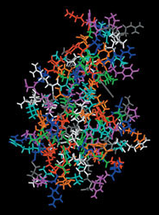
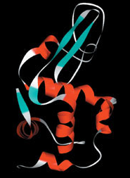
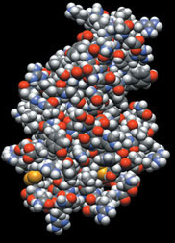
Proteins and signal transduction
BIO311
01.17.2017
Notes:
Talk about the different ways proteins are represented (stick, ribbon, and space-filling representations).

Slide 2
Protein Synthesis
DNA
RNA
Protein

Slide 3
Proteins
Majority of the dry weight of the cell
Variety of functions:
_____________proteins – cytoskeleton (microtubules, actin), chromosome scaffolds
____________– catalyze chemical reactions (metabolism). Synthesize molecules (___________).
Transfer information (TFs, _____________)
Molecular Machines. _______________

Slide 4
How can one class of biomolecules give rise to so many diverse functions?
They can adopt many different structures (_____________________)

Slide 5
Structural variety in proteins
Made up of __________aa, not just 4 residues like in RNA or DNA – computational possibilities
Flexible about the C-N _____________bond
Structure → _______________

Slide 6
Making proteins
Watch the translational machine, the ribosome, in action

Slide 7
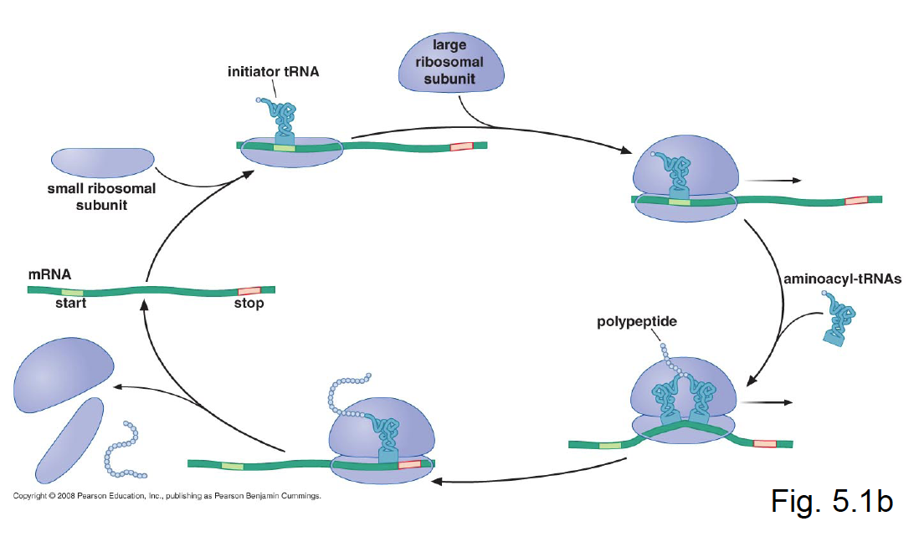
Translation: how proteins are made

Slide 8
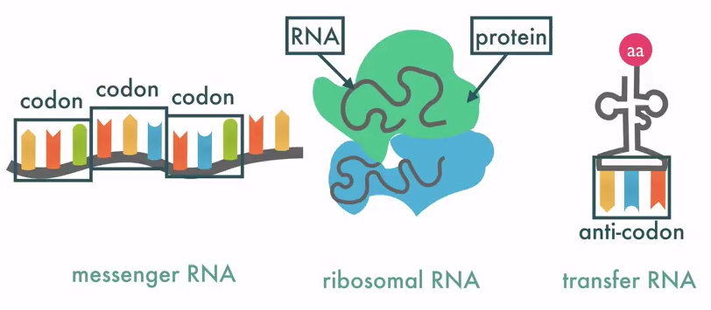
How are proteins made?
Translation
Machinery

Slide 9
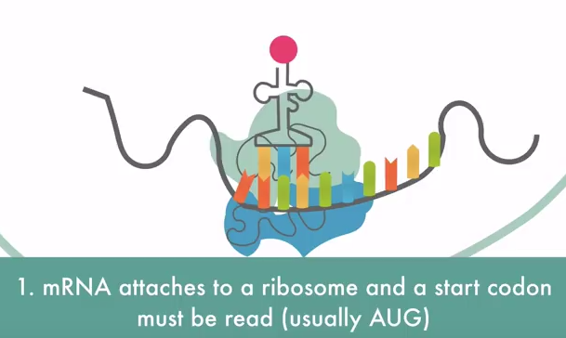
How are proteins made?
Translation
Process

Slide 10
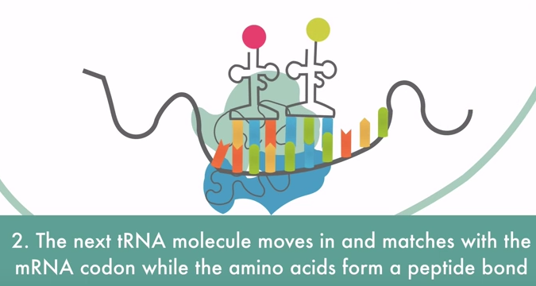
How are proteins made?
Translation
Process

Slide 11
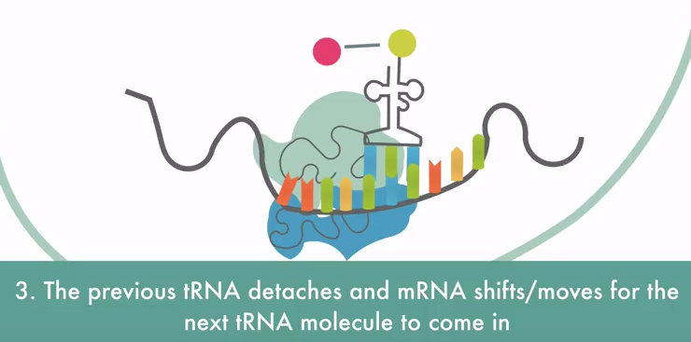
How are proteins made?
Translation
Process

Slide 12
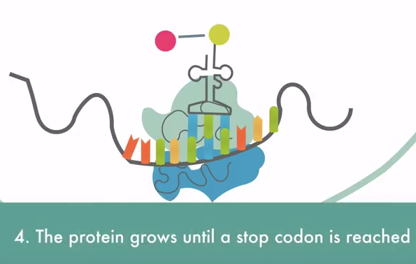
How are proteins made?
Translation
Process

Slide 13
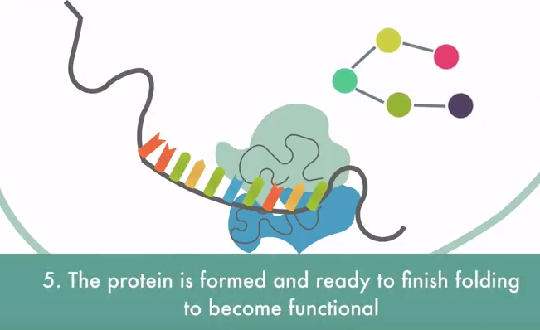
How are proteins made?
Translation
Process

Slide 14
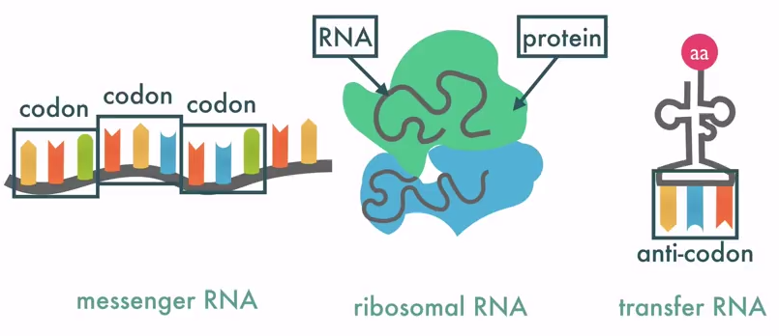
From the Genetic Code to the aa seq
_________: a set of 3 nucleotides in the mRNA seq that codes for 1 aa.
__________: corresponding triplete seqon the tRNA that brings the specific aa to the ribosome during the translation.

Slide 15
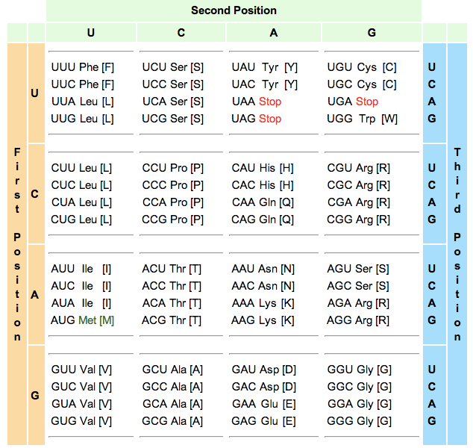
The genetic code

Slide 16
The Genetic Code
4 unique bases so 4³= 64 potential codons
20 amino acids
What do the other 44 codons code for?

Slide 17
The Genetic Code
4 unique bases = _________potential codons
_____amino acids
What do the other 44 codons code for?
Genetic code is redundant (several codons for 1 amino acid)
Punctuation

Slide 18
The Genetic Code
Punctuation
Start codon is ____ = ____________
Translational ________
Stop codons: UAA, UAG, UGA
Translational stop

Slide 19
4 levels of protein structure
Primary 1°
Secondary 2°
Tertiary 3°
Quarternary 4°

Slide 20
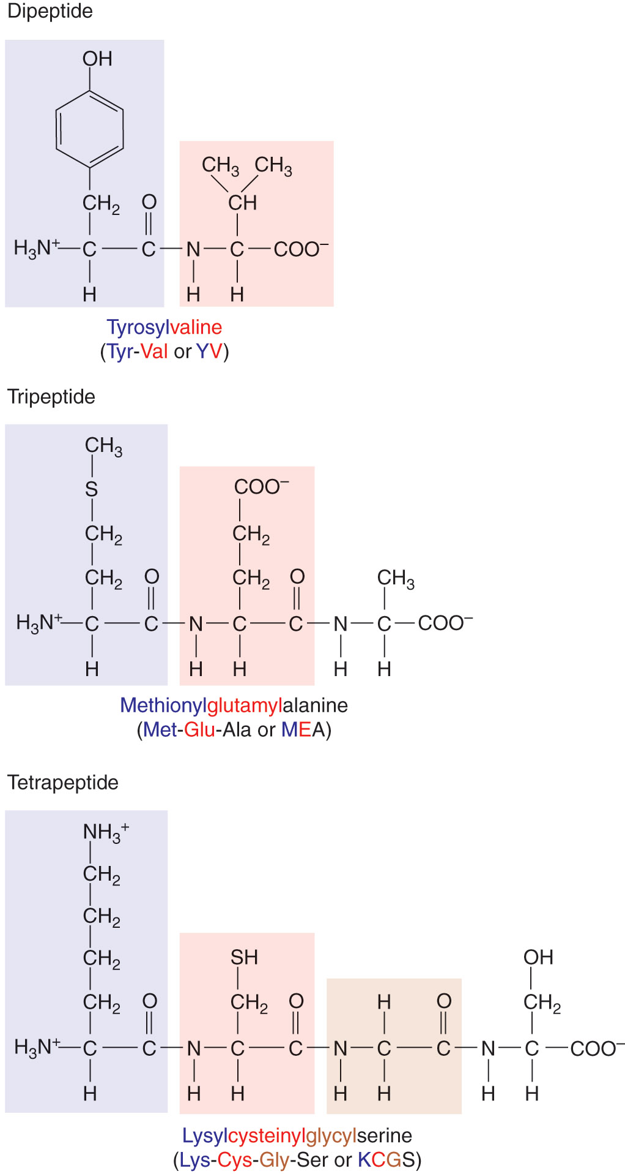
Primary Structure of proteins
Linear sequence of amino acids
in the polymer (_______________)

Slide 21
PROTEIN STRUCTURE
Proteins don’t exist in the cell as extended chains
They fold into __________and _________structures (Globular)
Primary structure determines these structures

Slide 22
Strong chemical bonds
______________– peptide bond = strong
______________– reversible, weaker

Slide 23
Weak chemical bonds (noncovalent) stabilize protein structure
Ionic bond
Hydrogen bond
van der Waals interaction
Hydrophobic interaction
clustering of side chains

Slide 24
Secondary structures
3 flavors
_________helix
________sheet
________coil

Slide 25
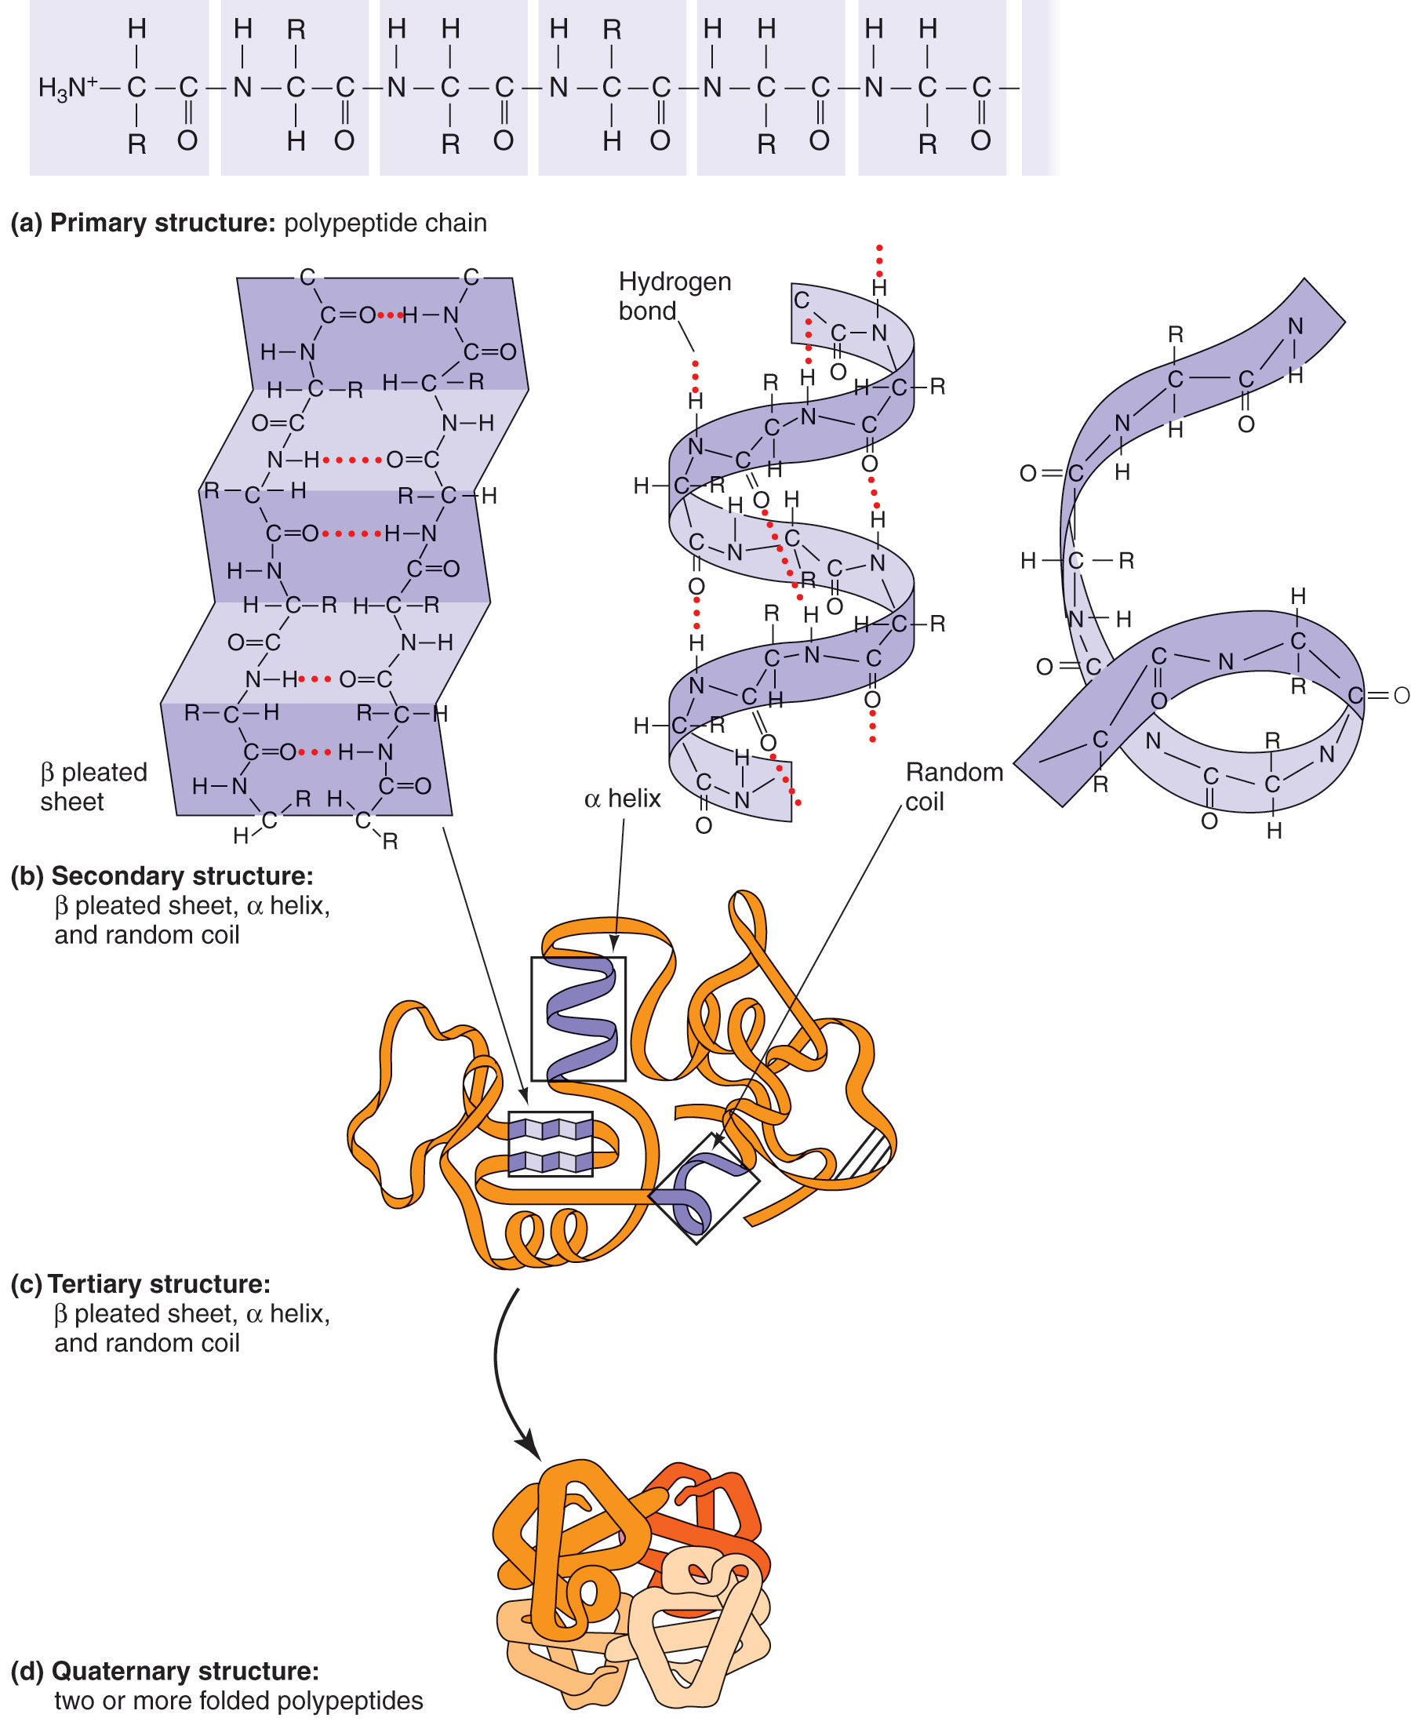
Figure 2.23b
Adapted from Tropp, B. E. Biochemistry: Concepts and Applications. Brooks/Cole Publishing Company, 1997.

Slide 26
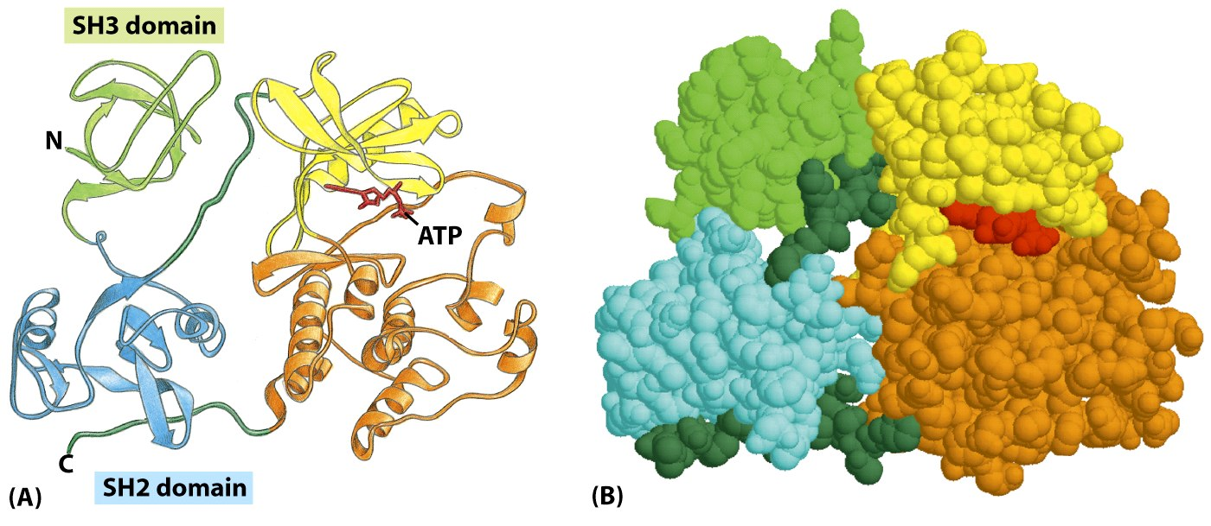
Tertiary structure
Figure 3-10 Molecular Biology of the Cell (© Garland Science 2008)

Slide 27
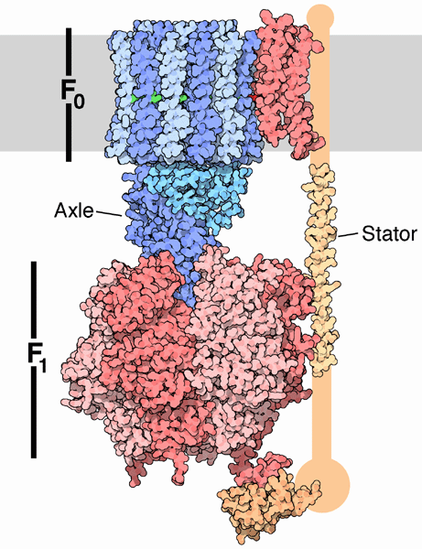
Quaternary structure

Slide 28
Quaternary structure in action
ATP synthase: a molecular machine in motion

Slide 29
Think/pair/share
Design a protein for a cellular function of your choice. How would you make it? (Hint: consider tertiary and/or quaternary structure).
“Break” your engineered protein. How would you do it? (Hint: think about the genetic code).

Slide 30
PROTEIN FUNCTIONS
Enzymes: biological catalysts

Slide 31
Activation energy
In biological systems,
____________________facilitates getting over the
__________________to move the reaction forward.
__________effectively __________the activation energy.

Slide 32
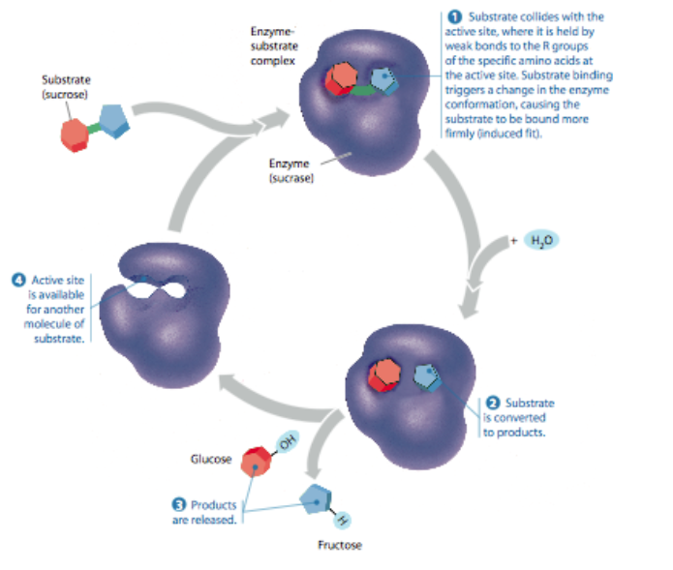
Active sites

Slide 33
Kinases
Bind a ____________group onto another protein
Phosphate group ______________the other protein

Slide 34
What is signal transduction?
Signal (small molecule, light, hormone, sugar, salt…..)
Signal gets inside cell (___________________)
Signal transfer and __________________
Change in cell behavior (________,____________,____________...)

Slide 35
Prokaryotic signal transduction: direct sensing
transcription factor

Slide 36
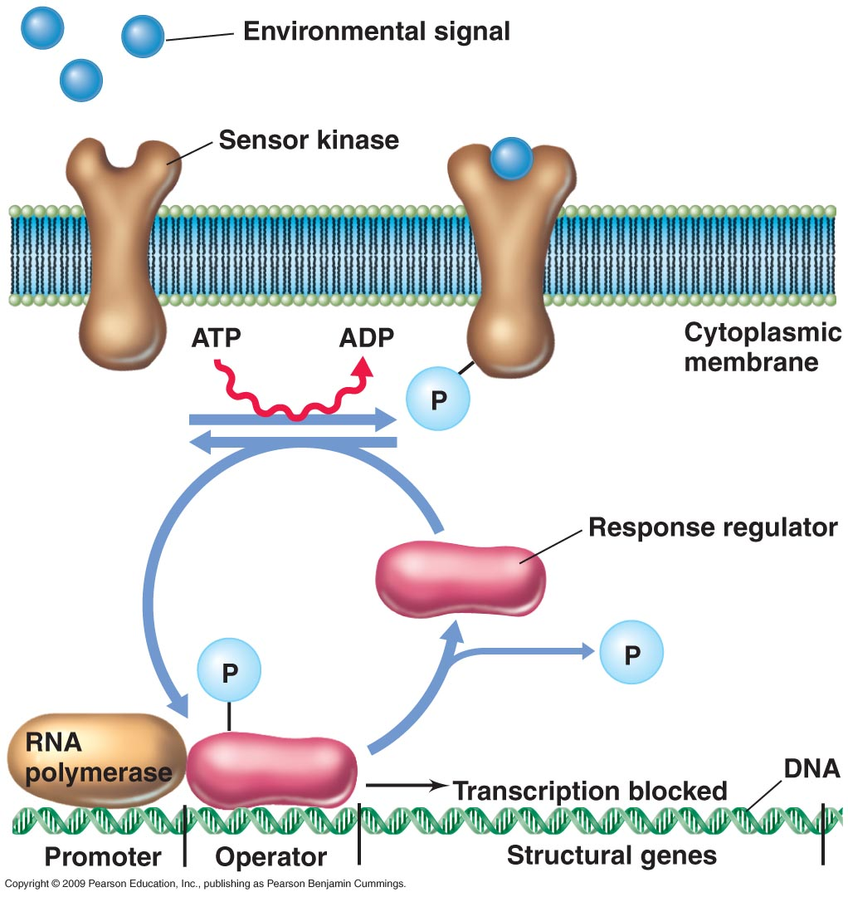
Two-component systems

Slide 37
Many types of two-component systems
Nitrate and nitrite utilization
Inorganic phosphate utilization
Oxygen
Cell cycle (e.g. Caulobacter crescentus)

Slide 38
Eukaryotic signal transduction
Allows for rapid _________________of a stimulus
______________the signal coming from the stimulus.

Slide 39
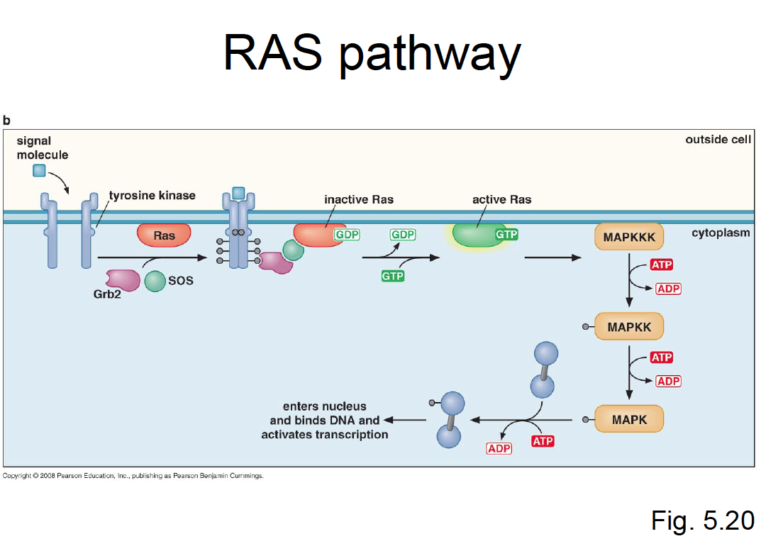
Information transfer
https://www.youtube.com/watch?v=oDjDUUhGVsI

