Slide 1
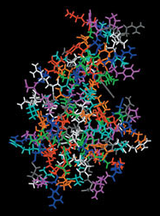
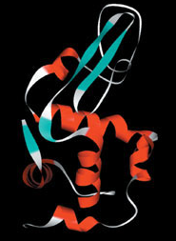
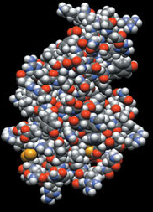
Proteins and signal transduction
BIO311
01.17.2017
Notes:
Talk about the different ways proteins are represented (stick, ribbon, and space-filling representations).

Slide 2
Protein Synthesis
DNA
RNA
Protein

Slide 3
Proteins
Majority of the dry weight of the cell
Variety of functions:
_____________proteins – cytoskeleton (microtubules, actin), chromosome scaffolds
____________– catalyze chemical reactions (metabolism). Synthesize molecules (___________).
Transfer information (TFs, _____________)
Molecular Machines. _______________

Slide 4
How can one class of biomolecules give rise to so many diverse functions?
They can adopt many different structures (_____________________)

Slide 5
Structural variety in proteins
Made up of __________aa, not just 4 residues like in RNA or DNA – computational possibilities
Flexible about the C-N _____________bond
Structure → _______________

Slide 6
Making proteins
Watch the translational machine, the ribosome, in action

Slide 7
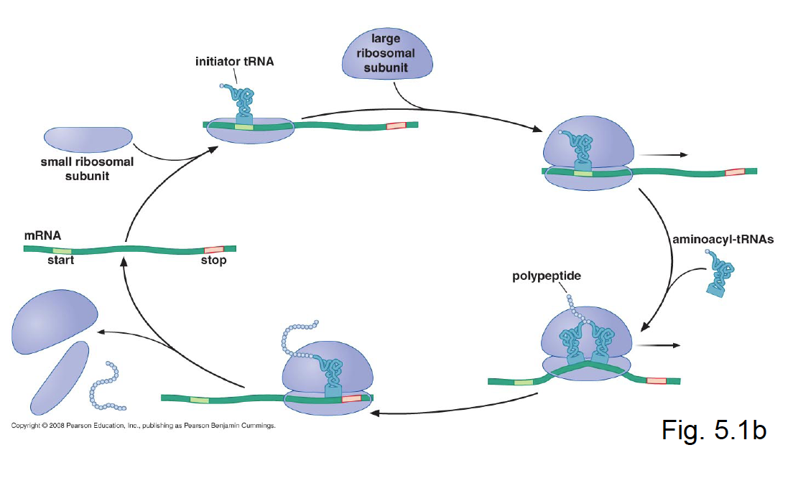
Translation: how proteins are made

Slide 8
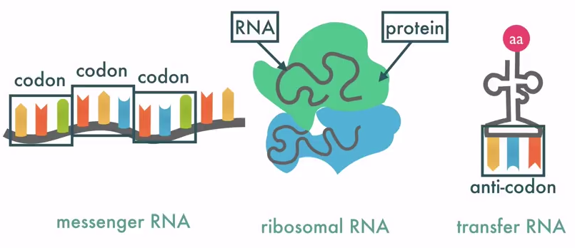
From the Genetic Code to the aa seq
_________: a set of 3 nucleotides in the mRNA seq that codes for 1 aa.
__________: corresponding triplete seqon the tRNA that brings the specific aa to the ribosome during the translation.

Slide 9
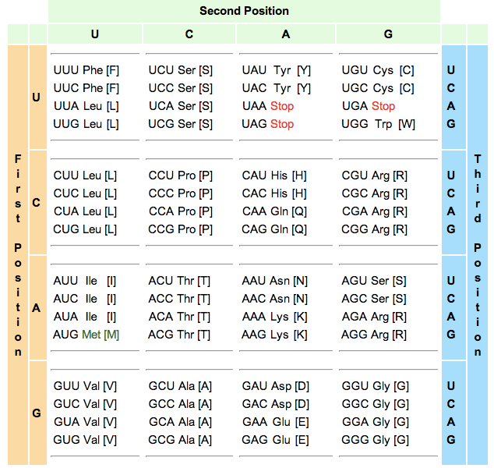
The genetic code

Slide 10
The Genetic Code
4 unique bases so 4³= 64 potential codons
20 amino acids
What do the other 44 codons code for?

Slide 11
The Genetic Code
4 unique bases = _________potential codons
_____amino acids
What do the other 44 codons code for?
Genetic code is redundant (several codons for 1 amino acid)
Punctuation

Slide 12
The Genetic Code
Punctuation
Start codon is ____ = ____________
Translational ________
Stop codons: UAA, UAG, UGA
Translational stop

Slide 13
Terminology: coding vs non-coding DNA

Slide 14
4 levels of protein structure
Primary 1°
Secondary 2°
Tertiary 3°
Quarternary 4°

Slide 15
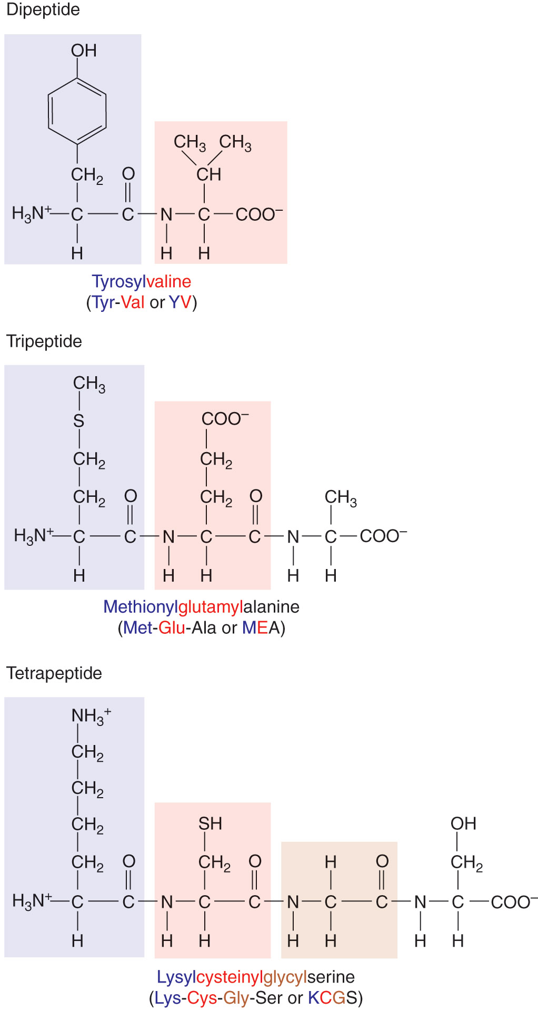
Primary Structure of proteins
Linear sequence of amino acids
in the polymer (_______________)

Slide 16
PROTEIN STRUCTURE
Proteins don’t exist in the cell as extended chains
They fold into __________and _________structures (Globular)
Primary structure determines these structures

Slide 17
Strong chemical bonds
______________– peptide bond = strong
______________– reversible, weaker

Slide 18
Weak chemical bonds (noncovalent) stabilize protein structure
Ionic bond
Hydrogen bond
van der Waals interaction
Hydrophobic interaction
clustering of side chains

Slide 19
Secondary structures
3 flavors
_________helix
________sheet
________coil

Slide 20
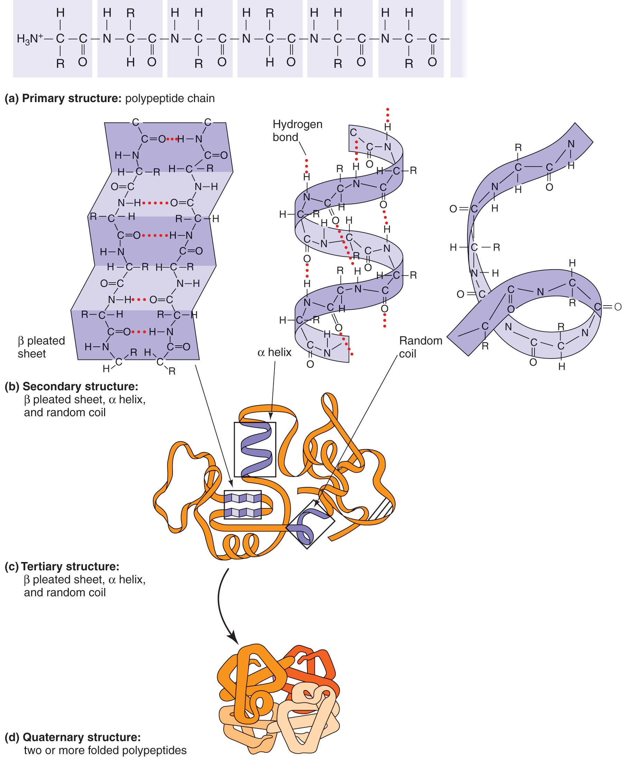
Figure 2.23b
Adapted from Tropp, B. E. Biochemistry: Concepts and Applications. Brooks/Cole Publishing Company, 1997.

Slide 21
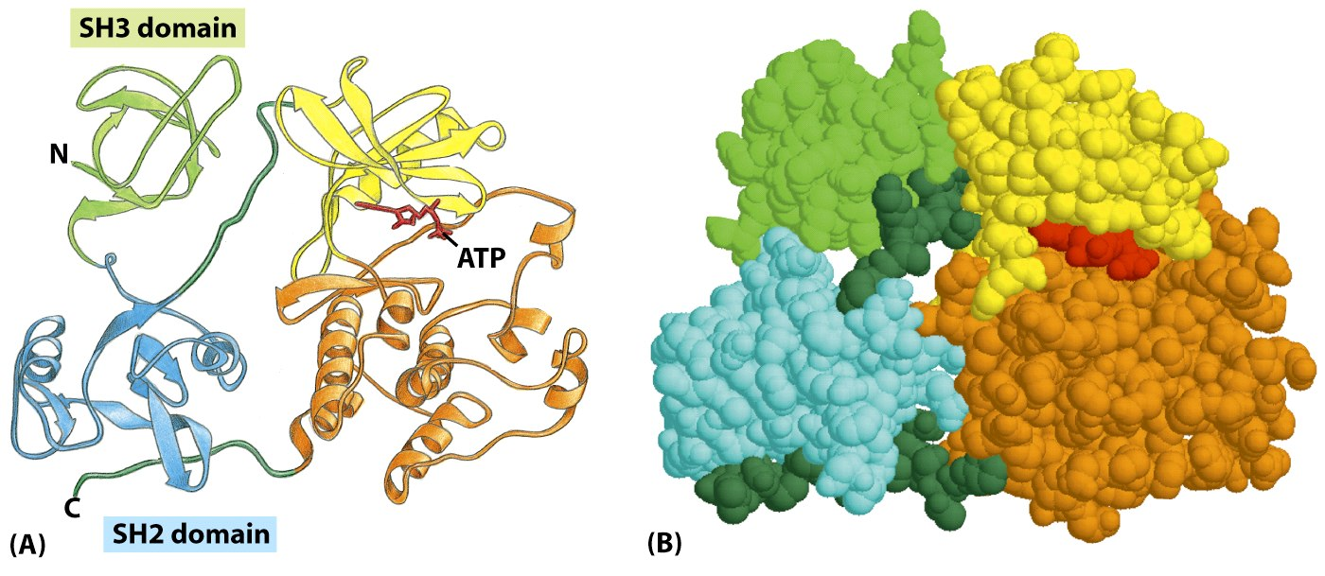
Tertiary structure
Figure 3-10 Molecular Biology of the Cell (© Garland Science 2008)

Slide 22
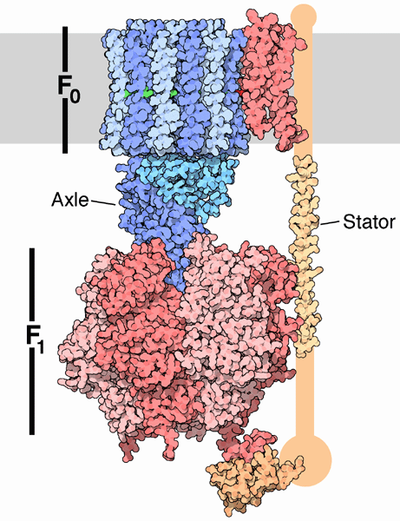
Quaternary structure

Slide 23
Quaternary structure in action
ATP synthase: a molecular machine in motion

Slide 24
Think/pair/share
Design a protein for a cellular function of your choice. How would you make it? (Hint: consider tertiary and/or quaternary structure).
“Break” your engineered protein. How would you do it? (Hint: think about the genetic code).

Slide 25
PROTEIN FUNCTIONS
Enzymes: biological catalysts

Slide 26
Activation energy
In biological systems,
____________________facilitates getting over the
__________________to move the reaction forward.
__________effectively __________the activation energy.

Slide 27
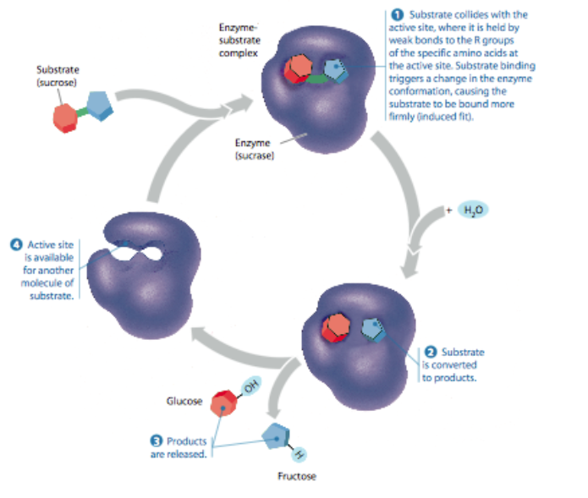
Active sites

Slide 28
Kinases
Bind a ____________group onto another protein
Phosphate group ______________the other protein

Slide 29
What is signal transduction?
Signal (small molecule, light, hormone, sugar, salt…..)
Signal gets inside cell (___________________)
Signal transfer and __________________
Change in cell behavior (________,____________,____________...)

Slide 30
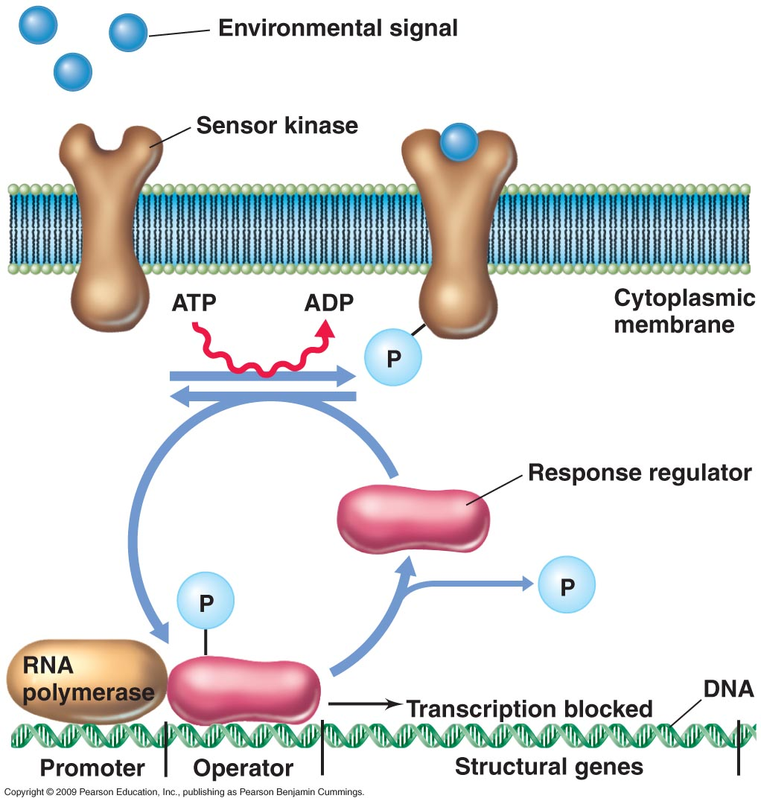
Two-component systems

Slide 31
Many types of two-component systems
Nitrate and nitrite utilization
Inorganic phosphate utilization
Oxygen
Cell cycle (e.g. Caulobacter crescentus)

Slide 32
Eukaryotic signal transduction
Allows for rapid _________________of a stimulus
______________the signal coming from the stimulus.

Slide 33
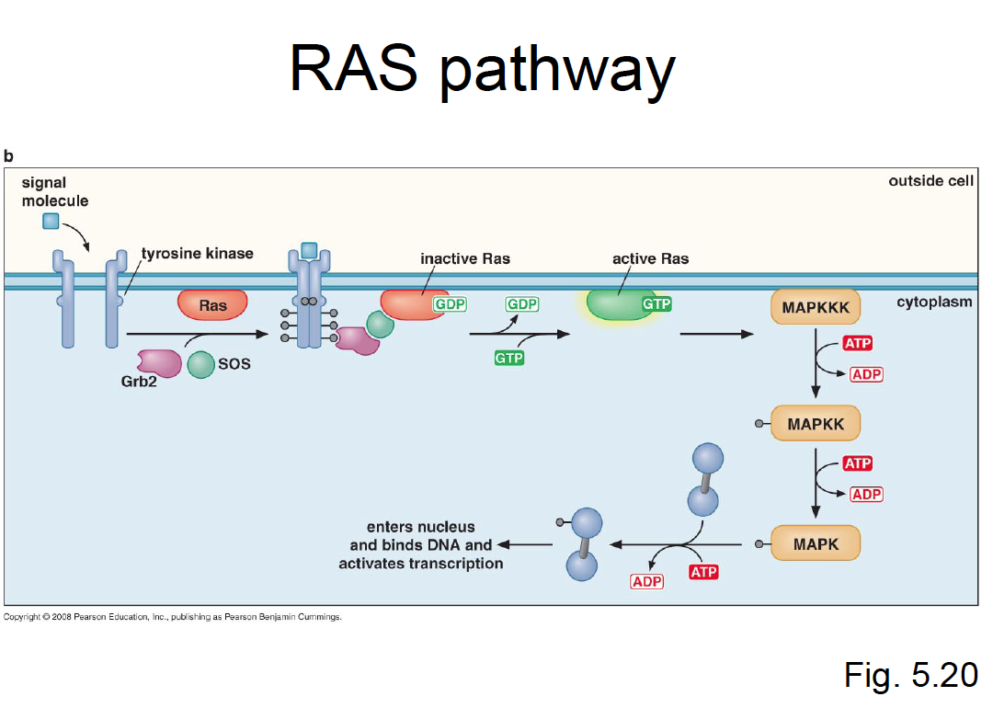
Information transfer
https://www.youtube.com/watch?v=oDjDUUhGVsI

