Slide 2
Transcription and gene regulation

Slide 3
Central Dogma of Molecular Biology
Transcription Translation
DNA
RNA
(transcript)
Protein

Slide 4
The four types of biopolymer molecules “macromolecules”
Carbohydrates
___________
Fats (lipids)
_______________

Slide 5
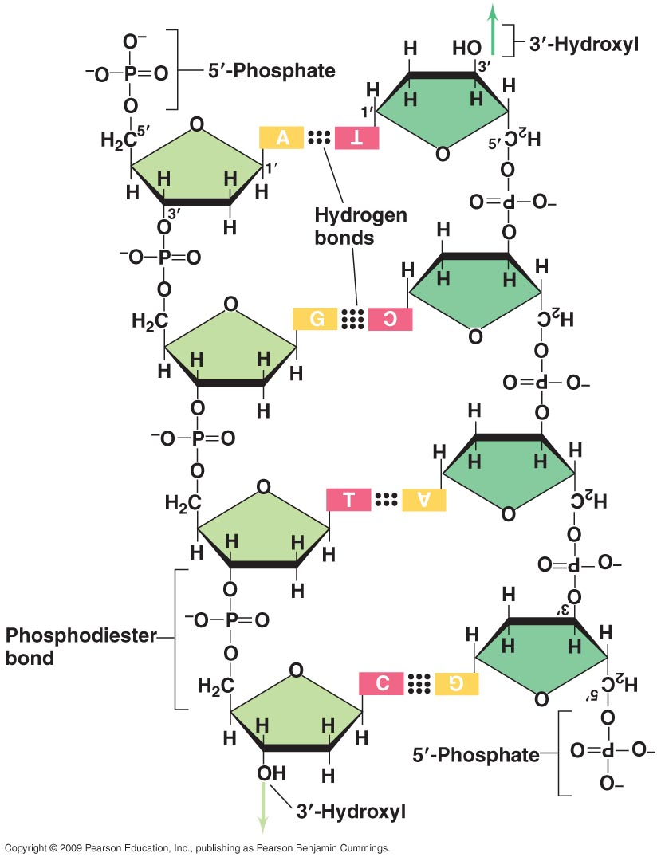
DNA Structure
Figure 7.4

Slide 6
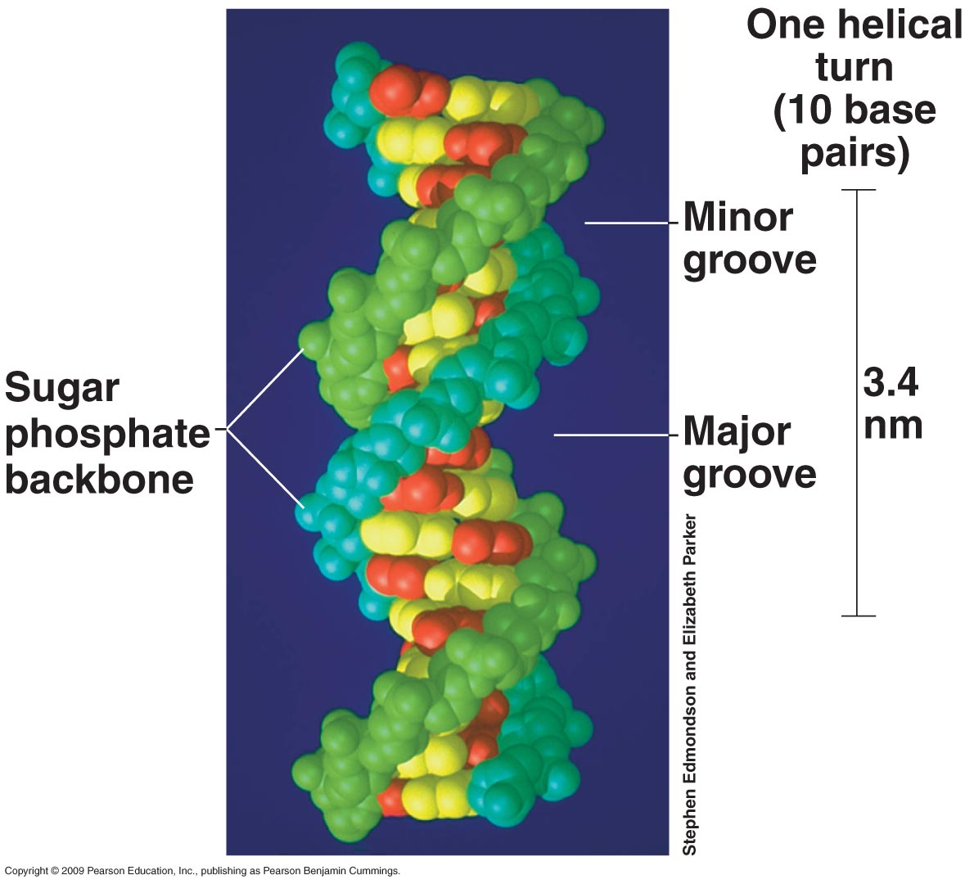
DNA structure is a double helix
Notes:
Antiparallel
Sequence of bases / letters

Slide 7
Features that distinguish RNA from DNA
RNA is relatively ______________. DNA is _____________.
Multiple copies of _____, while _______is usually single copy.
____________instead of ________________in RNA

Slide 8
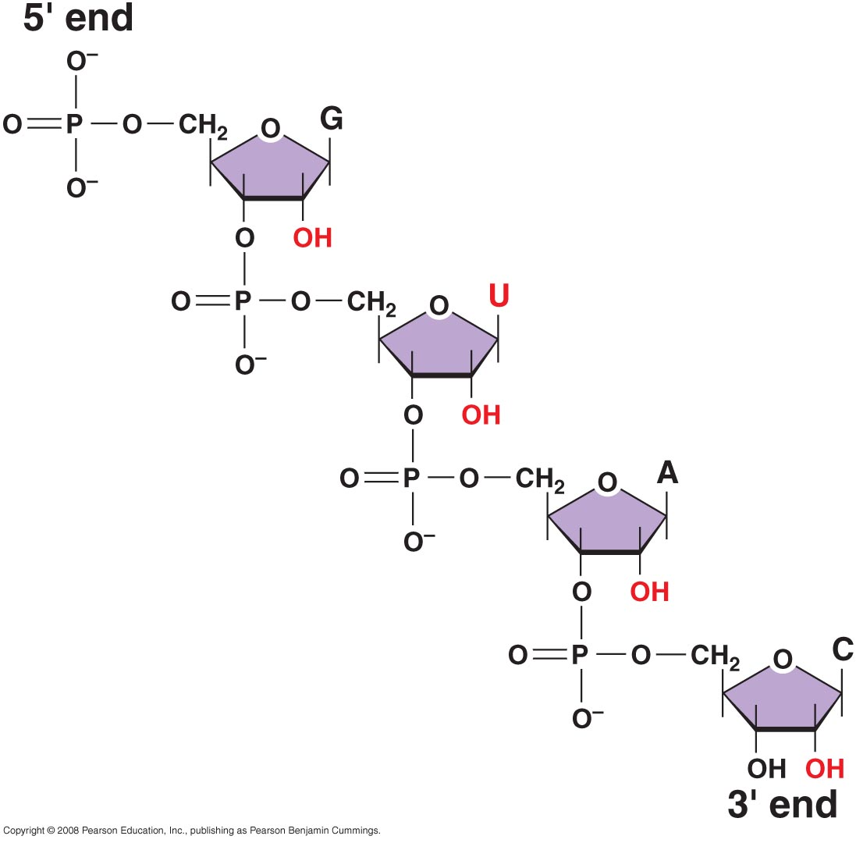
3.2

Slide 9
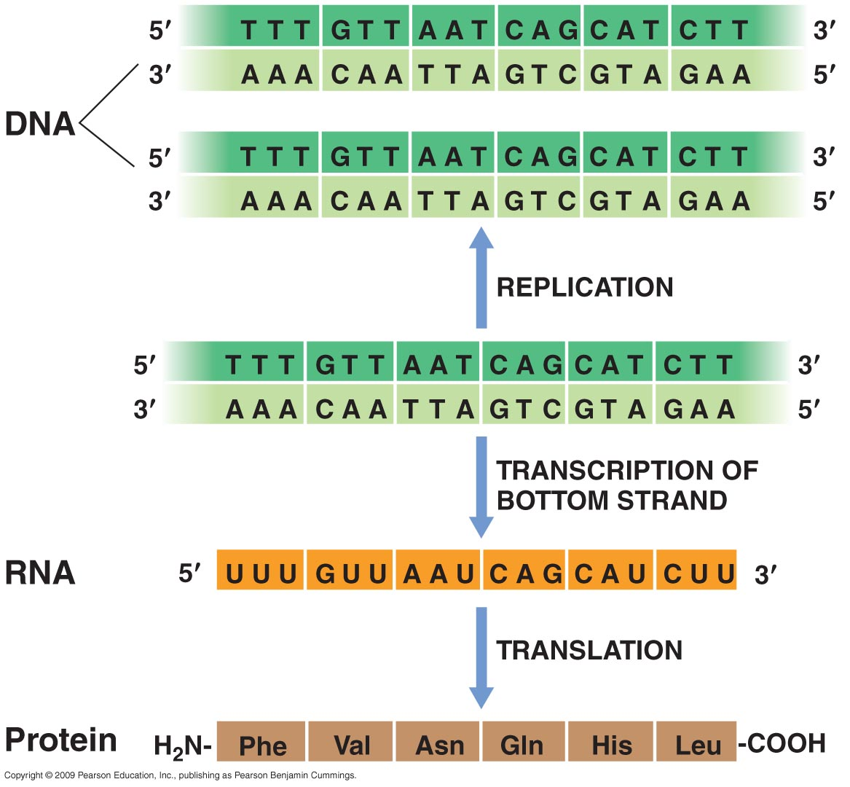
Synthesis of the Informational Macromolecules
Figure 7.1

Slide 10
Transcription in action: RNA polymerase
Check out this video for an overview:
https://www.youtube.com/watch?v=SMtWvDbfHLo

Slide 11
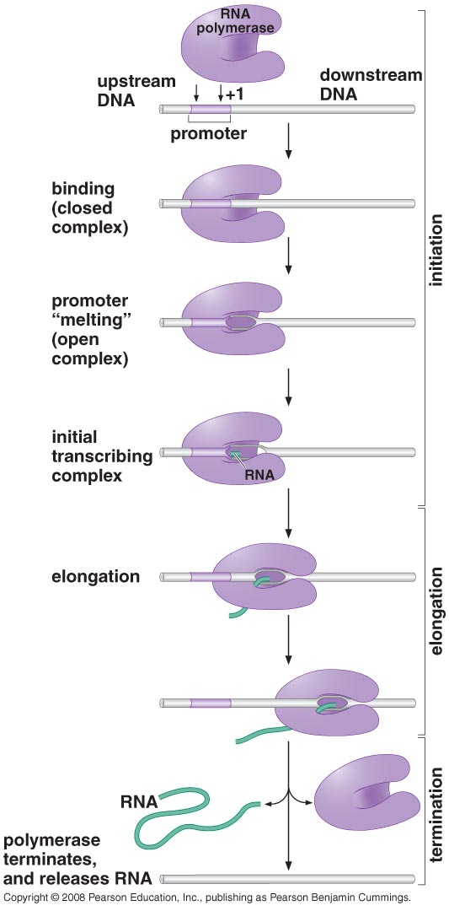
Making RNA from DNA:
“Transcription”
TRANSCRIPT
3.3

Slide 12
Gene expression
Genes on DNA code for an _____________
When mRNA copy/copies made from DNA, it is said to be “____________________”

Slide 13
Basal transcription
The rate at which transcription initiation and elongation would proceed ________________________________________.

Slide 14
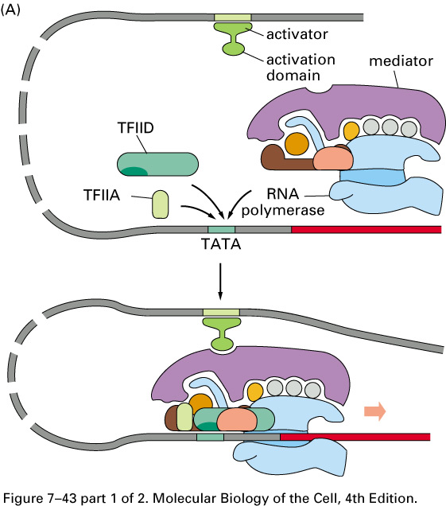
Basal Transcription

Slide 15
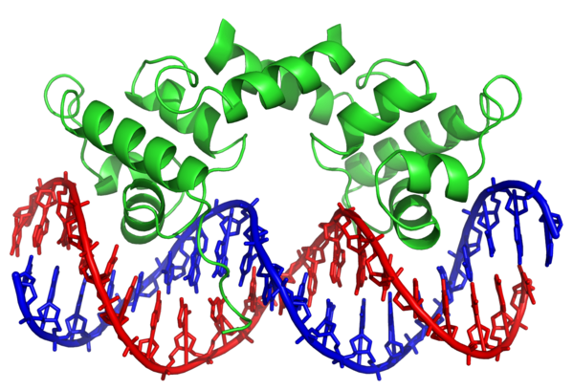
Transcription factors are proteins that bind DNA

Slide 16
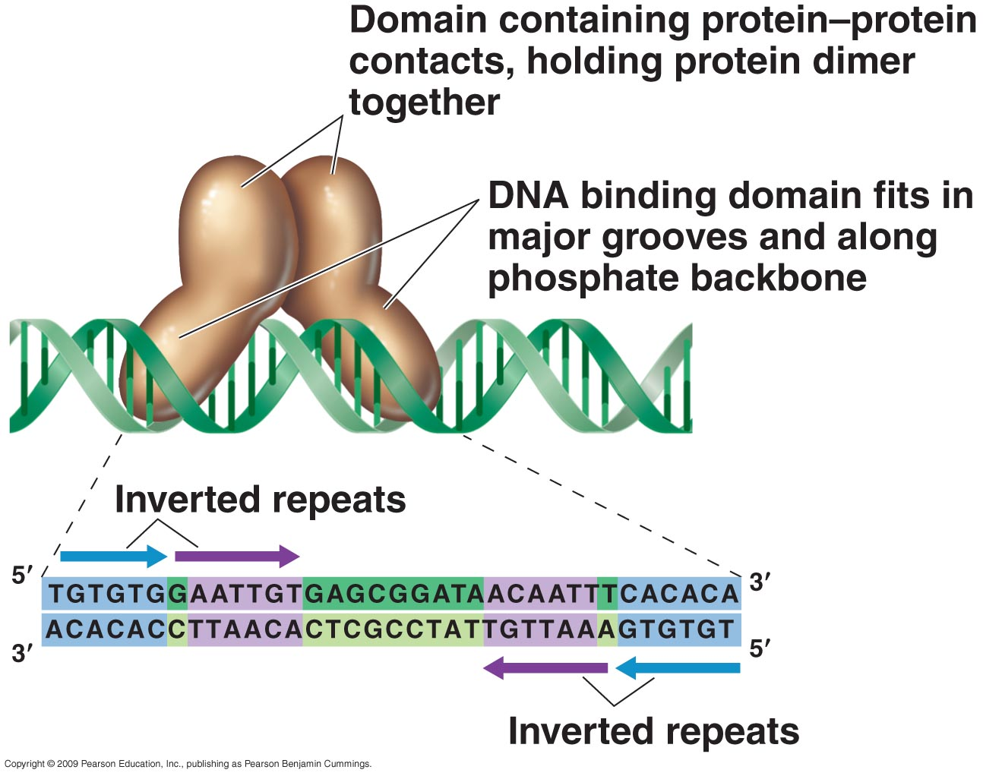
DNA binding regulatory proteins: Transcription factors
Binding SITE
Binding SITE
Notes:
Includes RNAP, TFs.

Slide 17
TFs bind to specific non-coding DNA sequences
These sequences are also called ________________________________.
They can be found throughout ________________and, although the motifs for a given TF
follow a certain ________________, they are not exactly the same.
The motif therefore has a “___________________”
The more a motif resembles a “_____________”, the more likely _____________________.

Slide 18
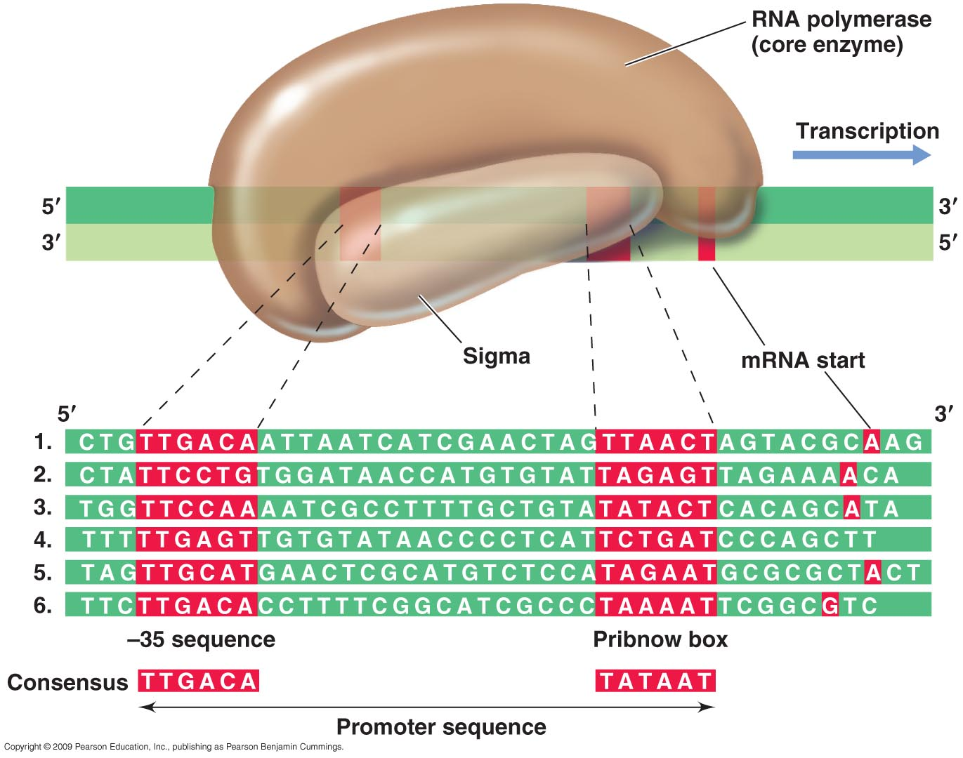
Example: TFs bind to specific non-coding DNA sequences

Slide 19
Regulatory TFs change the basal transcription rate in response to stimuli
Activators = ___________________the rate of transcription
Attract/recruit _____________
Stabilize ___________________
Repressors = ___________________or block rate of transcription
Block ______________*
Block ___________________
Destabilize ________________
Etc.
Video of regulated transcription: https://www.youtube.com/watch?v=vi-zWoobt_Q
Notes:
Need to include information about how different genes are expressed in certain cells, some genes are expressed all the time (constitutive), some are expressed only in response to a certain signal. Also need to talk about how an increase in expression means that the RNAP transcribes the same gene over and over again to make lots of copies of that same RNA, thus increasing the concentration (“activation”) o that RNA.

Slide 20
Reminder: Signals from outside the cell are relayed by signal transduction cascades that culminate in changing the levels of transcription
Genes are expressed at different _______in response to different _________.
Different genes are expressed in different ____________________________________
Genes are expressed within the ________________of eukaryotic cells, where the ___________is located.

Slide 21
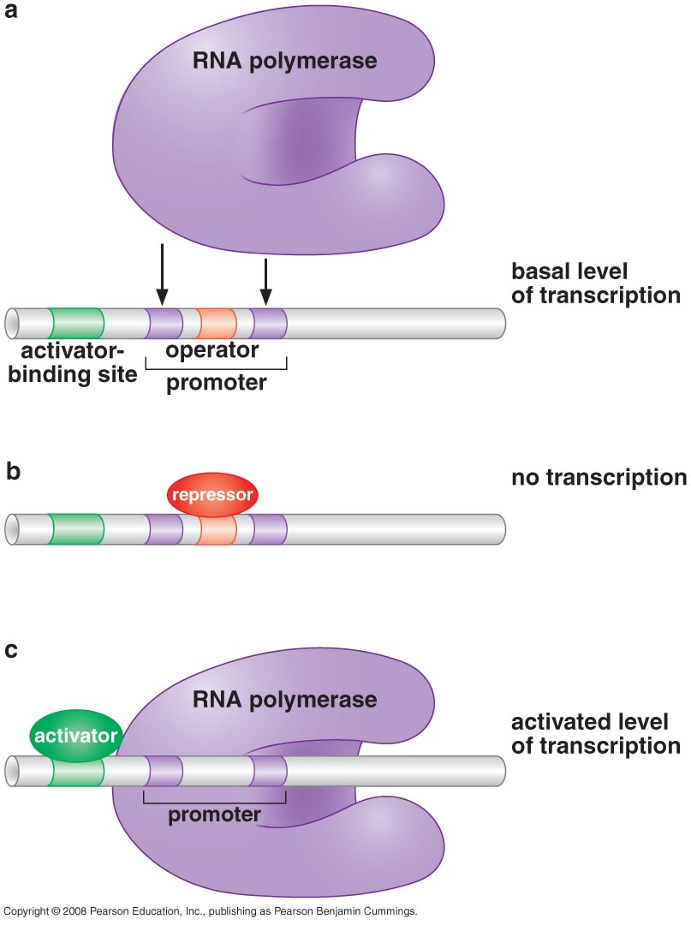
TFs can regulate transcription
when they bind DNA next to
RNA polymerase
Operator:
Activator binding site:
3.10b

Slide 22
Transcription factors can also regulate transcription at a distance
Enhancer:

Slide 23
How are TFs themselves regulated?
By phosphorylation (the end of a signal transduction cascade). Phosphorylation usually induces a ________________________that allows the TF to bind DNA
By binding a small molecule directly (__________________________________). Again, ____________change and binding. Binding can occur in the presence or absence of the signal, also called a _______________.
By increase or decrease in their __________________(i.e. some TFs regulate the transcription of genes encoding ____________). Some TFs regulate the expression of their own gene.

Slide 24
Combinatorial complexity of gene regulation
Heterodimerization – when two different TFs make a ___________together. Formation of this complex is required to _________________________.
A few different transcription factors can bind to different _____________________ DNA locations to regulate the same gene

Slide 25
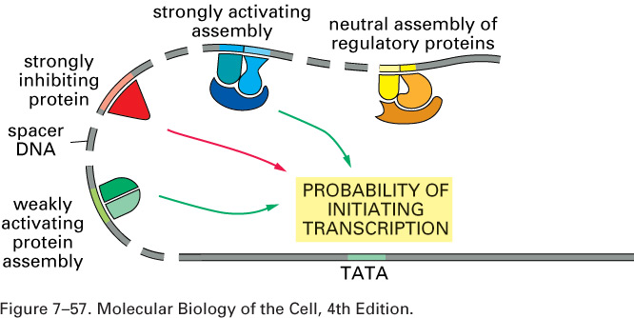
3.19

Slide 26
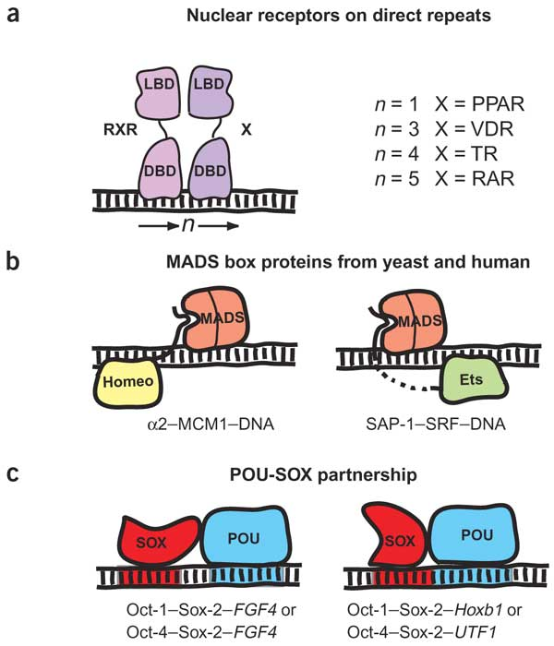
Combinatorial control, specific examples
Attila Reményi, Hans R Schöler & Matthias Wilmanns Nature Structural & Molecular Biology 11, 812 - 815 (2004)

Slide 27
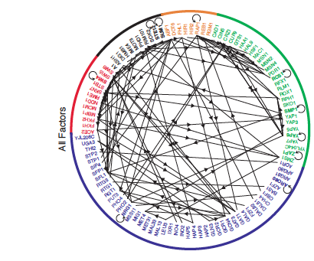
Inter-TF gene regulatory network of yeast
Figure 5, Lee et al., 2002
Notes:
What is a network? Relate this to the underlying biological mechanism.

