Slide 1
Methods and analysis of TF-DNA binding data
BIO311
02/02/2017

Slide 2
Outline
Experimental designs
Review experimental protocol
Data analysis – from raw scans to binding peaks
Finding binding motifs – MEME
Integrated analysis

Slide 3
ChIP-chip experiments and computational analysis
_______does each TF bind ___________?
________does each TF bind _________________?
To answer these questions, need to grow cells ___________________.

Slide 4
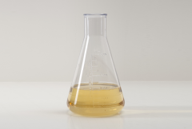
ChIP-chip cell harvest
Formaldehyde
Replicate 1
Replicate 2
Replicate 3

Slide 5
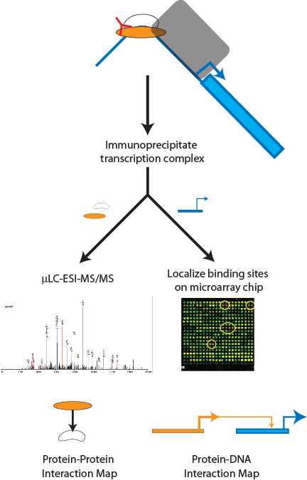

Overview: ChIP-chip to determine TF binding locations
Immunoprecipitated DNA
Randomly sheared DNA
Immunoprecipitate
Localize binding sites
on microarray chip
Protein-DNA interaction map
Facciotti, et al., PNAS (2007)

Slide 6
ChIP-chip / ChIP-seq experimental protocol
What are the steps of the protocol?
____________with formaldehyde
(Wash)
Cell _______________
Sonication (shear ________ into ___________ _________)
________________________(enrich for TF-DNA of interest), wash, elute,
Separate _____________________
______________purification
Prepare DNA for __________________
Label with ___________(IP DNA = one color; randomly sheared genomic DNA = other color)
Microarray (or seq)

Slide 7
ChIP-chip data analysis: from raw data to binding lists
Preprocessing
Quality control
_________________
__________calculation
Calculate p-values for each ____________for each TF (error model)
Combine p-values for ______________(weighted average)
Significance filter (Fig 1b).
Match significant regions to _____________.
Notes:
Split into groups: each group explain one of these…purpose and generally how it’s done.

Slide 8
How exactly was this done?
http://younglab.wi.mit.edu/regulator_network/
Supplementary data: www.sciencemag.org/cgi/content/full/298/5594/799/DC1

Slide 9
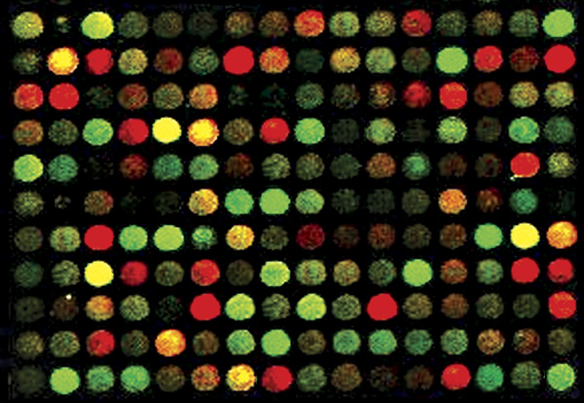
Preprocessing
Raw spot intensities
Background subtraction
Normalizing
Ratio calculation
Notes:
Bkgrd subtraction: median intensity of a batch of control spots.
Normalize: Correcting for different total amounts of DNA on slide: (median of IP / median of WCE) ← norm factor applied to whole chip
Ratio calculation: log (IP/WCE)
Normalize ratios to overcome bias for different IP’d TFs: For a given IG region, final log ratio = initial log ratio – average log ratio across all IPs for that region.

Slide 10
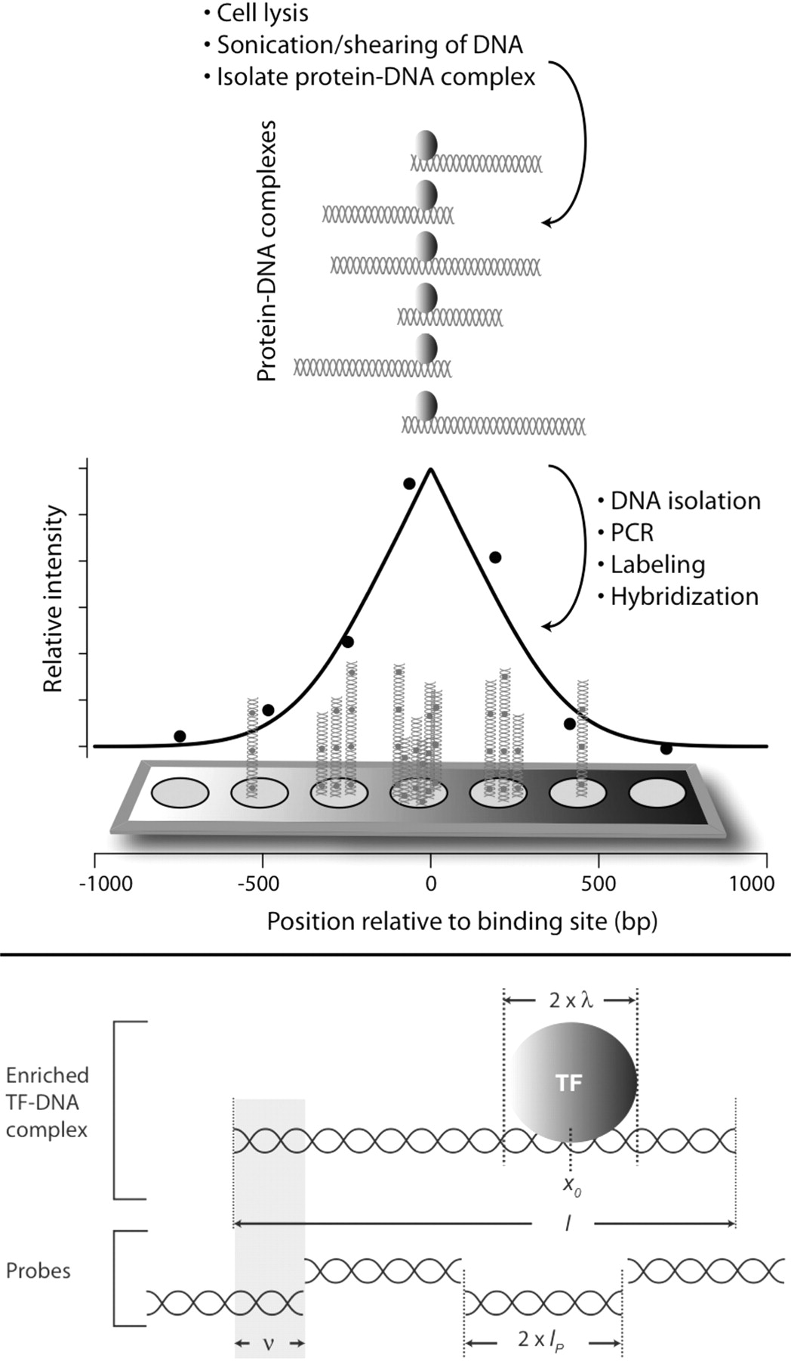
ChIP-chip data analysis: an example
Reiss et al., 2008
BMC Bioinformatics
24(3):396

Slide 11
ChIP-chip data analysis: Pick peaks

Slide 12
In your projects
You will receive data that has already been pre-processed (ratios, p-values, and genes assigned)
Why will you need to analyze this further in the context of gene expression?

Slide 13
Biological questions
Are the genes we think are regulated based on gene expression data also bound by the TF?
Do TF binding events result in a change in gene expression?
If genes do not overlap between the two datasets, what could this mean?

Slide 14
Integrated analysis: GE + ChIP-chip data

Slide 15
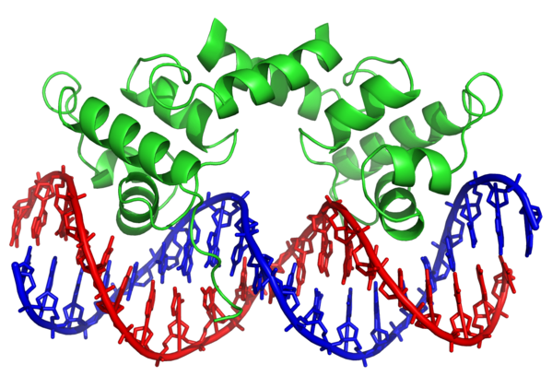
What additional information would ChIP-chip / -seq under different environmental conditions tell us?

Slide 16
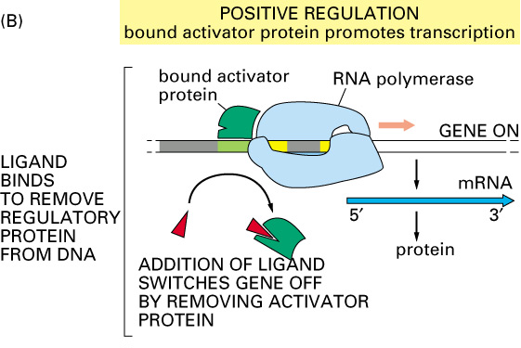
Important consideration: ChIP-chip under varying conditions

Slide 17
Integrated analysis: ChIP-chip + GE + cis-regulatory binding sequences

Slide 18
Combinatorial complexity
Heterodimerization
Binding of different transcription factors to same regulatory region

Slide 19
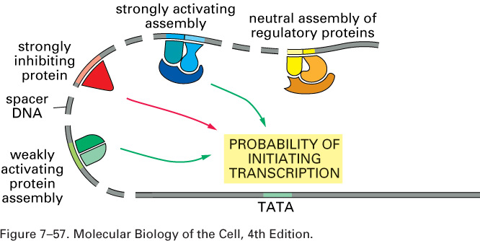
3.19

Slide 20
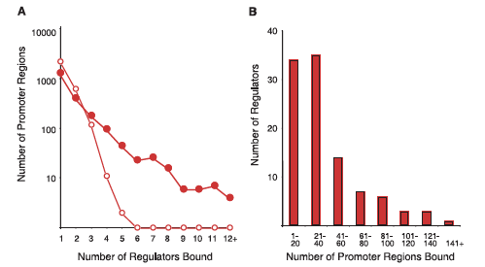
Quantifying combinatorial relationships
Figure 2, Lee et al., 2002.
Notes:
Lots of TFs bind to one promoter, one TF binds to lots of promoters.

Slide 21
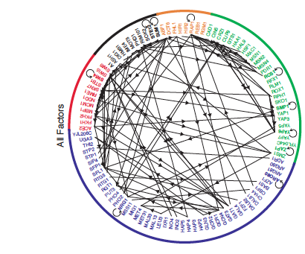
Gene regulatory network
Figure 5, Lee et al., 2002
Notes:
What is a network? Relate this to the underlying biological mechanism.

Slide 22
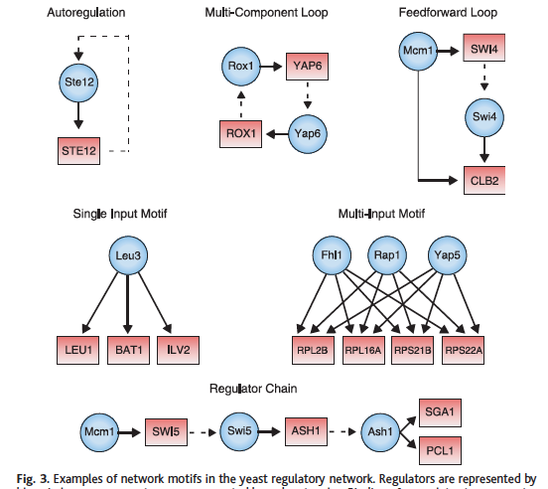
MOTIFS

Slide 23
Lee et al., 2002, Science 298:799
Main conclusions of the study?
Recurring _______________give clues to _____________________
TFs regulate other _____, providing a link between different cellular processes.
Combining global _____________data with _____________binding data allows building a network with good biological significance with no prior knowledge.
Many other studies have been done in other organisms (humans, mice, bacteria, flies, etc etc) that have similar conclusions.

Slide 24
Evaluating the ChIP-chip / -seq method
Drawbacks (also called “caveats”) of the approach? What future studies does this open up?
Why is this method so important?
Notes:
Revisit concept map

