Slide 1

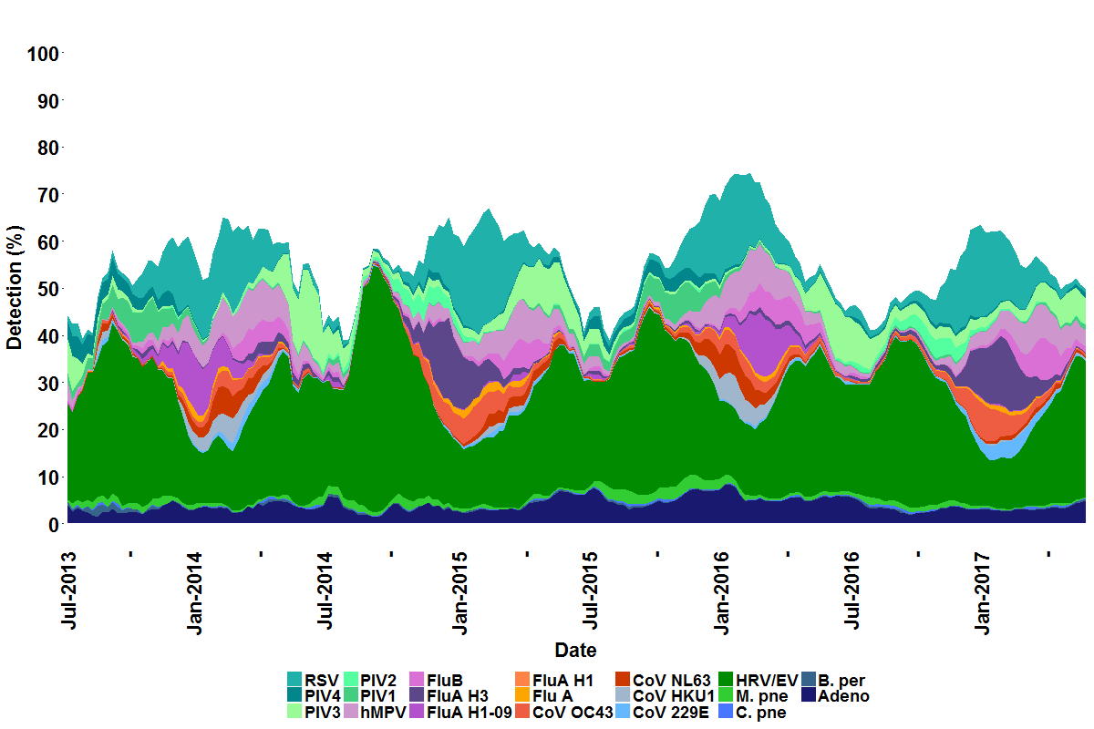
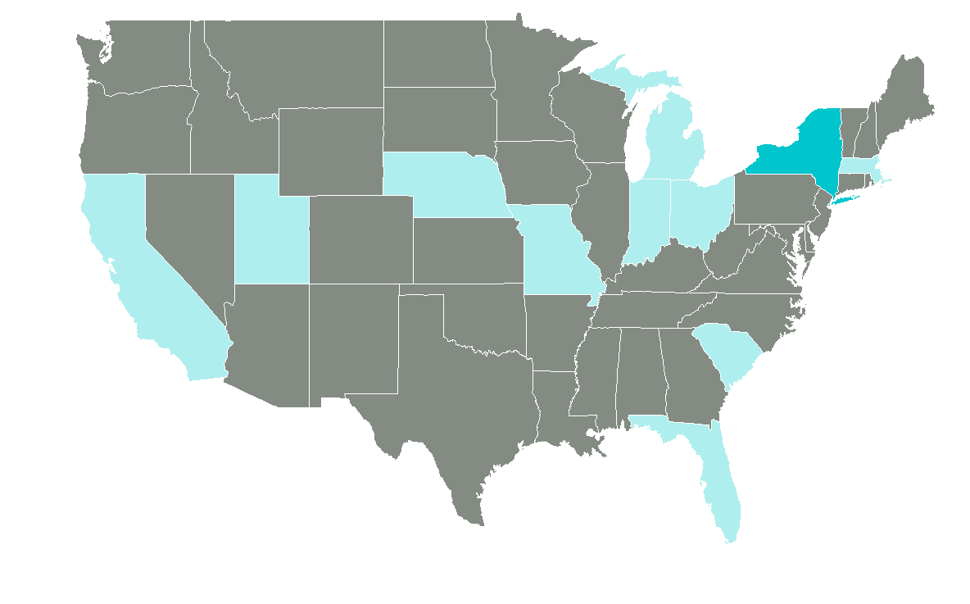
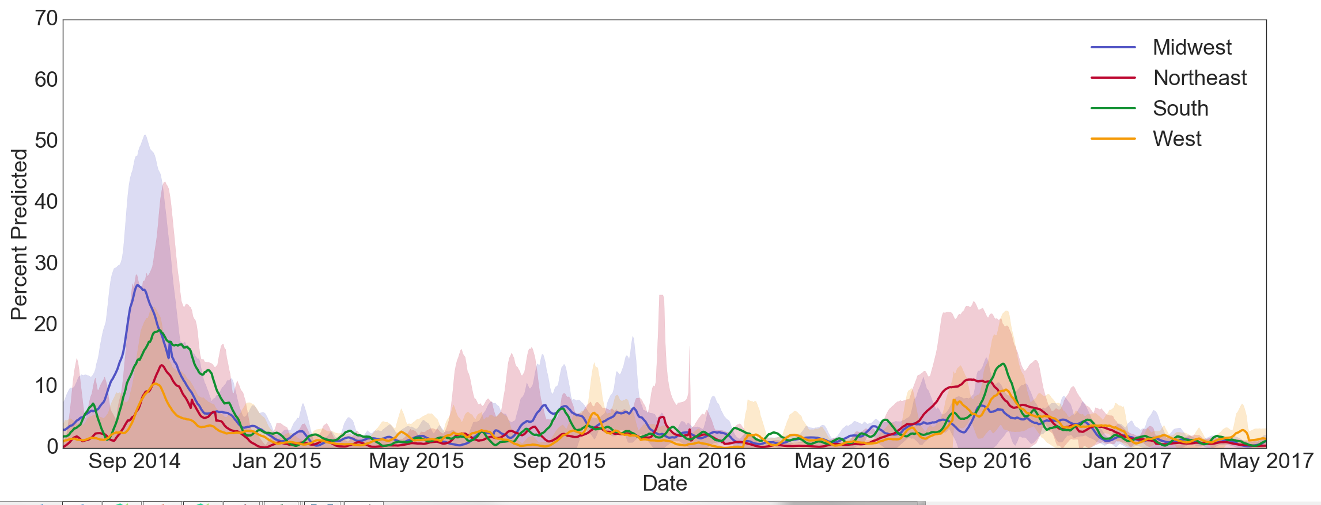
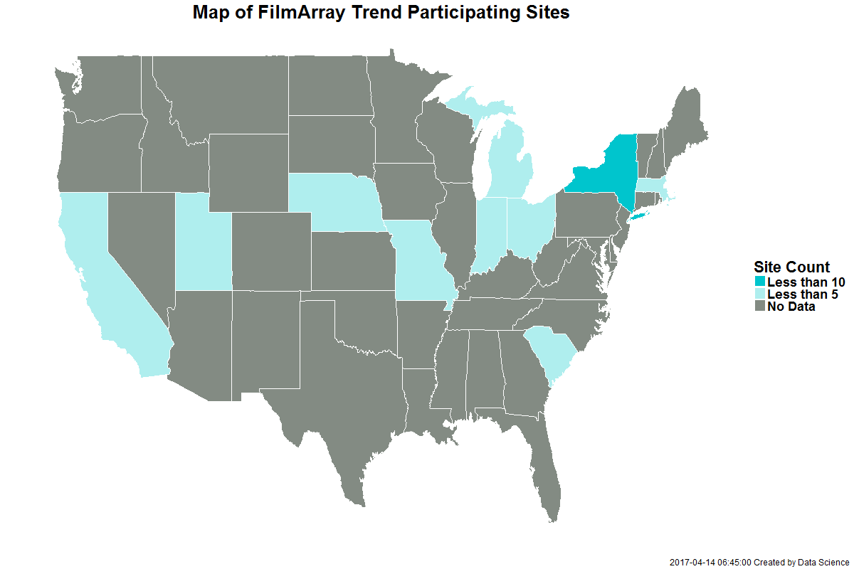
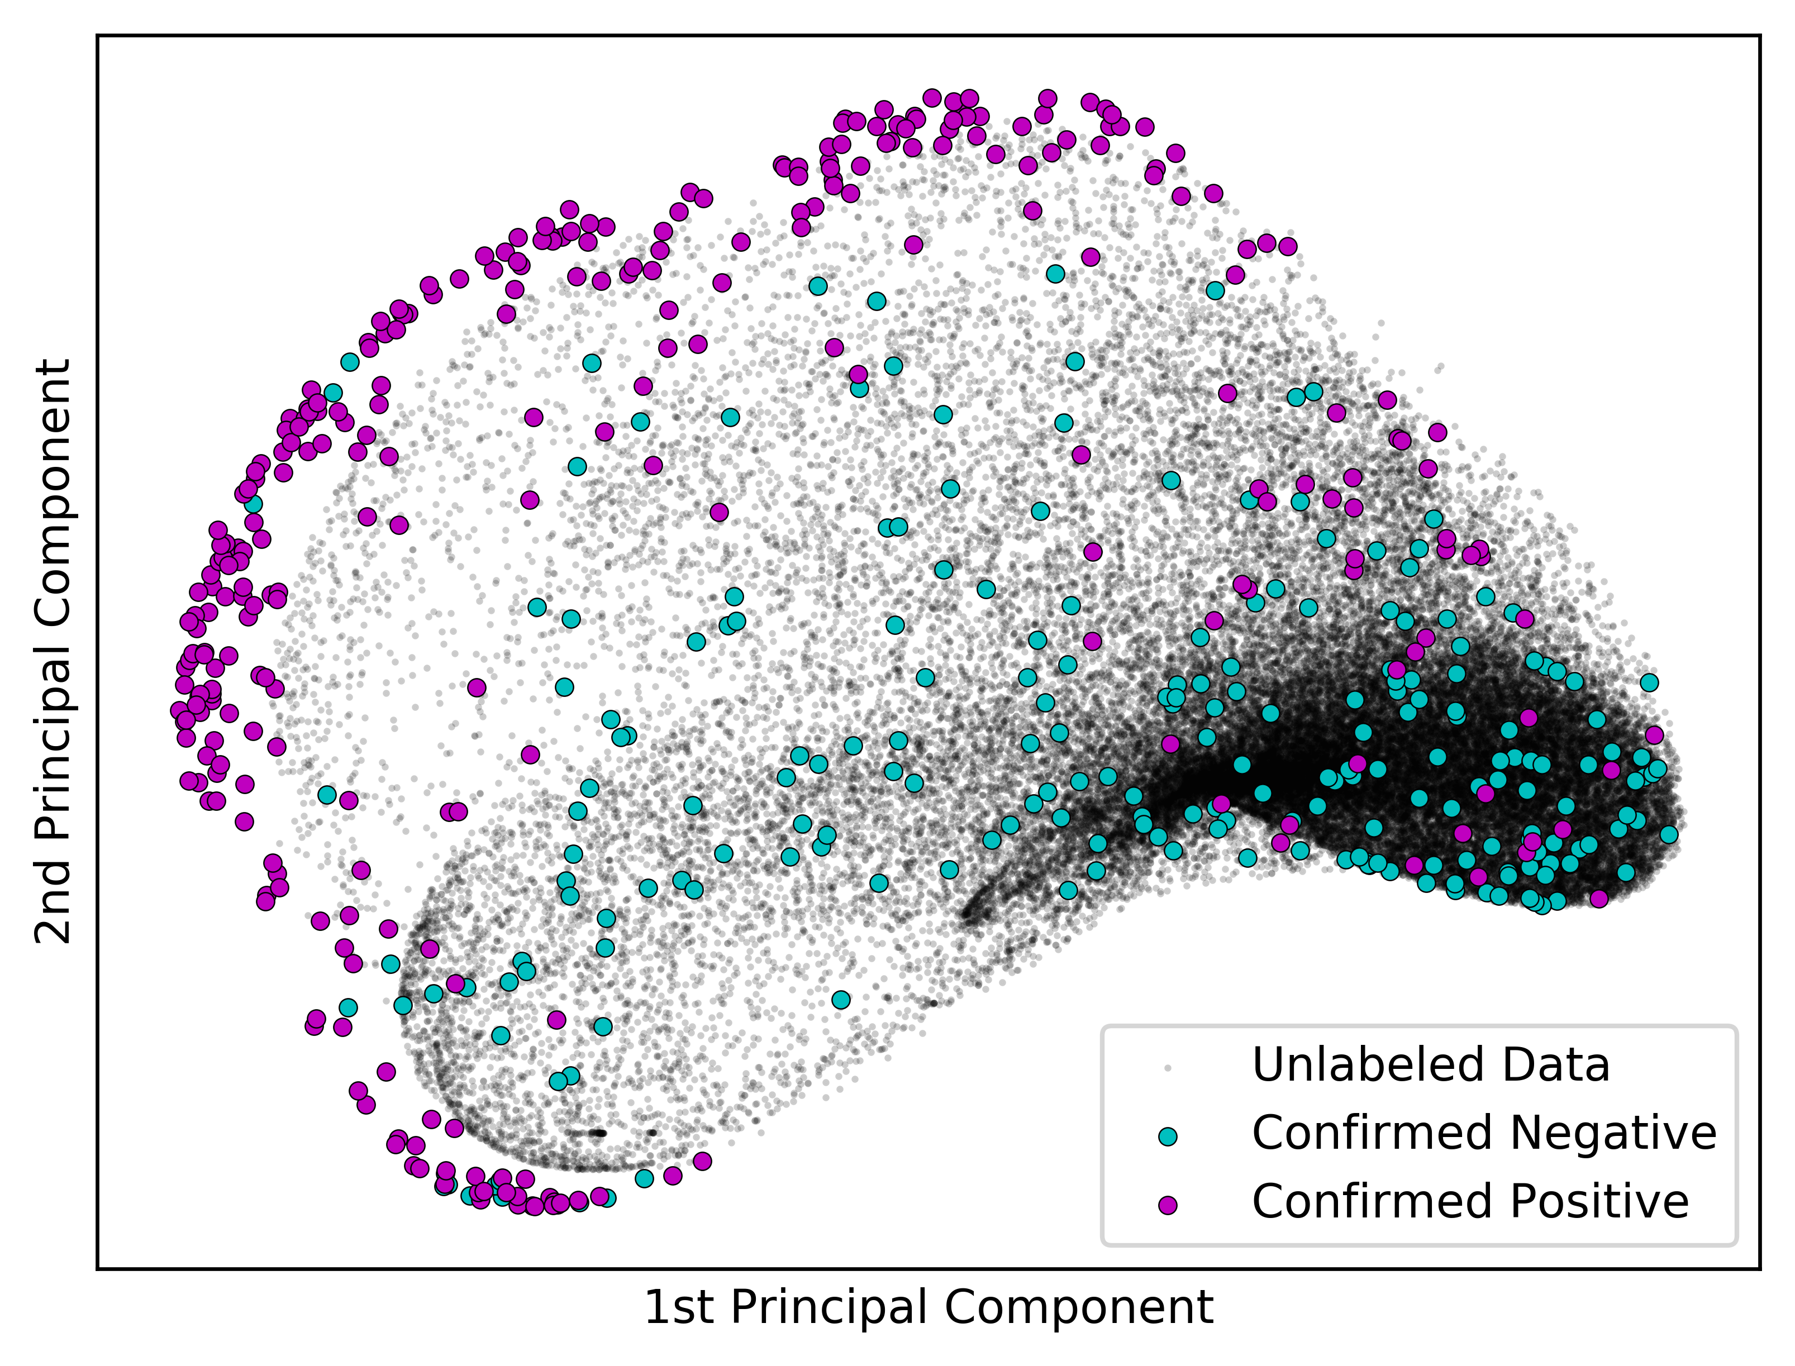
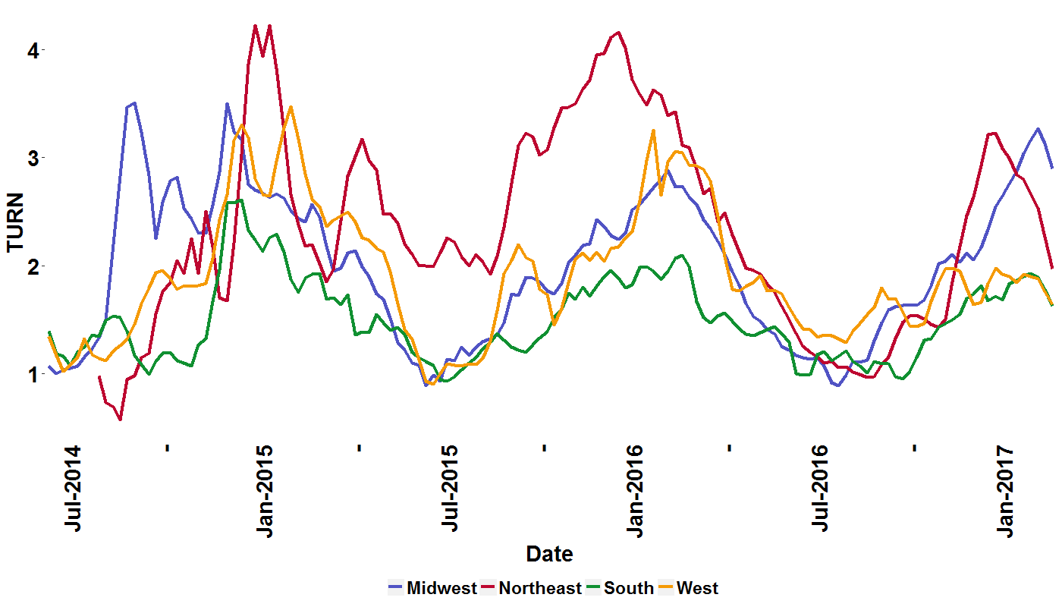
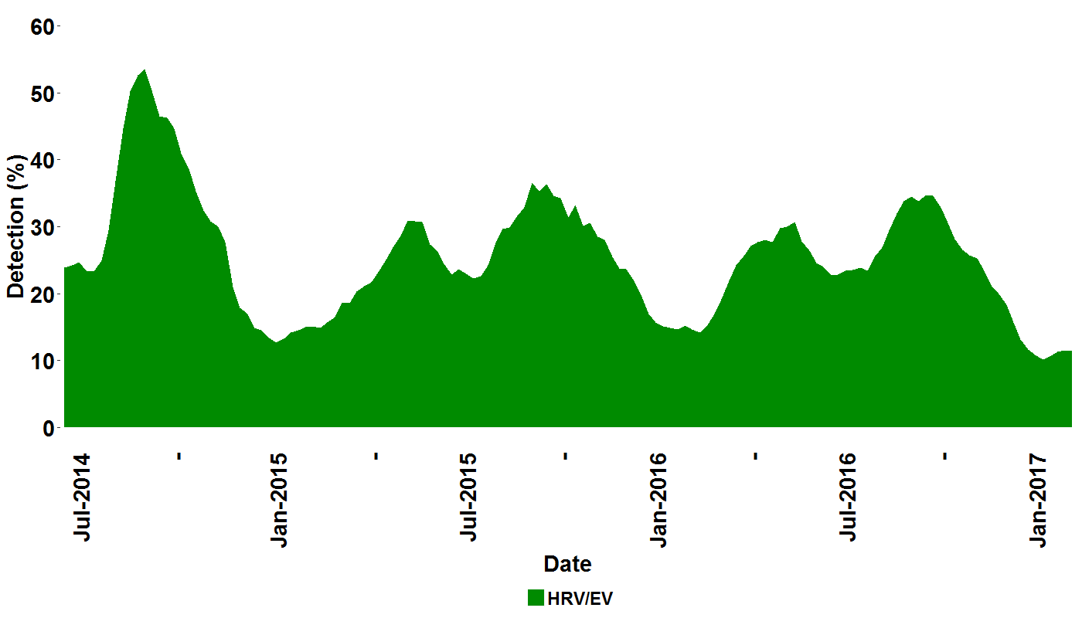


Development of a comprehensive metrics for monitoring seasonal respiratory disease using syndromic test data as an alternative to influenza like illness surveillance
A. Faucett¹, L. Meyers¹, J. Nawrocki¹, A. Hoffee¹, B.M. Althouse², S.V. Scarpino², M.A. Poritz³
¹BioFire Diagnostics, Salt Lake City, UT; ²Santa Fe Institute, Santa Fe, NM; ³BioFire Defense, Salt Lake City, UT
Epidemics 2017 #XXX
Background
In the United States (US), epidemiological reporting of respiratory illness typically focuses on influenza-like illness (ILI), which is disseminated by the Centers for Disease Control and Prevention (CDC) and used by healthcare professionals to monitor seasonal disease onset, duration, and severity. We have developed the Test Utilization Rate Normalized (TURN) metric using FilmArray® Trend, a cloud-based epidemiology system. Trend aggregates the FilmArray® Respiratory Panel (RP) test results from sites across the US. RP tests for 20 targets simultaneously, making TURN an indicator of broader respiratory illness. TURN is more comprehensive than ILI, which focuses on influenza and may mask other etiologies of respiratory disease.
Method Summary
57,000 HRV/EV positive test results were identified in the FilmArray Trend dataset. We examined patterns within the real time PCR data from the six HRV/EV assays and developed an algorithm for detecting EV-D68: the Pathogen Extended Resolution (PER) test. Four sites within the FilmArray Trend working group: Children’s Hospital of Los Angeles (CHLA), Children’s Mercy Hospital (CMH), Albany Medical Center (AMC) and Primary Children’s Hospital (PCMC), contributed FilmArray data files from samples that were independently characterized by an EV-D68 specific PCR test. This data was used for algorithm tuning and evaluation.
Pathogen Extended Resolution (PER) Test Development
The PER test was developed using machine learning to resolve patterns within the real time PCR measurements of the HRV/EV assays. The measurements applied were Cp, TM and Max Fluorescence.
A predictive classification model was trained on PCR amplification and melt measurements.
A subset of FilmArray run files positive for HRV/EV and confirmed positive or negative by EV-D68 PCR were used in training the PER test to identify EV-D68.
A cross-validation of the PER test was performed using the CMH dataset. PER was used to evaluate the remaining laboratory datasets.
EV-D68 rates predicted by the PER test were plotted by region and time.
Evaluation of PER
The FilmArray tests characterized as EV-D68 were used for PER test development and performance evaluation. A repeated cross validation of the PER test on CMH data, where 30% of the results were blinded, was used to define positive and negative predictions for EV-D68. The PER test was then trained on the full CMH dataset and used to evaluate the remaining three datasets for EV-D68 prediction, compared to laboratory tests (Table 1). The CMH results shown in Table 1, are those from the cross validation.
Table 1: Evaluation of the PER Test and EV-D68 PCR
Figure 1: Trend RP pathogen percent positivity
Clinical Site | Location | Samples Month-Year | FilmArray Tests | Sensitivity |  | Specificity
Children’s Hospital of Los Angeles | Los Angeles, CA | Sept. 2016 | 79 | 11/11 | 100% | 64/68 | 94%
Children’s Mercy Hospital | Kansas City, MO | Jul. – Dec. 2014 | 532 | 279/306 | 91% | 205/226 | 91%
Albany Medical Center | Albany, NY | Aug. – Sept. 2014 | 77 | 16/18 | 89% | 42/59 | 71%
Primary Children’s Hospital | Salt Lake City, UT | Aug. – Sept. 2014 | 22 | 10/12 | 83% | 9/10 | 90%
 |  | Combined | 710 | 316/347 | 91% | 320/363 | 88%
Summary of Results
The percent positivity for the PER test, trained to identify EV-D68, demonstrated an overall sensitivity of 91% and specificity of 88% when evaluated against 710 clinical samples.
The PER test predicted EV-D68 positivity in 3% of all RP tests within the Trend dataset.
When plotted over time, the percentages of predicted EV-D68 per regional RP tests were generally low with occasional regional peaks: the Midwest at >25% in fall 2014 and the South at nearly 15% in 2016. Individual sites within these regions showed much higher rates, peaking at 45% of all RP tests.
Regional Trends of EV-D68 PER Test 2013-2017
Three week moving average of percent organism positivity detected at the participating sites in the period of July 2013 to October 2017. www.SyndromicTrends.com
The EV-D68 PER test was used to estimate prevalence of EV-D68 in the population of over 300,000 Respiratory Panel tests, from July 2014 to May 2017. The predicted smoothed weekly percent detection of the EV-D68 tests among all patients tested with the Respiratory Panel shows the highest percentage of positives in the Midwest, fall of 2014 (Figure 4). A moderate resurgence of detections occurred across several regions in fall of 2016.
FilmArray Trend Working Group
Fredrick S. Nolte, Med. Univ. of South Carolina; Amy Leber, Nationwide Child. Hosp.; Kevin Maggert, South Bend Med. Found; Virginia Donovan, Winthrop Univ. Hosp.; Jenifer Dien Bard, Child. Hosp. of Los Angeles; Silvia Spitzer, Stony Brook Univ. Hosp.; Kathleen Stellrecht, Albany Med. Cent.; Hossein Salimnia, Detroit Med. Cent.; Rangaraj Selvarangan, Child. Mercy Hosp.; Stefan Juretschko, Northwell Health; Judy A. Daly, Primary Child. Hosp.; Jeremy C. Wallentine, Intermountain Med. Cent.; Kristy Lindsey, Baystate Health; Sharon L. Read, UC San Diego Med. Center; Maria Aguero-Rosenfeld, NYU Langone Med. Cent.; Paul Fey, University of Nebraska Med Center; Gregory A. Storch, St. Louis Child. Hosp.; Jennifer Meredith, Greenville Health System; Steve Melnick, Miami Child. Hosp.
Figure 3: Visualizing Labeled and Unlabeled data via Kernel Principal Component Analysis
Figure 4: Regional Percentages of EV-D68 as Predicted by the PER test
306 of 532 samples from Children’s Mercy Hospital (Kansas City, MO), tested positive by EV-D68 PCR (57%); Principal Component Analysis (PCA) is a method for identifying patterns in multi- dimensional data. The first two components of a non-linear kernel PCA are plotted to visualize the confirmed positive (purple) and negative (blue) tests. Trend dataset HRV/EV positives from all sites with unknown EV-D68 status are shown in black.
100% Confidence Interval
Figure 2: Test Utilization and HRV/EV Detections
AREA
A
We have developed a metric, Test Utilization Rate Normalized (TURN) which estimates increased test usage at a given site compared to historical data. TURN for each region was plotted over time and evaluated for increased RP usage associated with HRV/EV positivity and the 2014 EV-D68 outbreak. Figure 2.A displays an increase in TURN of 3.5 fold over the previous summer test rate for the Midwest region. Correlating with this is a peak HRV/EV positivity rate of 55% across all sites (Figure 2B) and 65% for that region.
B
Conclusions
We have demonstrated that the PCR amplification data available to BioFire through the FilmArray Trend database can be used to identify signatures associated with EV-D68, a serotype implicated in severe disease. Development of the Pathogen Expanded Resolution (PER) Test to identify patterns masked within the FilmArray® software has the potential to provide alerts to network participants of anomalous patterns in pathogen trends. Further validation, development and refinement of these trend algorithms and how to use them must be explored before broad implementation.
Lindsay Meyers
Contact Information: BioFire Diagnostics, LLC
Lindsay.Meyers@BioFireDx.com

