Slide 1

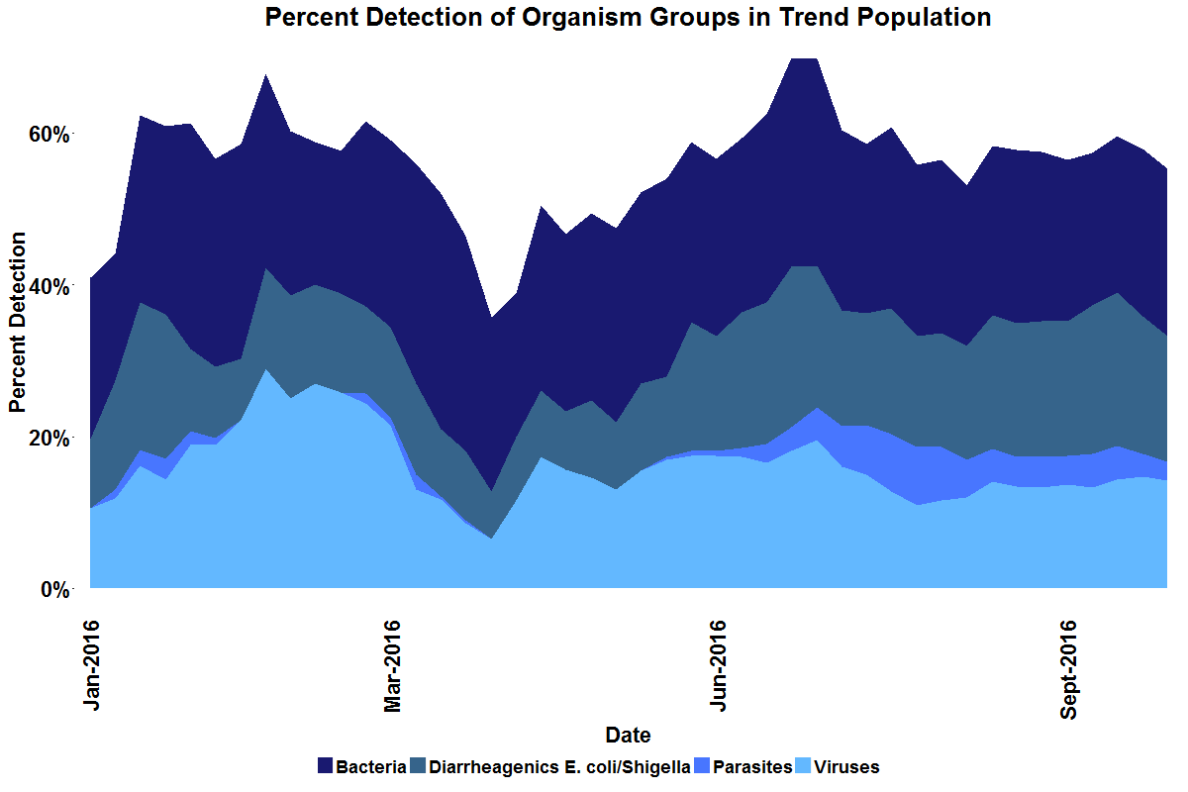
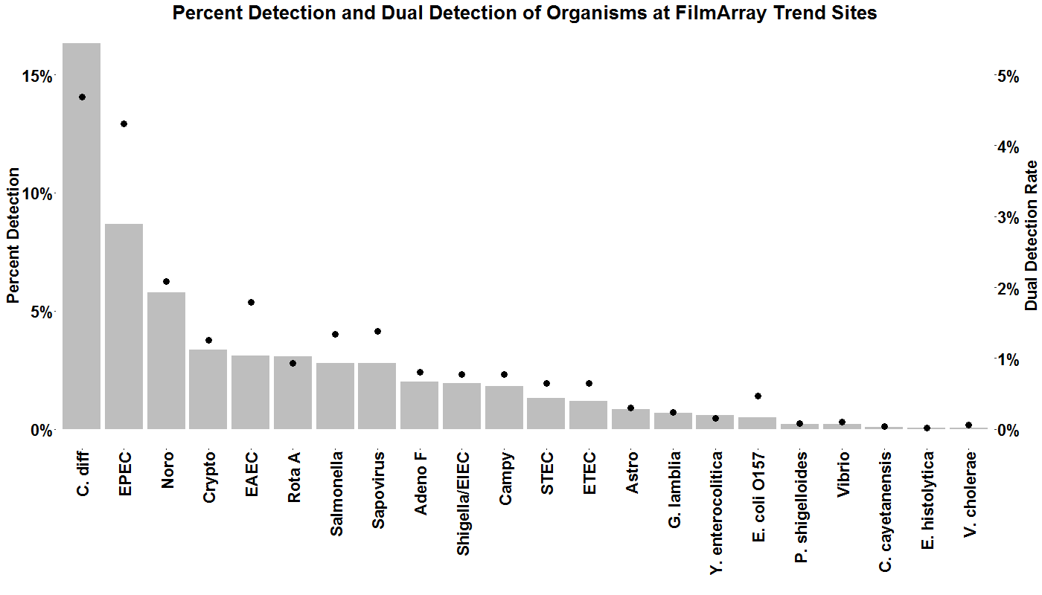
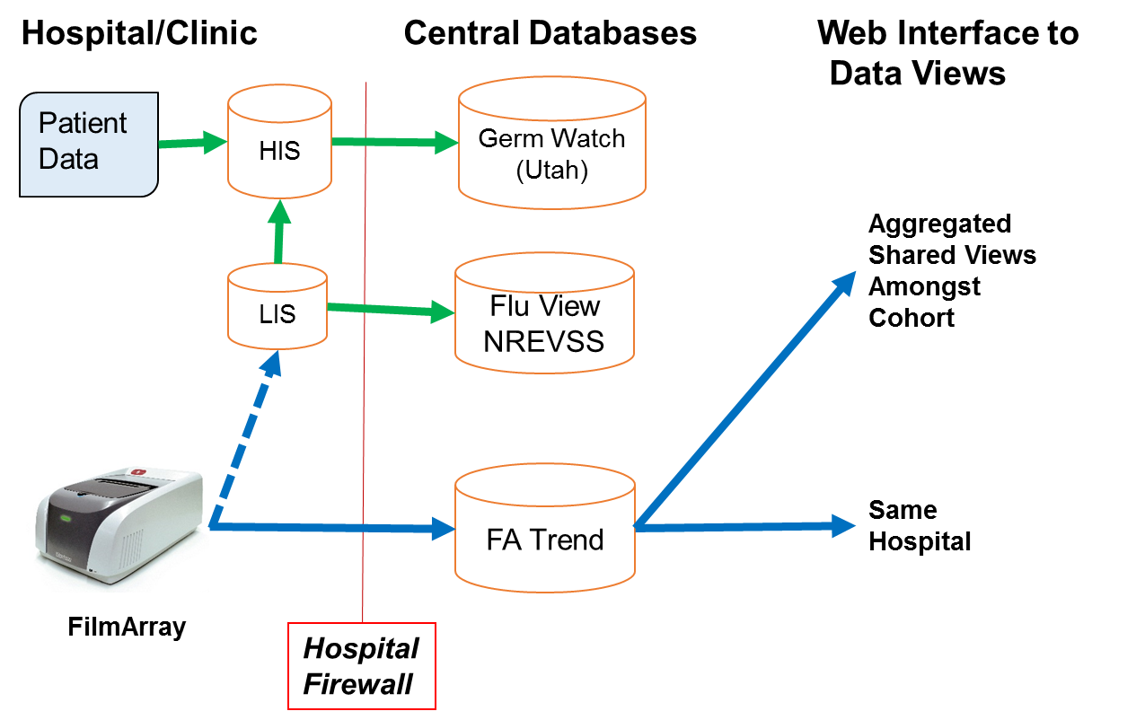
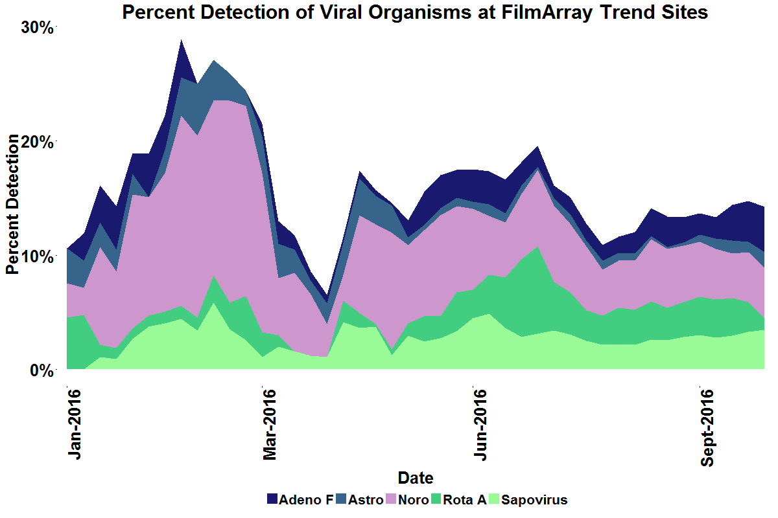
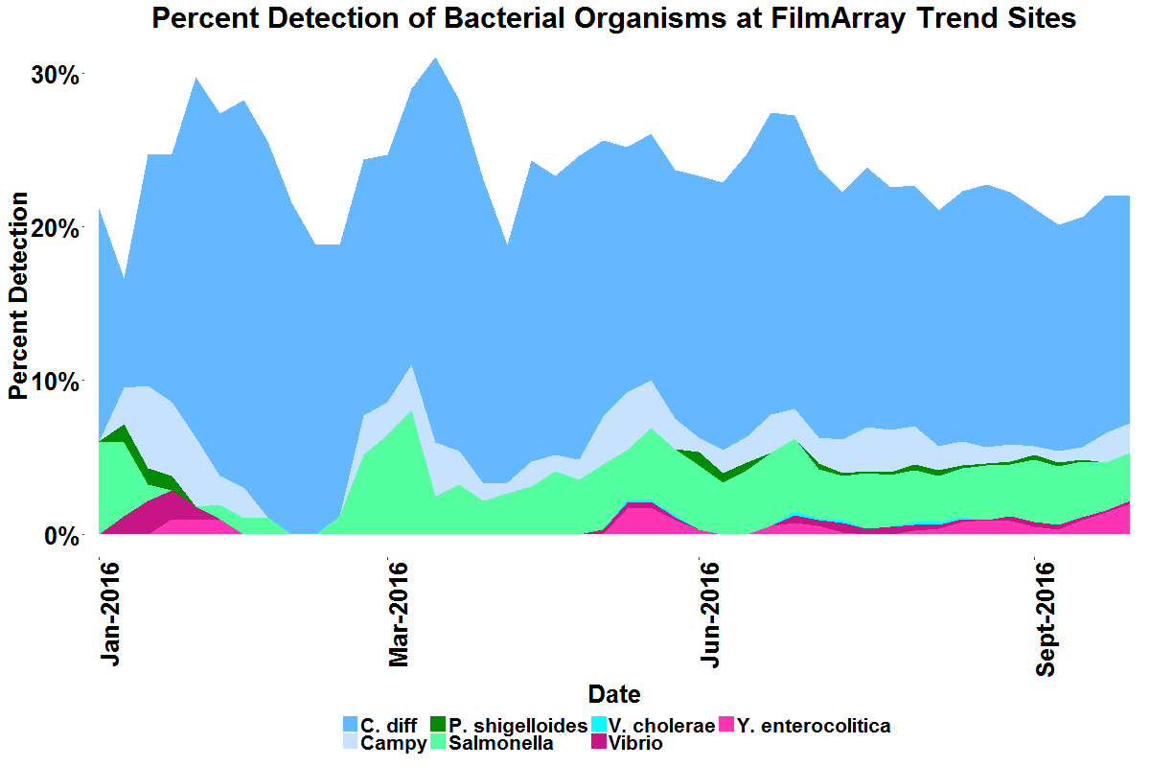
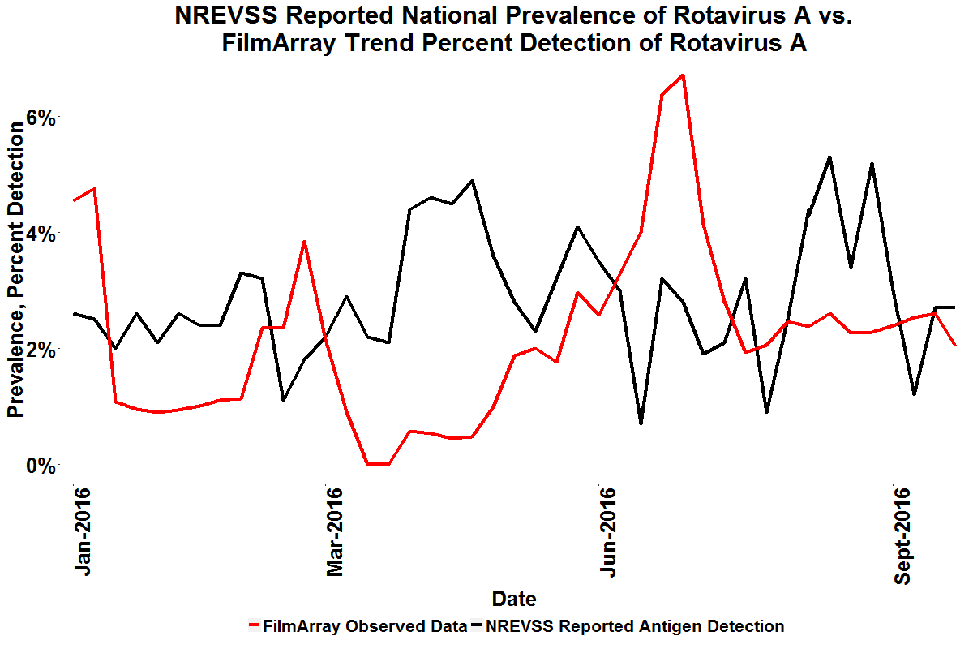
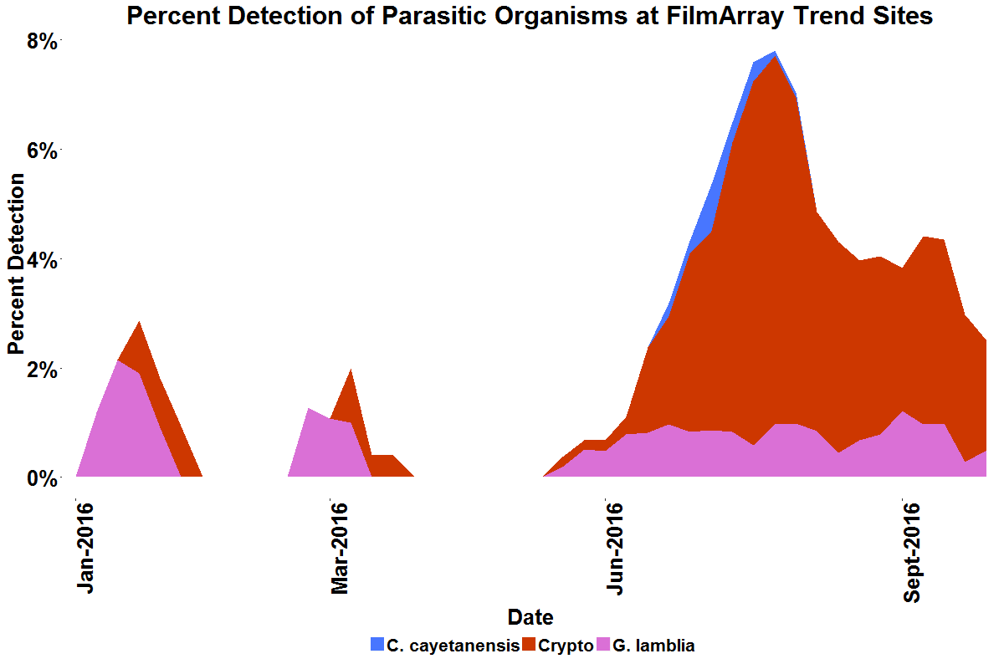
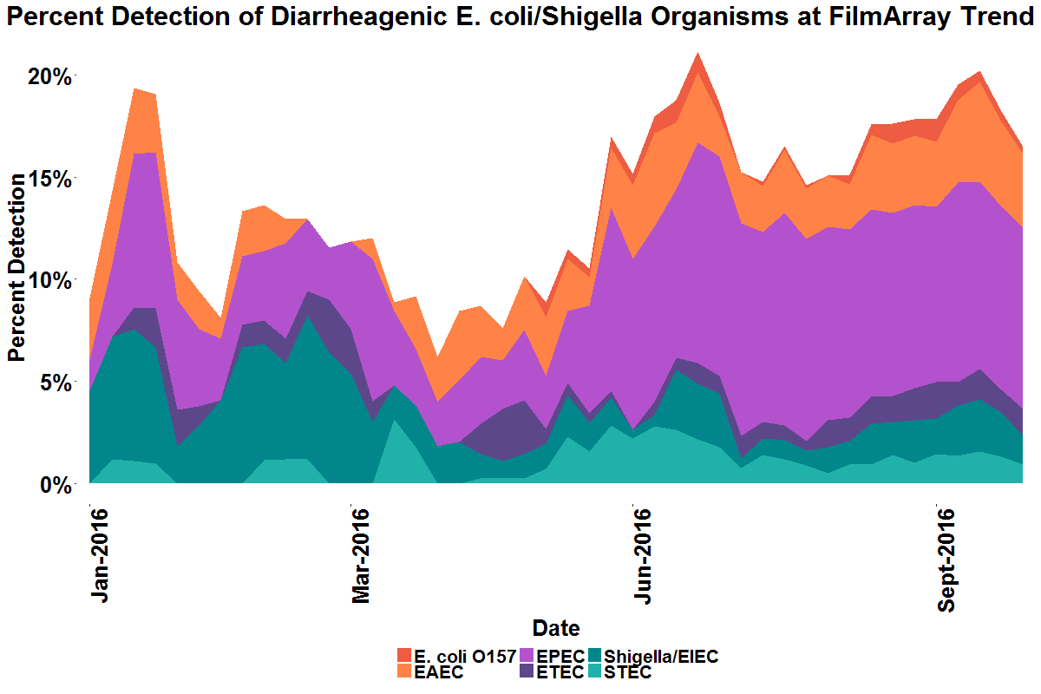
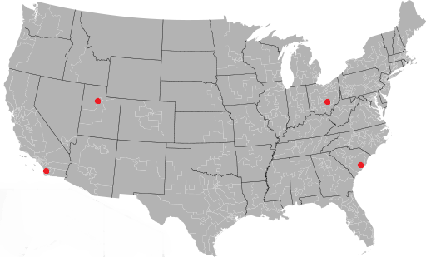


A Cloud Based Epidemiology Network to Track Gastrointestinal Pathogens in Real Time
A. N. Faucett¹, R. K. Nelson¹, F. S. Nolte², M. Aguero-Rosenfeld³, J. A. Daly⁴, J. C. Wallentine⁵ , S. L. Reed⁶, A. Leber⁷ , M. Rogatcheva¹, B. A. Malin⁸, C. C. Ginocchio¹, M. A. Poritz⁹, L. Meyers¹
¹BioFire Diagnostics, Salt Lake City, UT, ²Med. Univ. of South Carolina, Charleston, SC, ³NYU Langone Med. Ctr., New York, NY, ⁴Primary Child. Hosp., Salt Lake City, UT, ⁵Intermountain Med. Ctr., Murry, UT, ⁶UC San Diego, San Diego, CA, ⁷Nationwide Child. Hosp., Columbus, OH, ⁸Vanderbilt Univ., Nashville, TN, ⁹BioFire Defense, Murray, UT
#I11
Background
Real-time monitoring of gastrointestinal infectious diseases has the potential to benefit public health by facilitating the early detection of pathogen outbreaks. Efficient tracking of infectious diseases requires 1) broadly-distributed, comprehensive diagnostic testing and 2) rapid electronic collection, analysis and distribution of data. Several FDA-cleared diagnostic platforms are in use in clinical laboratories, which have assays for many of the large groups of infectious agents known to cause diarrhea. The BioFire Diagnostics’ FilmArray® is one such system. The FilmArray Gastrointestinal (GI) Panel detects 22 pathogens. While the first condition for tracking GI diseases has been met, the second has not; there is no general, automated electronic mechanism for aggregating GI test results from across the United States in real-time.
FilmArray Trend GI Pathogen Percent Detection
De-identified percent detection trends are displayed in stacked graphs as a 3-week moving average of positive pathogen results per total FilmArray GI panels run. Percent detection of the 22 pathogens that can be detected in a single FilmArray GI Panel are shown for calendar year 2016 (year-to-date). The time series plots show GI Panel detections due to viral organisms was elevated in Spring, while parasites and diarrheagenic E. coli/Shigella were detected at higher rates in late Summer. These trends indicate increased periods of positivity within our sample population exist. Bacterial pathogens appear to be present in approximately 25% of GI Panel test over the duration of 2016.
Viral organisms show an increase in percent positivity in Spring 2016 within the sample population. Among viruses, norovirus is associated with the elevated rate of detection, while rotavirus had an isolated period of elevated detection in late Summer. In the same population, the rate of detection of bacterial organisms tends to fluctuate about a mean of 23.8% with a relatively low standard deviation (3.1%) for the duration of 2016.
Parasites and diarrheagenic E. coli/Shigella show an increase in detection rate in late Summer within the FilmArray Trend population. The parasitic detections occur at a relatively low rate (<5% in most periods) with the late summer increase associated with Cryptosporidium. Diarrheagenic E. coli/Shigella detections appear to have a sustained period of increased detection in late Summer into Fall, associated with Enteropathogenic E. coli (EPEC).
GI Panel Polymicrobial Detections
Percent detection of organisms in FilmArray GI Panel tests are aggregated for all six US sites in 2016. One or more organisms are detected in 47.8% (35.8%-69.9% range) of all tests. The dual detection rates, i.e. tests in which two targets are detected as positive within a single FilmArray GI Panel, are calculated and reported below. Dual detections occur in 11.4% of tests, while 14.9% of tests contain 2-4 positive pathogens. The rate of dual detection is expected to correlate with percent detection for each organism. The dots display the organism’s total dual detection rate. The bars indicate the organism’s percent detection rate. The figure shows that a general correlation exists; however, variances can be observed (i.e. the detection rate of EPEC and C. diff are significantly different, yet the rate of dual detection of these organisms are similar).
Methods
BioFire Diagnostics has implemented a cloud-based epidemiology network, FilmArray Trend. The system connects FilmArray Systems directly to the cloud, automatically exporting electronic de-identified test results to a secure, HIPAA-compliant database. Web-based views of the aggregated data are accessible to various user groups: clinical users can track institutional and local trends, and the public can monitor bacteria, viruses and parasites causing infectious GI disease. This automated approach does not require labor intensive manual processing or data extraction from information systems that vary by hospital.
Bottom-Out vs Top-Out Data export
Lines: Green: existing data export pathways. Blue dashes: LIS connectivity of FilmArray System. Blue solid: FilmArray export pathways developed through FilmArray Trend.
Percent Detection
Percent Detection
Dual Detection Rate
Prevalence Trends of Rotavirus
The percent detection of rotavirus A is calculated as a three-week centered moving average for the FilmArray Trend population and overlaid with the national prevalence of rotavirus over the same time frame as reported by the National Respiratory and Enteric Virus Surveillance System (NREVSS). While rotavirus had a winter seasonality prior to widespread vaccination in the United States, both NREVSS and FilmArray Trend data show no increase of rotavirus detection in Winter 2016. Time series plots are noisy in both datasets. This may be due to the small sample size of the FilmArray Trend dataset or the lack of seasonality/outbreaks over the 2016 season.
Results
Six US sites are participants in the initial GI FilmArray Trend pilot study, Medical University of South Carolina (SC), Primary Children’s Medical Center (UT), UC San Diego Medical Center (CA), NYU Langone Medical Center (NY), Nationwide Children’s Hospital (OH), and Intermountain Healthcare (UT), with approximately 45 FilmArray Systems in the cohort. The group contributed over 5,300 test results to the project in 2016. Data presented include: 1) GI pathogen percent detection; 2) Polymicrobial detections, which may indicate interactions between pathogens in the infected population, and; 3) Rotavirus prevalence trends compared to CDC national rotavirus surveillance.
Trend Site Participation
Conclusions
FilmArray Trend is a real-time monitoring system that allows automated electronic aggregation and analysis of FilmArray GI Panel test results collected from participating sites around the United States. FilmArray Trend is scalable as it is easy to implement the system at a large number of sites. Adoption of FilmArray Trend should enable monitoring of GI infectious disease with greater seasonal and geographic resolution. The greater the number of contributing sites, the finer the geographic resolution that can be obtained while maintaining privacy of individual site trends. Sites participating in FilmArray Trend may also utilize the Trend website to facilitate GI infectious disease reporting.
Aimie Faucett
Contact Information: BioFire Diagnostics, LLC
Aimie.Faucett@BioFireDx.com

