Slide 1

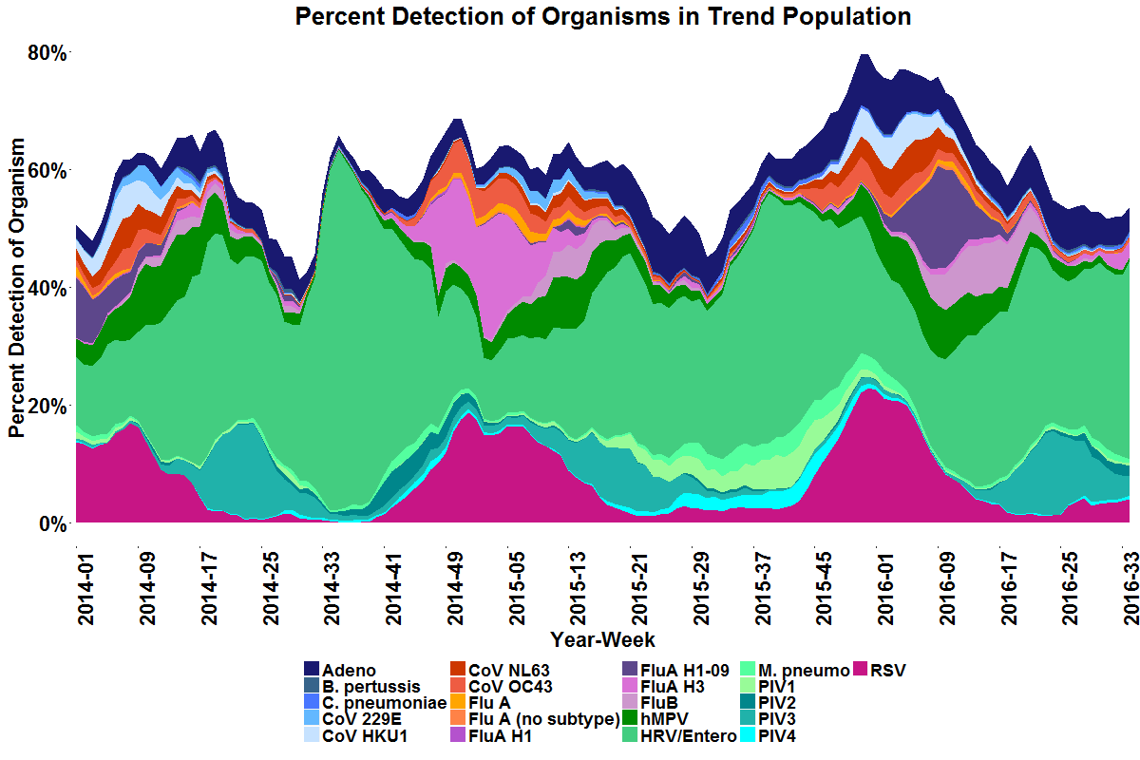
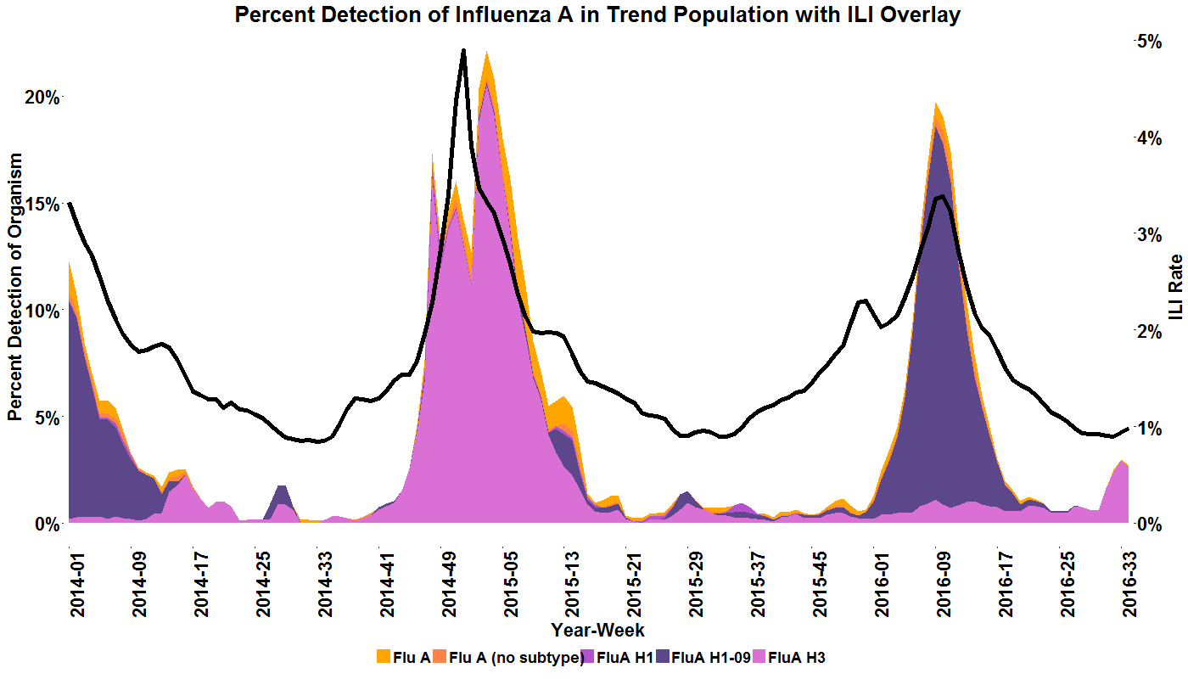
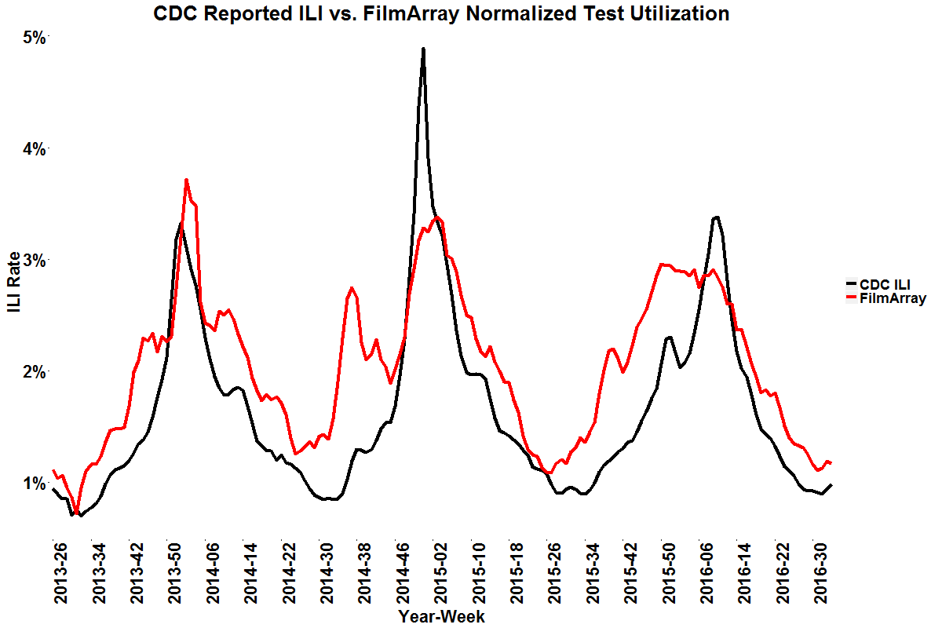
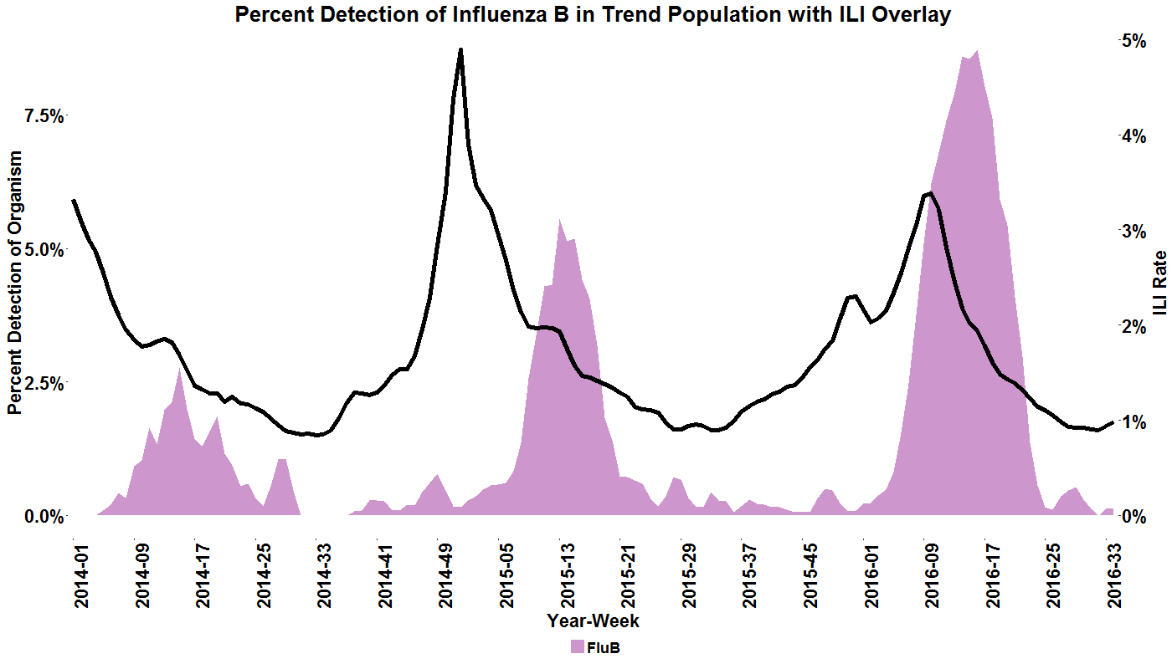
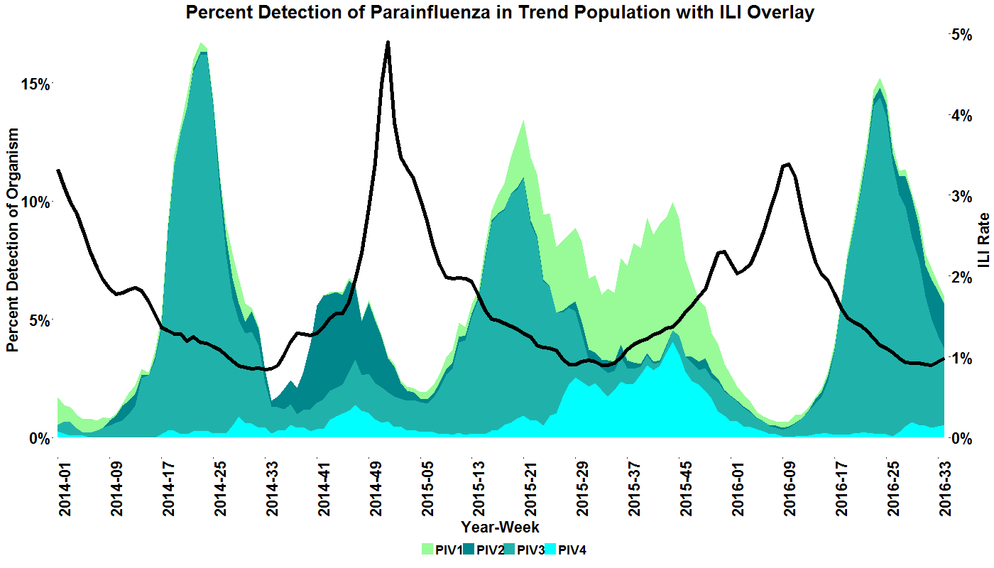
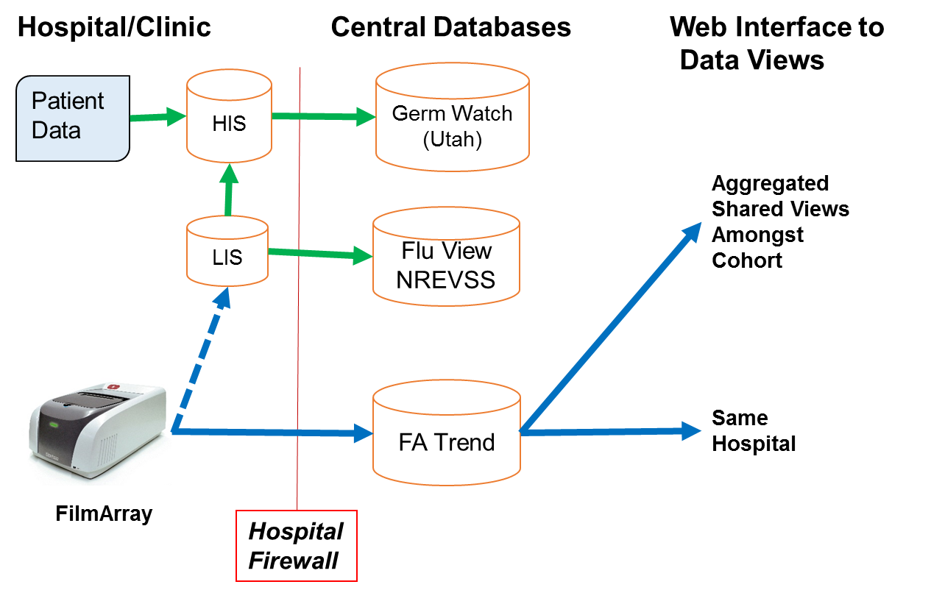
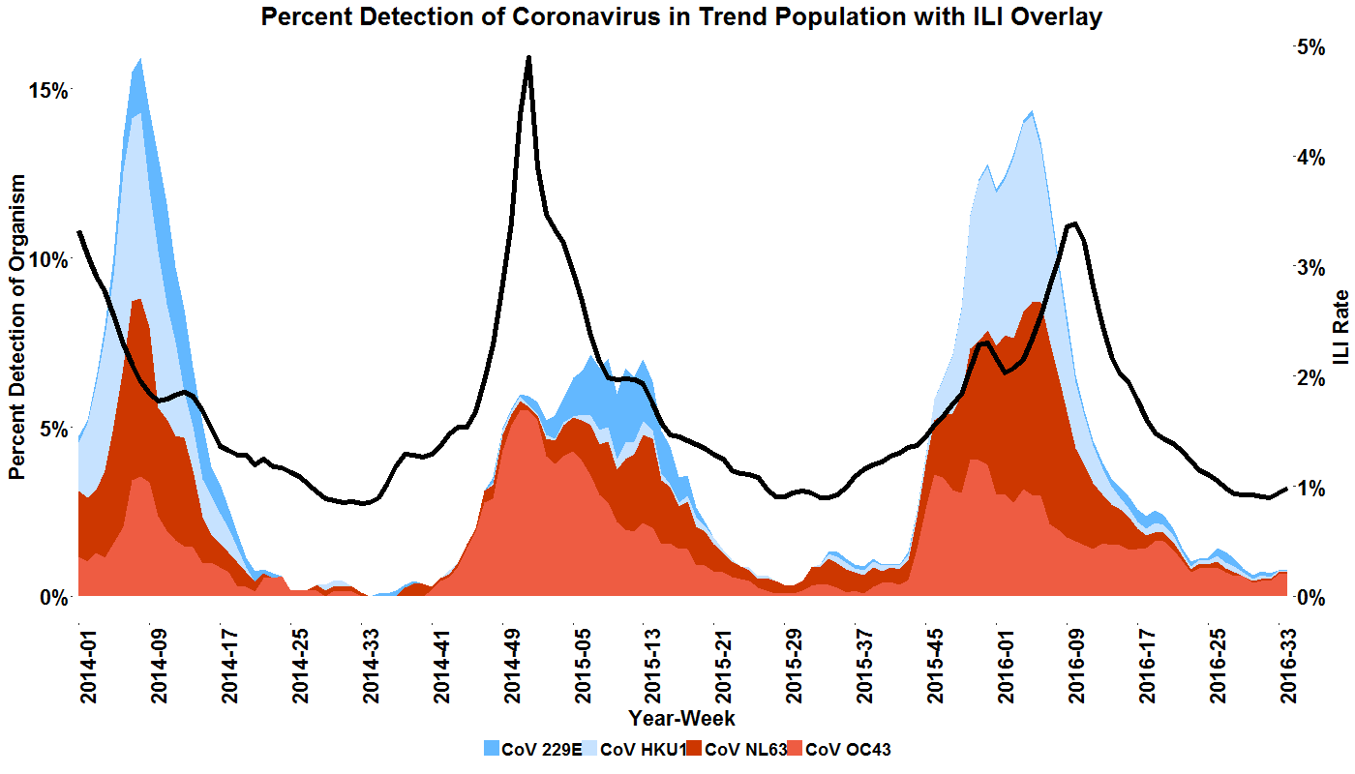
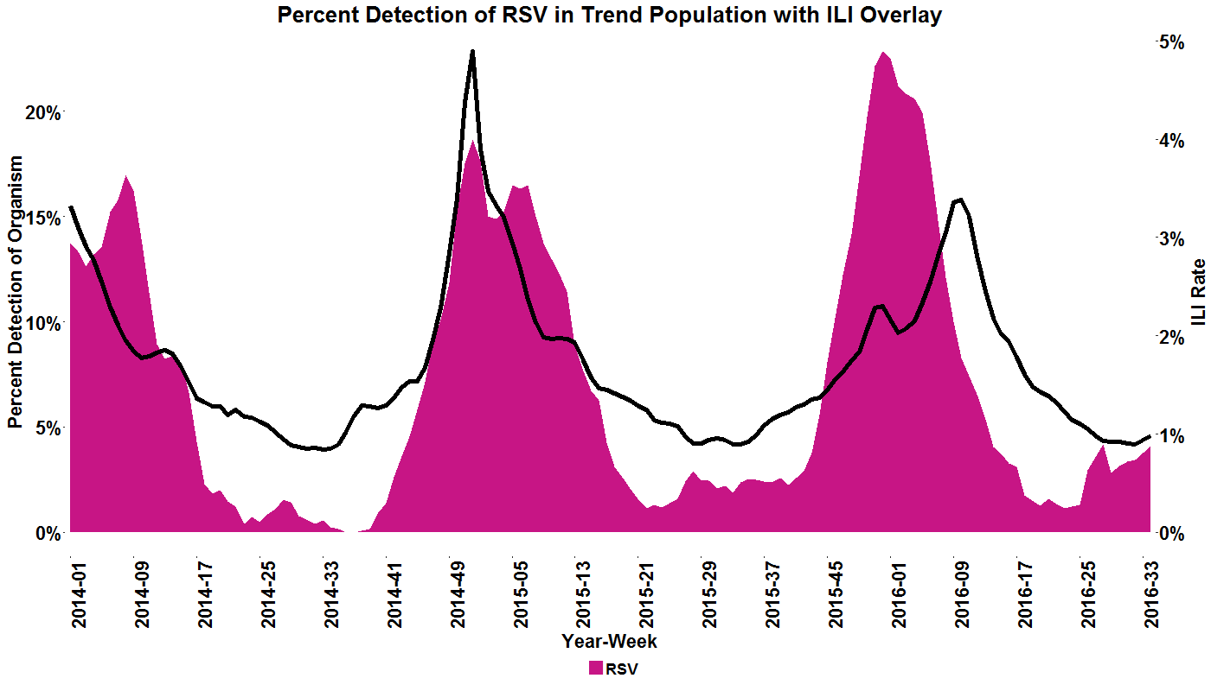
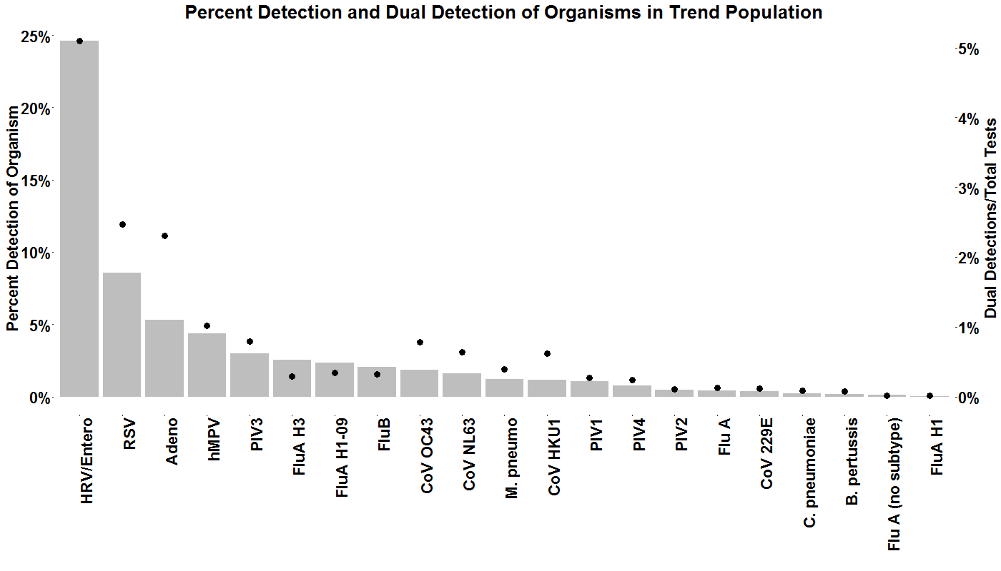
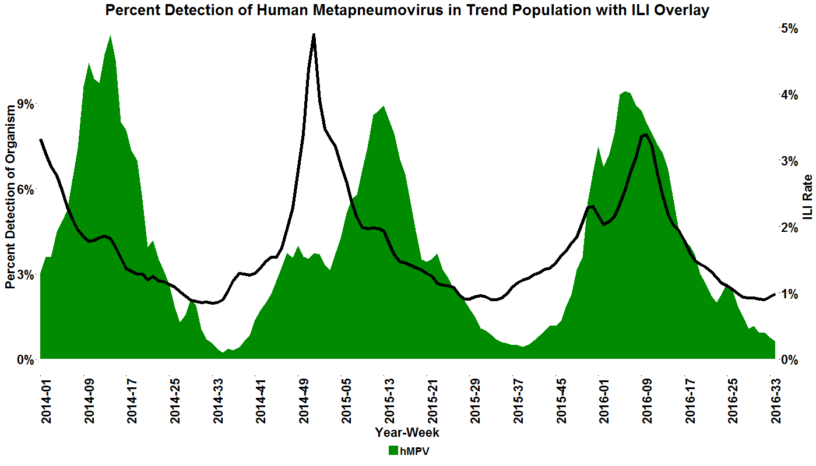
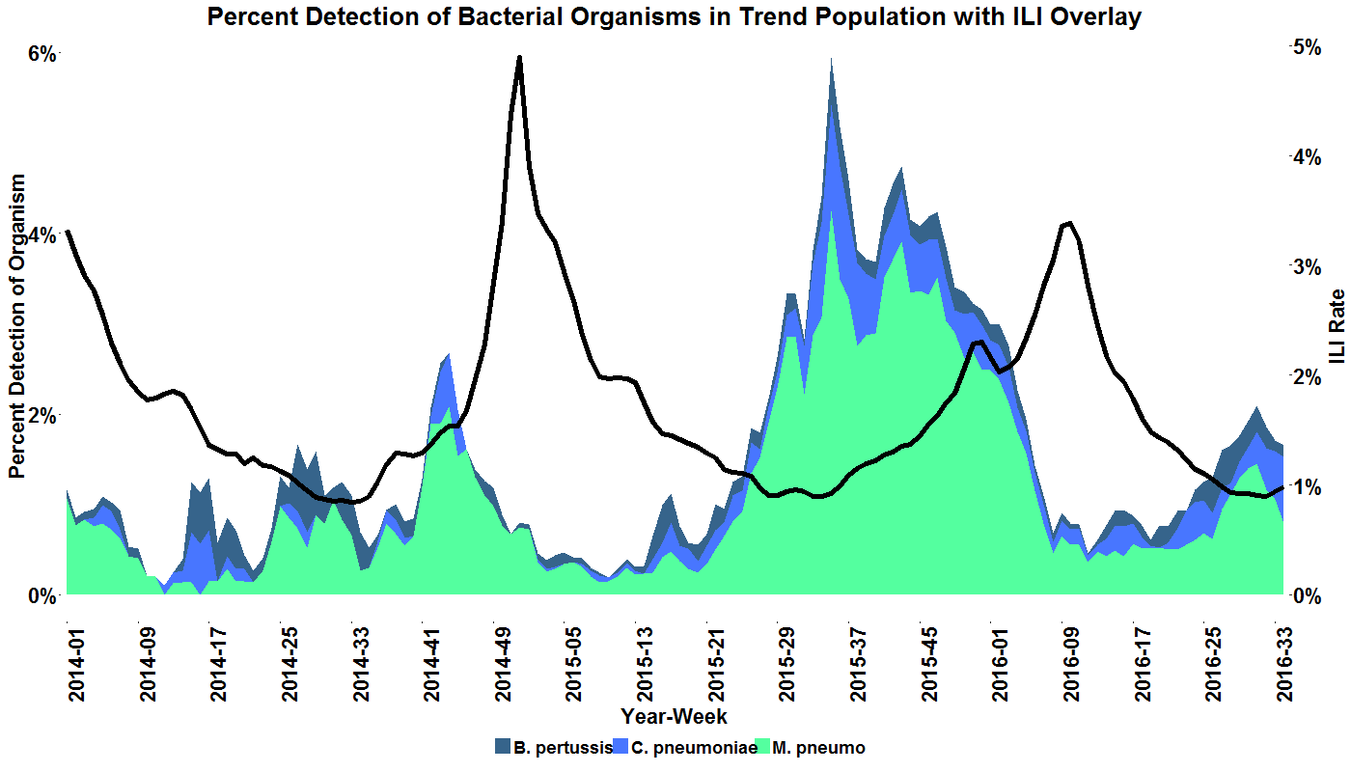
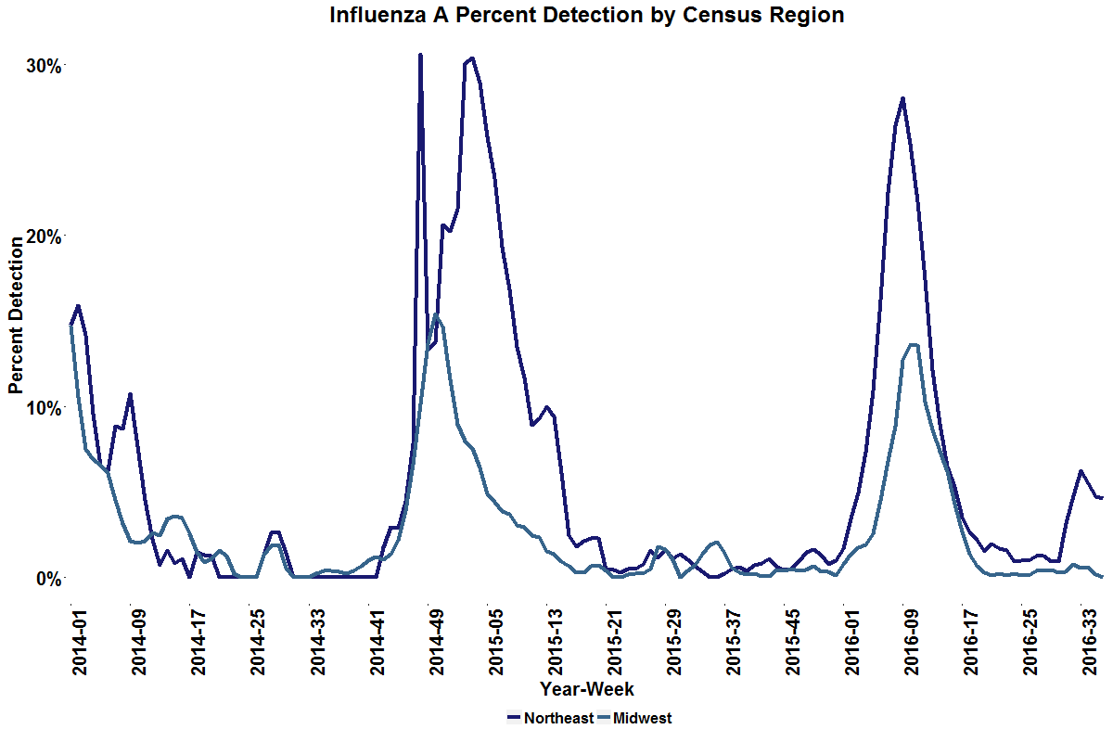
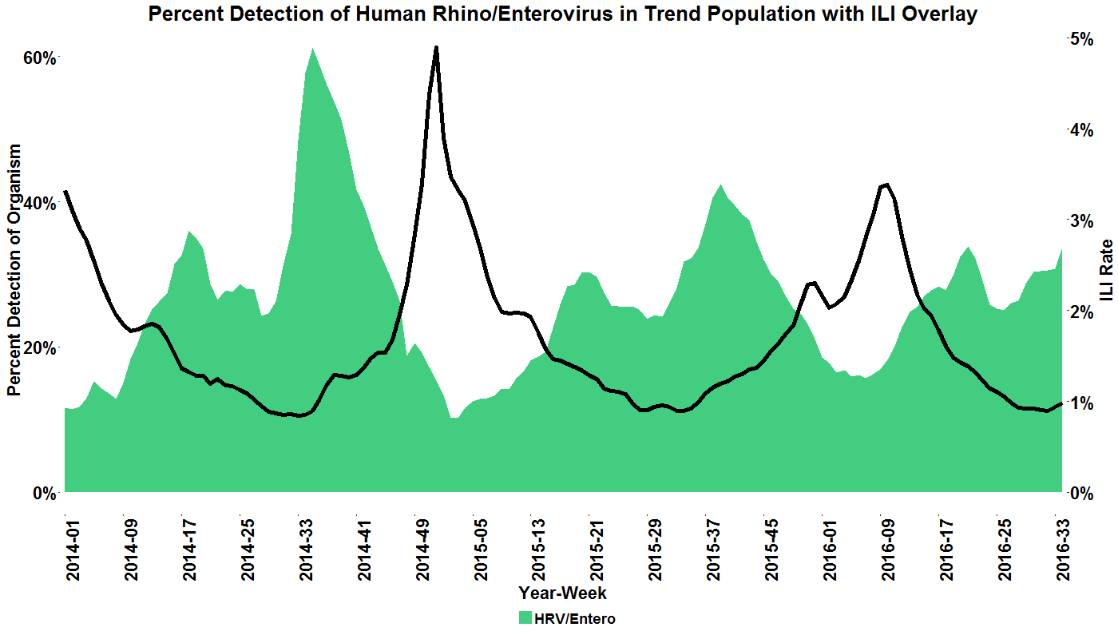
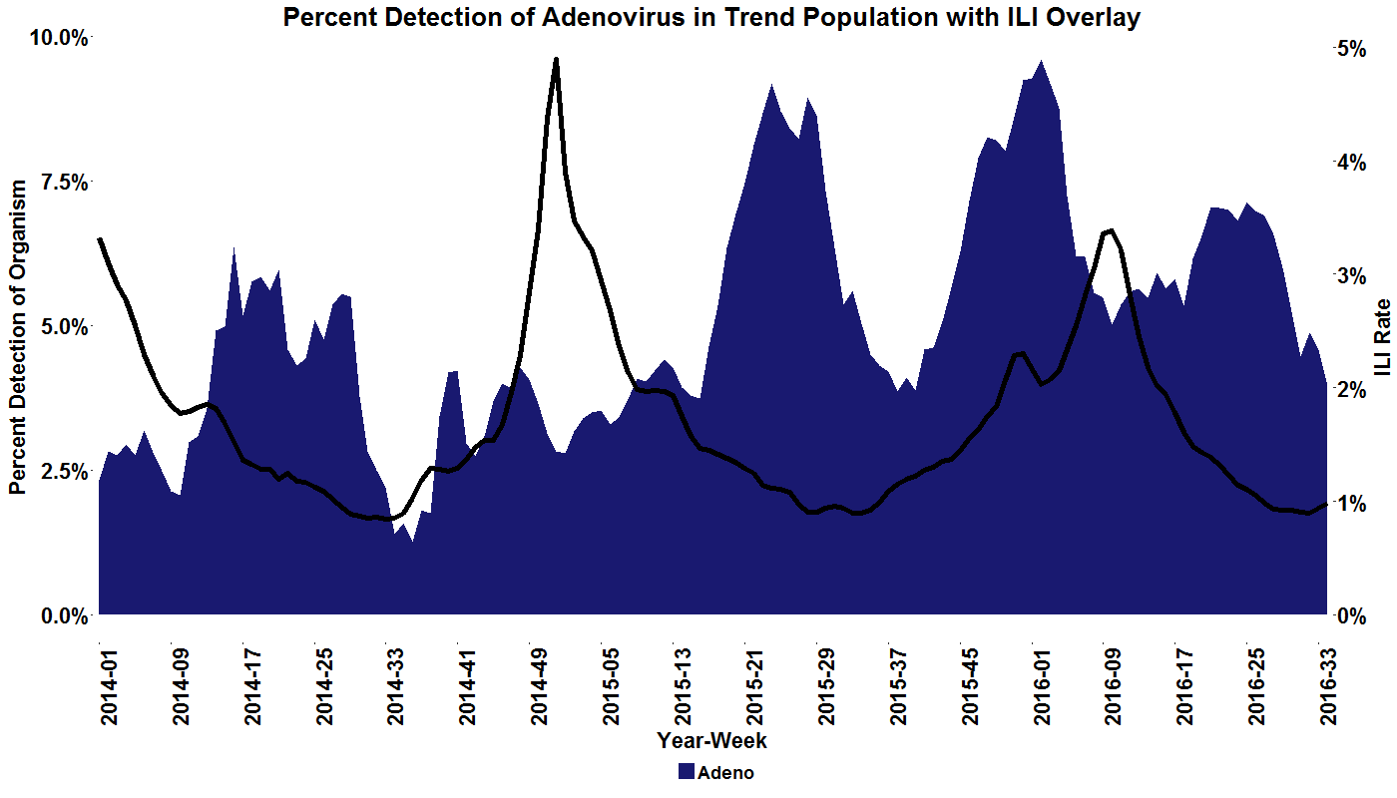
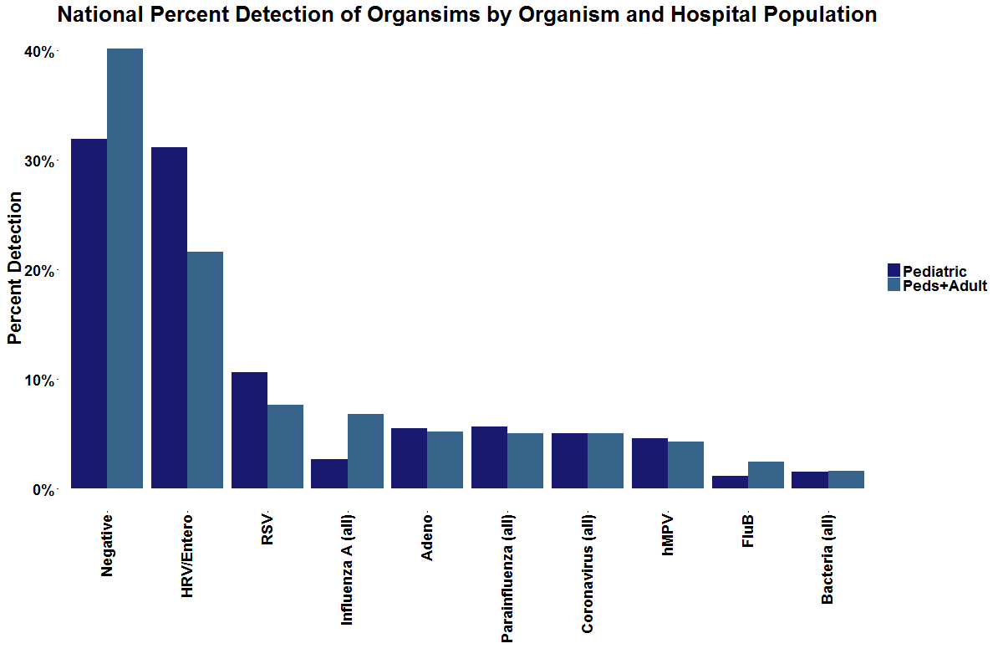


Implementation of an Instantaneous Pathogen Specific Surveillance (iPaSS) System
L. Meyers¹, R. K. Nelson¹, F. S. Nolte², D. Janowiak³, V. Donovan⁴, A. Leber⁵, J. Dien Bard⁶, S. Spitzer⁷, K. Stellrecht⁸, P. Fey⁹, H. Salimnia¹⁰, M. Aguero-Rosenfeld¹¹, K. Lindsey¹², G. A. Storch¹³, J. Daly¹⁴, A.N. Faucett¹, P. Gestland¹⁴, B. A. Malin¹⁵, C. C. Ginocchio¹, M. A. Poritz¹⁶;
¹BioFire Diagnostics, Salt Lake City, UT, ²Med. Univ. of South Carolina, Charleston, SC, ³South Bend Med. Fndn., South Bend, IN, ⁴Wintrhop Univ. Hosp., Mineola, NY, ⁵Nationwide Child. Hosp., Columbus, OH, ⁶Child. Hosp. of L.A., Los Angeles, CA, ⁷Stony Brook Univ. Med. Ctr., Stony Brook, NY, ⁸Albany Med. Ctr., Albany, NY, ⁹U. of Nebraska Med. Ctr., Omaha, NE, ¹⁰Detroit Med. Ctr., Detroit, MI,¹¹NYU Langone Med. Ctr., New York, NY, ¹²Baystate Med. Ctr. Springfield, MA, ¹³St. Louise Child. Hosp., St. Louise, MO, ¹⁴Primary Child. Hosp., Salt Lake City, UT, ¹⁵Vanderbilt Univ., Nashville, TN, ¹⁶BioFire Defense, Murray, UT
#1363
Background
Real-time monitoring of infectious disease (ID) across the United States benefits public health. Tracking ID requires 1) comprehensive, diagnostic testing and 2) rapid automated collection, analysis and distribution of this data. The first requirement has been met. Several diagnostic platforms are available for testing large groups of infectious agents causing similar syndromes. BioFire’s FilmArray® (FA) Instrument is one such system. The FA® Respiratory Pathogen (RP) panel detects 20 organisms. However, the second requirement for ID tracking has not been fully addressed; there is no general mechanism for exporting test results and integrating the information across time and space. Existing ID surveillance systems are limited to a small number of pathogens, labor intensive and slow, complex to implement, geographically localized or based only on symptoms.
Pathogen Percent Detection Trending
We generate reports of organism percent detection per RP test dating back to 2014. Three week moving averages of pathogen positivity rates are shown in stacked area graphs. Detection rates are overlaid with CDC Influenza-Like Illness (ILI) rates, displaying respiratory season fluctuations of common viral and bacterial pathogens.
Normalized FA Test Utilization Rate
We generate a normalized FilmArray Test Utilization (FATU) rate per week as an indicator of generalized respiratory disease fluctuations. The FATU rate is shown along with the ILI rate reported by the CDC. Fluctuations in the FATU rate are similar to ILI trends, and may identify general respiratory disease not detected by ILI as seen in the increased test rate associated with Human Rhinovirus, fall 2014.
Methods
We have implemented an Instantaneous Pathogen Specific Surveillance (iPaSS) system: FA-Trend. It automates the flow of test results from FA Instruments to a secure, HIPAA-compliant, database in real time. Specific views of this information can be presented to different audiences: source laboratories can track local trends and the public will have an up-to-date view of viruses and bacteria currently circulating. This approach does not require data extraction from hospital information systems that vary between hospitals, and does not need labor intensive manual data extraction.
Figure 1: Bottom-Out vs Top-Out Date export
Lines: Green: existing data export pathways. Blue dashes: LIS connectivity of FA 2.0. Blue solid: FA export pathways developed through the FA Trend project.
Polymicrobial Detections
We display dual-positive detection rates, where two targets are detected within a single RP test for polymicrobial reports. The report below displays the organism percent positivity along with the percent dual positivity. These rates of dual positivity show some correlation with the overall rates of detection.
Results
FA Trend software was installed on 55 FA instruments at 14 US sites. Nearly all IRBs ruled this study exempt. Greater than 130,000 runs were uploaded to the database. Data presented will include plots of: 1) Pathogen percent detection by institution and in aggregate, displaying annual fluctuations of influenza and seasonality of organisms; 2) Polymicrobial detection to look for over- or under-represented co-detections; 3) Pouch testing rate fluctuations, comparted with the CDC Influenza-Like Illness trends; 4) Comparison of the onset and duration of specific pathogens making up the respiratory season at different sites.
Pathogen Percent Detection
We display the overall pathogen percent detection per FA test aggregate for all 14 US Pediatric and mixed population sites since 2013 with human rhinovirus being the most prominent.
Regional Differences
We demonstrate regional differences in seasonality of percent organism detection per FilmArray test. Here we show influenza A three week moving average percent detection trends for the Midwest and Northeast regions differing in 2015 and converging in 2016.
Conclusions
FA Trend is easily scalable (number of sites and different panels) and the lessons learned will make it easier to bring the next 100 to 500 laboratories on board. As the participants and scope of FA-Trend expands it will be possible to demonstrate, in real time and in high resolution, the spread of various IDs across the US.
Lindsay Meyers
Contact Information: BioFire Diagnostics, LLC
Lindsay.Meyers@BioFireDx.com

