Slide 1

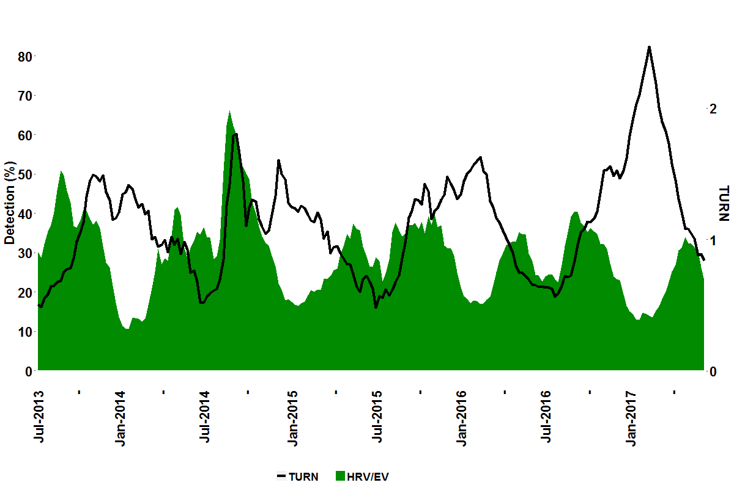
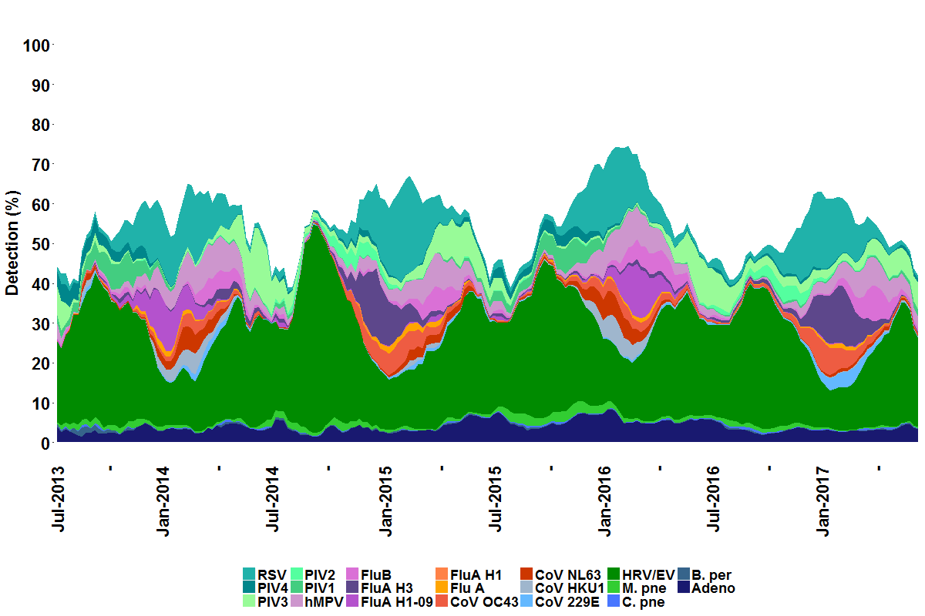
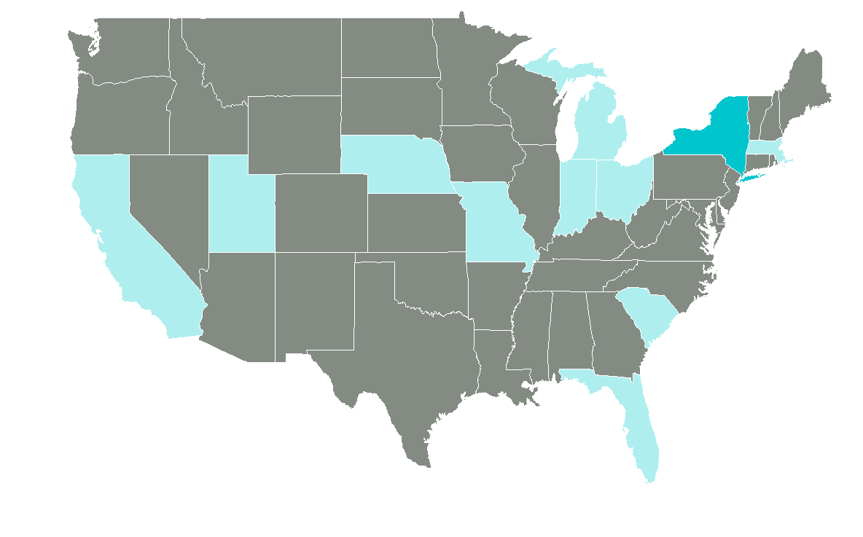
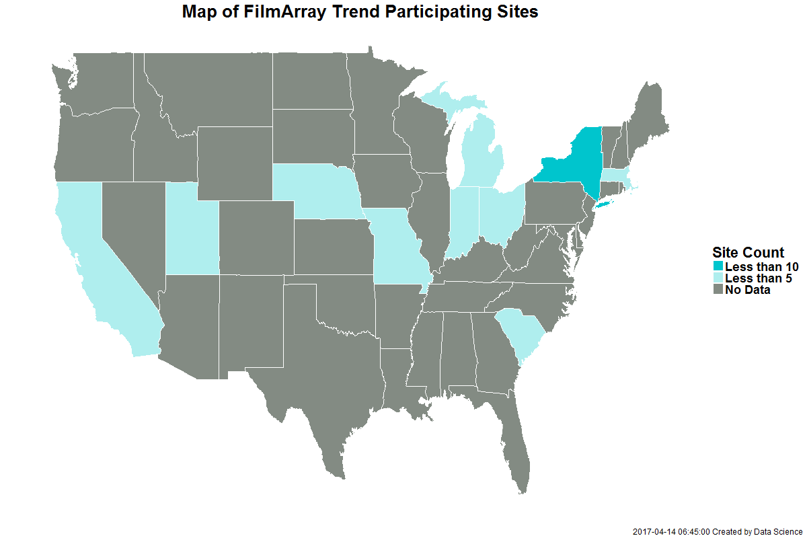
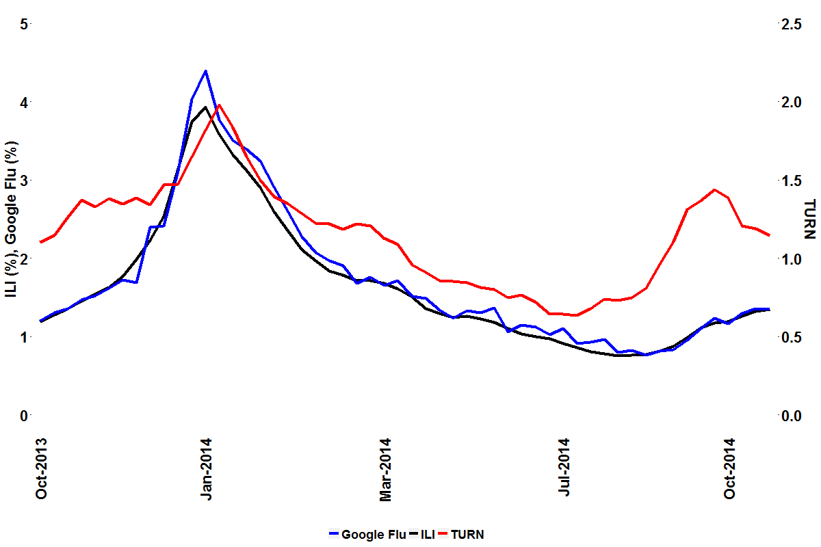
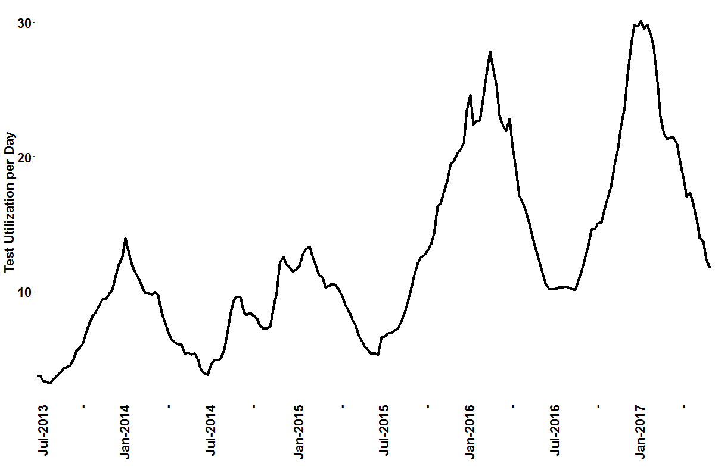


Surveillance of respiratory illness using pathogen specific diagnostic test utilization: an alternative to influenza-like illness
A. Faucett¹, J. Nawrocki¹, A. Hoffee¹, B.M. Althouse^{2,3}, S.V. Scarpino⁴, M.A. Poritz⁵, L. Meyers¹
¹BioFire Diagnostics, Salt Lake City, UT; ²University of Washington, Seattle, WA; ³New Mexico State University, Las Cruces, NM; ⁴Northeastern University, Boston, MA; ⁵BioFire Defense, Salt Lake City, UT
Epidemics 2017 #XXX
Background
In the United States (US), epidemiological reporting of respiratory illness typically focuses on influenza-like illness (ILI), which healthcare professionals use to monitor seasonal disease onset, duration, and severity. The Test Utilization Rate Normalized (TURN) metric we calculate using data from FilmArray® Trend, a cloud-based epidemiology system, measures generalized respiratory illness based on the rate that physicians order FilmArray® Respiratory Panel (RP) tests. Patients with respiratory symptoms are tested with RP, which can identify 20 pathogens in a single test, at Trend sites. TURN is based on test utilization, and is therefore a broader respiratory disease surveillance system in comparison to ILI, which focuses on influenza and may mask other etiologies of respiratory disease.
Method Summary
271,428 RP test results from the FilmArray Trend dataset were used in the analysis. The TURN metric is calculated and compared to other surveillance methods, including ILI as reported by the Centers for Disease Control and Prevention (CDC) and legacy Google Flu data for the 2013-2014 season. The metric is used to identify outbreaks of illness at specific sites or regions, such as non-Polio Enterovirus (EV-D68) in 2014, which cannot be detected by methods that survey for flu only. Finally, multiple regression of TURN by the pathogen percent positivity (Figure 1) is used to determine which pathogens contribute most to seasonal respiratory disease in the dataset.
Test Utilization Rate Normalized (TURN) Development
The total tests run at each participating Trend site in a given epidemiological week are summed and smoothed over time.
The average number of FilmArray instruments running RP tests in the same period are calculated.
Gaps in site data contribution, defined as five or more weeks without any RP tests performed, are identified and a start date is determined based on continuous test data prior to linear regression.
A linear regression of tests by instruments is performed in a rolling 52-week period (i.e. the current period and the 51 prior periods) and the tests per day and tests per day per instrument are weighted by the coefficient of determination to normalize for increased adoption of FilmArray.
The median test utilization rate in the same rolling 52-week period is determined and used as a denominator for each period, such that TURN can be compared across all seasons.
Evaluation of TURN
TURN can be applied on a site-by-site basis, and can be aggregated across sites to calculate regional and national averages. In applying the TURN algorithm to RP testing patterns regionally, we detected an uptick in the metric in the Midwest region of the US in 2014. Identification of this anomaly lead to investigation of each pathogen percent detection at sites in the Midwest. It was determined that Human Rhinovirus/Enterovirus (HRV/EV) detection increased dramatically at this time. Collaboration with clinical sites participating in Trend culminated in an algorithm that can identify EV-D68 using data from the six HRV/EV assays in the RP test.
Figure 4: TURN Patterns in the Midwest in 2014 Corresponds to EV-D68 Outbreak
Figure 1: Trend RP pathogen percent positivity
Summary of Results
The cross-correlation of TURN with ILI and Google flu are 0.83 and 0.80, respectively, at a lag of one period. ILI and Google Flu have a cross-correlation of 0.99 and no lag.
TURN can identify outbreaks of respiratory disease unrelated to influenza, unlike ILI. One such example is the 2014 outbreak of EV-D68 in the US Midwest (“Population-Level Detection Of EV-D68 In The United States Through a Cloud Based Epidemiology Network”, L. Meyers et al.).
Respiratory Syncytial Virus, Influenza A (all subtypes), and Human Rhinovirus/Enterovirus are the most significant contributors to TURN, indicating that these pathogens are the main drivers of seasonal respiratory illness in our dataset.
Three week moving average of percent organism positivity detected at the participating sites in the period of July 2013 to October 2017. www.SyndromicTrends.com
To determine which pathogens drive respiratory disease more generally, a multiple regression of percent detection with TURN at the national level was performed. Respiratory Syncytial Virus, Influenza A (all subtypes), and HRV/EV contributed most to the TURN metric. The adjusted R² for the multiple regression with the three aforementioned pathogens is 0.77 and residual standard error of 0.18. Further details of the model are shown in Table 1.
FilmArray Trend Working Group
Fredrick S. Nolte, Med. Univ. of South Carolina; Amy Leber, Nationwide Child. Hosp.; Kevin Maggert, South Bend Med. Found; Virginia Donovan, Winthrop Univ. Hosp.; Jenifer Dien Bard, Child. Hosp. of Los Angeles; Silvia Spitzer, Stony Brook Univ. Hosp.; Kathleen Stellrecht, Albany Med. Cent.; Hossein Salimnia, Detroit Med. Cent.; Rangaraj Selvarangan, Child. Mercy Hosp.; Stefan Juretschko, Northwell Health; Judy A. Daly, Primary Child. Hosp.; Jeremy C. Wallentine, Intermountain Med. Cent.; Kristy Lindsey, Baystate Health; Sharon L. Read, UC San Diego Med. Center; Maria Aguero-Rosenfeld, NYU Langone Med. Cent.; Paul Fey, University of Nebraska Med Center; Gregory A. Storch, St. Louis Child. Hosp.; Jennifer Meredith, Greenville Health System; Steve Melnick, Miami Child. Hosp.
Figure 3: TURN compared to ILI and Google Flu Surveillance Methods in 2013-2014
Table 1: Primary Drivers of TURN
Comparator surveillance metrics are plotted for the 2013-2014 flu season (last reported Google Flu data). We expected TURN to more closely match Google Flu, but since the algorithm was tuned to ILI (“Detecting influenza epidemics using search engine query data”, J. Ginsberg, et al.), it is unsurprising that ILI and Google Flu correlate very well (R=0.99) compared to TURN. Cross-correlation of TURN with ILI and Google Flu have an offset of -1 and correlation of 0.83 and 0.80, respectively. The Fall 2014 uptick in TURN corresponds to the Midwest outbreak of EV-D68.
Pathogen | t-value (measure of contribution) | p-value (hypothesis test of t-value)
Respiratory Syncytial Virus | 12.97 | 2.23E-28
Influenza A (all subtypes) | 10.24 | 4.33E-20
Human Rhinovirus/Enterovirus | 6.85 | 8.77E-11
Residual Standard Error | 0.182
F-statistic | 219.5
p-value of F-statistic | < 2e-16
The RP test frequency is used as an indicator of respiratory illness; however, increased adoption of FilmArray products may increase utilization unrelated to disease severity (Figure 2). We have developed a metric, Test Utilization Rate Normalized (TURN) which normalizes test utilization and allows for comparison of respiratory disease onset, duration, and severity across seasons.
Figure 2: Test Utilization
Conclusions
The establishment of a large-scale, real-time epidemiology system (Trend) has made it possible to develop TURN into a surveillance metric for respiratory disease onset, duration, and severity in the US. TURN can be used to monitor “respiratory season” rather than “flu season”, as RP can diagnose 20 pathogens and the test may be ordered for any patient suffering acute respiratory symptoms. This is a departure from current surveillance methods which focus on few individual pathogens, such as influenza. This has implications for the diagnosis, treatment, and epidemiology of respiratory illness, as our results show that pathogens other than influenza are stronger contributors to test utilization and respiratory illness prevalence.
Lindsay Meyers
Contact Information: BioFire Diagnostics, LLC
Lindsay.Meyers@BioFireDx.com

