Slide 1

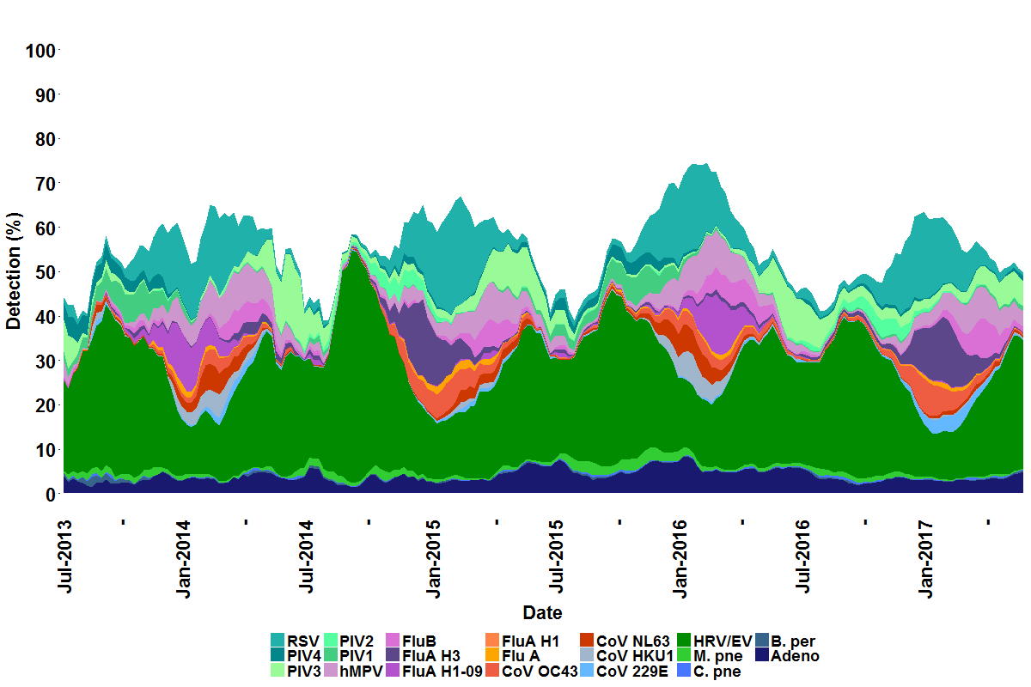
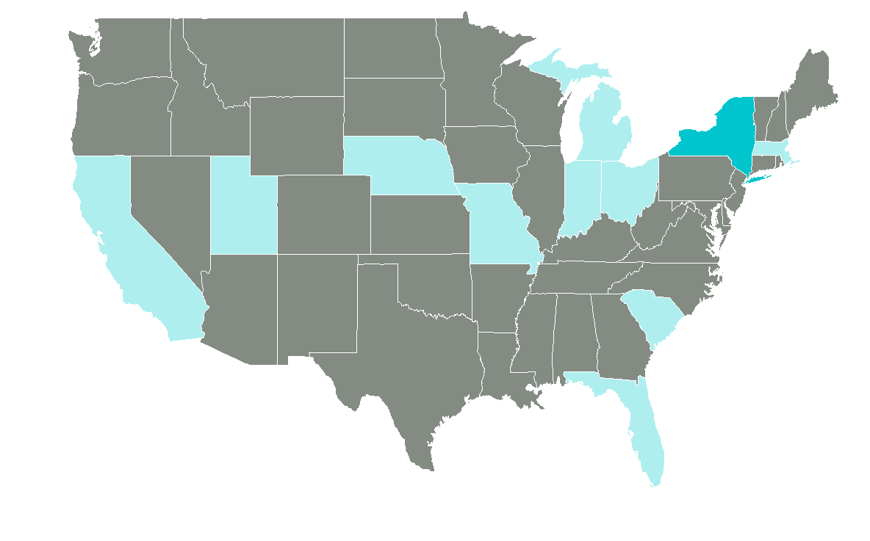
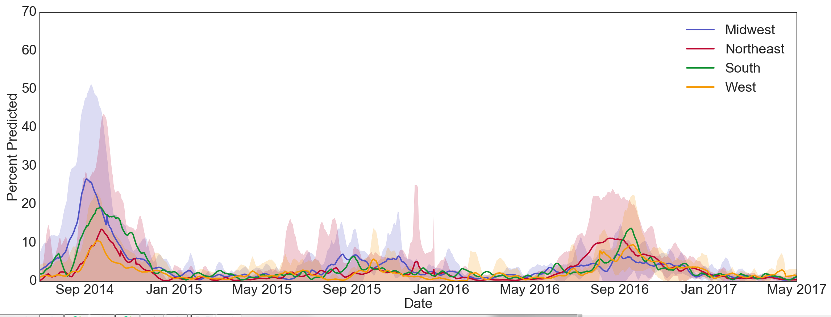
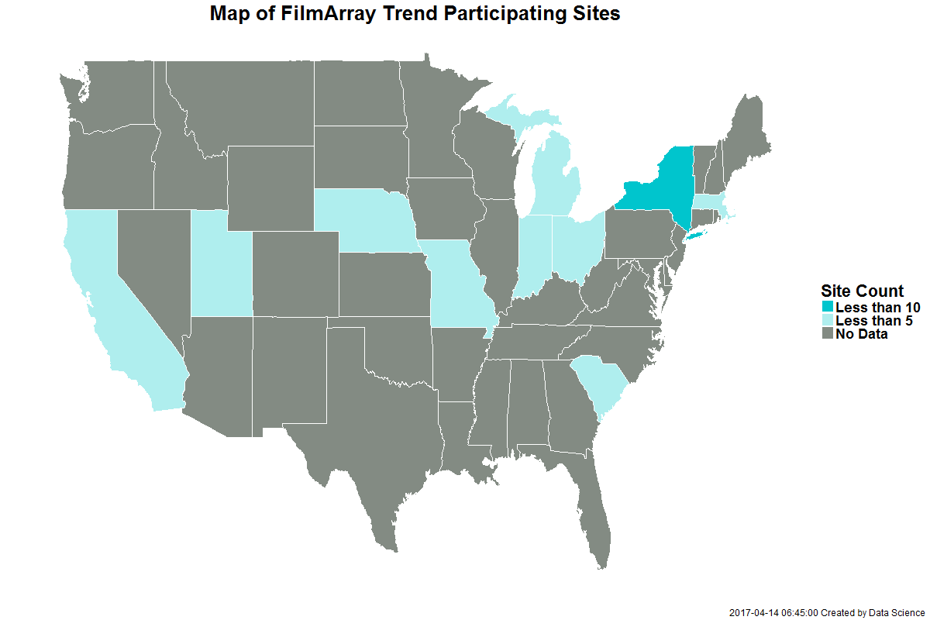
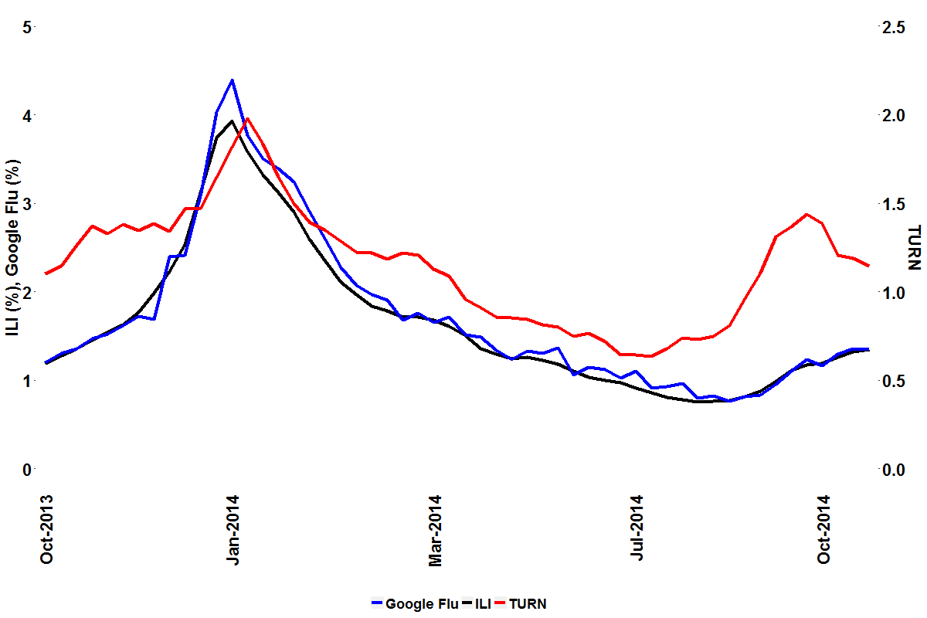
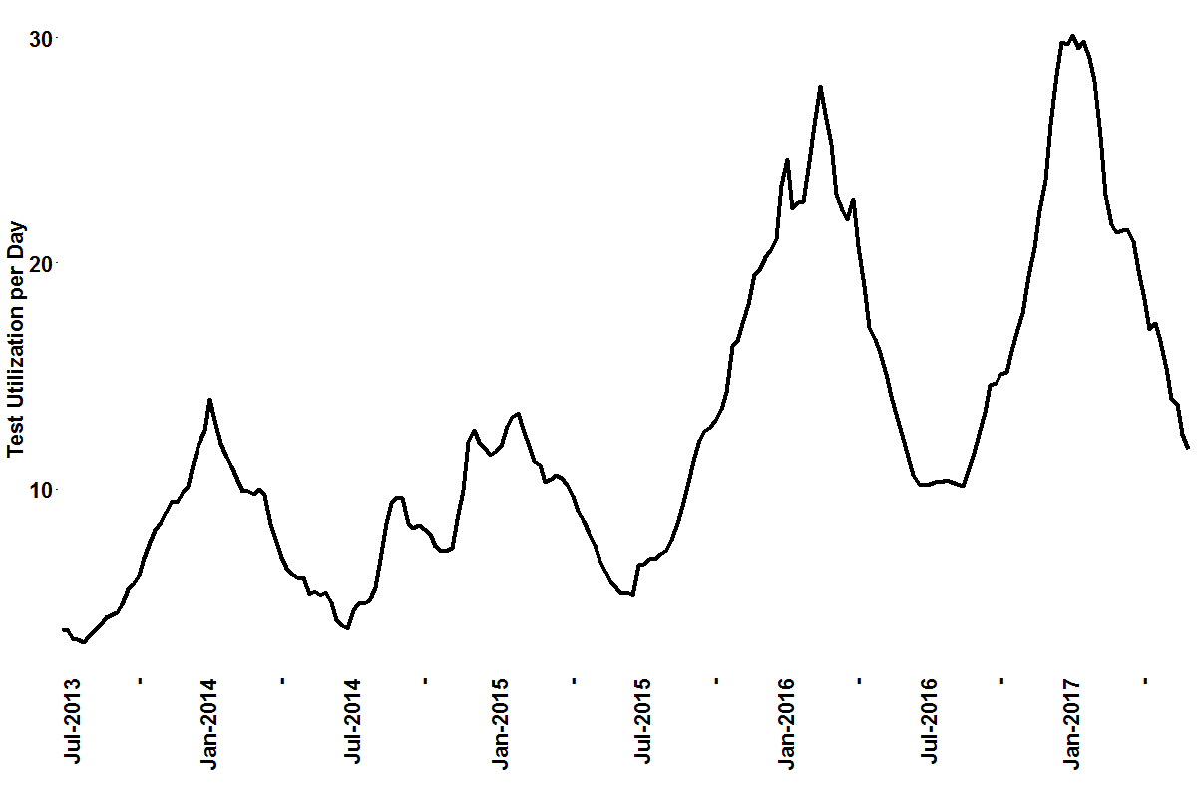


Surveillance of respiratory illness using pathogen specific diagnostic test utilization: an alternative to influenza-like illness
A. Faucett¹, J. Nawrocki¹, A. Hoffee¹, B.M. Althouse^{2,3}, S.V. Scarpino⁴, M.A. Poritz⁵, L. Meyers¹
¹BioFire Diagnostics, Salt Lake City, UT; ²University of Washington, Seattle, WA; ³New Mexico State University, Las Cruces, NM; ⁴Northeastern University, Boston, MA; ⁵BioFire Defense, Salt Lake City, UT
Epidemics 2017 #XXX
Background
In the United States (US), epidemiological reporting of respiratory illness typically focuses on influenza-like illness (ILI), which is used by healthcare professionals to monitor seasonal disease onset, duration, and severity. We have developed the Test Utilization Rate Normalized (TURN) metric using FilmArray® Trend, a cloud-based epidemiology system, to measure generalized respiratory illness based on the rate that physicians order FilmArray® Respiratory Panel (RP) tests. Patients with respiratory symptoms are tested with RP, making TURN a general respiratory disease surveillance system. RP tests for 20 pathogens; therefore, TURN is more comprehensive than ILI, which focuses on influenza and may mask other etiologies of respiratory disease.
Method Summary
271,428 RP test results from the FilmArray Trend dataset were used in the analysis. The TURN metric is calculated and compared to other surveillance methods, including ILI as reported by the Centers for Disease Control and Prevention (CDC) and legacy Google Flu data for the 2013-2014 season. The metric is used to identify outbreaks of illness at specific sites or regions, such as non-Polio Enterovirus (EV-D68) in 2014, which cannot be detected by methods that survey for flu only. Finally, multiple regression of TURN by the pathogen percent positivity (Figure 1) is used to determine which pathogens contribute most to seasonal respiratory disease in the dataset.
Test Utilization Rate Normalized (TURN) Development
The total tests run at each participating Trend site in a given epidemiological week are summed and smoothed over time.
The average number of FilmArray instruments running RP tests in the same period are calculated.
Gaps in site data contribution, defined as five or more weeks without any RP tests performed, are identified and a start date is determined based on continuous test data prior to linear regression.
A linear regression of tests by instruments is performed in a rolling 52-week period (i.e. the current period and the 51 prior periods) and the tests per day and tests per day per instrument are weighted by the coefficient of determination to normalize for increased adoption of FilmArray.
The median test utilization rate in the same rolling 52-week period is determined and used as a denominator for each period, such that TURN can be compared across all seasons.
Evaluation of TURN (show detection of EV-
The FilmArray tests characterized as EV-D68 were used for PER test development and performance evaluation. A repeated cross validation of the PER test on CMH data, where 30% of the results were blinded, was used to define positive and negative predictions for EV-D68. The PER test was then trained on the full CMH dataset and used to evaluate the remaining three datasets for EV-D68 prediction, compared to laboratory tests (Table 1). The CMH results shown in Table 1, are those from the cross validation.
Table 1: Evaluation of the PER Test and EV-D68 PCR
Clinical Site | Location | Samples Month-Year | FilmArray Tests | Sensitivity |  | Specificity
Children’s Hospital of Los Angeles | Los Angeles, CA | Sept. 2016 | 79 | 11/11 | 100% | 64/68 | 94%
Children’s Mercy Hospital | Kansas City, MO | Jul. – Dec. 2014 | 532 | 279/306 | 91% | 205/226 | 91%
Albany Medical Center | Albany, NY | Aug. – Sept. 2014 | 77 | 16/18 | 89% | 42/59 | 71%
Primary Children’s Hospital | Salt Lake City, UT | Aug. – Sept. 2014 | 22 | 10/12 | 83% | 9/10 | 90%
 |  | Combined | 710 | 316/347 | 91% | 320/363 | 88%
Figure 1: Trend RP pathogen percent positivity
Summary of Results
The cross-correlation of TURN with ILI and Google flu are 0.83 and 0.80, respectively, at a lag of one period. ILI and Google Flu have a cross-correlation of 0.99 and no lag.
TURN can identify outbreaks of respiratory disease unrelated to influenza, unlike ILI. One such example is the 2014 outbreak of EV-D68 in the US Midwest (“Population-Level Detection Of EV-D68 In The United States Through a Cloud Based Epidemiology Network”, L. Meyers et al.).
Respiratory Syntactical Virus, Influenza A (all subtypes), and Human Rhinovirus/Enterovirus are the most significant contributors to TURN, indicating that these pathogens are the main drivers of seasonal respiratory illness in our dataset.
Regional Trends of EV-D68 PER Test 2013-2017
Three week moving average of percent organism positivity detected at the participating sites in the period of July 2013 to October 2017. www.SyndromicTrends.com
The EV-D68 PER test was used to estimate prevalence of EV-D68 in the population of over 300,000 Respiratory Panel tests, from July 2014 to May 2017. The predicted smoothed weekly percent detection of the EV-D68 tests among all patients tested with the Respiratory Panel shows the highest percentage of positives in the Midwest, fall of 2014 (Figure 4). A moderate resurgence of detections occurred across several regions in fall of 2016.
FilmArray Trend Working Group
Fredrick S. Nolte, Med. Univ. of South Carolina; Amy Leber, Nationwide Child. Hosp.; Kevin Maggert, South Bend Med. Found; Virginia Donovan, Winthrop Univ. Hosp.; Jenifer Dien Bard, Child. Hosp. of Los Angeles; Silvia Spitzer, Stony Brook Univ. Hosp.; Kathleen Stellrecht, Albany Med. Cent.; Hossein Salimnia, Detroit Med. Cent.; Rangaraj Selvarangan, Child. Mercy Hosp.; Stefan Juretschko, Northwell Health; Judy A. Daly, Primary Child. Hosp.; Jeremy C. Wallentine, Intermountain Med. Cent.; Kristy Lindsey, Baystate Health; Sharon L. Read, UC San Diego Med. Center; Maria Aguero-Rosenfeld, NYU Langone Med. Cent.; Paul Fey, University of Nebraska Med Center; Gregory A. Storch, St. Louis Child. Hosp.; Jennifer Meredith, Greenville Health System; Steve Melnick, Miami Child. Hosp.
Figure 4: Regional Percentages of EV-D68 as Predicted by the PER test
Figure 3: TURN compared to ILI and Google Flu Surveillance Methods in 2013-2014
Comparator surveillance metrics are plotted for the 2013-2014 flu season (last reported Google Flu data). We expected TURN to more closely match Google Flu, but since the algorithm was tuned to ILI (“Detecting influenza epidemics using search engine query data”, J. Ginsberg, et al.), it is unsurprising that ILI and Google Flu correlate very well (R=0.99) compared to TURN. Cross-correlation of TURN with ILI and Google Flu have an offset of -1 and correlation of 0.83 and 0.80, respectively. The Fall 2014 uptick in TURN corresponds to the Midwest outbreak of EV-D68.
100% Confidence Interval
The RP test frequency is used as an indicator of respiratory illness; however, increased adoption of FilmArray products may increase utilization unrelated to disease severity (Figure 2). We have developed a metric, Test Utilization Rate Normalized (TURN) which normalizes test utilization and allows for comparison of respiratory disease onset, duration, and severity across seasons.
AREA
Figure 2: Test Utilization
Conclusions
We have demonstrated that the PCR amplification data available to BioFire through the FilmArray Trend database can be used to identify signatures associated with EV-D68, a serotype implicated in severe disease. Development of the Pathogen Expanded Resolution (PER) Test to identify patterns masked within the FilmArray® software has the potential to provide alerts to network participants of anomalous patterns in pathogen trends. Further validation, development and refinement of these trend algorithms and how to use them must be explored before broad implementation.
Lindsay Meyers
Contact Information: BioFire Diagnostics, LLC
Lindsay.Meyers@BioFireDx.com

Slide 2
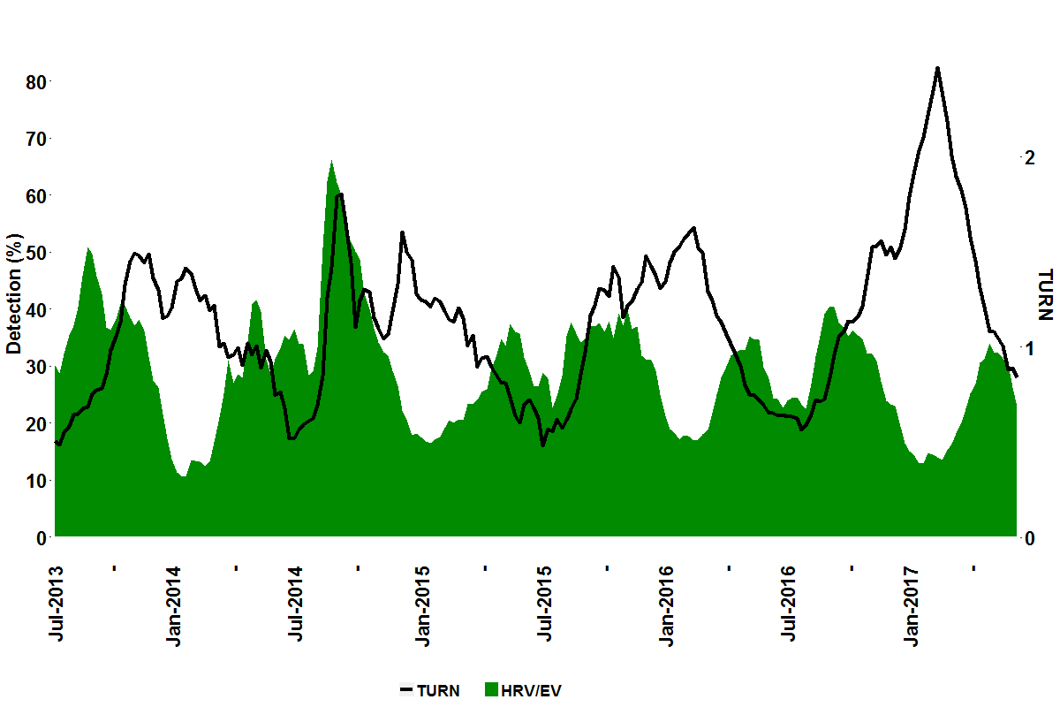
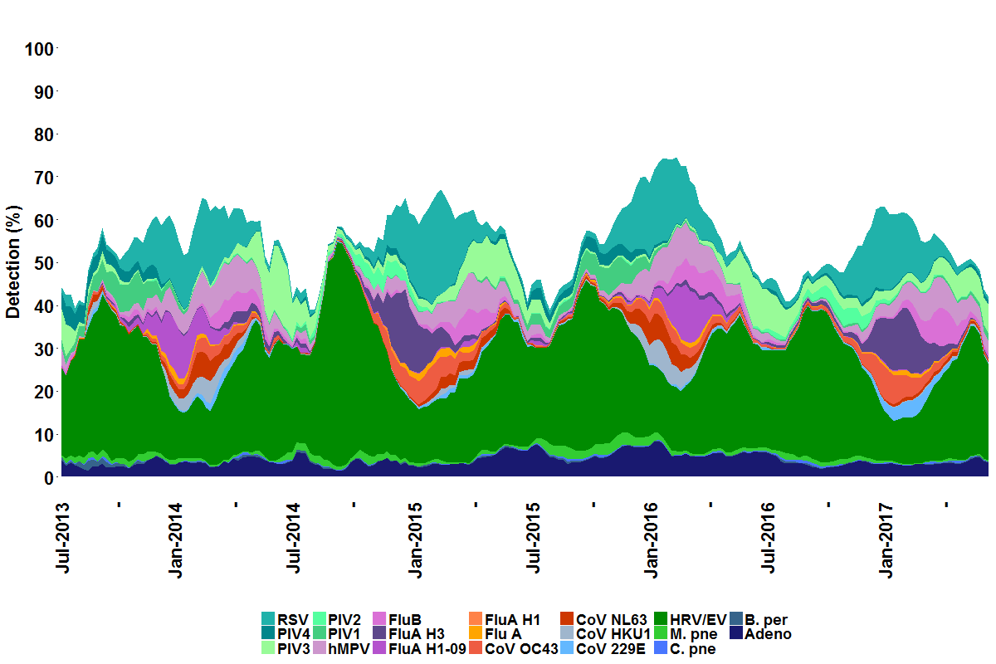
Surveillance of respiratory illness using pathogen specific diagnostic test utilization: an alternative to influenza-like illness
A. Faucett¹, J. Nawrocki¹, A. Hoffee¹, B.M. Althouse^{2,3}, S.V. Scarpino⁴, M.A. Poritz⁵, L. Meyers¹
¹BioFire Diagnostics, Salt Lake City, UT; ²University of Washington, Seattle, WA; ³New Mexico State University, Las Cruces, NM; ⁴Northeastern University, Boston, MA; ⁵BioFire Defense, Salt Lake City, UT
Epidemics 2017 #XXX
Background
In the United States (US), epidemiological reporting of respiratory illness typically focuses on influenza-like illness (ILI), which is used by healthcare professionals to monitor seasonal disease onset, duration, and severity. We have developed the Test Utilization Rate Normalized (TURN) metric using FilmArray® Trend, a cloud-based epidemiology system, to measure generalized respiratory illness based on the rate that physicians order FilmArray® Respiratory Panel (RP) tests. Patients with respiratory symptoms are tested with RP, making TURN a general respiratory disease surveillance system. RP tests for 20 pathogens; therefore, TURN is more comprehensive than ILI, which focuses on influenza and may mask other etiologies of respiratory disease.
Method Summary
271,428 RP test results from the FilmArray Trend dataset were used in the analysis. The TURN metric is calculated and compared to other surveillance methods, including ILI as reported by the Centers for Disease Control and Prevention (CDC) and legacy Google Flu data for the 2013-2014 season. The metric is used to identify outbreaks of illness at specific sites or regions, such as non-Polio Enterovirus (EV-D68) in 2014, which cannot be detected by methods that survey for flu only. Finally, multiple regression of TURN by the pathogen percent positivity (Figure 1) is used to determine which pathogens contribute most to seasonal respiratory disease in the dataset.
Test Utilization Rate Normalized (TURN) Development
The total tests run at each participating Trend site in a given epidemiological week are summed and smoothed over time.
The average number of FilmArray instruments running RP tests in the same period are calculated.
Gaps in site data contribution, defined as five or more weeks without any RP tests performed, are identified and a start date is determined based on continuous test data prior to linear regression.
A linear regression of tests by instruments is performed in a rolling 52-week period (i.e. the current period and the 51 prior periods) and the tests per day and tests per day per instrument are weighted by the coefficient of determination to normalize for increased adoption of FilmArray.
The median test utilization rate in the same rolling 52-week period is determined and used as a denominator for each period, such that TURN can be compared across all seasons.
Evaluation of TURN
TURN can be applied on a site-by-site basis, and can be aggregated across sites to calculate regional and national averages. In applying the TURN algorithm to RP testing patterns regionally, we detected an uptick in the metric in the Midwest region of the US in 2014. Identification of this anomaly lead to investigation of each pathogen percent detection at sites in the Midwest. It was determined that Human Rhinovirus/Enterovirus (HRV/EV) detection increased dramatically at this time. Collaboration with clinical sites participating in Trend culminated in an algorithm that can identify EV-D68 using data from the six HRV/EV assays in the RP test.
Figure 4: TURN Patterns in the Midwest in 2014 Corresponds to EV-D68 Outbreak
Figure 1: Trend RP pathogen percent positivity
Summary of Results
The cross-correlation of TURN with ILI and Google flu are 0.83 and 0.80, respectively, at a lag of one period. ILI and Google Flu have a cross-correlation of 0.99 and no lag.
TURN can identify outbreaks of respiratory disease unrelated to influenza, unlike ILI. One such example is the 2014 outbreak of EV-D68 in the US Midwest (“Population-Level Detection Of EV-D68 In The United States Through a Cloud Based Epidemiology Network”, L. Meyers et al.).
Respiratory Syncytial Virus, Influenza A (all subtypes), and Human Rhinovirus/Enterovirus are the most significant contributors to TURN, indicating that these pathogens are the main drivers of seasonal respiratory illness in our dataset.
Three week moving average of percent organism positivity detected at the participating sites in the period of July 2013 to October 2017. www.SyndromicTrends.com
To determine which pathogens drive respiratory disease more generally, a multiple regression of percent detection with TURN at the national level was performed. Respiratory Syncytial Virus, Influenza A (all subtypes), and HRV/EV contributed most to the TURN metric. The adjusted R² for the multiple regression with the three aforementioned pathogens is 0.77 and residual standard error of 0.18. Further details of the model are shown in Table 1.
FilmArray Trend Working Group
Fredrick S. Nolte, Med. Univ. of South Carolina; Amy Leber, Nationwide Child. Hosp.; Kevin Maggert, South Bend Med. Found; Virginia Donovan, Winthrop Univ. Hosp.; Jenifer Dien Bard, Child. Hosp. of Los Angeles; Silvia Spitzer, Stony Brook Univ. Hosp.; Kathleen Stellrecht, Albany Med. Cent.; Hossein Salimnia, Detroit Med. Cent.; Rangaraj Selvarangan, Child. Mercy Hosp.; Stefan Juretschko, Northwell Health; Judy A. Daly, Primary Child. Hosp.; Jeremy C. Wallentine, Intermountain Med. Cent.; Kristy Lindsey, Baystate Health; Sharon L. Read, UC San Diego Med. Center; Maria Aguero-Rosenfeld, NYU Langone Med. Cent.; Paul Fey, University of Nebraska Med Center; Gregory A. Storch, St. Louis Child. Hosp.; Jennifer Meredith, Greenville Health System; Steve Melnick, Miami Child. Hosp.
Figure 3: TURN compared to ILI and Google Flu Surveillance Methods in 2013-2014
Table 1: Primary Drivers of TURN
Comparator surveillance metrics are plotted for the 2013-2014 flu season (last reported Google Flu data). We expected TURN to more closely match Google Flu, but since the algorithm was tuned to ILI (“Detecting influenza epidemics using search engine query data”, J. Ginsberg, et al.), it is unsurprising that ILI and Google Flu correlate very well (R=0.99) compared to TURN. Cross-correlation of TURN with ILI and Google Flu have an offset of -1 and correlation of 0.83 and 0.80, respectively. The Fall 2014 uptick in TURN corresponds to the Midwest outbreak of EV-D68.
Pathogen | t-value (measure of contribution) | p-value (hypothesis test of t-value)
Respiratory Syncytial Virus | 12.97 | 2.23E-28
Influenza A (all subtypes) | 10.24 | 4.33E-20
Human Rhinovirus/Enterovirus | 6.85 | 8.77E-11
Residual Standard Error | 0.182
F-statistic | 219.5
p-value of F-statistic | < 2e-16
The RP test frequency is used as an indicator of respiratory illness; however, increased adoption of FilmArray products may increase utilization unrelated to disease severity (Figure 2). We have developed a metric, Test Utilization Rate Normalized (TURN) which normalizes test utilization and allows for comparison of respiratory disease onset, duration, and severity across seasons.
Figure 2: Test Utilization
Conclusions
We have demonstrated that the PCR amplification data available to BioFire through the FilmArray Trend database can be used to identify signatures associated with EV-D68, a serotype implicated in severe disease. Development of the Pathogen Expanded Resolution (PER) Test to identify patterns masked within the FilmArray® software has the potential to provide alerts to network participants of anomalous patterns in pathogen trends. Further validation, development and refinement of these trend algorithms and how to use them must be explored before broad implementation.
Lindsay Meyers
Contact Information: BioFire Diagnostics, LLC
Lindsay.Meyers@BioFireDx.com

