Slide 1
PIPEMB-WDL FILTERS

Slide 2
Processo | Tipo de estudo | Tipo de Sample | PIPE-MB v3 (script) | PIPE-MB v4 (Cromwell + Singularity + WDL)
Filter | Germline | Single sample | SelectVariant + VariantFiltration + CombineVariants | CNNScoreVariants + FIlterVariantTranches
 |  | Multisample | VariantRecalibrator + ApplyRecalibration | VariantRecalibrator + ApplyRecalibration
 | Somatic | - | - | FilterMutectCalls
Hard filter script:
Variant Quality Score Recalibration (VQSR)

Slide 3
Hard filtering vs VQSR
Hard-filtering:
Consists of choosing specific thresholds for one or more annotations and throwing out any variants that have annotation values above or below the set thresholds.
Annotations: properties or statistics that describe for each variant e.g. what the sequence context is like around the variant site, how many reads covered it, how many reads covered each allele, what proportion of reads were in forward vs reverse orientation, and so on.
The problem with this approach is that it is very limiting because it forces you to look at each annotation dimension individually, and you end up throwing out good variants just because one of their annotations looks bad, or keeping bad variants in order to keep those good variants.
VQSR:
More powerful because it uses machine-learning algorithms to learn from the data what are the annotation profiles of good variants (true positives) and of bad variants (false positives) in a particular dataset. This empowers you to pull out variants based on how they cluster together along different dimensions, and liberates you to a large extent from the linear tyranny of single-dimension thresholds.
Unfortunately this method requires a large number of variants and well-curated known variant resources. For those of you working with small gene panels or with non-model organisms, this is a deal-breaker, and you have to fall back on hard-filtering.
https://gatk.broadinstitute.org/hc/en-us/articles/360035890471-Hard-filtering-germline-short-variants (06/2021 updated)
This document aims to provide some insight into the logic of the generic hard-filtering recommendations that we provide as a substitute for VQSR (the method we normally recommend for filtering germline short variants).
Notes:
algoritmos de aprendizaje automático para aprender de los datos cuáles son los perfiles de anotación de las variantes buenas (verdaderos positivos) y de las malas variantes (falsos positivos) en un conjunto de datos en particular

Slide 4
Links relacionados
https://gatk.broadinstitute.org/hc/en-us/articles/360035890471-Hard-filtering-germline-short-variants (06/2021 updated)
https://gatk.broadinstitute.org/hc/en-us/articles/360035531112--How-to-Filter-variants-either-with-VQSR-or-by-hard-filtering
https://gatk.broadinstitute.org/hc/en-us/articles/360035531612-Variant-Quality-Score-Recalibration-VQSR-

Slide 5
Hard filtering vs VQSR
Hard filtering is applied by filtering via thresholds for metrics such as QualByDepth, FisherStrand, RMSMappingQuality, MappingQualityRankSumTest, ReadPosRankSumTest, and StrandOddsRatio.
VQSR, on the other hand, relies on machine learning to identify annotation profiles of variants that are likely to be real. It requires a large training dataset (minimum 30 WES data, at least one WGS data if possible) and well-curated sets of known variants. The aim is to assign a well-calibrated probability to each variant call to create accurate variant quality scores that are then used for filtering.
The accuracy of variant calling is also affected by coverage. Coverage can be broadly defined as the number of unique reads that include a given nucleotide. Coverage is affected by the accuracy of alignment algorithms and by the “mappability” of reads. Coverage can be utilized for both the filtration of variants and for a general evaluation of the sequencing experiment.
https://www.intechopen.com/books/bioinformatics-tools-for-detection-and-clinical-interpretation-of-genomic-variations/bioinformatics-workflows-for-genomic-variant-discovery-interpretation-and-prioritization

Slide 6
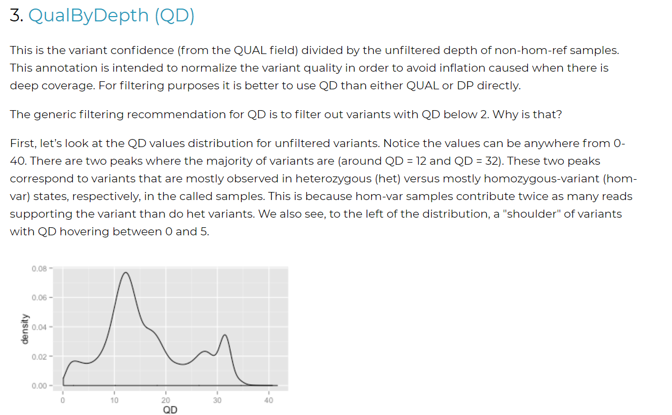
https://gatk.broadinstitute.org/hc/en-us/articles/360035890471-Hard-filtering-germline-short-variants
Notes:
https://gatk.broadinstitute.org/hc/en-us/articles/360035890471-Hard-filtering-germline-short-variants

Slide 7
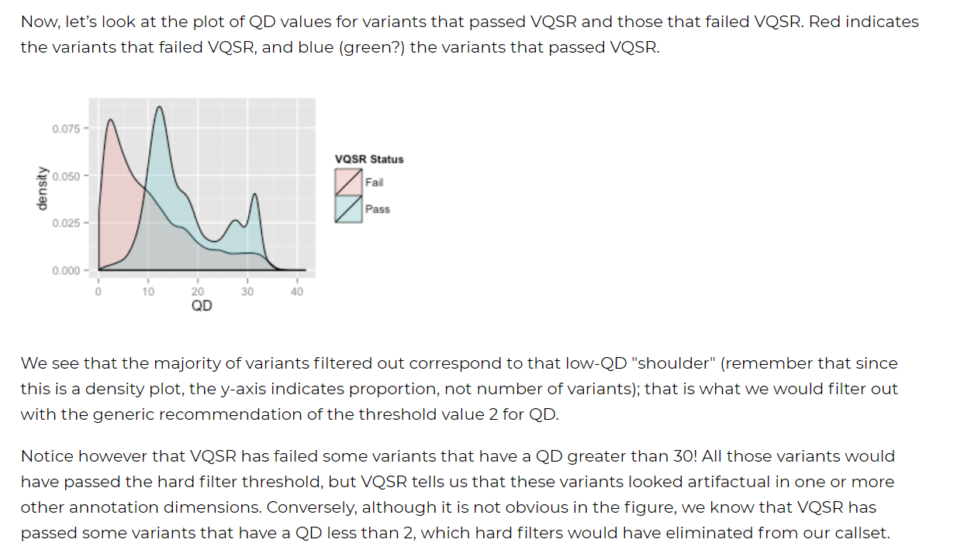

Slide 8
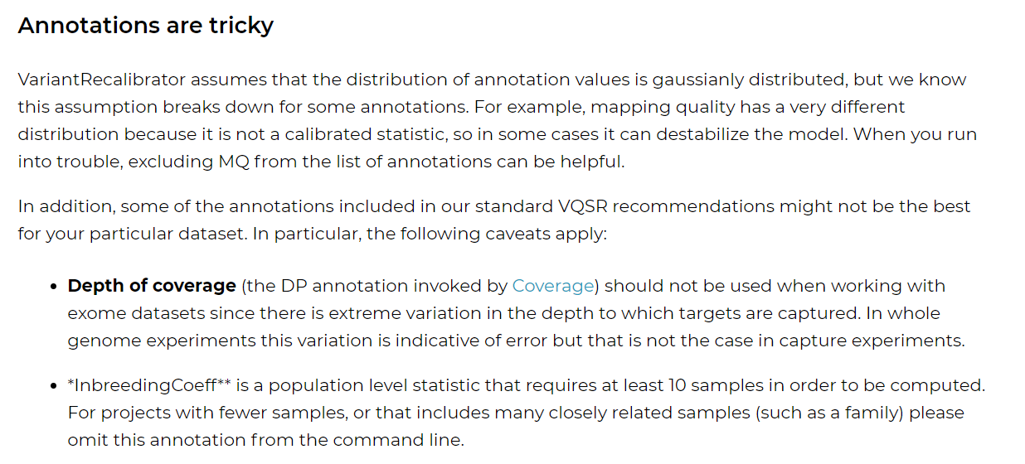
Variant-Quality-Score-Recalibration-VQSR-
https://gatk.broadinstitute.org/hc/en-us/articles/360035531612-Variant-Quality-Score-Recalibration-VQSR-

Slide 9
CNNScoreVariants
https://gatk.broadinstitute.org/hc/en-us/community/posts/360073082912-What-is-the-correct-step-VQSR-and-CNNScoreVariants-
VQSR:
https://core.ac.uk/download/pdf/323064116.pdf
https://gatk.broadinstitute.org/hc/en-us/articles/360035890551-Allele-specific-annotation-and-filtering-of-germline-short-variants

Slide 10
Texto do Relatorio/2021
No caso das variantes germinativas, para análises de amostras independentes, na versão GATK 4 é recomendado o uso de ferramentas baseadas em Inteligência Artificial, CNNScoreVariants(GATK-Team 2022b) e FilterVariantTranches (GATK-Team 2022d).
A primeira ferramenta, CNNScoreVariants, usa um modelo computacional pré-treinado (no caso uma Rede Neural Convolucional – CNN), para dar pontuações a cada variante num arquivo VCF. Já o FilterVariantTranches, recebe como parâmetros a faixa das pontuações permissíveis e acessa a alguns recursos que usa como guia para filtrar as variantes.
A anotação consiste num valor numérico no campo INFO de um VCF. “As faixas são especificadas em porcentagem de sensibilidade às variantes nos arquivos de recursos. Por exemplo, se você especificar faixas INDEL 98.0 e 99.0 usando a pontuação de tipo CNN_1D, o VCF filtrado conterá 2 faixas de filtro para INDELS: CNN_1D_INDEL_Tranche_98.00_99.00 e CNN_1D_INDEL_Tranche_99.00_100.00. As variantes que pontuaram melhor que o percentil 98 de variantes nos recursos passam pelo filtro e terão 'PASS' no campo de filtro. Esperamos que as variantes na parcela CNN_2D_INDEL_Tranche_99.00_100.00 sejam mais sensíveis, mas menos precisas do que CNN_2D_INDEL_Tranche_98.00_99.00, porque as variantes em CNN_2D_INDEL_Tranche_99.00_100.00 têm pontuações mais baixas do que as variantes na parcela CNN_2D_INDEL_Tranche_98.00_99.00. O limite de filtragem das faixas padrão para SNPs é 99,95 e para INDELs é 99,4. Esses limites maximizam a pontuação F1 (a média harmônica de sensibilidade e precisão) para dados humanos de genoma inteiro, mas podem precisar ser ajustados para diferentes conjuntos de dados”. (GATK-Team 2022d)

Slide 11
Issues →Estudo Nano (Carol)
shard-2
19:10:15.017 INFO FilterVariantTranches - Found 18 SNPs and 7 indels with INFO score key:CNN_1D.
19:10:15.017 INFO FilterVariantTranches - Found 14 SNPs and 0 indels in the resources.
19:10:15.017 INFO FilterVariantTranches - Filtered 0 SNPs out of 18 and filtered 0 indels out of 7 with INFO score: CNN_1D.
19:10:15.023 INFO FilterVariantTranches - Shutting down engine
[September 2, 2021 7:10:15 PM GMT] org.broadinstitute.hellbender.tools.walkers.vqsr.FilterVariantTranches done. Elapsed time: 0.02 minutes.
Runtime.totalMemory()=2053111808
***********************************************************************
A USER ERROR has occurred: Bad input: Indels are present in input VCF, but cannot be filtered because no overlapping indels were found in the resources.

Slide 12
Germline
Single sample variant discovery uses HaplotypeCaller in its default single-sample mode to call variants in an analysis-ready BAM file. The VCF that HaplotypeCaller emits errs on the side of sensitivity, so some filtering is often desired. To filter variants first run the CNNScoreVariants tool. This tool annotates each variant with a score indicating the model's prediction of the quality of each variant. To apply filters based on those scores run the FIlterVariantTranches tool with SNP and INDEL sensitivity tranches appropriate for your task.
https://github.com/broadinstitute/gatk/tree/master/scripts
https://github.com/broadinstitute/gatk/tree/master/scripts/cnn_variant_wdl
https://github.com/broadinstitute/gatk/tree/master/scripts/cnn_variant_cromwell_tests

Slide 13
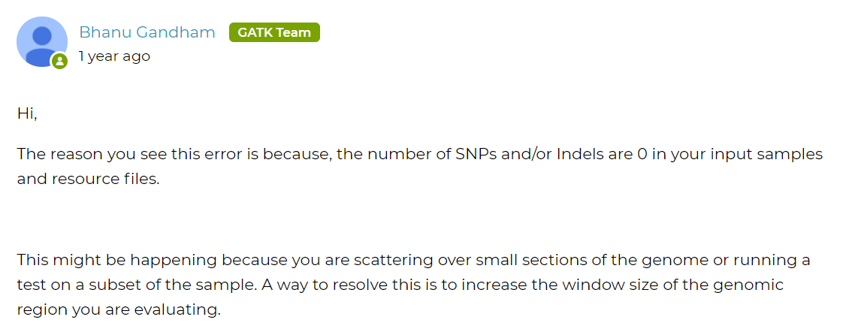
https://gatk.broadinstitute.org/hc/en-us/community/posts/360056456092-FilterVariantTranches-User-error

Slide 14
Proposta para FilterVariantTranches :
Avaliar resources:
FilterVariantTranches \
-V /cromwell-executions/VariantStudy_INCA_v1/e45744e1-ae8d-4f3c-9e7e-5f2c5ff53882/call-HaplotypeCallerGvcf_GATK4/shard-39/HaplotypeCallerGvcf_GATK4/c4dcddfa-c364-4d66-a69e-51a531d682ee/call-FilterVariantTranches/inputs/2033626005/S-50.hg38.vcf.gz \
--output S-50.hg38_cnn_filtered.vcf.gz \
--resource /cromwell-executions/VariantStudy_INCA_v1/e45744e1-ae8d-4f3c-9e7e-5f2c5ff53882/call-HaplotypeCallerGvcf_GATK4/shard-39/HaplotypeCallerGvcf_GATK4/c4dcddfa-c364-4d66-a69e-51a531d682ee/call-FilterVariantTranches/inputs/497750659/hapmap_3.3.hg38.vcf.gz -resource /cromwell-executions/VariantStudy_INCA_v1/e45744e1-ae8d-4f3c-9e7e-5f2c5ff53882/call-HaplotypeCallerGvcf_GATK4/shard-39/HaplotypeCallerGvcf_GATK4/c4dcddfa-c364-4d66-a69e-51a531d682ee/call-FilterVariantTranches/inputs/497750659/1000G_phase1.snps.high_confidence.hg38.vcf.gz -resource /cromwell-executions/VariantStudy_INCA_v1/e45744e1-ae8d-4f3c-9e7e-5f2c5ff53882/call-HaplotypeCallerGvcf_GATK4/shard-39/HaplotypeCallerGvcf_GATK4/c4dcddfa-c364-4d66-a69e-51a531d682ee/call-FilterVariantTranches/inputs/497750659/Mills_and_1000G_gold_standard.indels.hg38.vcf.gz \
--info-key CNN_1D \
--snp-tranche 99.9 \
--indel-tranche 99.5 \`
Control de erros. Que passa com a tarefa FilterPass, criaria arquivos com header, info, mas com ninhuma linha variante:
continueOnReturnCode (https://cromwell.readthedocs.io/en/stable/RuntimeAttributes/#continueonreturncode)

Slide 15
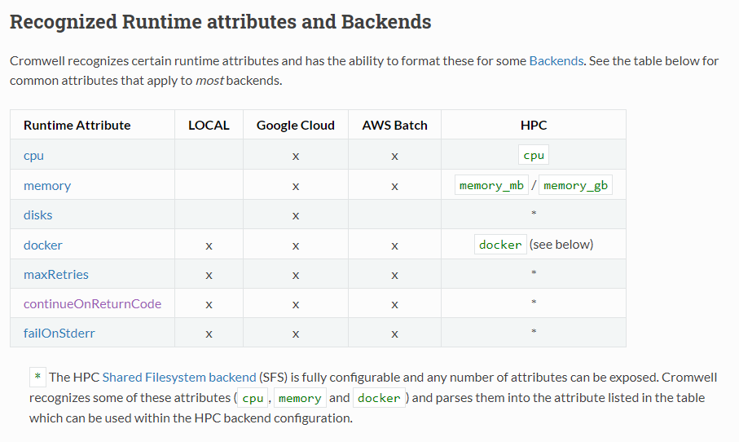
FilterVariantTranches. Gerenciamento do erro.
https://cromwell.readthedocs.io/en/stable/RuntimeAttributes/#continueonreturncode

Slide 16
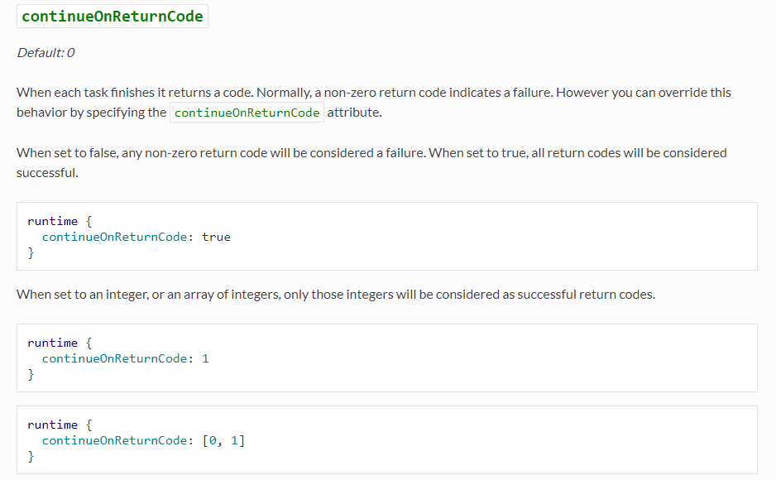

Slide 17
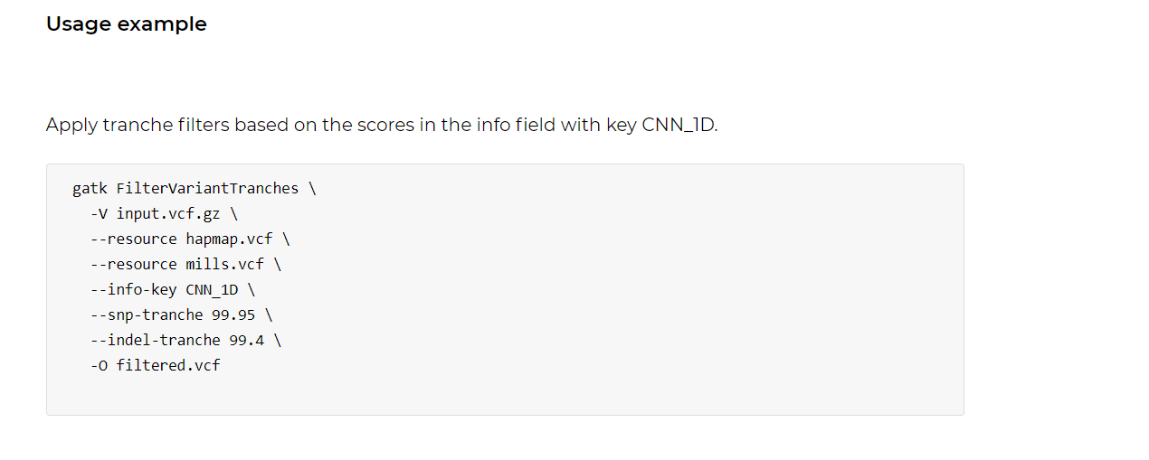
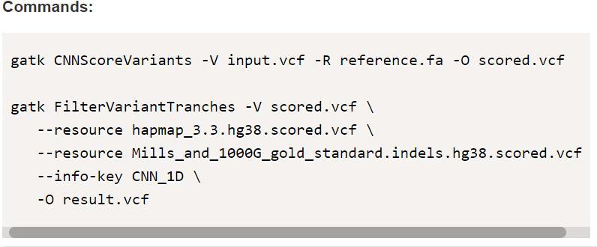
FilterVariantTranches. Resources.
https://gatk.broadinstitute.org/hc/en-us/community/posts/360056456092-FilterVariantTranches-User-error
b) the command used: gatk FilterVariantTranches -V vcf_cnn_annotated/TCGA-A2-A0ES_meig1_cnnAnno.vcf --resource hapmap_3.3.hg38.vcf.gz --resource Mills_and_1000G_gold_standard.indels.hg38.vcf.gz --info-key CNN_1D --snp-tranche 99.95 --indel-tranche 99.4 -O try/filtered3.vcf
https://www.biostars.org/p/452089/

Slide 18
hardFiltering
Parameter: germline_is_gene_panel
String SNP_DP = 6 /parametro = 10
String INDEL_DP = 32

Slide 19
Entendendo melhor os filtros
Hard-filtering germline short variants: https://gatk.broadinstitute.org/hc/en-us/articles/360035890471-Hard-filtering-germline-short-variants
(How to) Filter variants either with VQSR or by hard-filtering: https://gatk.broadinstitute.org/hc/en-us/articles/360035531112--How-to-Filter-variants-either-with-VQSR-or-by-hard-filtering
Hard-filtering germline short variants: https://gatk.broadinstitute.org/hc/en-us/articles/360035890471 , https://sites.google.com/a/broadinstitute.org/legacy-gatk-forum-discussions/methods-and-algorithms/6925-understanding-and-adapting-the-generic-hard-filtering-recommendations
I am unable to use VQSR (recalibration) to filter variants: https://gatk.broadinstitute.org/hc/en-us/articles/360037499012

Slide 20
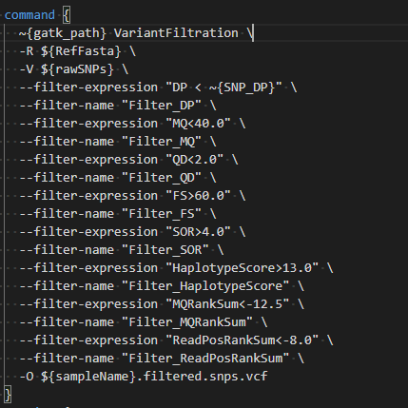
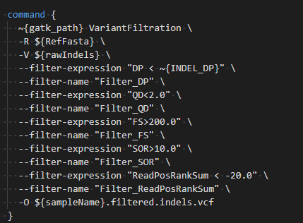
Hard Filtering Parameters
QualByDepth (QD)
FisherStrand (FS)
StrandOddsRatio (SOR)
RMSMappingQuality (MQ)
MappingQualityRankSumTest (MQRankSum)
ReadPosRankSumTest (ReadPosRankSum)
SNP_DP = 6
INDEL_DP = 32
hardFilterSNP
hardFilterIndel
Notes:
A saida sao ao menos que cumpla

Slide 21
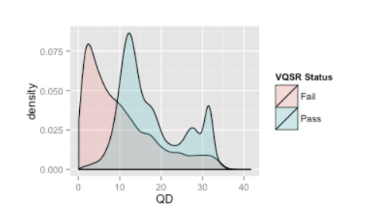
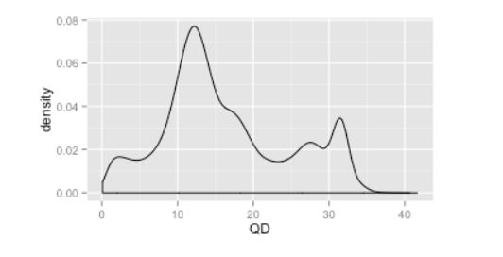
QualByDepth (QD): variant confidence (from the QUAL field) divided by the unfiltered depth of non-hom-ref samples. This annotation is intended to normalize the variant quality in order to avoid inflation caused when there is deep coverage. For filtering purposes it is better to use QD than either QUAL or DP directly.
QD is to filter out variants with QD below 2. Why is that?
QD values distribution for unfiltered variants
QD values for variants that passed VQSR and those that failed VQSR
https://gatk.broadinstitute.org/hc/en-us/articles/360035890471-Hard-filtering-germline-short-variants

Slide 22
FisherStrand (FS)
This is the Phred-scaled probability that there is strand bias at the site. Strand Bias tells us whether the alternate allele was seen more or less often on the forward or reverse strand than the reference allele. When there little to no strand bias at the site, the FS value will be close to 0.
Note: SB, SOR and FS are related but not the same! They all measure strand bias (a type of sequencing bias in which one DNA strand is favored over the other, which can result in incorrect evaluation of the amount of evidence observed for one allele vs. the other) in different ways. SB gives the raw counts of reads supporting each allele on the forward and reverse strand. FS is the result of using those counts in a Fisher's Exact Test. SOR is a related annotation that applies a different statistical test (using the SB counts) that is better for high coverage data.
Our hard filtering recommendations tell us to fail variants with an FS value greater than 60.

Slide 23
StrandOddsRatio (SOR)
This is another way to estimate strand bias using a test similar to the symmetric odds ratio test. SOR was created because FS tends to penalize variants that occur at the ends of exons. Reads at the ends of exons tend to only be covered by reads in one direction and FS gives those variants a bad score. SOR will take into account the ratios of reads that cover both alleles.
hard filtering recommendation of failing variants with an SOR value greater than 3

Slide 24
RMSMappingQuality (MQ)
This is the root mean square mapping quality over all the reads at the site. Instead of the average mapping quality of the site, this annotation gives the square root of the average of the squares of the mapping qualities at the site. It is meant to include the standard deviation of the mapping qualities. Including the standard deviation allows us to include the variation in the dataset. A low standard deviation means the values are all close to the mean, whereas a high standard deviation means the values are all far from the mean.
When the mapping qualities are good at a site, the MQ will be around 60.

Slide 25
MappingQualityRankSumTest (MQRankSum)
This is the u-based z-approximation from the Rank Sum Test for mapping qualities. It compares the mapping qualities of the reads supporting the reference allele and the alternate allele. A positive value means the mapping qualities of the reads supporting the alternate allele are higher than those supporting the reference allele; a negative value indicates the mapping qualities of the reference allele are higher than those supporting the alternate allele. A value close to zero is best and indicates little difference between the mapping qualities.
Remember, our hard filtering recommendations are meant to be very lenient. If you do plot your annotation values for your samples and find none of your variants have MQRankSum less than -12.5, you may want to refine your hard filters. Our recommendations are indeed recommendations that you the scientist will want to refine yourself.
It is up to you to decide how many false positives you would like to remove from your dataset vs how many true positives you would like to keep and adjust your threshold based on that.

Slide 26
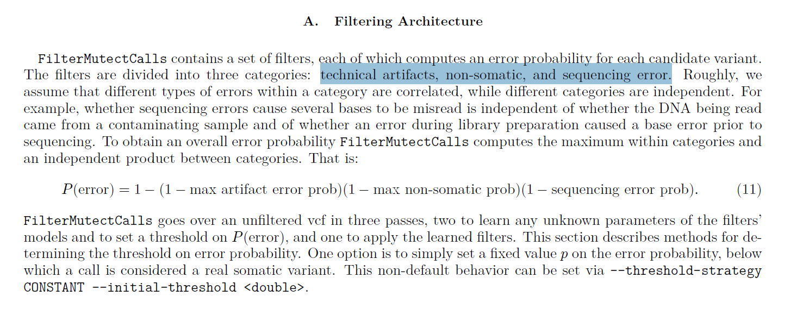
FilterMutectCalls
--autosomal-coverage | 0.0 | Median autosomal coverage for filtering potential polymporphic NuMTs when calling on mitochondria.
https://github.com/broadinstitute/gatk/blob/master/docs/mutect/mutect.pdf

Slide 27
FilterMutectCalls
https://github.com/broadinstitute/gatk/blob/master/docs/mutect/mutect.pdf

Slide 28
UPDATE
https://gatk.broadinstitute.org/hc/en-us/articles/360035531132--How-to-Call-somatic-mutations-using-GATK4-Mutect2

