Slide 1

Android Development
Chapter 4 – Designing your User Interface with Views
Notes:
https://www.google.com/design/spec/material-design/

Slide 2
Android Development Chapter 4 – Designing your User Interface with Views
ListView

Slide 3

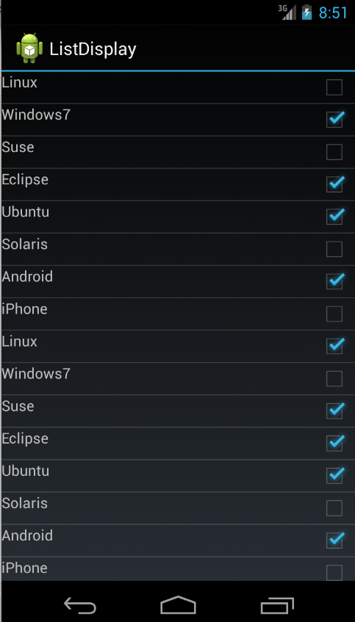
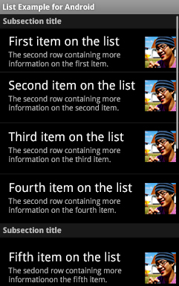
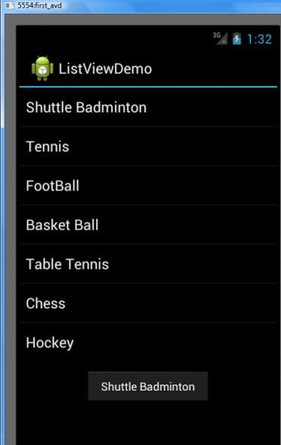
ListView
ListView is a view group that displays a list of scrollable items.
The list items are automatically inserted to the list using an Adapter that pulls content from a source such as an array or database query
It converts each item into a view that's placed into the list

Slide 4
Filling an adapter view with data
You can populate an AdapterView such as ListView or GridView by binding the AdapterView instance to an Adapter
It retrieves data from an external source and creates a View that represents each data entry.
Android provides several subclasses of Adapter that are useful for retrieving different kinds of data and building views for an AdapterView. The two most common adapters are:
ArrayAdapter
Use this adapter when your data source is an array.
By default, ArrayAdapter creates a view for each array item by calling toString() on each item and placing the contents in a TextView.
SimpleCursorAdapter
Use this adapter when your data comes from a Cursor (database query for example)

Slide 5
ListView
Step 1 – Create an Activity without a layout which inherits from ListActivity
public class MainActivity extends ListActivity {
@Override
protected void onCreate(Bundle savedInstanceState) {
super.onCreate(savedInstanceState);
// We don't need this (automatically generated)
// setContentView(R.layout.activity_main);
}
}

Slide 6
ListView
Step 2 – The data
Let’s create a simple array of strings with hobbies
public class MainActivity extends ListActivity {
private String[] hobbies = {
"Gaming",
"Programming",
"Jogging",
"Skating",
"Playing Guitar",
"Other"
};
// .....
}

Slide 7
The Adapter
Step 3 – Instantiating the an ArrayAdapter
For example, if you have an array of strings you want to display in a ListView, initialize a new ArrayAdapter using a constructor to specify the layout for each string and the string array
Check out http://developer.android.com/reference/android/widget/ArrayAdapter.html
simple_list_item_1 display a single item per line
private void pupulateListView() {
// Create an ArrayAdapter
ArrayAdapter<String> adapter = new ArrayAdapter<String>(this,
android.R.layout.simple_list_item_1, hobbies);
// ...
}

Slide 8
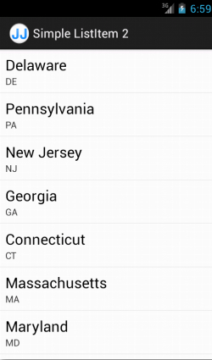
The Adapter
simple_list_item_1 display a single item per line
simple_list_item_2 displays 2 items per line
Cannot be used with standard ArrayAdapter

Slide 9
Setting the Adapter of the ListView
Step 4 – Set the adapter of the ListView to our adapter
private void pupulateListView() {
// Create an ArrayAdapter
ArrayAdapter<String> adapter = new ArrayAdapter<String>(this,
android.R.layout.simple_list_item_1, hobbies);
// Bind adapter to listview
this.setListAdapter(adapter);
// Or if you had another listview View (if this class would extend
// Activity instead of ListActivity)
// ListView listView = (ListView)findViewById(R.id.listview);
// listView.setAdapter(adapter);
}

Slide 10
Calling populate
Step 5 – Call the populate method
@Override
protected void onCreate(Bundle savedInstanceState) {
super.onCreate(savedInstanceState);
// We don't need this (automatically generated)
// setContentView(R.layout.activity_main);
// Populate the listview
pupulateListView();
}

Slide 11
Handling the onListItemClick event
Step 6 – When an item gets selected we generate Toast
Parameters
l: The ListView where the click happened
v: The view that was clicked within the ListView
position: The position of the view in the list
id: The row id of the item that was clicked
@Override
protected void onListItemClick(ListView l, View v, int position, long id) {
Toast.makeText(this, "You selected " + hobbies[position],
Toast.LENGTH_SHORT).show();
}

Slide 12
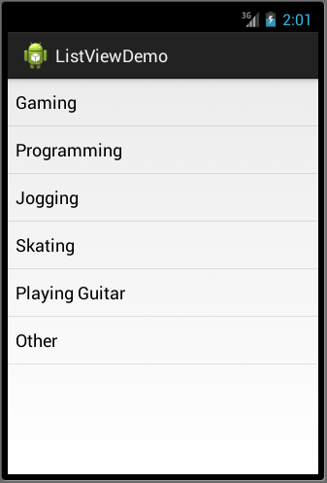
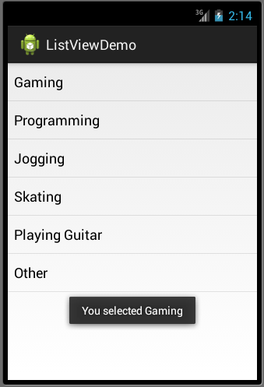
The End Result

Slide 13
Android Development Chapter 4 – Designing your User Interface with Views
Custom ListView

Slide 14
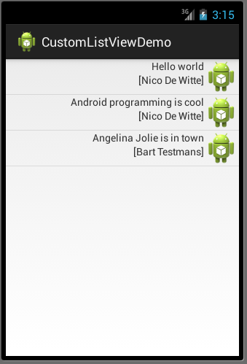
Our Goal
Creating a ListView with a custom view from a self-defined class

Slide 15
Our Self-Defined Class
Step 1 - Let’s create a Tweet class
package be.vives.nico.customlistviewdemo;
public class Tweet {
private String message;
private String sender;
public Tweet(String msg, String s) {
this.message = msg;
this.sender = s;
}
public String getMessage() { return this.message; }
public String getSender() { return this.sender; }
@Override
public String toString() {
return this.getMessage() + " - by " + this.getSender();
}
}

Slide 16
Creating the ListView Activity
Step 2 – Create an Activity without a layout which inherits from ListActivity
import android.app.ListActivity;
import android.os.Bundle;
public class MainActivity extends ListActivity {
@Override
protected void onCreate(Bundle savedInstanceState) {
super.onCreate(savedInstanceState);
}
}

Slide 17
Creating the Tweets
Step 3 – Create an array with some Tweet objects
public class MainActivity extends ListActivity {
private Tweet[] tweets = {
new Tweet("Hello world", "Nico De Witte"),
new Tweet("Android programming is cool", "Nico De Witte"),
new Tweet("Angelina Jolie is in town", "Bart Testmans")
};
// ...
}

Slide 18
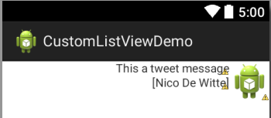
Creating a Tweet View
Step 4 – Define the View for a Tweet item in the List View
Create a tweet_view.xml in res/layout

Slide 19
Creating a Tweet View
<?xml version="1.0" encoding="utf-8"?>
<RelativeLayout xmlns:android="http://schemas.android.com/apk/res/android"
android:layout_width="match_parent"
android:layout_height="match_parent" >
<TextView
android:id="@+id/sender"
android:layout_width="wrap_content"
android:layout_height="wrap_content"
android:layout_alignRight="@+id/message"
android:layout_below="@+id/message"
android:text="[Nico De Witte]" />
<ImageView
android:id="@+id/image"
android:layout_width="wrap_content"
android:layout_height="wrap_content"
android:layout_alignParentRight="true"
android:layout_alignParentTop="true"
android:src="@drawable/ic_launcher" />
<TextView
android:id="@+id/message"
android:layout_width="wrap_content"
android:layout_height="wrap_content"
android:layout_alignParentTop="true"
android:layout_toLeftOf="@+id/imageView1"
android:text="This a tweet message" />
</RelativeLayout>

Slide 20
Creating a Custom Adapter Class
Step 5 – Create a custom adapter class
package be.vives.nico.customlistviewdemo;
import android.content.Context;
import android.view.LayoutInflater;
import android.view.View;
import android.view.ViewGroup;
import android.widget.ArrayAdapter;
import android.widget.TextView;
public class TweetArrayAdapter extends ArrayAdapter<Tweet> {
public TweetArrayAdapter(Context context, Tweet[] tweets) {
super(context, 0, tweets);
// Second param = resource id (we don't need to set this)
}
}

Slide 21
Creating a Custom Adapter Class
Step 5 – Create a custom adapter class
public class TweetArrayAdapter extends ArrayAdapter<Tweet> {
// ......
@Override
public View getView(int position, View convertView, ViewGroup parent) {
// Get the data item for this position
Tweet tweet = getItem(position);
// Check if an existing view is being reused, otherwise inflate the view
if (convertView == null) {
convertView = LayoutInflater.from(getContext()).inflate(
R.layout.tweet_view, parent, false);
}
// Populate the data into the template view using the data object
((TextView)convertView.findViewById(R.id.message)).setText(tweet.getMessage());
((TextView)convertView.findViewById(R.id.sender)).setText("[" + tweet.getSender() + "]");
// Return the completed view to render on screen
return convertView;
}
}
Notes:
LayoutInflater class is used to instantiate layout XML file into its corresponding View objects.
In other words, it takes as input an XML file and builds the View objects from it.

Slide 22
Setting the Adapter of the ListView
Step 6 – Set the adapter of the ListView to our custom adapter
private void populateTweets()
{
// Create custom Tweet adapter
ArrayAdapter<Tweet> adapter = new TweetArrayAdapter(this, tweets);
// Set the adapter for the ListView
this.setListAdapter(adapter);
}

Slide 23
Calling populate
Step 7 – Call the populate method
@Override
protected void onCreate(Bundle savedInstanceState) {
super.onCreate(savedInstanceState);
// We don't need this (automatically generated)
// setContentView(R.layout.activity_main);
// Populate the listview
pupulateTweets();
}

Slide 24
Handling the onListItemClick event
Step 8 – When an item gets selected we generate Toast
Parameters
l: The ListView where the click happened
v: The view that was clicked within the ListView
position: The position of the view in the list
id: The row id of the item that was clicked
@Override
protected void onListItemClick(ListView l, View v, int position, long id) {
Toast.makeText(this, "You selected " + tweets[position],
Toast.LENGTH_SHORT).show();
}

Slide 25
The End Result

Slide 26
Android Development Chapter 4 – Designing your User Interface with Views
Custom ListView with ArrayList

Slide 27
Replacing the Array with an ArrayList
If we wanted to change our array of tweets to an ArrayList of tweets we need to make a few alterations
Step 1 – Replace the tweets array with an ArrayList<Tweet>
private ArrayList<Tweet> tweets2;
@Override
protected void onCreate(Bundle savedInstanceState) {
super.onCreate(savedInstanceState);
tweets2 = new ArrayList<Tweet>();
tweets2.add(new Tweet("The world is all right", "Markske"));
tweets2.add(new Tweet("The world is all cool", "Jefrey"));
tweets2.add(new Tweet("Things are comming to an end", "Jackson"));
// Populate the listview
populateTweets();
}

Slide 28
Create a TweetArrayListAdapter
Step 2 – Create a new Adapter called TweetArrayListAdapter based on the TweetArrayAdapter
OLD CODE
public class TweetArrayAdapter extends ArrayAdapter<Tweet> {
public TweetArrayAdapter(Context context, Tweet[] tweets) {
super(context, 0, tweets);
}
@Override
public View getView(int position, View convertView, ViewGroup parent) {
// Get the data item for this position
Tweet tweet = getItem(position);
// .....
}
}

Slide 29
Create a TweetArrayListAdapter
Step 2 – Create a new Adapter called TweetArrayListAdapter based on the TweetArrayAdapter
NEW CODE
public class TweetArrayListAdapter extends ArrayAdapter<Tweet> {
public TweetArrayListAdapter(Context context, ArrayList<Tweet> tweets) {
super(context, 0, tweets);
}
@Override
public View getView(int position, View convertView, ViewGroup parent) {
// Get the data item for this position
Tweet tweet = getItem(position);
// ...
}
}

Slide 30
Setting the Adapter of the ListView
Step 3 – Create a TweetArrayListAdapter object for the ListView
private void populateTweets()
{
// Create custom Tweet adapter
//ArrayAdapter<Tweet> adapter = new TweetArrayAdapter(this, tweets);
ArrayAdapter<Tweet> adapter = new TweetArrayListAdapter(this, tweets2);
// Set the adapter for the ListView
this.setListAdapter(adapter);
}

Slide 31
Altering the click event handler
Step 4 – Alter the onListItemClick event handler to get the tweet from the ArrayList
@Override
protected void onListItemClick(ListView l, View v, int position, long id) {
//Toast.makeText(this, "You selected " + tweets[position],
Toast.LENGTH_SHORT).show();
Toast.makeText(this, "You selected " + tweets2.get(position),
Toast.LENGTH_SHORT).show();
}

Slide 32
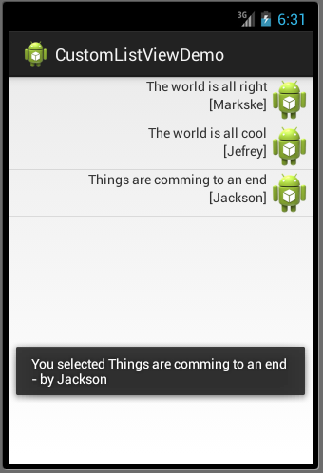
The End Result

