Slide 1

Android Development
Chapter 6 – Data Persistence
Lab Exercises

Slide 2
Assignment
Continue with the project you created last time (with the Target class, Target UI and ListView)
Download the DatabaseDemo project from Toledo and try it out
Next copy the following source files to your project
database/DbContract.java
database/DbHelper.java
database/TargetsDataSource.java
Edit the package names in the source files to match yours

Slide 3
Assignment
Add a button to your main activity which creates some demo targets in the database.
You can use the code below
public void createDemoTargets(View v) {
ArrayList<Target> demoList = new ArrayList<Target>();
demoList.add(new Target("http://www.google.be"));
demoList.add(new Target("http://www.labict.be"));
demoList.add(new Target("http://www.khbo.be"));
demoList.add(new Target("http://www.vives.be"));
demoList.add(new Target("http://www.example.be/fakesite"));
TargetsDataSource doa = new TargetsDataSource(this);
doa.open();
int successes = 0;
for (Target target : demoList) {
Target result = doa.insertTarget(target);
if (result != null) { successes++; }
}
doa.close();
if (successes == demoList.size()) {
Toast.makeText(this, "Created all new targets", Toast.LENGTH_SHORT).show();
} else {
Toast.makeText(this, "Created " + successes + " targets. " +
(demoList.size()-successes) + " failed to create.", Toast.LENGTH_LONG).show();
}
}

Slide 4
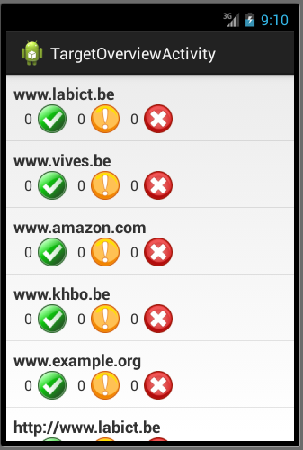
Assignment
Retrieve the targets to show in the ListView from the database
This should be done in the onCreate() method of the TargetOverviewActivity
Checkout the MainActivity of the Database Demo project

Slide 5

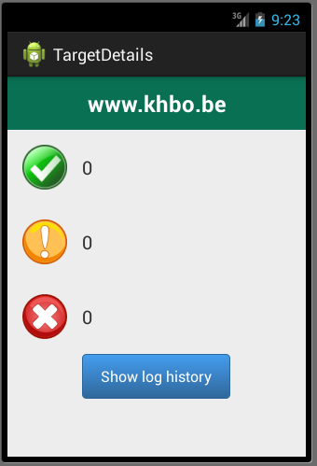
Assignment
Implement the onListItemClick event handler of the ListActivity to launch the detailed Target GUI you created in the previous exercise
Pass the id of the target that was clicked to the TargetDetails activity
This can be achieved using the setData() method of the Intent

Slide 6
Assignment
In the onCreate() method of the TargetDetails activity you should retrieve the target id of the Intent
Next retrieve the target with the specified id from the database
Populate the TargetDetails view with the values from the retrieved target

