Slide 1

Android Development
Chapter 4 – Designing your User Interface with Views
Lab Exercises

Slide 2
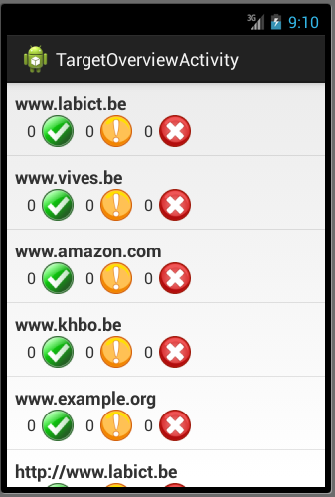
Assignment
Continue with the project you created last time (with the Target class and Target UI)
Create a custom ListActivity that display a ListView of an ArrayList of Target objects
Use your full imagination to create something like this

Slide 3
Assignment
Add an options menu to the ListActivity with the following options
Create Target
Refresh Targets
Delete All Targets
You do not have to supply an actual implementation for the click events, just display a Toast message for the moment
Add a context menu to the with the following options
Delete Target
Edit Target
You do not have to supply an actual implementation for the click events, just display a Toast message for the moment

Slide 4

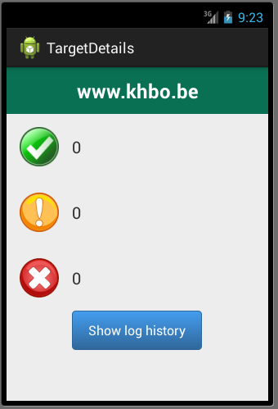
Assignment
Implement the onListItemClick event handler of the ListActivity to launch the detailed Target GUI you created in the previous exercise
You do not have to actually populate the details GUI for the moment, launching it is enoughW

