Slide 1

Android Development
Final Assignment 2015

Slide 2
Android Development
Final Assignment 2015
Part 1 - NeoPixel Control

Slide 3
Thumper RESTful Control
The final assignment for the Android course consist of building an Android application which controls the 6WD Thumper available in the LAB
The application should be able to control the NeoPixel LED-rings attached at the bottom exposed as a REST API
The application should be able to control the TRex motor controller to make the Thumper move. It is also exposes using a REST API
Basic requirements
User friendly
Good looking
Configurable
Error prone
Check all user input for errors

Slide 4
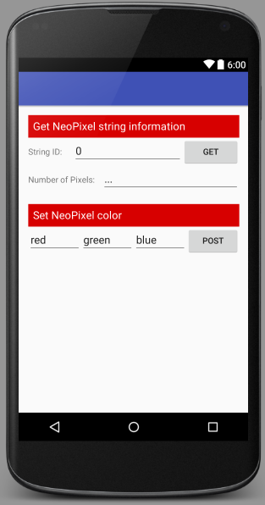
Thumper RESTful Control NeoPixel Control Activity
My example of the GUI
Make sure to create your own and be creative
Also make sure to check out the REST API documentation for other possible effects such as Strobe or Fade
Information on the REST API of the Thumper can be found on https://github.com/BioBoost/node_thumper_control
Make use of the Retrofit library to make requests to the REST API of the Thumper
Add at least one extra effect
The id of the NeoPixel string should not be entered by the user through the Activity but should be part of the application settings (see next slide)

Slide 5
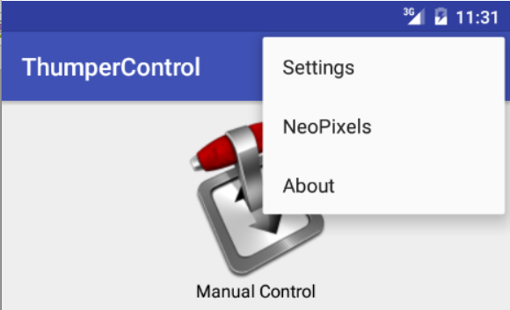
Thumper RESTful Control About Activity
Create a nice looking about activity with some information on the application
Describe the use of the application and who made it
The About activity should be invoked from the options menu added the main activity

Slide 6
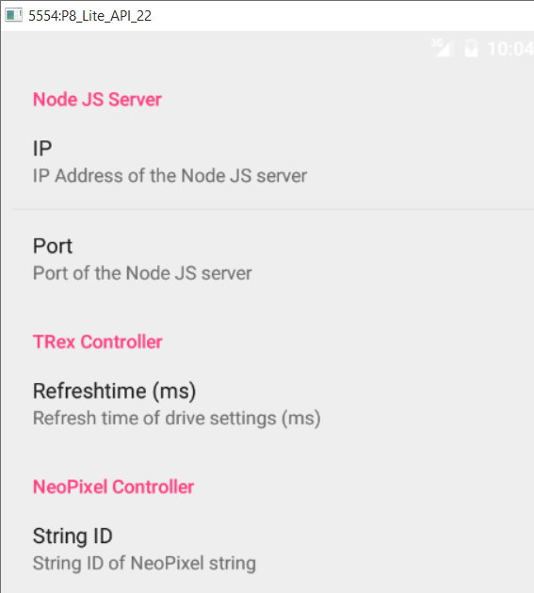
Thumper RESTful Control Settings Activity
Create an Application Settings Activity to host most configuration options of the application
This activity should be invoked from the options menu in the Main Activity
Some needed preferences are:
The IP address of the Thumper server
For the REST base_url
The port used for the Thumper server
For the REST base_url
The refresh time for the drive controls of the TRex controller
The NeoPixel string ID

Slide 7


Slide 8
Thumper RESTful Control
The Thumper drive control has a timeout of 500ms
This means that when drive is initiated and no command is received for 500ms, the TRex controller is automatically shut down
To take this into account you will need to make use of a timer to resend a drive command every x milliseconds
Do not make x overly small as it will flood the controller and crash the i2c bus
This parameter should be added to the application settings

