Slide 1

Android Development
Chapter 5 – Displaying Pictures and Menus with Views

Slide 2
Android Development Chapter 5 – Displaying Pictures and Menus with Views
Menus

Slide 3
Menus
Menus are useful for displaying additional options that are not directly visible on the main UI
There are two main types of menus in Android
Options menu
Displays information related to the current activity
You can activate the options menu by pressing the MENU button
Context menu
Displays information related to a particular view on an activity.
You can activate the context menu by tapping and holding on to an item (from example a ListView)

Slide 4
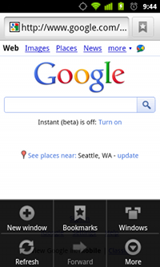
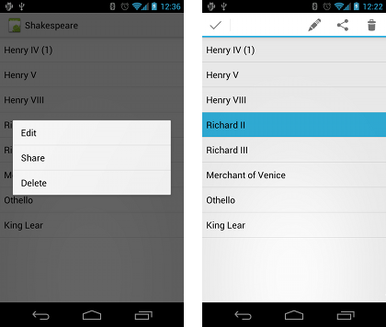
Menus
Options menu
Context menu

Slide 5
Android Development Chapter 5 – Displaying Pictures and Menus with Views
Creating an Options Menu

Slide 6
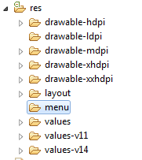
Creating a Resource Menu folder
Step 1 – Start by creating a res/menu folder
If you already haven’t got one

Slide 7
Creating the XML Menu Structure
Step 2 – Create the menu as an XML file (tweet_menu.xml) in res/menu
You can use the simple GUI wizard of eclipse to create it
<?xml version="1.0" encoding="utf-8"?>
<menu xmlns:android="http://schemas.android.com/apk/res/android" >
<item
android:id="@+id/create_tweet"
android:titleCondensed="Create"
android:title="Create Tweet"
android:icon="@drawable/ic_launcher" />
<item
android:id="@+id/refresh_tweets"
android:titleCondensed="Refresh"
android:title="Refresh Tweets"
android:icon="@drawable/ic_launcher" />
</menu>

Slide 8
Inflating the Menu
Step 3 – Override the onCreateOptionsMenu() method inside the ListActivity
We keep building on the custom Tweet list activity
public class MainActivity extends ListActivity {
// ...
@Override
public boolean onCreateOptionsMenu(Menu menu) {
MenuInflater inflater = getMenuInflater();
inflater.inflate(R.menu.tweet_menu, menu);
return true;
}
}

Slide 9
Handling the Menu Click Events
Step 4 – Handle the menu click events
Needs to be done in the onOptionsItemSelected () method
@Override
public boolean onOptionsItemSelected(MenuItem item) {
// Handle item selection
switch (item.getItemId()) {
case R.id.create_tweet:
Toast.makeText(this, "Create new tweet",
Toast.LENGTH_SHORT).show();
return true;
case R.id.refresh_tweets:
Toast.makeText(this, "Refresh tweets",
Toast.LENGTH_SHORT).show();
return true;
default:
return super.onOptionsItemSelected(item);
}
}

Slide 10
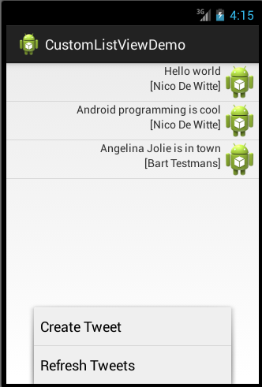
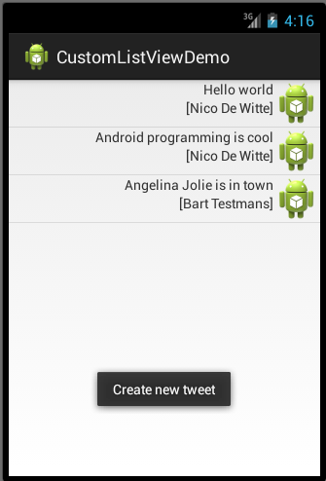
The End Result

Slide 11
Android Development Chapter 5 – Displaying Pictures and Menus with Views
Creating a Context Menu

Slide 12
Creating a Resource Menu folder
Step 1 – Start by creating a res/menu folder
If you already haven’t got one

Slide 13
Creating the XML Menu Structure
Step 2 – Create the menu as an XML file (tweet_context_menu.xml) in res/menu
You can use the simple GUI wizard of eclipse to create it
<?xml version="1.0" encoding="utf-8"?>
<menu xmlns:android="http://schemas.android.com/apk/res/android" >
<item
android:id="@+id/delete_tweet"
android:titleCondensed="Delete"
android:title="Delete Tweet" />
<item
android:id="@+id/edit_tweet"
android:titleCondensed="Edit"
android:title="Edit Tweet" />
</menu>

Slide 14
Inflating the Menu
Step 3 – Override the onCreateContextMenu () method inside the ListActivity
We keep building on the custom Tweet list activity
public class MainActivity extends ListActivity {
// ...
@Override
public void onCreateContextMenu(ContextMenu menu,
View v, ContextMenuInfo menuInfo) {
super.onCreateContextMenu(menu, v, menuInfo);
MenuInflater inflater = getMenuInflater();
inflater.inflate(R.menu.tweet_context_menu, menu);
}
}

Slide 15
Inflating the Menu
Step 4 – Register the context menu for the ListView object
@Override
protected void onCreate(Bundle savedInstanceState) {
super.onCreate(savedInstanceState);
// ...
// Register context menu for listview
registerForContextMenu(this.getListView());
// ...
}

Slide 16
Handling the Menu Click Events
Step 5 – Handle the menu click events
Needs to be done in the onContextItemSelected() method
@Override
public boolean onContextItemSelected(MenuItem item) {
// Get info on selected item
AdapterContextMenuInfo info = (AdapterContextMenuInfo) item.getMenuInfo();
switch (item.getItemId()) {
case R.id.delete_tweet:
Toast.makeText(this, "Deleting tweet " + info.id,
Toast.LENGTH_SHORT).show();
return true;
case R.id.edit_tweet:
Toast.makeText(this, "Editing tweet " + info.id,
Toast.LENGTH_SHORT).show();
return true;
default:
return super.onContextItemSelected(item);
}
}

Slide 17
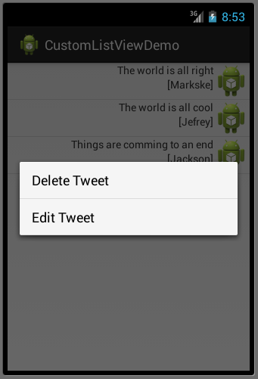
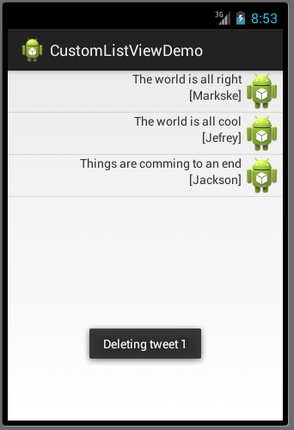
The End Result

