Slide 1

Android Development
Final Assignment 2015

Slide 2
Android Development
Final Assignment 2015
Part 2 - Thumper Control

Slide 3
Thumper RESTful Control
The final assignment for the Android course consist of building an Android application which controls the 6WD Thumper available in the LAB
The application should be able to control the NeoPixel LED-rings attached at the bottom exposed as a REST API
The application should be able to control the TRex motor controller to make the Thumper move. It is also exposes using a REST API
Basic requirements
User friendly
Good looking
Configurable
Error prone
Check all user input for errors

Slide 4
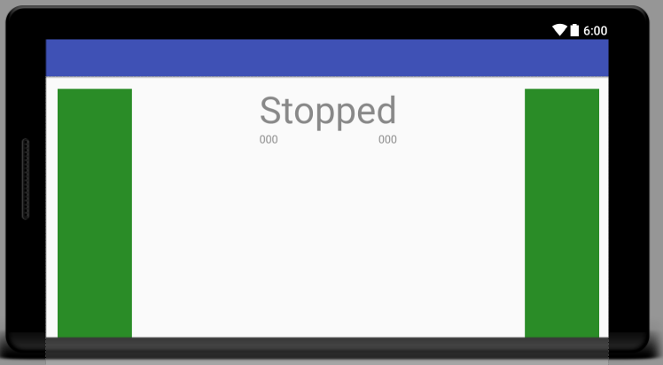
Thumper RESTful Control Thumper Control Activity
Create a separate activity to control the Thumper's movement
Start from 'ManualControlActivity.java' as a base for the actual control
Can be found @ Toledo
Implements multi-touch control to drive the Thumper as it were a tank
Make sure to check out the REST API documentation
https://github.com/BioBoost/node_thumper_control
Make use of the Retrofit library to make requests to the REST API of the Thumper to control it's speed and direction
Create a nice looking layout for the control activity
My Example:
Not so nice looking !

Slide 5
Thumper RESTful Control Thumper Control Activity
The Thumper drive control has a timeout of 250ms
This means that when drive is initiated and no command is received for 250ms, the TRex controller is automatically shut down
This has been handled by using a Runnable object that is executed every x milliseconds
You task is to make it send the actual commands to the Thumper
Make sure to display the voltage of the battery
See github docs (speed URI return battery_voltage)
Inherit from StatusReport ⬅ ThumperStatusReport and add attribute battery_voltage
Fix code where needed
Add View to GUI and update after setting speed of Trex
Download latest node app from Github !

Slide 6
Thumper RESTful Control
The application should be available in both Dutch and English
Full translation of values/strings.xml
So no hardcoded strings in code ANYWHERE !!

Slide 7
Some optional additions
Can give you extra credits
Pan and Tils for controlling the Thumper
Best to create separate activity for this
You can start from the example app @ Toledo
NeoPixel effects while driving
NeoPixel slider control
Sliders to control red, green and blue
Battery warning
SMS, Alarm, Vibrate

Slide 8
Thumper RESTful Control
Some reminders
Make sure your code is documented
Don't use hardcoded strings
Allow the user to configure the application
server IP and port
TRex timeout (now 250ms, may change later)
Battery alarm level (typically 6.8V)
…
Make the user interface nice and intuitive
Test the app thoroughly

