Slide 1

Android Development
Chapter 1 – Getting Started with Android Programming

Slide 2

Beginning Android 4 Application Development
Amazon.co.uk
http://www.amazon.co.uk/Beginning-Android-4-Application-Development/dp/1118199545/ref=pd_sim_b_2?ie=UTF8&refRID=0HCW1DQQPYNSVQ3A53D8
Bol.com
http://www.bol.com/nl/p/beginning-android-4-application-development/1001004011690816/

Slide 3
Android Development Chapter 1 – Getting Started with Android Programming
Android and its history

Slide 4
Android – The Mobile Operating System
Android is a mobile operating system
Based on the Linux kernel (version 2.6)
Originally developed by a startup company called Android inc.
Bought by Google in 2005
Released under the open source Apache License
Manufacturer’s such as Motorola and Sony Ericsson saw Android as a replacement for their own mobile OS’s
Main advantage is that Android offers a unified approach to application development
Developers only need to develop for Android and their app should run on numerous Android devices

Slide 5
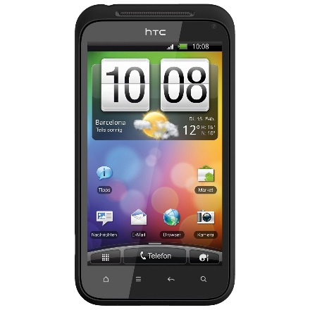
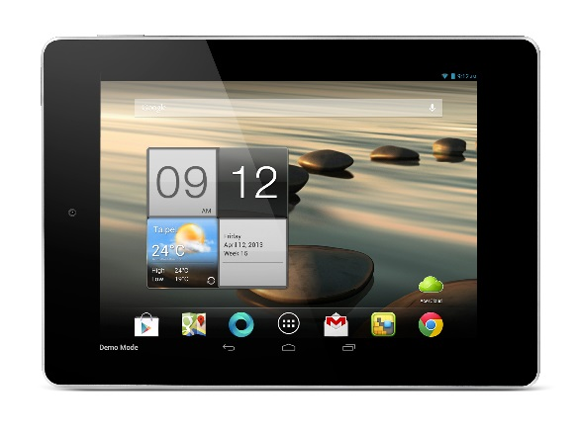
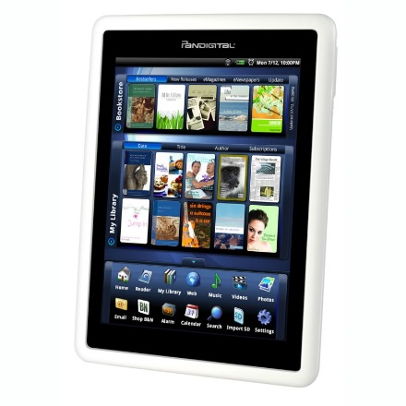
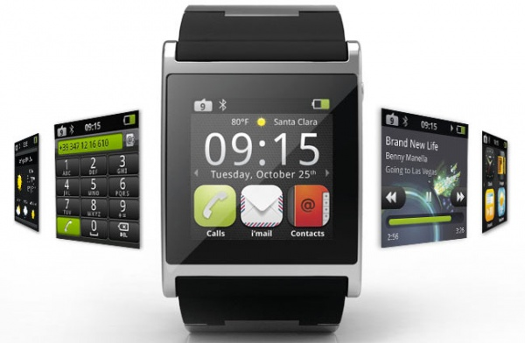
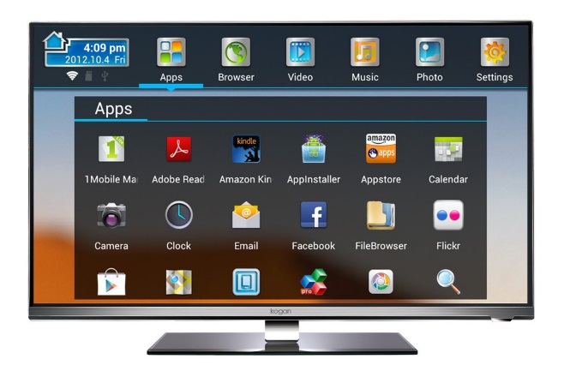
Android Devices
Smartphones
Tablets
e-book readers
Watches
TVs

Slide 6
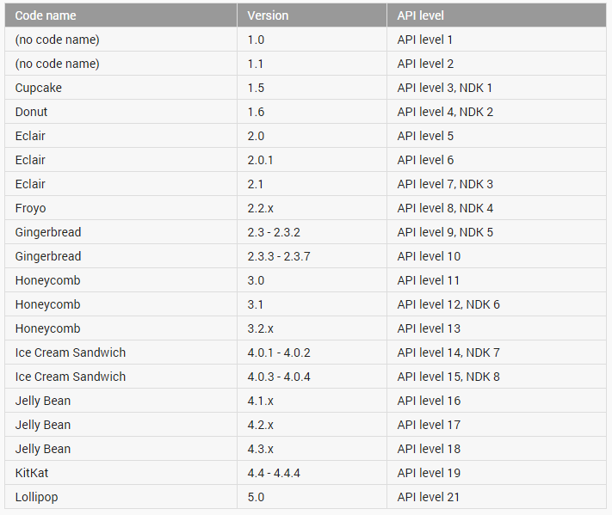
Android Versions

Slide 7
Android Versions - Milestones
Android 1.6, Donut
The world's information is at your fingertips – search the web, get driving directions... or just watch cat videos.
Android 2.0, Eclair
Make your home screen just how you want it. Arrange apps and widgets across multiple screens and in folders. Stunning live wallpapers respond to your touch.
Android 2.2, Froyo
Voice Typing lets you input text, and Voice Actions let you control your phone, just by speaking.
Android 2.3, Gingerbread
New sensors make Android great for gaming - so you can touch, tap, tilt, and play away.

Slide 8
Android Versions - Milestones
Android 3.0, Honeycomb
Optimized for tablets
New UI, refined multitasking, tabbed browsing, auto fill form, bookmark synchronization, private browsing, ...
New features are not supported on smartphones
Android 4.0, Ice Cream Sandwich
Android comes of age with a new, refined design. Simple, beautiful and beyond smart.
All 3.0 features are supported on smartphones as well

Slide 9
Android Versions - Milestones
Android 4.1, Jelly Bean
Android is fast and smooth with buttery graphics. With Google Now, you get just the right information at the right time.
With more than 1 million apps on Google Play, and thousands of Android devices, you've got the freedom to do what you want on any device you choose.
Android 4.4, KitKat
Smart, simple, and truly yours. A more polished design, improved performance, and new features.
New features introduced such as facial recognition unlock, data usage monitoring and control, Near Field Communication (NFC)

Slide 10
Android Versions - Milestones
Android 5.0, Lollipop
A sweet new take on Android. Get the smarts of Android on screens big and small – with the right information at the right moment.
Notification control, better battery management, security, device sharing, support for TVs, ...
Released November the 3th (2014)

Slide 11
Android Features
Because Android is open source and freely available to manufacturers for customization, there are no fixed hardware or software configurations. However, Android itself supports the following features:
Storage - Uses SQLite, a lightweight relational database, for data storage.
Connectivity - Supports GSM/EDGE, IDEN, CDMA, EV-DO, UMTS, Bluetooth (includes A2DP and AVRCP), Wi-Fi, LTE, and WiMAX.
Messaging - Supports both SMS and MMS.
Web browser - Based on the open source WebKit, together with Chrome’s V8 JavaScript engine
Media support - Includes support for the following media: H.263, H.264 (in 3GP or MP4 container), MPEG-4 SP, AMR, AMR-WB (in 3GP container), AAC, HE-AAC (in MP4 or 3GP container), MP3, MIDI, Ogg Vorbis, WAV, JPEG, PNG, GIF, and BMP
Hardware support - Accelerometer Sensor, Camera, Digital Compass, Proximity Sensor, and GPS
Multi-touch - Supports multi-touch screens
Multi-tasking - Supports multi-tasking applications
Flash support - Android 2.3 supports Flash 10.1.
Tethering - Supports sharing of Internet connections as a wired/wireless hotspot

Slide 12
Android Development Chapter 1 – Getting Started with Android Programming
Android Architecture

Slide 13
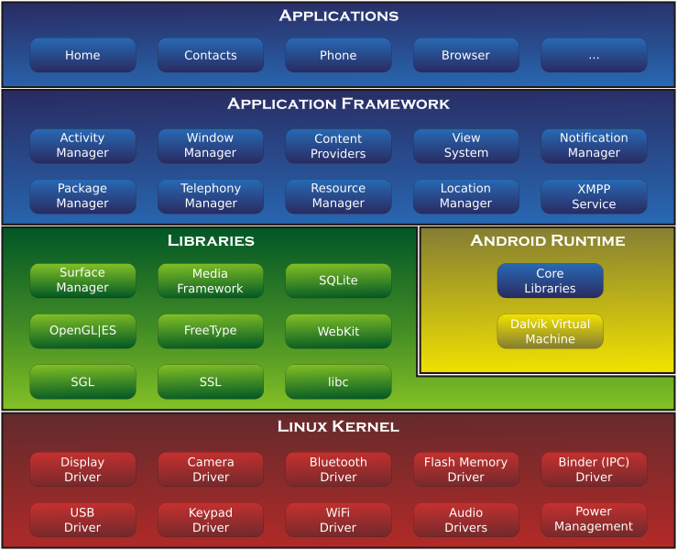
Android Architecture

Slide 14
Linux Kernel
Android is build on top of the Linux 2.6 kernel
Linux core functionality
Memory management
Process management
Networking
Security settings
Low-level device drivers for various hardware components of an Android device

Slide 15
Libraries
Contain all the code that provides the main features of an Android OS.
Examples:
SQLite library provides database support so that applications can use it for data storage
WebKit library provides functionalities for web browsing
Libc: c standard lib.
SSL: Secure Socket Layer
SGL: 2D image engine
OpenGL|ES: 3D image engine
Media Framework: media codecs
FreeType: Bitmap and Vector
SurfaceManager: Compose window manager with off-screen buffering

Slide 16
Android Runtime
Core Libraries
Provides the functionality of the JAVA Programming Language
Dalvik VM
A type of Java Virtual Machine
Register based (not stack machine like JVM)
Optimization for low memory requirements
Executes .dex (Dalvik-Executable) files instead of .class
Android application (APK) files contain executable bytecode files in the form of Dalvik Executable (DEX) files, which contain the compiled code used to run your app.
DX tool converts classes to .dex format
Each Android application:
runs on its own Process
runs on its own Instance of Dalvik VM
is assigned its own Linux user ID

Slide 17
Application Framework
Exposes the various capabilities of the Android OS to application developers so they can be used in their apps
Important blocks:
Activity Manager: Manages the activity life cycle of applications
Content Providers: Manage the data sharing between applications
Telephony Manager: Manages all voice calls. We use telephony manager if we want to access voice calls in our application.
Location Manager: Location management, using GPS or cell tower
Resource Manager: Manage the various types of resources we use in our Application

Slide 18
Applications
This is where our applications are placed.
Some pre-installed applications:
SMS client app
Dialer
Web browser
Contact manager
...
As developers, we are able to write an app which replaces any existing system app.
No compulsory applications
Equality among apps
Easily embedded web browser
Parallel running

Slide 19
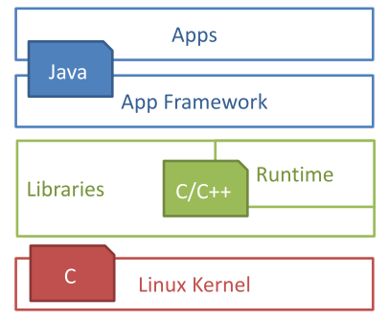
Used languages
Design goals
Open Source
High flexibility
High data accessibility
Rapid development (XML, Java)
Used Languages
App: Java
Framework: Java
Libraries: C/C++
OS & Drivers: C

Slide 20
Android Development Chapter 1 – Getting Started with Android Programming
Developing for Android

Slide 21
The Long Way
Using Eclipse with the official Android Developers Tools (ADT) plugin and the Android Virtual Device Manager
For this you will need
Java SE Development Kit (JDK) which can be downloaded @ http://www.oracle.com/technetwork/java/javase/downloads/index.html
Download the latest JDK
Android SDK: contains android.jar with all needed classes to build an app, together with docs, samples, tools (adb), usb_driver (to allow deployment to your device and live debugging)
Eclipse IDE: free IDE used for Java, C++, ...
Android Development Tools (ADT): the Eclipse plugin which enables the use of the Android SDK

Slide 22
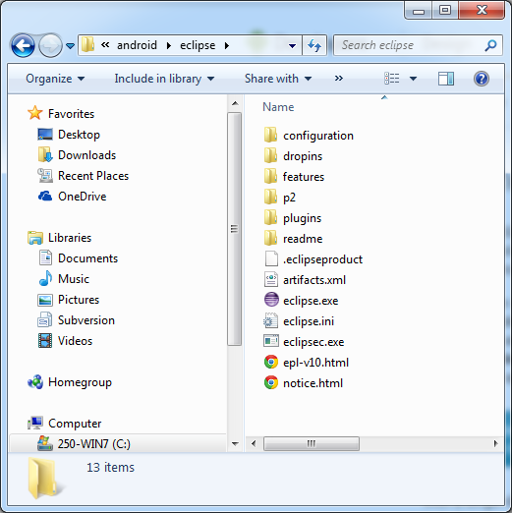
The Easy Way
Just download the all-in-one bundle containing everything you need from https://developer.android.com/sdk/index.html
After agreeing to the license and choosing the correct architecture (32-bit or 64-bit) your download should start. Create a directory called “android” on your C-drive (or D-drive) and copy the zip-file there. Extract it and traverse to the eclipse directory. You can now run the eclipse executable.

Slide 23
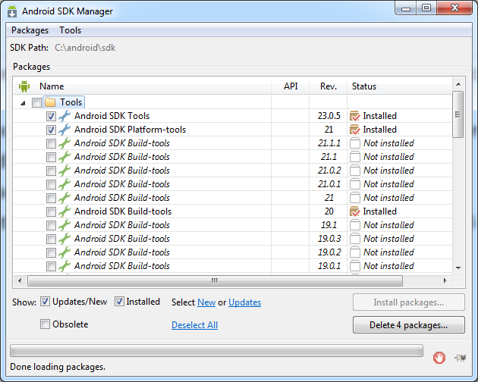
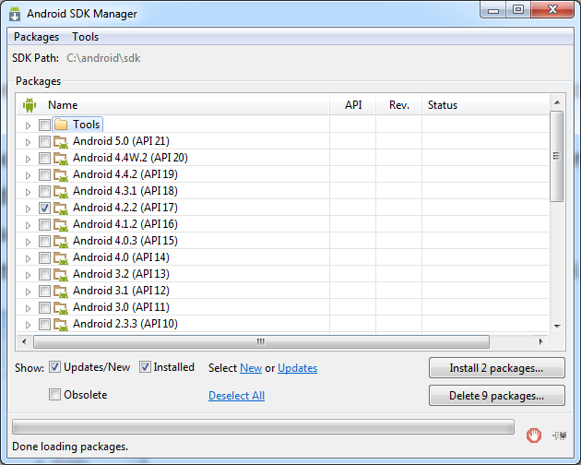
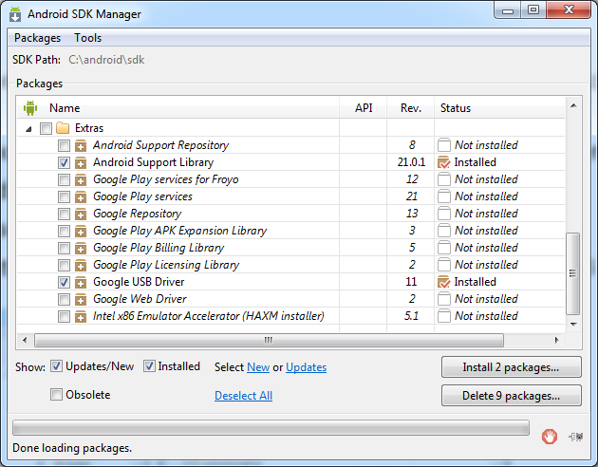
The Android SDK Manager
Launch the SDK manager (C:\android\SDK Manager.exe) or via Eclipse Window menu
Check “Tools\Android SDK Tools” and “Tools\Android SDK Platform-tools”
Check Android 4.2.2 (API17)
Don’t select Android 5.0
Check “Extras\Android Support Library” and “Extras\Google USB Driver”

Slide 24
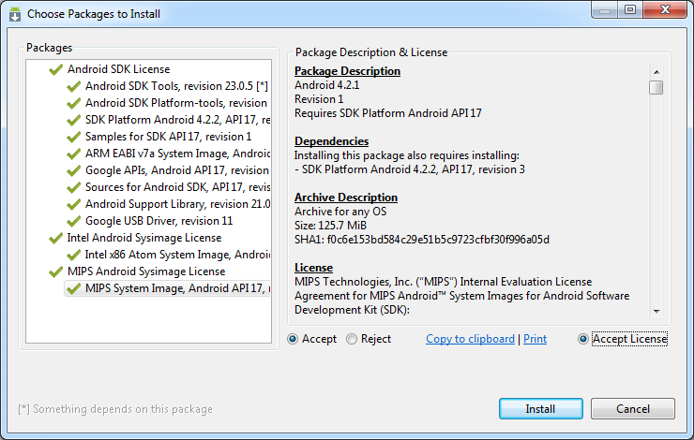
The Android SDK Manager
Make sure to accept ALL licenses
All components should have a green checkmark
Restart Eclipse after the installation finished (important !)

Slide 25
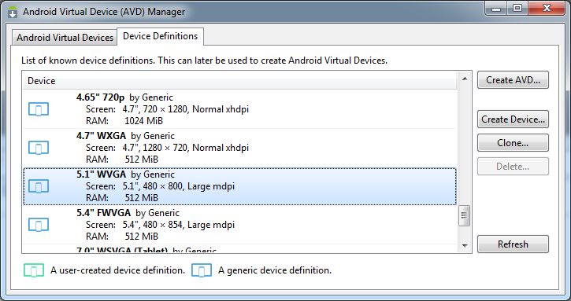
Creating an Android Virtual Device (AVD)
Android applications may be run on a real device or on the Android Emulator, which ships with the Android SDK.
In Eclipse navigate to Window => Android Virtual Device Manager
Open the second tab (Device Definitions) and select the ‘5.1” WVGA’

Slide 26
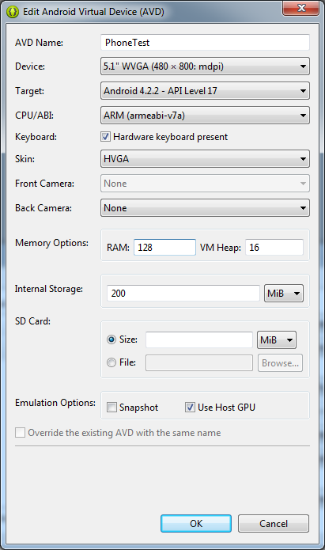
Creating an Android Virtual Device (AVD)
Click “Create AVD”
Give it a name
Choose “Android 4.2.2 – API Level 17” as target
Choose an ARM CPU
Select HVGA as skin
Memory should be set to 128
Make sure to check “Use Host GPU”

Slide 27
Android Development Chapter 1 – Getting Started with Android Programming
Your First Android Application

Slide 28
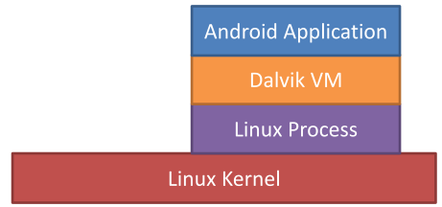
Application Fundamentals
Development Language
Java
Android SDK tools compile the code into an Android package, an archive file with an .apk suffix
Security sandbox
Each application has a unique Linux user ID
Each process has its own virtual machine (VM)
Every application runs in its own Linux process
Principle of least privilege
Each application, has access only to the components that it requires to do its work and no more.

Slide 29
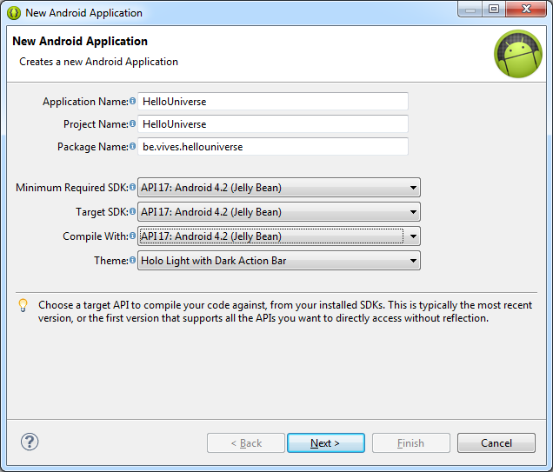
Create a Hello Universe Application
Select File => New Android Project
Give your project a name
Also set the Package name
Make sure to select “API level 17” for all SDK versions

Slide 30
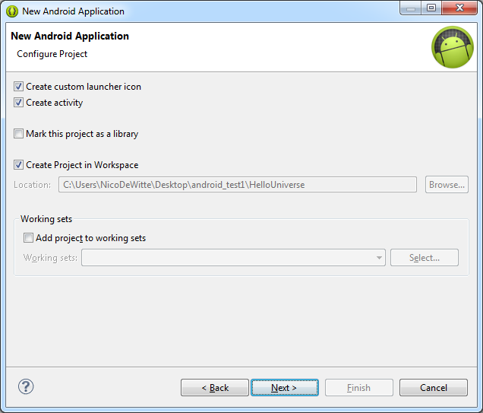
Create a Hello Universe Application

Slide 31
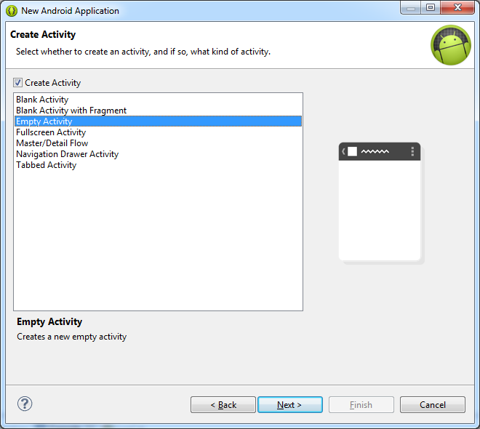
Create a Hello Universe Application
Create an empty activity

Slide 32
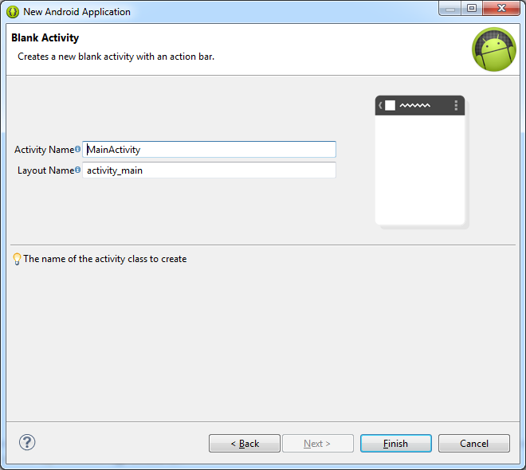
Create a Hello Universe Application

Slide 33
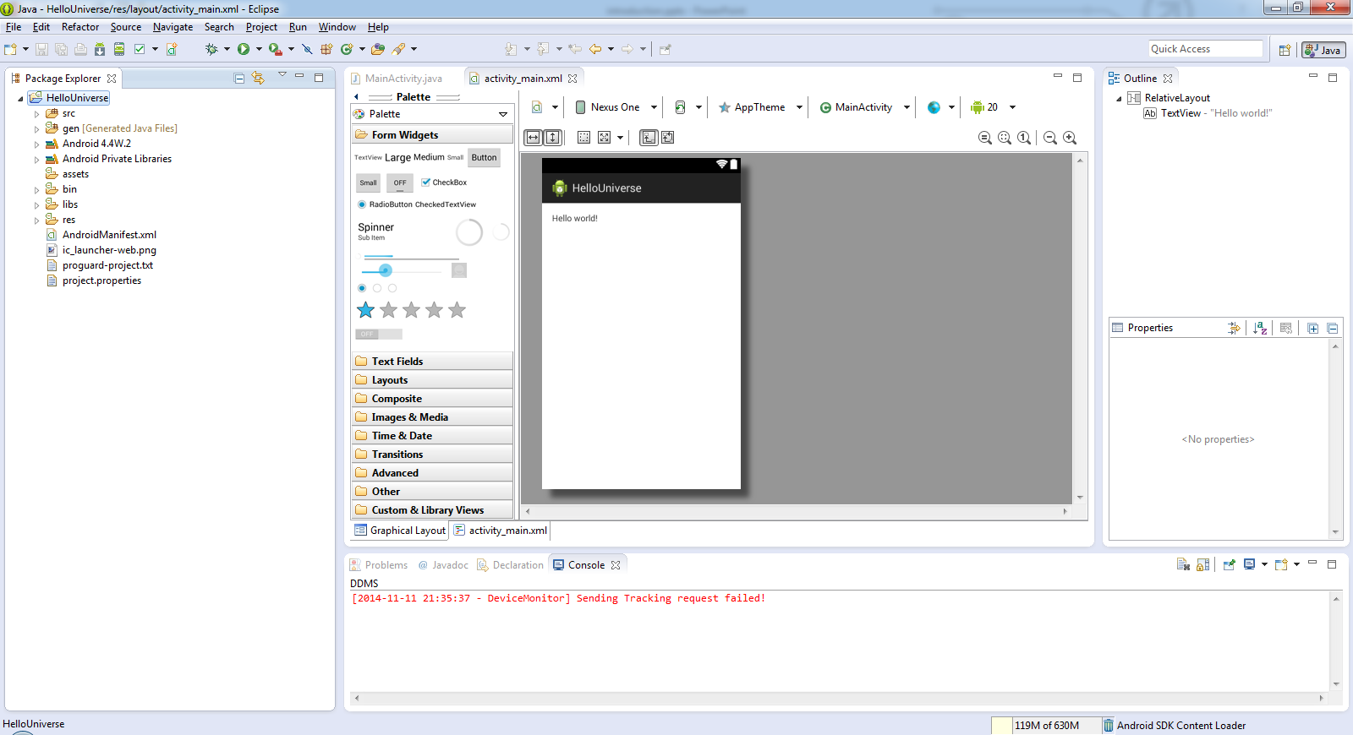
Result

Slide 34
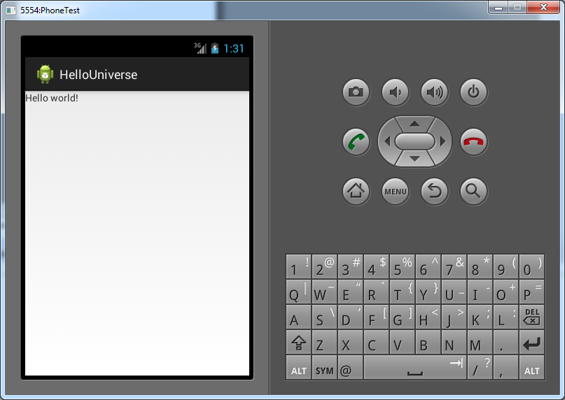
Running the Application
Right click on the project directory in Eclipse and choose “Run as => Android Application”
It takes some time for your emulator to start !

Slide 35
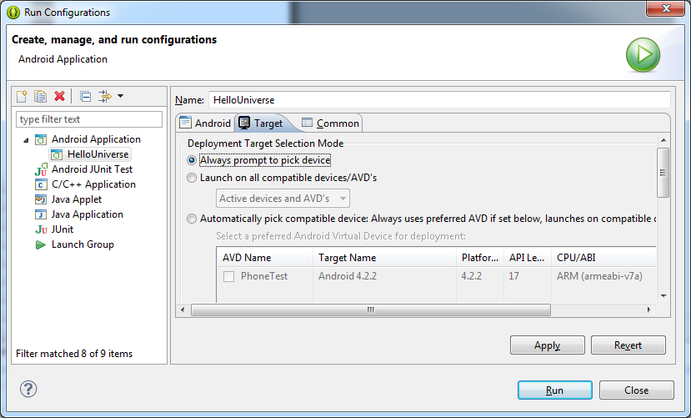
Multiple AVDs
If you have multiple AVDs or also develop for a physical machine you should enable selection of the run device
Click the dropdown icon on the “Run as” icon at the top of eclipse and choose “Run configurations”
Select the “Target” tab
Select “Always prompt to pick device”
Hit Apply and Close

Slide 36
Deploying on a Real Device
To deploy or test your application on a real android device you will need to connect the device to your development machine via USB
Next you will need to enable USB debugging
Can mostly be found under Settings/Developers or Settings/Applications
Next you need a USB driver for your Android device on your host machine
Check out http://developer.android.com/tools/extras/oem-usb.html#Drivers
When selecting the “Run as” options from Eclipse select the physical device instead of an AVD

Slide 37
Anatomy of an Android Application
src
Contains the java source code files.
gen
Contains R.java, a compiler generated file that references all the resources found in your project.
Do not change anything in these files !
Android 4.x
The Android library. Contains a single jar file with class libraries needed for an Android application.
assets
Contains all the assets used by the application (HTML, Databases, text files)

Slide 38
Anatomy of an Android Application
bin
Contains the files built by the ADT (Android Development Tools) during the build process. Your application binary can be found here (*.apk)
res
Contains all the resource files used in the application such as images (multiple resolutions), GUI layout and string literals (selection based on users locale)
In computing, a locale is a set of parameters that defines the user's language, country and any special variant preferences that the user wants to see in their user interface. Usually a locale identifier consists of at least a language identifier and a region identifier.

Slide 39
Anatomy of an Android Application
res/layout/*.xml
Defines the user interface for your activities.
Note the line:
@string refers to the resource string.xml file located in the res/values folder. "hello_world" is the id of the string defined in that file. In other words this is a reference to the string value "Hello World“ defined as:
All your strings should be constructed this way. NO HARDCODED values.
Allows us to easily add support for other languages without to much effort
Just copy the values folder as “values-<language_code>” and modify the values of strings.xml
android:text="@string/hello_world"c
<string name="hello_world">Hello World</string>

Slide 40
Anatomy of an Android Application
AndroidManifest.xml
This is the manifest file for the application. Here you can specify permissions needed by the application, as well as others features such as intent-filters (events), receivers, ...
The manifest file contains
The name of the package
The version number of the application
The minimal SDK version required to run the application
The targeted SDK version
The icon used for the application (can be found in res/drawable)
The entry point of the application, defined inside an intent-filter. This defines how to application can be started and what the entry point is.

Slide 41
Anatomy of an Android Application
src/<package_path>/Main_Activity.java
The code in the onCreate() method connects the GUI to your application using
More on this later ...
public class MainActivity extends Activity {
@Override
protected void onCreate(Bundle savedInstanceState) {
super.onCreate(savedInstanceState);
setContentView(R.layout.activity_main);
}
}
setContentView(R.layout.activity_main);

Slide 42
Android Development Chapter 1 – Getting Started with Android Programming
Exercise – Application Locales

Slide 43
Exercise – Application Locales
Copy the values folder as “values-nl”
Change the hello_world string value to “Hallo Wereld!”
Deploy the application
Set the emulator device to “Dutch”
More info in the LAB

Slide 44
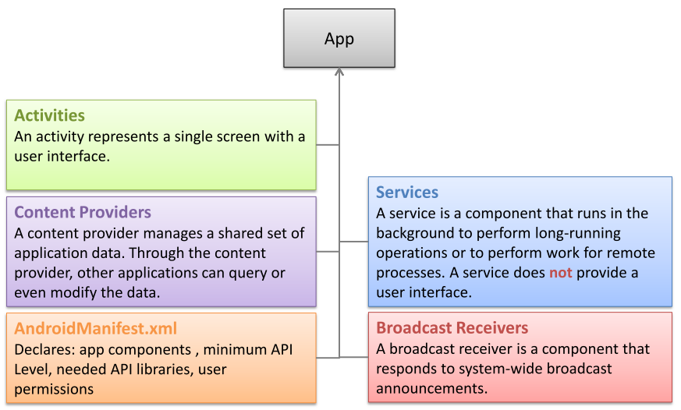
Application Components

Slide 45
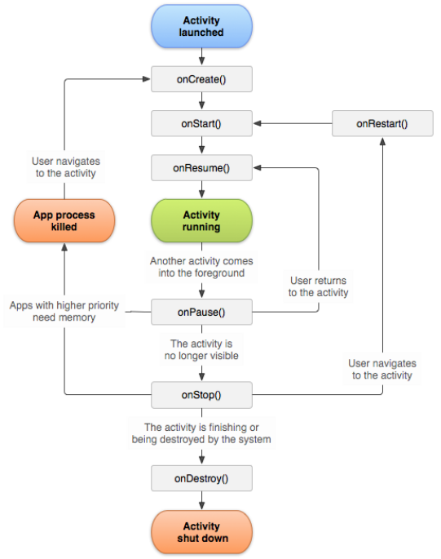
Activity Lifecycle

Slide 46
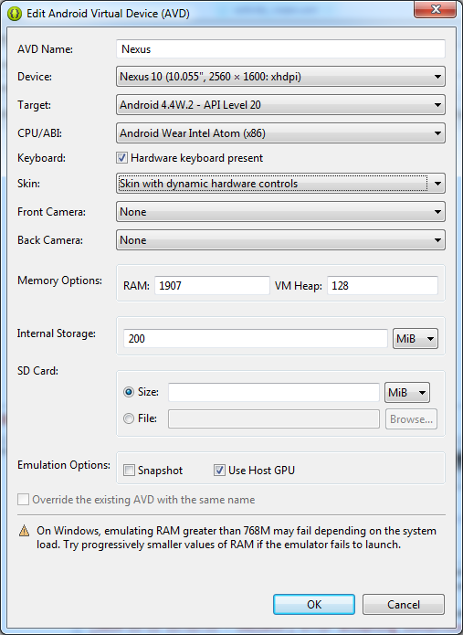
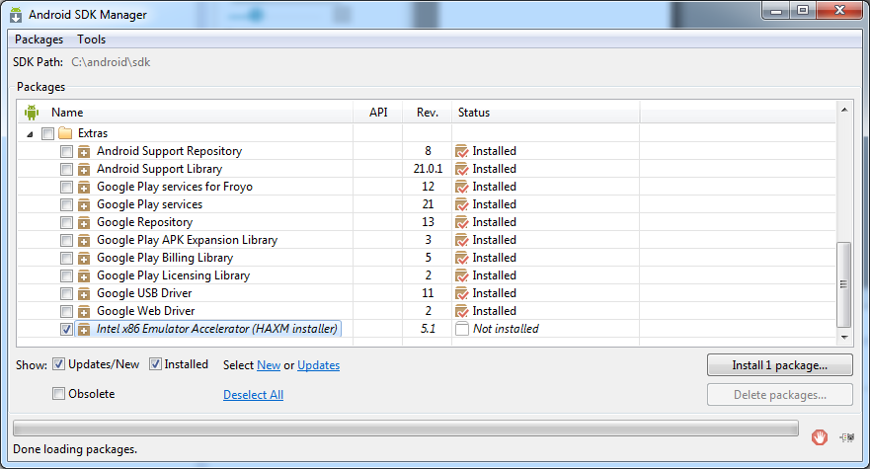
Fixing the Slow Emulator
https://www.infinum.co/the-capsized-eight/articles/is-your-android-emulator-just-too-slow
Enable host GPU usage in AVD
Install x86 Emulator Accelerator

Slide 47
Fixing the Slow Emulator
Traverse to C:\android\sdk\extras\intel\Hardware_Accelerated_Execution_Manager
Execute the installer and follow instructions
Implication:
Google API not available for Intel based platform

Slide 48
The ADB (Android Debug Bridge)
The ADB utility lets you connect to the phone itself and issue rudimentary shell commands, such as copying files to and from the device.
TODO

