Slide 1

Android Development
Chapter 2 – Activities, Fragments and Intents

Slide 2
Android Development Chapter 2 – Activities, Fragments and Intents
Activities

Slide 3
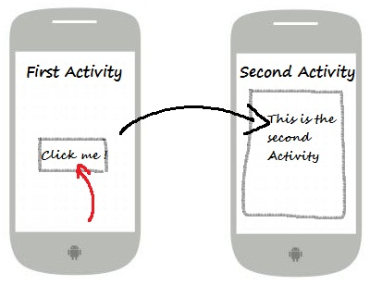
Activities
An activity is a window that contains the user interface of your application
An application can have any number of activities
Main purpose is user interaction

Slide 4
Creating a new Activity
To create a new activity in Eclipse all you need to do is go to
Choose one of the templates and give the activity a name
Good practice to add the suffix “Activity” to the name
You will find the following new files
src/<package_path>/.....Activity.java
Which is your Java class file for this new activity
res/layout/activity_......xml
Which is the layout of the activity’s UI
File => New => Other => Android => Android Activity

Slide 5
Android Development Chapter 3 – Getting to know the Android User Interface
Application and Activity Templates

Slide 6
Application Templates
Application templates create basic Android applications that you can immediately run and test on your Android device.
These templates are available when you create a new Android project, though you can also use these templates to add new activities to an existing project.
We’ll take a quick look at
BlankActivity
FullScreenActivity
MasterDetailFlow
The other activity template options also create applications, however these applications require further modification before they can be launched on an Android device.

Slide 7
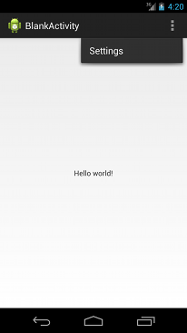
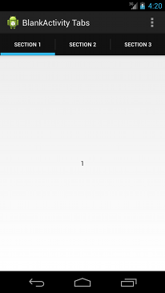
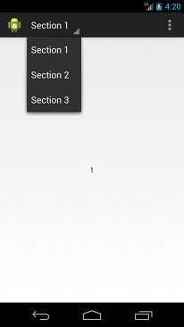
Blank Activity Template
The Blank Activity template creates a simple application that follows the Android Design guidelines. Use this template to create a basic app as a starting point for your project.

Slide 8

Full Screen Activity Template
This template provides an implementation of an activity which alternates between a primary, full screen view and a view with standard user interface controls, including the notification bar and application title bar.
The full screen view is the default and a user can activate the standard view by touching the device screen.

Slide 9
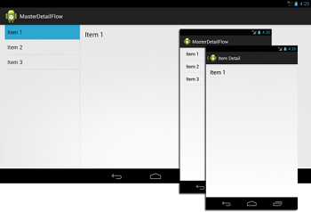
Master Detail Flow Template
This template creates an adaptive layout for a set of items and associated details.
On a tablet device, the item list and item details are displayed on the same screen.
On a smaller device, the list and details are displayed on separate screens.

Slide 10
Activity Templates
Android activity templates provide options to add new activities to your existing application.
The following templates create the same type of activity as they do when used as an application template.
BlankActivity
FullScreenActivity
MasterDetailFlow
We’ll take a quick look at
LoginActivity
SettingsActivity

Slide 11
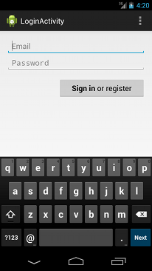
Login Activity Template
This activity template provides input fields and a sample implementation of an AsyncTask that asks users to login or register with their credentials.
AsyncTask implementation handles network operations separately from the main user interface thread
Keeps the UI responsive

Slide 12
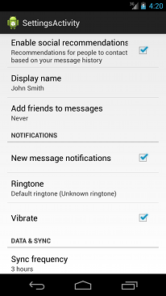
Settings Activity Template
This template extends the PreferenceActivity class and uses an XML file to create preference settings.
This template also demonstrates how to implement several data types for settings.

Slide 13
Android Development Chapter 2 – Activities, Fragments and Intents
Blank Activity Boilerplate Code

Slide 14
Boilerplate Code
When creating a new activity most of the start code is generated by the IDE
Almost all activities interact with the user, so the Activity class takes care of creating a window for you in which you can place your UI with setContentView(View).
The activity loads its UI component from the XML file defined in res/layout
package be.vives.nico.androiddemo;
import android.app.Activity;
import android.os.Bundle;
public class AboutActivity extends Activity {
@Override
protected void onCreate(Bundle savedInstanceState) {
super.onCreate(savedInstanceState);
setContentView(R.layout.activity_about);
}
}

Slide 15
Boilerplate Code
In the layout xml file you will find the following starting code which shows a TextView component inside a Layout container
<RelativeLayout xmlns:android="http://schemas.android.com/apk/res/android"
xmlns:tools="http://schemas.android.com/tools"
android:layout_width="match_parent"
android:layout_height="match_parent"
tools:context="${relativePackage}.${activityClass}" >
<TextView
android:layout_width="wrap_content"
android:layout_height="wrap_content"
android:text="@string/hello_world" />
</RelativeLayout>

Slide 16
Boilerplate Code
The activity also needs to be defined as an XML node inside the Manifest file
<application
android:allowBackup="true"
android:icon="@drawable/ic_launcher"
android:label="@string/app_name"
android:theme="@style/AppTheme" >
<activity
android:name=".MainActivity"
android:label="@string/app_name" >
<intent-filter>
<action android:name="android.intent.action.MAIN" />
<category android:name="android.intent.category.LAUNCHER" />
</intent-filter>
</activity>
<activity
android:name=".AboutActivity"
android:label="@string/title_activity_about" >
</activity>
</application>
The name of the class that implements the activity, a subclass of Activity. The attribute value should be a fully qualified class name (such as, "com.example.project.MyActivity"). However, as a shorthand, if the first character of the name is a period (for example, ".MyActivity"), it is appended to the package name specified in the <manifest>.

Slide 17
Activity’s lifecycle
From creation to destruction an activity goes through a number of stages, known as the activity’s lifecycle
An activity has essentially four states:
If an activity in the foreground of the screen, it is active or running.
If an activity has lost focus but is still visible (that is, a new non-full-sized or transparent activity has focus on top of your activity), it is paused. A paused activity is completely alive (it maintains all state and member information and remains attached to the window manager), but can be killed by the system in extreme low memory situations.
If an activity is completely obscured by another activity, it is stopped. It still retains all state and member information, however, it is no longer visible to the user so its window is hidden and it will often be killed by the system when memory is needed elsewhere.
If an activity is paused or stopped, the system can drop the activity from memory by either asking it to finish, or simply killing its process. When it is displayed again to the user, it must be completely restarted and restored to its previous state.

Slide 18
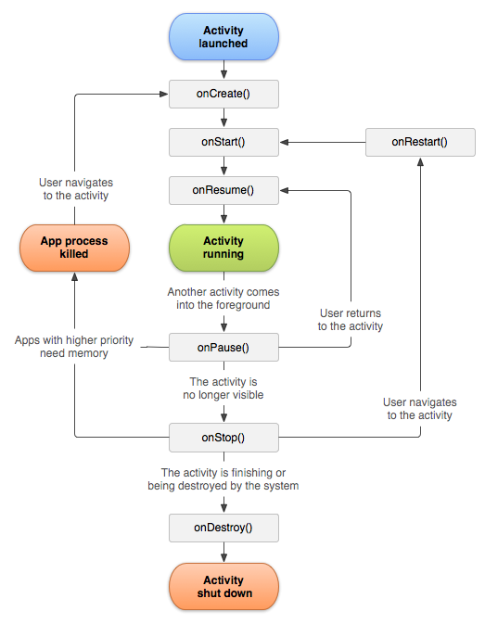
Activity’s lifecycle

Slide 19
Activity’s lifecycle
Each of these stages are bound to the methods of the Activity class which can be overridden to add our code logic
onCreate()
Called when the activity is first created
onStart()
Called when the activity becomes visible to the user
onResume()
Called when the activity starts interacting with the user
onPause()
Called when the current activity is being paused and the previous activity is being resumed
onStop()
Called when the activity is no longer visible to the user

Slide 20
Activity’s lifecycle
onDestroy()
Called before the activity is destroyed by the system (either manually or by the system to recover memory)
onRestart()
Called when the activity has been stopped and is restarting again
A simple application to learn to know all the stages of an activity’s lifecycle is just overriding all the lifecycle methods and outputting a message to the log
We will do this in the lab
When using Eclipse as an IDE just go to the activities java file and type the name of the method (onStop for example) and hit CTRL-SPACE to show the available code snippets
Select the correct one and hit enter to insert the snippet

Slide 21
Activity’s lifecycle
Crucial to know is that an Activity can be destroyed by the OS or the user at any time the activity loses focus
Hence you will need to provide the necessary code to save the state of your application when it is destroyed.
General guidelines
Use onCreate() to create and instantiate objects that your application will be using
Use onResume() to start any services or code that needs to run while your activity is in the foreground
Use onPause() to stop any services or code that does not need to run when your application is in the background
Use onDestroy() to free up resources before your activity is destroyed

Slide 22
Android Development Chapter 2 – Activities, Fragments and Intents
Intents

Slide 23
Intents
An Intent is a messaging object you can use to request an action from another app component. Although intents facilitate communication between components in several ways
There are three fundamental use-cases
To start an activity:
An Activity represents a single screen in an app. You can start a new instance of an Activity by passing an Intent to startActivity().
The Intent describes the activity to start and carries any necessary data.
Notes:
Source: http://developer.android.com/guide/components/intents-filters.html

Slide 24
Intents
To start a service:
A Service is a component that performs operations in the background without a user interface.
You can start a service to perform a one-time operation (such as download a file) by passing an Intent to startService().
The Intent describes the service to start and carries any necessary data.
To deliver a broadcast:
A broadcast is a message that any app can receive.
The system delivers various broadcasts for system events, such as when the system boots up or the device starts charging.
You can deliver a broadcast to other apps by passing an Intent to sendBroadcast(), sendOrderedBroadcast(), or sendStickyBroadcast().
Notes:
Source: http://developer.android.com/guide/components/intents-filters.html

Slide 25
Intent Types
There are two types of intents:
Explicit intents
Specify the component to start by name (the fully-qualified class name).
You'll typically use an explicit intent to start a component in your own app, because you know the class name of the activity or service you want to start.
When you create an explicit intent to start an activity or service, the system immediately starts the app component specified in the Intent object.
Implicit intents
Do not name a specific component, but instead declare a general action to perform, which allows a component from another app to handle it.
For example, if you want to show the user a location on a map, you can use an implicit intent to request that another capable app show a specified location on a map.

Slide 26
Intent Types
Implicit intents
When you create an implicit intent, the Android system finds the appropriate component to start by comparing the contents of the intent to the intent filters declared in the manifest file of other apps on the device.
If the intent matches an intent filter, the system starts that component and delivers it the Intent object.
If multiple intent filters are compatible, the system displays a dialog so the user can pick which app to use.

Slide 27
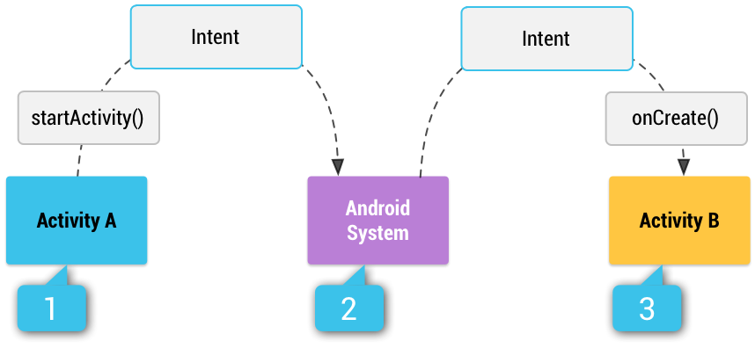
Intent Types – Implicit Intents
Example
Activity A creates an Intent with an action description and passes it to startActivity().
The Android System searches all apps for an intent filter that matches the intent.
When a match is found, the system starts the matching activity (Activity B) by invoking its onCreate() method and passing it the Intent.

Slide 28
Intent Filters
An intent filter is an expression in an app's manifest file that specifies the type of intents that the component would like to receive.
For instance, by declaring an intent filter for an activity, you make it possible for other apps to directly start your activity with a certain kind of intent.
Likewise, if you do not declare any intent filters for an activity, then it can be started only with an explicit intent.
Example of an AboutActivity
<activity
android:name=".About"
android:label="@string/title_activity_about" >
<intent-filter>
<action android:name="be.vives.nico.About" />
<category android:name="android.intent.category.DEFAULT" />
</intent-filter>
</activity>

Slide 29
Intent Filters
In order to receive implicit intents, you must include the CATEGORY_DEFAULT category in the intent filter.
The methods startActivity() and startActivityForResult() treat all intents as if they declared the CATEGORY_DEFAULT category.
If you do not declare it in your intent filter, no implicit intents will resolve to your activity.
<activity
android:name=".About"
android:label="@string/title_activity_about" >
<intent-filter>
<action android:name="be.vives.nico.About" />
<category android:name="android.intent.category.DEFAULT" />
</intent-filter>
</activity>

Slide 30
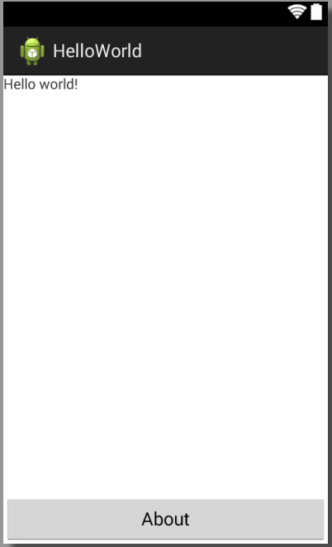
Linking Activities using Intents
An android device can have any number of activities.
When your application has more than one, you most likely want to navigate from one activity to another.
This can be achieved using intents.
Suppose a simple HelloWorld application with a MainActivity and an AboutActivity (added via File => New => Other => Android => Android Activity)
Add a an about button to the main Activity
<Button
android:id="@+id/btnAbout"
android:layout_width="wrap_content"
android:layout_height="wrap_content"
android:layout_alignParentBottom="true"
android:layout_alignParentLeft="true"
android:layout_alignParentRight="true"
android:text="@string/button_about"
android:onClick="onAboutClick" />
Method name of event handler

Slide 31
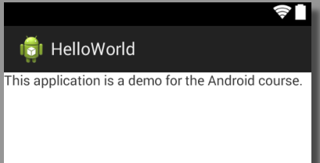
Linking Activities using Intents
Change the text of the About activity to show something about the application
Create an intent filter for the About Activity in the manifest file of your application
<activity
android:name=".AboutActivity"
android:label="@string/title_activity_about" >
<intent-filter>
<action android:name="be.vives.nico.About" />
<category android:name="android.intent.category.DEFAULT" />
</intent-filter>
</activity>

Slide 32
Linking Activities using Intents
Define an event handler inside the Activity’s Java code file where the about button belongs to
In this case in the src/<package_path>/MainActivity.java
Name of method should be the same as specified inside the Layout file as the onClick handler of the button
Handler takes a View as an argument
To start the activity we use the startActivity (Intent intent) method
Test the application
You can use the back button to exit the About activity
public void onAboutClick(View v) {
startActivity(new Intent("be.vives.nico.About"));
}

Slide 33
Explicit Intents
If you do not specify any intent filters for your activity then it cannot be invoked using implicit intents
In this case you will need to use explicit intents to start the activity inside your own application
Example for the AboutActivity
public void onAboutClick(View v) {
// Implicit intent
// startActivity(new Intent("be.vives.nico.About"));
// Explicit Intent
Intent about = new Intent(this, AboutActivity.class);
startActivity(about);
}

Slide 34
Android Development Chapter 2 – Activities, Fragments and Intents
Returning Results from an Activity

Slide 35
Returning Results from an Activity
Starting another activity doesn't have to be one-way. You can also start another activity and receive a result back. To receive a result, call startActivityForResult() (instead of startActivity()).
For example, your app can start a camera app and receive the captured photo as a result. Or, you might start the People app in order for the user to select a contact and you'll receive the contact details as a result.
Of course, the activity that responds must be designed to return a result.
When it does, it sends the result as another Intent object.
Your activity receives it in the onActivityResult() callback.

Slide 36
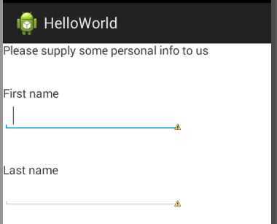
The Activity that will Return the Result
Let’s suppose we have an activity called AskPersonalInfoActivity which asks the user for some personal info
<LinearLayout
android:layout_width="wrap_content"
android:layout_height="wrap_content"
android:layout_alignBaseline="@+id/textView2"
android:layout_marginTop="56dp"
android:orientation="vertical" >
<TextView
android:id="@+id/txtFirstname"
android:layout_width="wrap_content"
android:layout_height="wrap_content"
android:layout_marginTop="38dp"
android:text="@string/firstname" />
<EditText
android:id="@+id/txtInputFirstname"
android:layout_width="wrap_content"
android:layout_height="wrap_content"
android:ems="10" >
<requestFocus />
</EditText>
...
....
<TextView
android:id="@+id/txtLastname"
android:layout_width="wrap_content"
android:layout_height="wrap_content"
android:layout_marginTop="38dp"
android:text="@string/lastname" />
<EditText
android:id="@+id/txtInputLastname"
android:layout_width="wrap_content"
android:layout_height="wrap_content"
android:ems="10" />
</LinearLayout>

Slide 37
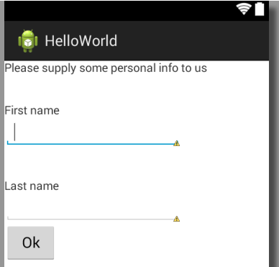
The Activity that will Return the Result
We also add an “Ok” button so we can confirm the input and return to the main activity
The handler is configured as onClick="onPersonalInfoOk“
In the manifest file an intent filter
<Button
android:id="@+id/btnOk"
android:layout_width="wrap_content"
android:layout_height="wrap_content"
android:text="@string/button_ok"
android:onClick="onPersonalInfoOk" />
<activity
android:name=".AskPersonalInfoActivity"
android:label="@string/title_activity_ask_personal_info" >
<intent-filter>
<action android:name="be.vives.nico.AskPersonalInfo" />
<category android:name="android.intent.category.DEFAULT" />
</intent-filter>
</activity>

Slide 38
Starting the Activity that will Generate the Result
The MainActivity has a button which has an onClick=“onPersonalInfo” handler set
There's nothing special about the Intent object you use when starting an activity for a result, but you do need to pass an additional integer argument to the startActivityForResult() method.
The integer argument is a "request code" that identifies your request. When you receive the result Intent, the callback provides the same request code so that your app can properly identify the result and determine how to handle it.
static final int ASK_PERSONAL_INFO = 1; // The request code
// ....
public void onPersonalInfo(View v) {
startActivityForResult(new Intent("be.vives.nico.AskPersonalInfo"), ASK_PERSONAL_INFO);
}

Slide 39
Creating the Result
As a result we want to return the values of the two TextViews (txtInputFirstname and txtInputlastname)
Need to be done inside the event handler of the Ok button
public void onPersonalInfoOk(View v) {
Intent intent = new Intent();
// Get EditText components
EditText fn = (EditText)findViewById(R.id.txtInputFirstname);
EditText ln = (EditText)findViewById(R.id.txtInputLastname);
// Get content of EditText
String firstname = fn.getText().toString();
String lastname = ln.getText().toString();
// Add to the data object
intent.putExtra("firstname", firstname);
intent.putExtra("lastname", lastname);
// Indicate all went well and add intent Object
setResult(RESULT_OK, intent);
// Kill the current activity
finish();
}
Key (as used with a HashMap)

Slide 40
Receiving the Result
When the user is done with the subsequent activity and returns, the system calls your activity's onActivityResult() method.
This method includes three arguments:
The request code you passed to startActivityForResult().
A result code specified by the second activity.
This is either RESULT_OK if the operation was successful or RESULT_CANCELED if the user backed out or the operation failed for some reason.
An Intent that carries the result data.

Slide 41
Receiving the Result
So inside our MainActivity we define the following callback method
@Override
protected void onActivityResult(int requestCode, int resultCode, Intent data) {
// Check which request we're responding to
if (requestCode == ASK_PERSONAL_INFO) {
// Make sure the request was successful
if (resultCode == RESULT_OK) {
String firstname = data.getStringExtra("firstname");
String lastname = data.getStringExtra("lastname");
Toast.makeText(this , "Hello " + firstname + " "
+ lastname, Toast.LENGTH_SHORT).show();
}
}
}
We need to use the method that corresponds to the actual object type
A toast provides simple feedback about an operation in a small popup. It only fills the amount of space required for the message and the current activity remains visible and interactive.

Slide 42
Returning Results from an Activity
Besides using the putExtra() method, you can also create a Bundle object and then attach it using the putExtras() method.
Think of a Bundle object as a dictionary object — it contains a set of name/value pairs.
The following statements create a Bundle object and then add two name/value pairs to it. It is then attached to the Intent object:
// use a Bundle object to add new name/values pairs
Bundle extras = new Bundle();
extras.putString("name", "Nico De Witte");
extras.putInt("age", 28);
// attach the Bundle object to the Intent object
Intent intent = new Intent();
intent.putExtras(extras);
// Retrieving the bundle
Bundle bundle = getIntent().getExtras();
See book page 67 and 68

Slide 43
Android Development Chapter 2 – Activities, Fragments and Intents
Passing Data to an Activity using an Intent Object
&
Sending an Implicit Intent

Slide 44
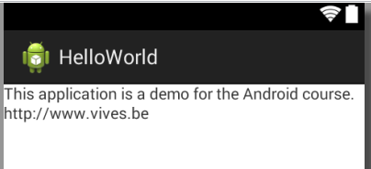
Passing Data using an Intent Object and Generating an Implicit Intent
It is common to pass data to an activity.
This can be done by using the Intent object to pass the data to the target activity.
Very similar to the way we pass data back from an Activity
Let’s combine this with sending an implicit intent for opening a web page
Add a TextView with a url to the About activity
Also add an event handler for a click event
<TextView
android:id="@+id/textView1"
android:layout_width="wrap_content"
android:layout_height="wrap_content"
android:layout_alignParentLeft="true"
android:layout_below="@+id/textView2"
android:text="@string/about_site“
android:clickable="true"
android:onClick="onSiteClick" />

Slide 45
Passing Data using an Intent Object and Generating an Implicit Intent
Now we need to generate an implicit intent for opening the url in a browser
We also need to supply the address of the site that should be opened
Data can also be added and retrieved from an intent using the setData() and getData() methods
Usually, you use the setData() method to set the data on which an Intent object is going to operate (such as passing a URL to an Intent object so that it can invoke a web browser to view a web page.
// Create the Intent object
String url = getResources().getString(R.string.about_site); // Get the URL
Intent intent = new Intent(Intent.ACTION_VIEW);
intent.setData(Uri.parse(url));
// Verify that the intent will resolve to an activity
if (intent.resolveActivity(getPackageManager()) != null) {
startActivity(intent);
}

Slide 46
Android Development Chapter 2 – Activities, Fragments and Intents
Responding to Implicit Intents

Slide 47
Responding to Implicit Intents
Earlier, you saw how an activity can invoke another activity using the Intent object.
In order for other activities to invoke your activity, you need to specify the action and category within the <intent-filter> element in the AndroidManifest.xml file
Let’s create an activity called MyBrowserActivity and the following intent-filter
<activity
android:name=".MyBrowserActivity"
android:label="@string/title_activity_my_browser" >
<intent-filter>
<action android:name="be.vives.nico.MyBrowser" />
<action android:name="android.intent.action.view" />
<category android:name="android.intent.category.DEFAULT" />
<data android:scheme="http" />
</intent-filter>
</activity>

Slide 48
Responding to Implicit Intents
The following allows your activity to respond to a general ACTION_VIEW intent
The data node states that the intent data should adhere to the http-scheme
In other words, the data attached to the intent object should start with “http://”
To allow this to work we need to give the application permission to access the internet
Place the following permission node on the same level as the application node in the manifest file
<action android:name="android.intent.action.VIEW" />
<category android:name="android.intent.category.DEFAULT" />
<data android:scheme="http" />
<uses-permission android:name="android.permission.INTERNET"/>

Slide 49
Responding to Implicit Intents
Add a Webview component to the MyBrowserActivity GUI
We also need to extend the WebViewClient class and override the shouldOverrideUrlLoading() method
<WebView
android:id="@+id/browser_view"
android:layout_width="wrap_content"
android:layout_height="wrap_content" />
private class Callback extends WebViewClient {
@Override
public boolean shouldOverrideUrlLoading(WebView view, String url) {
// Allows the app to interfere with loading of a url
return false;
// return true means the host application handles the url
// return false means the current WebView handles the url
}
}
Notes:
If we specify a webclient ourselfes (see next slide) we can return true here to handle a url by the app itself (not opening the url with the webview) or return false if we want the url to be loaded by the webview.
If we do not specify a webclient then the url will be loaded by another application that listens to the action_view intent filter.

Slide 50
Responding to Implicit Intents
In the onCreate() method of MyBrowserActivity we need to get the data (the url of the site) from the intent
@Override
protected void onCreate(Bundle savedInstanceState) {
super.onCreate(savedInstanceState);
setContentView(R.layout.activity_my_browser);
// Get the URL
Uri url = getIntent().getData();
// Get the WebView
WebView webview = (WebView)findViewById(R.id.browser_view);
// Specify a WebViewClient
webview.setWebViewClient(new Callback());
// Load up the URL
webview.loadUrl(url.toString());
}
More info on http://developer.android.com/reference/android/webkit/WebViewClient.html

Slide 51
Android Development Chapter 2 – Activities, Fragments and Intents
Fragments

Slide 52
Fragments
We’ll come back to this later

