Slide 1

Android Development
Chapter 2 – Activities, Fragments and Intents
Lab Exercises

Slide 2
Assignment 1
Create a new Android project and override all the lifecycle stage methods of the main activity.
Output a log message in each method identifying the method
You can use the following methods of the Log class
Test the application and take a look at the logcat output when pausing and resuming the application. Also try to open another application while keeping your application in the background.
Create a logcat filter to only show the messages with your TAG.
Log.v(“Lifecycle”, “My message”); // Verbose
Log.w(“Lifecycle”, “My message”); // Warning
Log.e(“Lifecycle”, “My message”); // Error
Log.d(“Lifecycle”, “My message”); // Debug
TAG
Message

Slide 3
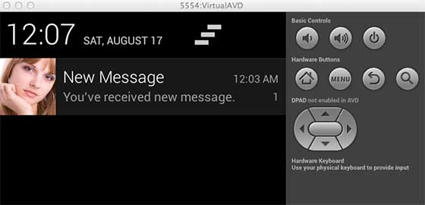
Assignment 2
Display a notification when your application is started
Vibrate the phone for 300ms when you generated the notification
You will need to add a permission for this to the manifest file
Check out the book from page 98 till 103

Slide 4
Assignment 3
Create a new application
Add an EditText component to the UI and a button with the text “Open Website”
When the user presses the button a webbrowser should open the website URL that the user has given in the EditText
If the user has not provided a valid URL do not open the browser and display a ToastMessage stating that the URL is invalid
Also make the background color of the EditText component slightly red
Useful tip on checking if URL is valid: http://stackoverflow.com/questions/5617749/how-to-validate-a-url-website-name-in-edittext-in-android/7754297
Also add an About Activity with some information on your application.
Add a button on your main activity to launch the About activity

