Slide 1

Android Development
Chapter 4 - Context and Option Menus

Slide 2
Android Development Chapter 4 - Context and Option Menus
Menus

Slide 3
Menus
Menus are useful for displaying additional options that are not directly visible on the main UI
There are two main types of menus in Android
Options menu
Displays information related to the current activity
You can activate the options menu by pressing the MENU button
Context menu
Displays information related to a particular view on an activity.
You can activate the context menu by tapping and holding on to an item (from example a ListView)

Slide 4
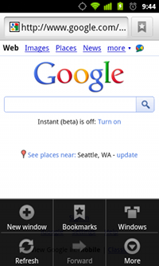
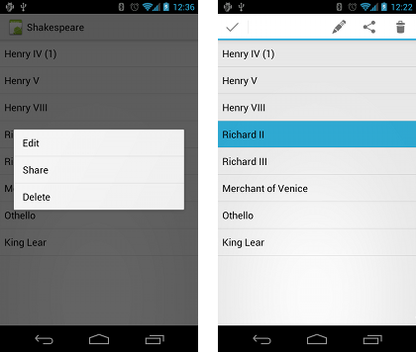
Menus
Options menu
Context menu

Slide 5
Android Development Chapter 4 - Context and Option Menus
Creating an Options Menu

Slide 6
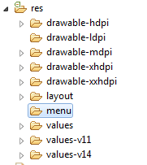
Creating a Resource Menu folder
Step 1 – Start by creating a res/menu folder
If you already haven’t got one

Slide 7
Creating the XML Menu Structure
Step 2 – Create the menu as an XML file (menu_main.xml) in res/menu
This is already there when you use a "Blank Activity"
<menu xmlns:android="http://schemas.android.com/apk/res/android" xmlns:app="http://schemas.android.com/apk/res-auto" xmlns:tools="http://schemas.android.com/tools" tools:context=".MainActivity">
<item android:id="@+id/action_settings" android:title="@string/action_settings" android:orderInCategory="100" app:showAsAction="never" />
<item android:id="@+id/action_about" android:title="@string/action_about" android:orderInCategory="200" app:showAsAction="never" />
</menu>
Notes:
android:orderInCategory: Integer. The order of "importance" of the item, within a group.
android:showAsAction
ifRoom
Only place this item in the app bar if there is room for it. If there is not room for all the items marked "ifRoom", the items with the lowest orderInCategory values are displayed as actions, and the remaining items are displayed in the overflow menu.
Never
Never place this item in the app bar. Instead, list the item in the app bar's overflow menu.

Slide 8
Creating the Toolbar Widget
Step 3 – Create a toolbar widget inside the activity container
This is already there when you use a "Blank Activity"
<android.support.v7.widget.Toolbar android:id="@+id/toolbar" android:layout_width="match_parent"
android:layout_height="?attr/actionBarSize" android:background="?attr/colorPrimary"
app:popupTheme="@style/AppTheme.PopupOverlay" />

Slide 9
Inflating the Menu
Step 4 – Set the toolbar and inflate the menu
This is already there when you use a "Blank Activity"
@Override protected void onCreate(Bundle savedInstanceState) { super.onCreate(savedInstanceState); setContentView(R.layout.activity_main); Toolbar toolbar = (Toolbar) findViewById(R.id.toolbar); setSupportActionBar(toolbar); //..
}
@Override public boolean onCreateOptionsMenu(Menu menu) { // Inflate the menu; this adds items to the action bar if it is present. getMenuInflater().inflate(R.menu.menu_main, menu); return true; }

Slide 10
Handling the Menu Click Events
Step 5 – Handle the menu click events
Needs to be done in the onOptionsItemSelected () method
@Override public boolean onOptionsItemSelected(MenuItem item) { // Handle action bar item clicks here. The action bar will // automatically handle clicks on the Home/Up button, so long // as you specify a parent activity in AndroidManifest.xml. int id = item.getItemId(); switch (id) { case R.id.action_settings: Toast.makeText(this, "Selected settings", Toast.LENGTH_SHORT).show(); return true; case R.id.action_about: Toast.makeText(this, "Selected about", Toast.LENGTH_SHORT).show(); return true; } return super.onOptionsItemSelected(item); }

Slide 11
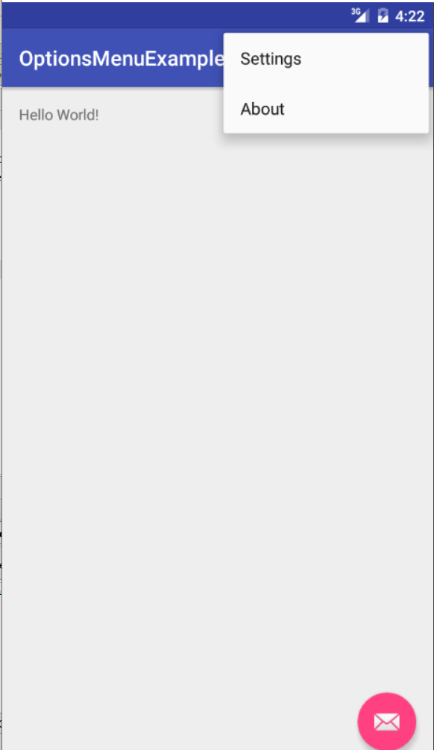
The End Result

Slide 12

Let's Try It Out
Add an about action to the main menu of the Main Activity
Create intent to show about activity in onOptionsItemSelected(…)
Create an about activity if you don't have one yet
Remove your old About button if you still have it

Slide 13
Android Development Chapter 4 - Context and Option Menus
Creating a Context Menu

Slide 14
Creating a Context Menu
Check out http://developer.android.com/guide/topics/ui/menus.html#context-menu

Slide 15
Creating a Resource Menu folder
Step 1 – Start by creating a res/menu folder
If you already haven’t got one

Slide 16
Creating the XML Menu Structure
Step 2 – Create the menu as an XML file (tweet_context_menu.xml) in res/menu
You can use the simple GUI wizard of eclipse to create it
<?xml version="1.0" encoding="utf-8"?>
<menu xmlns:android="http://schemas.android.com/apk/res/android" >
<item
android:id="@+id/delete_tweet"
android:titleCondensed="Delete"
android:title="Delete Tweet" />
<item
android:id="@+id/edit_tweet"
android:titleCondensed="Edit"
android:title="Edit Tweet" />
</menu>

Slide 17
Inflating the Menu
Step 3 – Override the onCreateContextMenu () method inside the ListActivity
We keep building on the custom Tweet list activity
public class MainActivity extends ListActivity {
// ...
@Override
public void onCreateContextMenu(ContextMenu menu,
View v, ContextMenuInfo menuInfo) {
super.onCreateContextMenu(menu, v, menuInfo);
MenuInflater inflater = getMenuInflater();
inflater.inflate(R.menu.tweet_context_menu, menu);
}
}

Slide 18
Inflating the Menu
Step 4 – Register the context menu for the ListView object
@Override
protected void onCreate(Bundle savedInstanceState) {
super.onCreate(savedInstanceState);
// ...
// Register context menu for listview
registerForContextMenu(this.getListView());
// ...
}

Slide 19
Handling the Menu Click Events
Step 5 – Handle the menu click events
Needs to be done in the onContextItemSelected() method
@Override
public boolean onContextItemSelected(MenuItem item) {
// Get info on selected item
AdapterContextMenuInfo info = (AdapterContextMenuInfo) item.getMenuInfo();
switch (item.getItemId()) {
case R.id.delete_tweet:
Toast.makeText(this, "Deleting tweet " + info.id,
Toast.LENGTH_SHORT).show();
return true;
case R.id.edit_tweet:
Toast.makeText(this, "Editing tweet " + info.id,
Toast.LENGTH_SHORT).show();
return true;
default:
return super.onContextItemSelected(item);
}
}

Slide 20
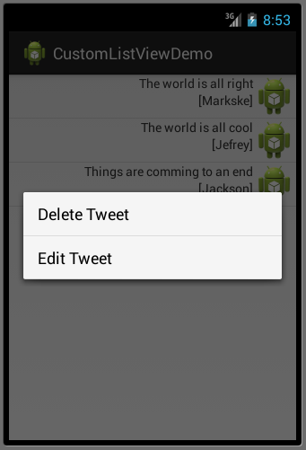
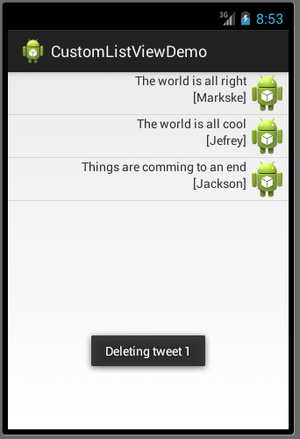
The End Result

