Slide 1

Android Development
Chapter 1 – Getting Started with Android Programming

Slide 2
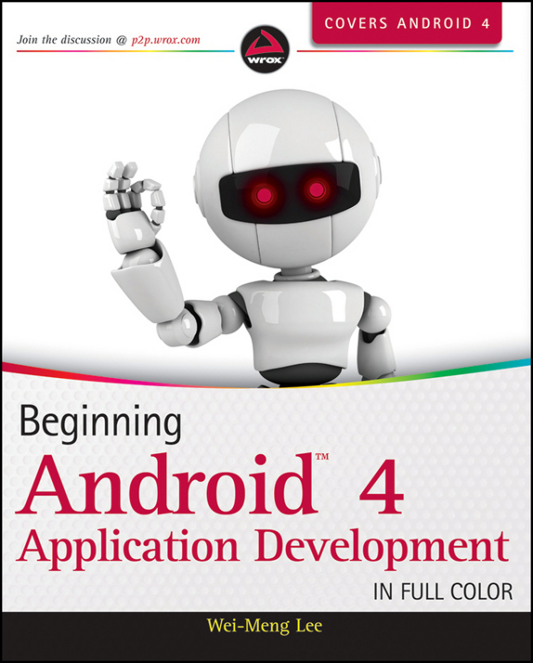
Beginning Android 4 Application Development
Amazon.co.uk
http://www.amazon.co.uk/Beginning-Android-4-Application-Development/dp/1118199545/ref=pd_sim_b_2?ie=UTF8&refRID=0HCW1DQQPYNSVQ3A53D8
Bol.com
http://www.bol.com/nl/p/beginning-android-4-application-development/1001004011690816/

Slide 3
Android Development Chapter 1 – Getting Started with Android Programming
Android and its history

Slide 4
Android – The Mobile Operating System
Android is a mobile operating system
Based on the Linux kernel (version 2.6)
Originally developed by a startup company called Android inc.
Bought by Google in 2005
Released under the open source Apache License
Manufacturer’s such as Motorola and Sony Ericsson saw Android as a replacement for their own mobile OS’s
Main advantage is that Android offers a unified approach to application development
Developers only need to develop for Android and their app should run on numerous Android devices

Slide 5
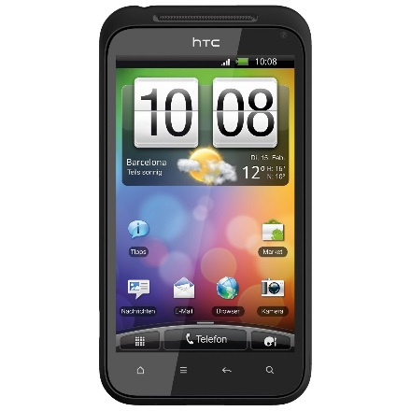
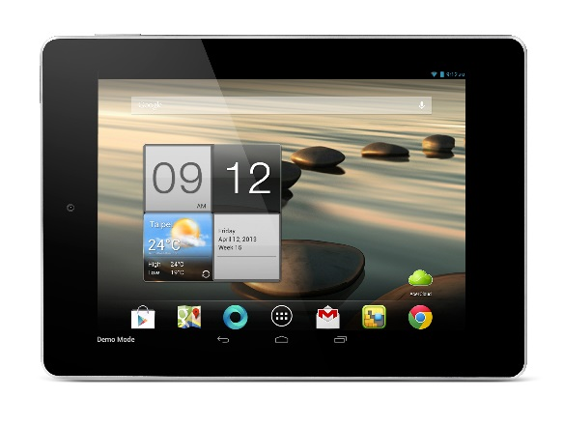
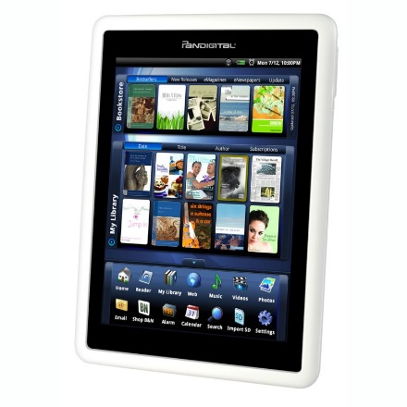
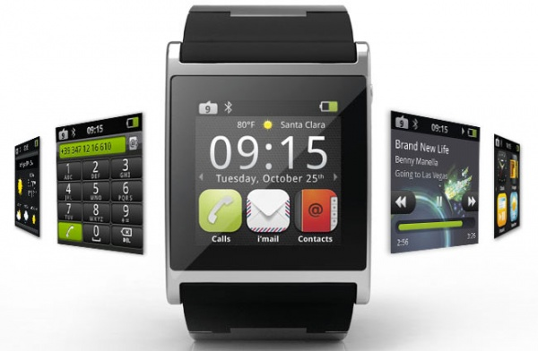
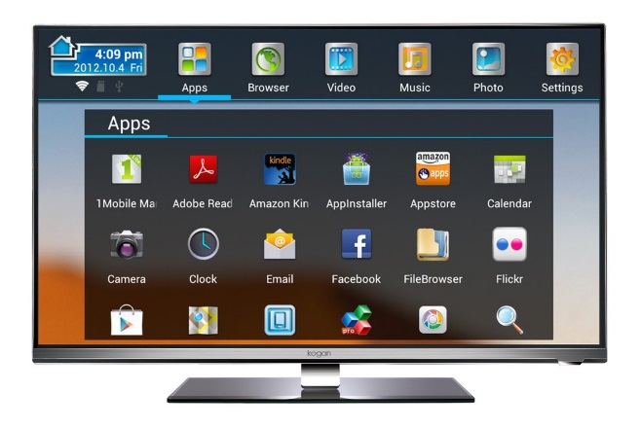
Android Devices
Smartphones
Tablets
e-book readers
Watches
TVs

Slide 6
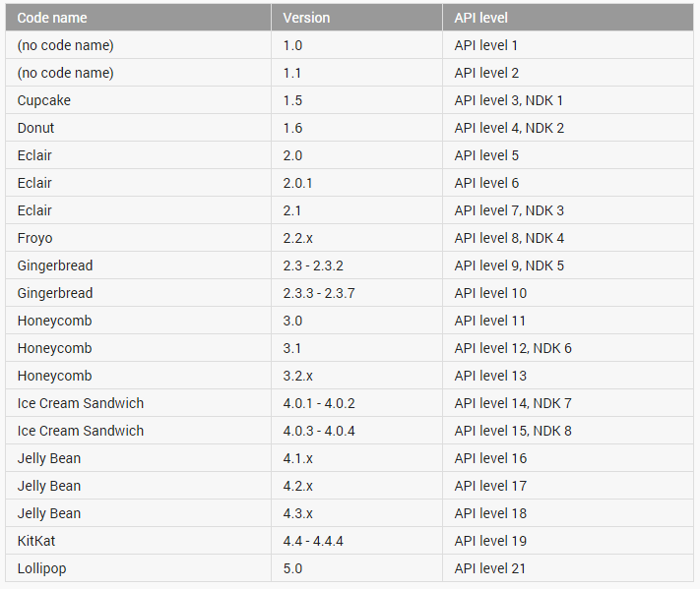
Android Versions

Slide 7
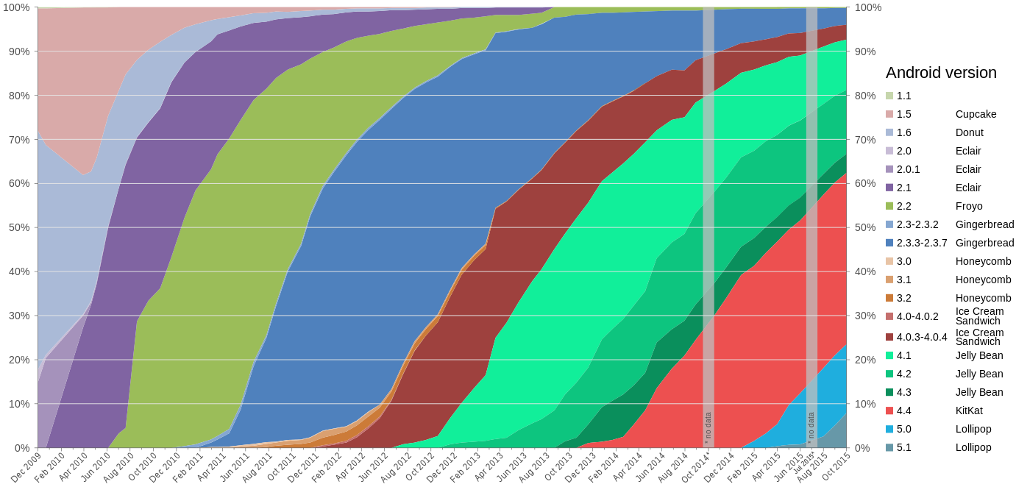
Android Versions

Slide 8
Android Versions - Milestones
Android 1.6, Donut
The world's information is at your fingertips – search the web, get driving directions ... or just watch cat videos.
Android 2.0, Eclair
Make your home screen just how you want it. Arrange apps and widgets across multiple screens and in folders. Stunning live wallpapers respond to your touch.
Android 2.2, Froyo
Voice Typing lets you input text, and Voice Actions let you control your phone, just by speaking.
Android 2.3, Gingerbread
New sensors make Android great for gaming - so you can touch, tap, tilt, and play away.

Slide 9
Android Versions - Milestones
Android 3.0, Honeycomb
Optimized for tablets
New UI, refined multitasking, tabbed browsing, auto fill form, bookmark synchronization, private browsing, ...
New features are not supported on smartphones
Android 4.0, Ice Cream Sandwich
Android comes of age with a new, refined design. Simple, beautiful and beyond smart.
All 3.0 features are supported on smartphones as well

Slide 10
Android Versions - Milestones
Android 4.1, Jelly Bean
Android is fast and smooth with buttery graphics. With Google Now, you get just the right information at the right time.
With more than 1 million apps on Google Play, and thousands of Android devices, you've got the freedom to do what you want on any device you choose.
Android 4.4, KitKat
Smart, simple, and truly yours. A more polished design, improved performance, and new features.
New features introduced such as facial recognition unlock, data usage monitoring and control, Near Field Communication (NFC)

Slide 11
Android Versions - Milestones
Android 5.0, Lollipop
A sweet new take on Android. Get the smarts of Android on screens big and small – with the right information at the right moment.
Notification control, better battery management, security, device sharing, support for TVs, ...
Released November the 3th (2014)
Android 5.1, Lollipop
Ability to join Wi-Fi networks and control paired Bluetooth devices from quick settings
Official support for multiple SIM cards
Device protection: if a device is lost or stolen it will remain locked until the owner signs into their Google account, even if the device is reset to factory settings.
High-definition voice calls, available between compatible devices running Android 5.1

Slide 12
Android Versions - Milestones
Android 6.0, Marshmallow
Unveiled under the codename "Android M" during Google I/O on May 28, 2015
For the Nexus 5 and Nexus 6 phones, Nexus 9 tablet, and Nexus Player set-top box
Native fingerprint reader support
Direct Share feature for target-specific sharing between apps
Do Not Disturb mode
Post-install/run-time permission requests
USB Type-C support
Automatic full data backup and restore for apps
4K Display mode for apps
Adoptable External storage to behave like Internal Storage
MIDI support for musical instruments
Experimental Multi Window feature

Slide 13
Android Features
Because Android is open source and freely available to manufacturers for customization, there are no fixed hardware or software configurations. However, Android itself supports the following features:
Storage - Uses SQLite, a lightweight relational database, for data storage.
Connectivity - Supports GSM/EDGE, IDEN, CDMA, EV-DO, UMTS, Bluetooth (includes A2DP and AVRCP), Wi-Fi, LTE, and WiMAX.
Messaging - Supports both SMS and MMS.
Web browser - Based on the open source WebKit, together with Chrome’s V8 JavaScript engine
Media support - Includes support for the following media: H.263, H.264 (in 3GP or MP4 container), MPEG-4 SP, AMR, AMR-WB (in 3GP container), AAC, HE-AAC (in MP4 or 3GP container), MP3, MIDI, Ogg Vorbis, WAV, JPEG, PNG, GIF, and BMP
Hardware support - Accelerometer Sensor, Camera, Digital Compass, Proximity Sensor, and GPS
Multi-touch - Supports multi-touch screens
Multi-tasking - Supports multi-tasking applications
Flash support - Android 2.3 supports Flash 10.1.
Tethering - Supports sharing of Internet connections as a wired/wireless hotspot

Slide 14
Android Development Chapter 1 – Getting Started with Android Programming
Android Architecture

Slide 15
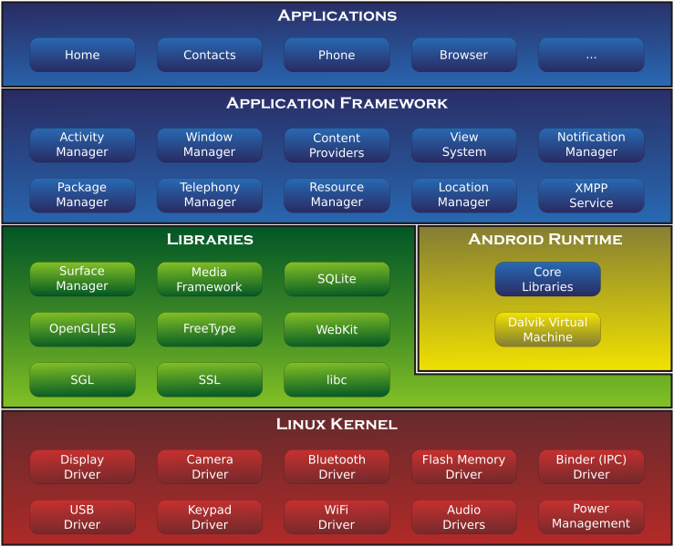
Android Architecture

Slide 16
Linux Kernel
Android is build on top of the Linux 2.6 kernel
Linux core functionality
Memory management
Process management
Networking
Security settings
Low-level device drivers for various hardware components of an Android device

Slide 17
Libraries
Contain all the code that provides the main features of an Android OS.
Examples:
SQLite library provides database support so that applications can use it for data storage
WebKit library provides functionalities for web browsing
Libc: c standard lib.
SSL: Secure Socket Layer
SGL: 2D image engine
OpenGL|ES: 3D image engine
Media Framework: media codecs
FreeType: Bitmap and Vector
SurfaceManager: Compose window manager with off-screen buffering

Slide 18
Android Runtime
Core Libraries
Provides the functionality of the JAVA Programming Language
Dalvik VM
A type of Java Virtual Machine
Register based (not stack machine like JVM)
Optimization for low memory requirements
Executes .dex (Dalvik-Executable) files instead of .class
Android application (APK) files contain executable bytecode files in the form of Dalvik Executable (DEX) files, which contain the compiled code used to run your app.
DX tool converts classes to .dex format
Each Android application:
runs on its own Process
runs on its own Instance of Dalvik VM
is assigned its own Linux user ID

Slide 19
Android Runtime
As of Android 5.0 (Lollipop) Google made internal changes to the platform, with the Android Runtime (ART) officially replacing Dalvik
Improved application performance
Changes intended to improve and optimize battery usage, known internally as Project Volta.
Dalvik
Android apps are deployed in Dalvik bytecode, which is portable, unlike native code.
To run the app on a device, the code has to be compiled to machine code.
Dalvik is based on JIT (just in time) compilation.
Each time you run an app, the part of the code required for its execution is going to be translated (compiled) to machine code at that moment.
As you progress through the app, additional code is going to be compiled and cached, so that the system can reuse the code while the app is running.
Pro: Smaller memory footprint and uses less physical space

Slide 20
Android Runtime
ART (Android RunTime)
Compiles the intermediate language, Dalvik bytecode, into a system-dependent binary.
The whole code of the app will be pre-compiled during install (once), thus removing the lag that we see when we open an app on our device.
With no need for JIT compilation, the code should execute much faster.
Except for the potential speed increase, the use of ART can provide an important secondary benefit.
As ART runs app machine code directly (native execution), it doesn't hit the CPU as hard as just-in-time code compiling on Dalvik.
Less CPU usage results in less battery drain, which is a big plus for portable devices in general.

Slide 21
Application Framework
Exposes the various capabilities of the Android OS to application developers so they can be used in their apps
Important blocks:
Activity Manager: Manages the activity life cycle of applications
Content Providers: Manage the data sharing between applications
Telephony Manager: Manages all voice calls. We use telephony manager if we want to access voice calls in our application.
Location Manager: Location management, using GPS or cell tower
Resource Manager: Manage the various types of resources we use in our Application

Slide 22
Applications
This is where our applications are placed.
Some pre-installed applications:
SMS client app
Dialer
Web browser
Contact manager
...
As developers, we are able to write an app which replaces any existing system app.
No compulsory applications
Equality among apps
Easily embedded web browser
Parallel running

Slide 23
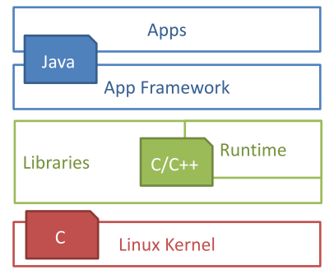
Used languages
Design goals
Open Source
High flexibility
High data accessibility
Rapid development (XML, Java)
Used Languages
App: Java
Framework: Java
Libraries: C/C++
OS & Drivers: C

Slide 24
Android Development Chapter 1 – Getting Started with Android Programming
Developing for Android

Slide 25
Android Studio
Android Studio is an integrated development environment (IDE) for developing for the Android platform.
Freely available under the Apache License 2.0.
First stable build was released in December 2014
Android Studio is designed specifically for Android development.
It is available for download on Windows, Mac OS X and Linux
Replaces Eclipse Android Development Tools (ADT) as Google's primary IDE for native Android application development.

Slide 26
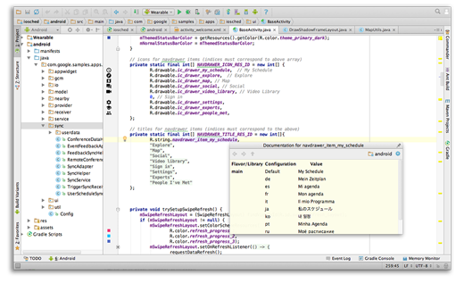
Android Studio
Intelligent code editor
At the core of Android Studio is an intelligent code editor capable of advanced code completion, refactoring, and code analysis.

Slide 27
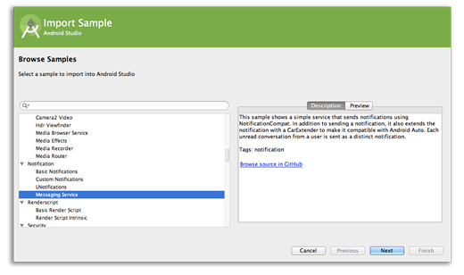
Android Studio
Code templates and GitHub integration
New project wizards make it easier than ever to start a new project.
Start projects using template code for patterns such as navigation drawer and view pagers, and even import Google code samples from GitHub.

Slide 28
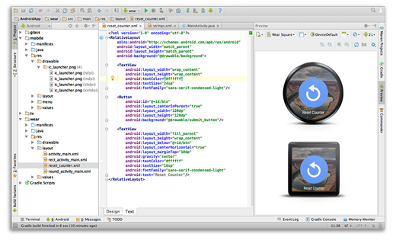
Android Studio
Multi-screen app development
Build apps for Android phones, tablets, Android Wear, Android TV, Android Auto and Google Glass.
With the new Android Project View and module support in Android Studio, it's easier to manage app projects and resources.

Slide 29
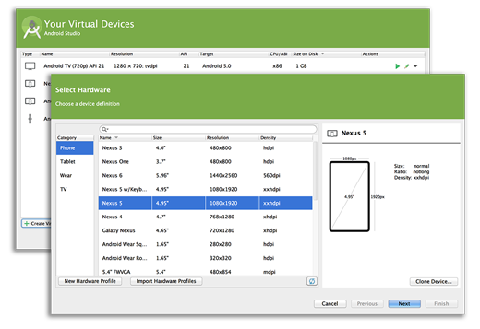
Android Studio
Virtual devices for all shapes and sizes
Android Studio comes pre-configured with an optimized emulator image.
The updated and streamlined Virtual Device Manager provides pre-defined device profiles for common Android devices.

Slide 30
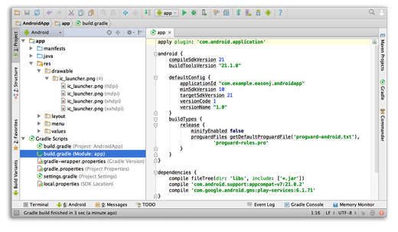
Android Studio
Android builds evolved, with Gradle
Create multiple APKs for your Android app with different features using the same project.
Manage app dependencies with Maven.
Build APKs from Android Studio or the command line.

Slide 31
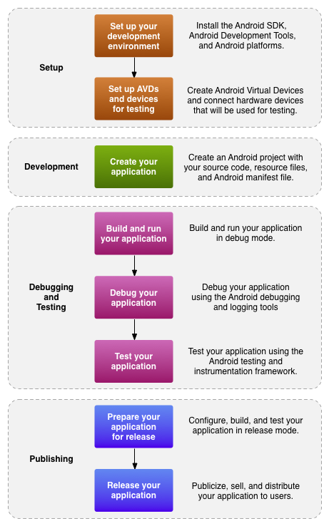
Development Workflow
❶
❷
❸
We are going to do all of this
❹
❺
❻
From this point on you're on your own

Slide 32
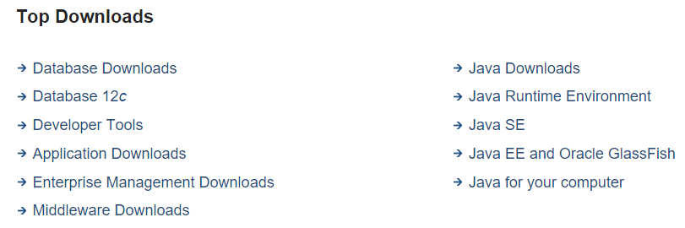
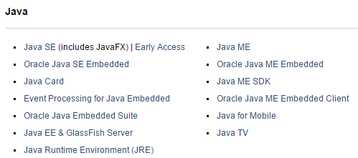
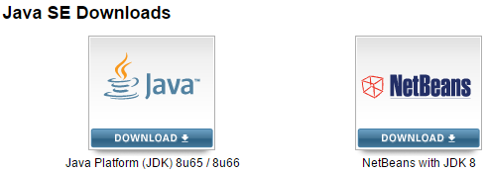
Step 1 - Setting Up Our Development Environment Installing Java SE
Start by installing the latest version of the Java Development Kit
Surf to https://www.oracle.com/downloads
Select "Java SE" from "Top Downloads"
Select "Java SE" from "Java" downloads
Choose the "JDK platform"

Slide 33
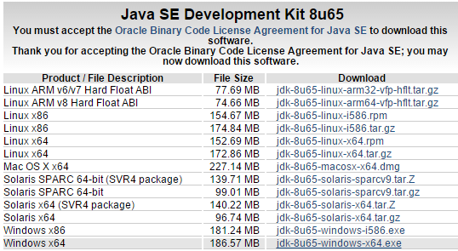
Step 1 - Setting Up Our Development Environment Installing Java SE
Download the latest stable release (x32 or x64) (don't forget to accept the license agreement)

Slide 34

Step 1 - Setting Up Our Development Environment Installing Java SE
Install the Java JDK before installing Android Studio.
Restart your computer (!MUST!)

Slide 35

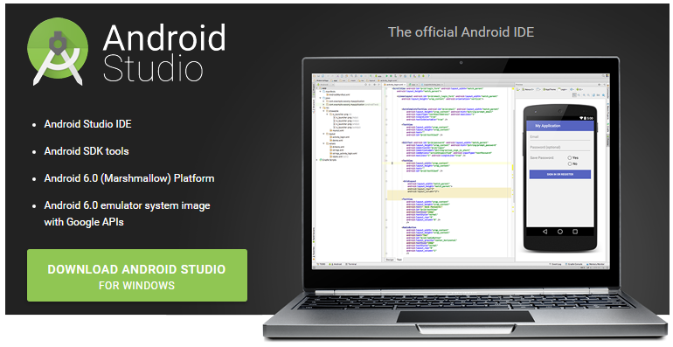
Step 1 - Setting Up Our Development Environment Installing Android Studio
To download Android Studio you need to surf to http://developer.android.com
Click the "Get the SDK"
Next choose "Download Android Studio"

Slide 36
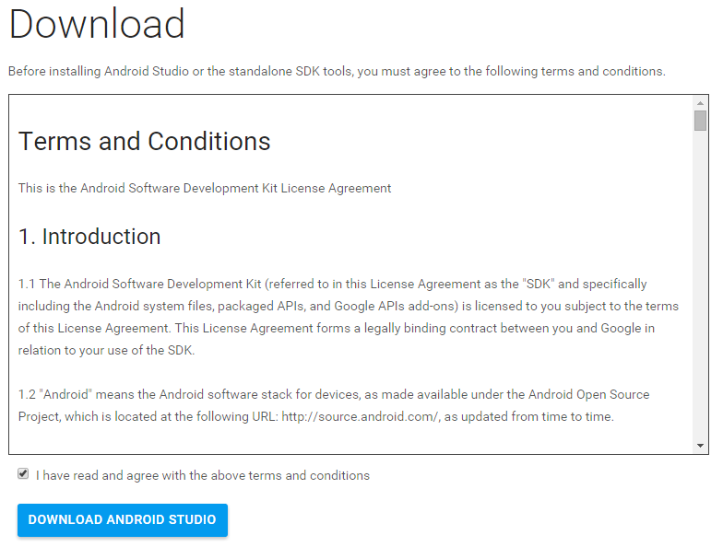
Step 1 - Setting Up Our Development Environment Installing Android Studio
Accept the license agreement and click "Download"

Slide 37
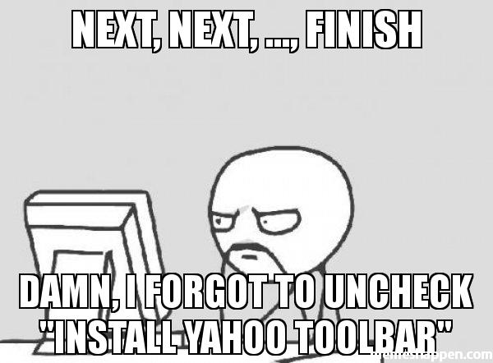
Step 1 - Setting Up Our Development Environment Installing Android Studio
Install Android Studio (Next -> Next -> .... -> Finish)

Slide 38
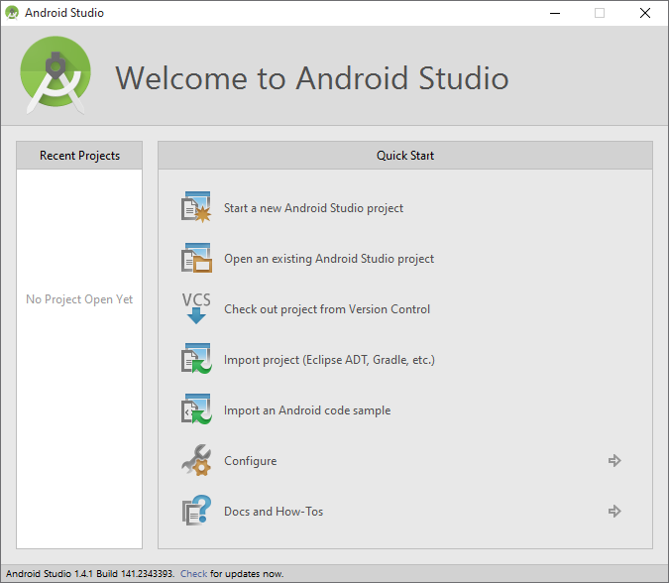
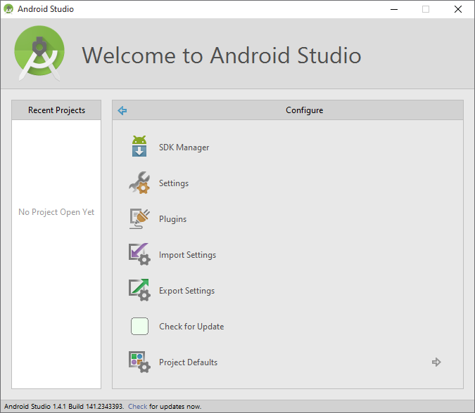
Step 1 - Setting Up Our Development Environment Installing Android Development Tools
Launch Android Studio
Choose "Configure"
Next pick "SDK Manager" to install Android SDK's

Slide 39
OLD SLIDES
OLD SLIDES
OLD SLIDES
OLD SLIDES
OLD SLIDES

Slide 40
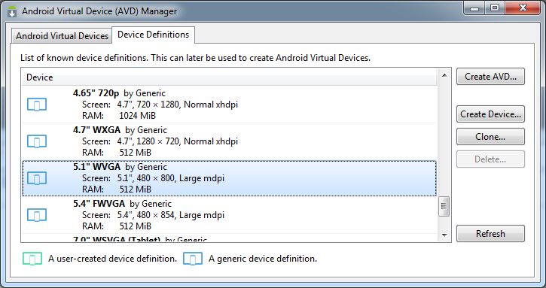
Creating an Android Virtual Device (AVD)
Android applications may be run on a real device or on the Android Emulator, which ships with the Android SDK.
In Eclipse navigate to Window => Android Virtual Device Manager
Open the second tab (Device Definitions) and select the ‘5.1” WVGA’

Slide 41
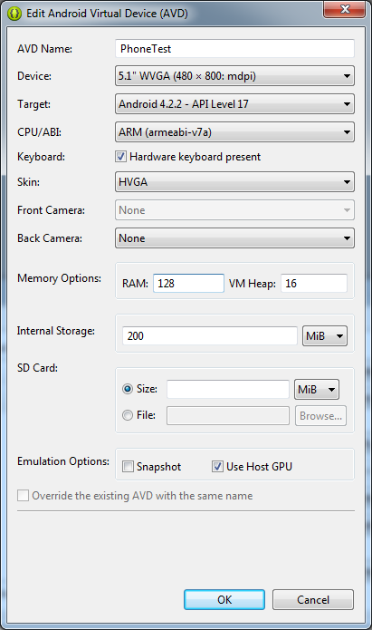
Creating an Android Virtual Device (AVD)
Click “Create AVD”
Give it a name
Choose “Android 4.2.2 – API Level 17” as target
Choose an ARM CPU
Select HVGA as skin
Memory should be set to 128
Make sure to check “Use Host GPU”

Slide 42
Android Development Chapter 1 – Getting Started with Android Programming
Your First Android Application

Slide 43
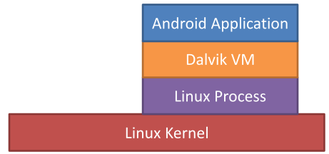
Application Fundamentals
Development Language
Java
Android SDK tools compile the code into an Android package, an archive file with an .apk suffix
Security sandbox
Each application has a unique Linux user ID
Each process has its own virtual machine (VM)
Every application runs in its own Linux process
Principle of least privilege
Each application, has access only to the components that it requires to do its work and no more.

Slide 44
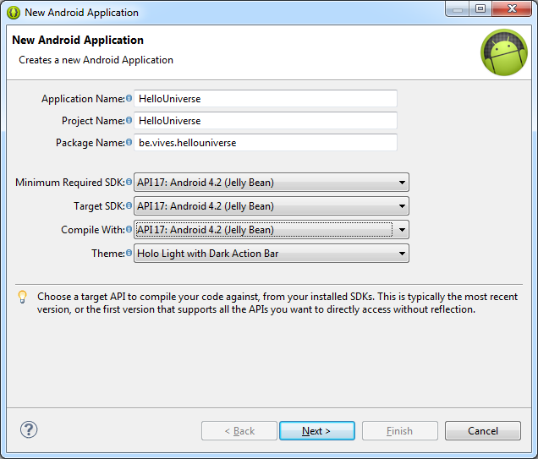
Create a Hello Universe Application
Select File => New Android Project
Give your project a name
Also set the Package name
Make sure to select “API level 17” for all SDK versions

Slide 45
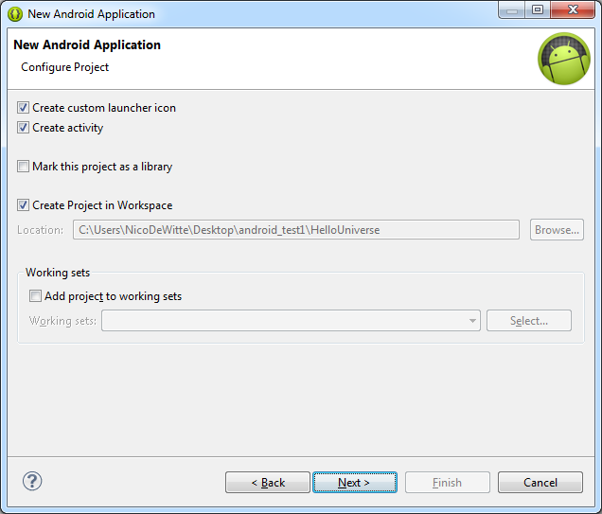
Create a Hello Universe Application

Slide 46
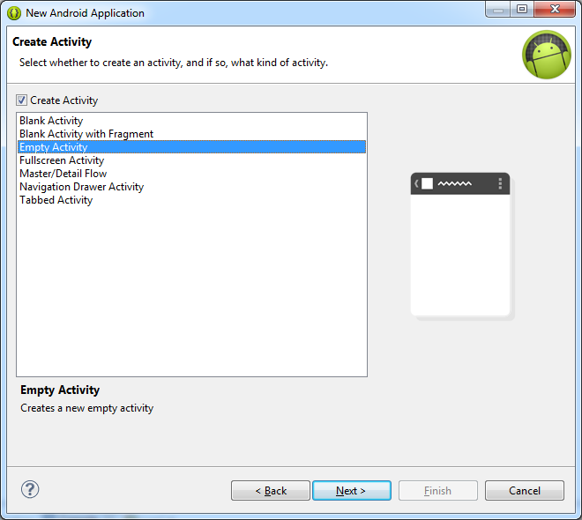
Create a Hello Universe Application
Create an empty activity

Slide 47
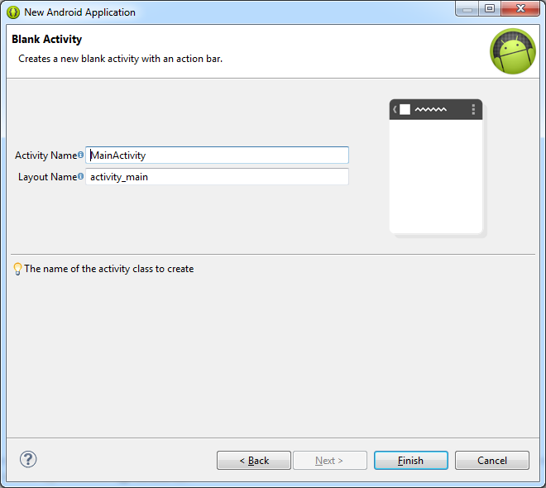
Create a Hello Universe Application

Slide 48
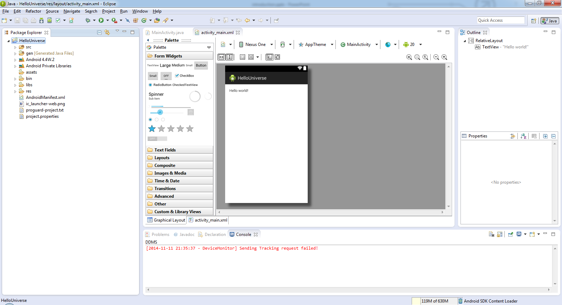
Result

Slide 49
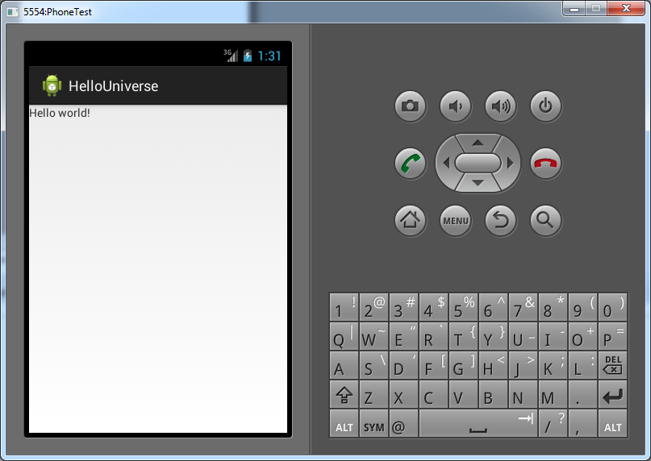
Running the Application
Right click on the project directory in Eclipse and choose “Run as => Android Application”
It takes some time for your emulator to start !

Slide 50
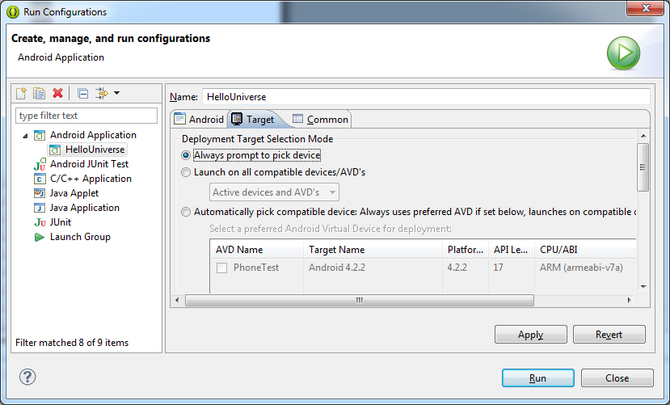
Multiple AVDs
If you have multiple AVDs or also develop for a physical machine you should enable selection of the run device
Click the dropdown icon on the “Run as” icon at the top of eclipse and choose “Run configurations”
Select the “Target” tab
Select “Always prompt to pick device”
Hit Apply and Close

Slide 51
Deploying on a Real Device
To deploy or test your application on a real android device you will need to connect the device to your development machine via USB
Next you will need to enable USB debugging
Can mostly be found under Settings/Developers or Settings/Applications
Next you need a USB driver for your Android device on your host machine
Check out http://developer.android.com/tools/extras/oem-usb.html#Drivers
When selecting the “Run as” options from Eclipse select the physical device instead of an AVD

Slide 52
Anatomy of an Android Application
src
Contains the java source code files.
gen
Contains R.java, a compiler generated file that references all the resources found in your project.
Do not change anything in these files !
Android 4.x
The Android library. Contains a single jar file with class libraries needed for an Android application.
assets
Contains all the assets used by the application (HTML, Databases, text files)

Slide 53
Anatomy of an Android Application
bin
Contains the files built by the ADT (Android Development Tools) during the build process. Your application binary can be found here (*.apk)
res
Contains all the resource files used in the application such as images (multiple resolutions), GUI layout and string literals (selection based on users locale)
In computing, a locale is a set of parameters that defines the user's language, country and any special variant preferences that the user wants to see in their user interface. Usually a locale identifier consists of at least a language identifier and a region identifier.

Slide 54
Anatomy of an Android Application
res/layout/*.xml
Defines the user interface for your activities.
Note the line:
@string refers to the resource string.xml file located in the res/values folder. "hello_world" is the id of the string defined in that file. In other words this is a reference to the string value "Hello World“ defined as:
All your strings should be constructed this way. NO HARDCODED values.
Allows us to easily add support for other languages without to much effort
Just copy the values folder as “values-<language_code>” and modify the values of strings.xml
android:text="@string/hello_world"c
<string name="hello_world">Hello World</string>

Slide 55
Anatomy of an Android Application
AndroidManifest.xml
This is the manifest file for the application. Here you can specify permissions needed by the application, as well as others features such as intent-filters (events), receivers, ...
The manifest file contains
The name of the package
The version number of the application
The minimal SDK version required to run the application
The targeted SDK version
The icon used for the application (can be found in res/drawable)
The entry point of the application, defined inside an intent-filter. This defines how to application can be started and what the entry point is.

Slide 56
Anatomy of an Android Application
src/<package_path>/Main_Activity.java
The code in the onCreate() method connects the GUI to your application using
More on this later ...
public class MainActivity extends Activity {
@Override
protected void onCreate(Bundle savedInstanceState) {
super.onCreate(savedInstanceState);
setContentView(R.layout.activity_main);
}
}
setContentView(R.layout.activity_main);

Slide 57
Android Development Chapter 1 – Getting Started with Android Programming
Exercise – Application Locales

Slide 58
Exercise – Application Locales
Copy the values folder as “values-nl”
Change the hello_world string value to “Hallo Wereld!”
Deploy the application
Set the emulator device to “Dutch”
More info in the LAB

Slide 59
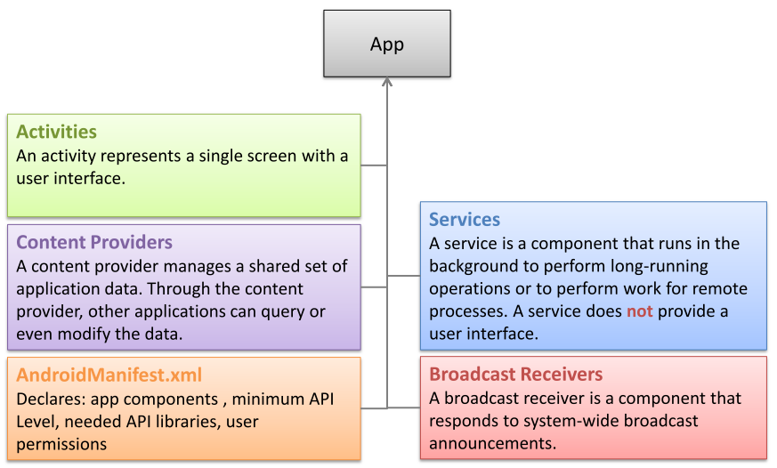
Application Components

Slide 60
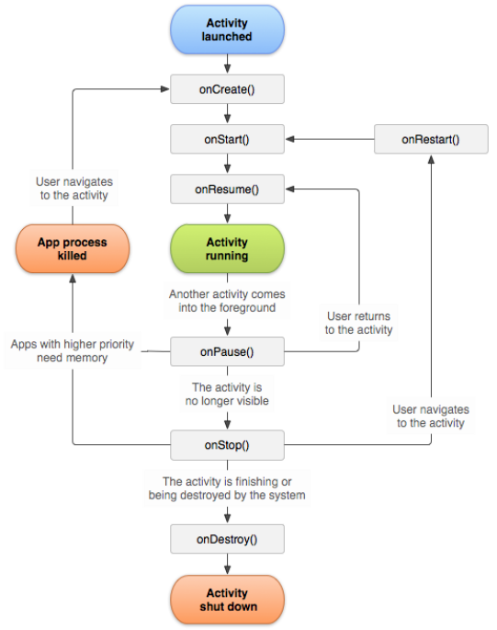
Activity Lifecycle

Slide 61
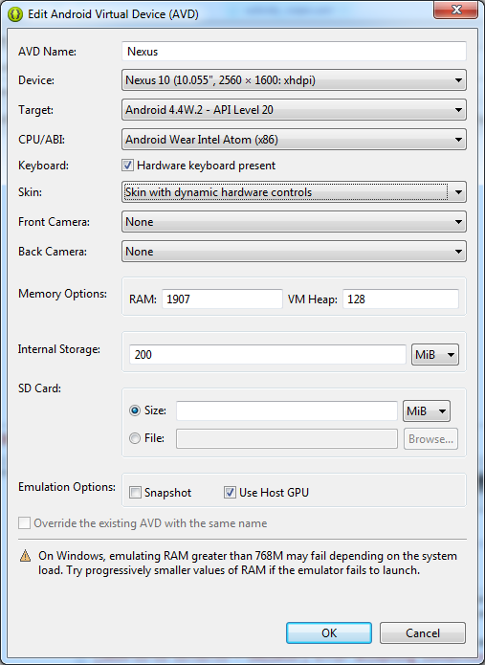
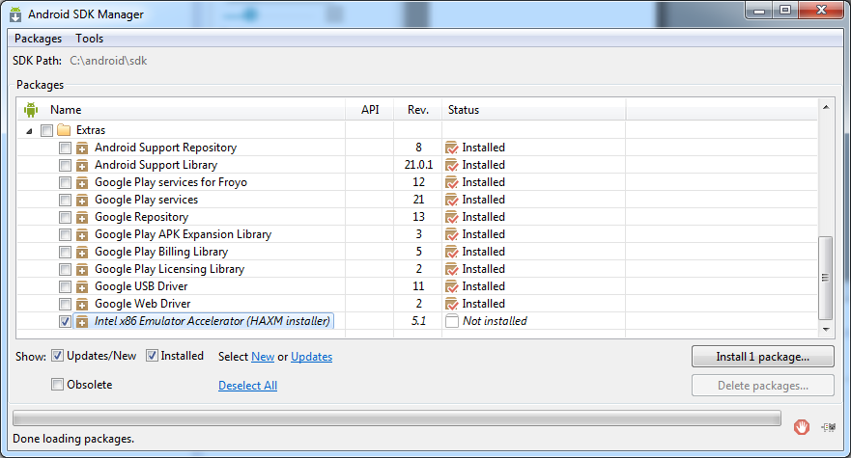
Fixing the Slow Emulator
https://www.infinum.co/the-capsized-eight/articles/is-your-android-emulator-just-too-slow
Enable host GPU usage in AVD
Install x86 Emulator Accelerator

Slide 62
Fixing the Slow Emulator
Traverse to C:\android\sdk\extras\intel\Hardware_Accelerated_Execution_Manager
Execute the installer and follow instructions
Implication:
Google API not available for Intel based platform

Slide 63
The ADB (Android Debug Bridge)
The ADB utility lets you connect to the phone itself and issue rudimentary shell commands, such as copying files to and from the device.
TODO

