Slide 1

Android Development
Chapter 8 - Android Locale

Slide 2
Android String Resources
Android String Resources
When starting a new application
Note the line:
@string refers to the resource string.xml file located in the res/values folder. "hello_world" is the id of the string defined in that file. In other words this is a reference to the string value "Hello World“ defined as:
All your strings should be constructed this way. NO HARDCODED values.
Allows us to easily add support for other languages without to much effort
Just copy the values folder as "values-<language_code>" and modify the values of strings.xml
android:text="@string/hello_world"c
<string name="hello_world">Hello World</string>

Slide 3
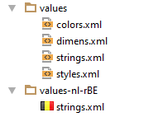
Application Locales
Create a new resource folder called "values-nl" (all Dutch speaking) or "values-nl-rBE" (Belgium only)
Copy the strings.xml resource from "values" to "values-nl" or " values-nl-rBE "
Notice how Android Studio displays some fancy flags ☺

Slide 4
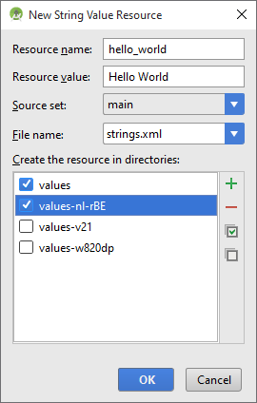
Application Locales
Translate all the values but make sure not to delete any resources
When adding a new resource string later on make sure to add them to all translations !
Android Studio makes this job easy for you
Deploy the application
Set the emulator device or the actual phone to "Nederlands (Belgie) " or "English (Belgium)"

