Slide 1

Android Development
Chapter 6 – Data Persistence

Slide 2
Android Development Chapter 6 – Data Persistence
Data Persistence

Slide 3
Data Persistence
Persisting data is an important topic in application development
Users typically expect to reuse data in the future
Example
User information
Configuration settings (preferences)
Application data
Logs
...

Slide 4
Data Persistence
Android provides several options for you to save persistent application data.
The solution you choose depends on your specific needs, such as whether the data should be private to your application or accessible to other applications (and the user) and how much space your data requires.
Your data storage options are
Shared Preferences
Store private primitive data in key-value pairs
Internal Storage
Store private data on the device memory
External Storage
Store public data on the shared external storage
SQLite Databases
Store structured data in a private database
Network Connection
Store data on the web with your own network server

Slide 5
Android Development Chapter 6 – Data Persistence
Saving and Loading User Preferences

Slide 6
Saving and Loading User Preferences
Android provides the SharedPreferences object to help you save simple application data.
For example
Your application may have an option that enables users to specify the font size of the text displayed in your application.
In this case, your application needs to remember the size set by the user so that the next time he or she uses the application again, it can set the size appropriately.
In order to do so, you have several options.
You can save the data to a file, but you have to perform some file management routines, such as writing the data to the file, indicating how many characters to read from it, and so on.
Also, if you have several pieces of information to save, such as text size, font name, preferred background color, and so on, then the task of writing to a file becomes more onerous.

Slide 7
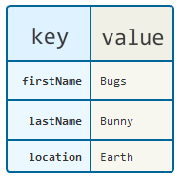
Saving and Loading User Preferences
An alternative to writing to a text file is to use a database
However saving simple data to a database is a bit overkill
Both from a developer’s point of view and in terms of the application’s run-time performance.
Using the SharedPreferences object, however, you save the data you want through the use of name/value pairs
Can also be used to save small chunks of general data
Specify a name for the data you want to save, and then both it and its value will be saved automatically to an XML file for you.

Slide 8
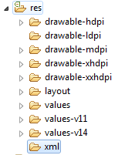
Creating a Preferences XML file
Step 1 – Start by creating an xml folder inside the res folder

Slide 9
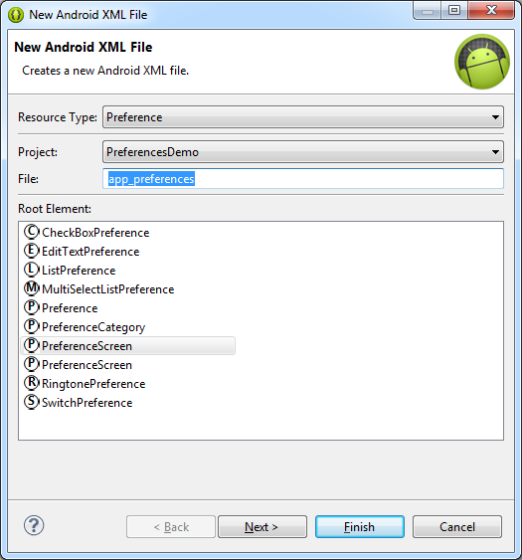
Creating a Preferences XML file
Step 2 – Right click the xml folder and select “New XML file”
Set the resource type to Preferences and select PreferenceScreen as the root element
Give the file a name

Slide 10
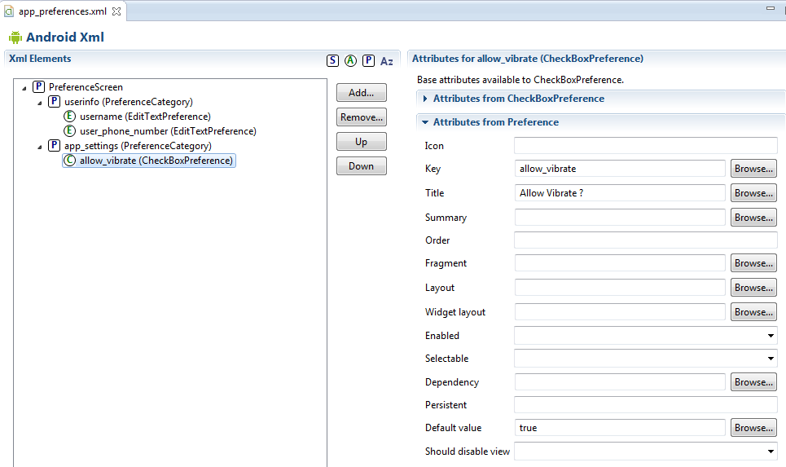
Building the Preferences Structure
Step 3 – The preference options and hierarchy can be easily build using the visual editor in Eclipse

Slide 11
Creating an Activity to Display the Preferences
Step 4 – Create a new Activity called AppPreferenceActivity and remove the layout file
Step 5 - Let the activity inherit from PreferenceActivity and load the preferences from the XML file in the onCreate() method
May give a deprecated warning but can be ignored for the moment
public class AppPreferenceActivity extends PreferenceActivity {
@Override
protected void onCreate(Bundle savedInstanceState) {
super.onCreate(savedInstanceState);
//setContentView(R.layout.activity_app_preference);
// Load the preferences from the xml file
addPreferencesFromResource(R.xml.app_preferences);
}
}

Slide 12
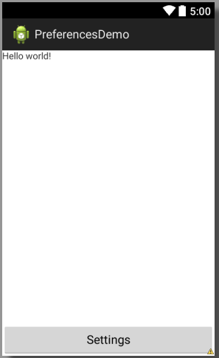
Access to the Preferences Activity
Step 6 – Add a way to launch your preferences activity
public void onSettings(View v) {
// Launch settings activity
startActivity(new Intent(this,
AppPreferenceActivity.class));
}

Slide 13
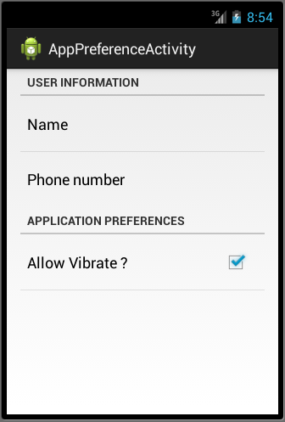
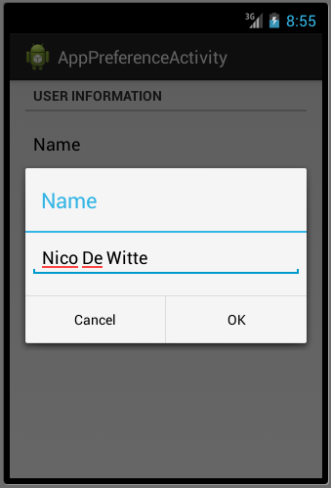
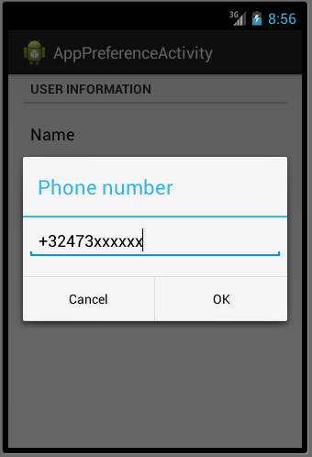
The End Result

Slide 14
The End Result
You can actually download the written XML file from the emulator (and from some phones)
Open the DDMS perspective (Window => Open Perspective => DDMS)
Open the File Explorer tab and make sure you select the correct device on the left
Navigate to /data/data/<your_package_path/shared_prefs/<your_file.xml>
Pull it from the device (top right of the DDMS)
<?xml version='1.0' encoding='utf-8' standalone='yes' ?>
<map>
<string name="user_phone_number">+32473xxxxxx</string>
<string name="username">Nico De Witte</string>
<boolean name="allow_vibrate" value="false" />
</map>

