Slide 1

Android Development
Chapter 2 – Activities, Fragments and Intents

Slide 2
Android Development Chapter 2 – Activities, Fragments and Intents
Activities

Slide 3
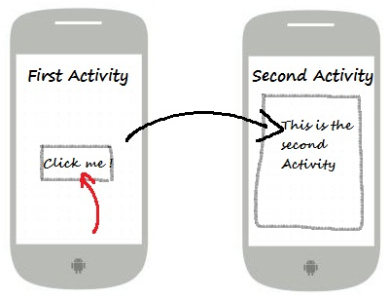
Activities
An activity is a window that contains the user interface of your application
An application can have any number of activities
Main purpose is user interaction

Slide 4
Creating a new Activity
To create a new activity in Android Studio all you need to do is go to
Choose one of the templates and give the activity a name
For starters always choose the "Empty Activity" or "Blank Activity"
Always add the suffix "Activity" to the name
File => New => Activity => Gallery

Slide 5
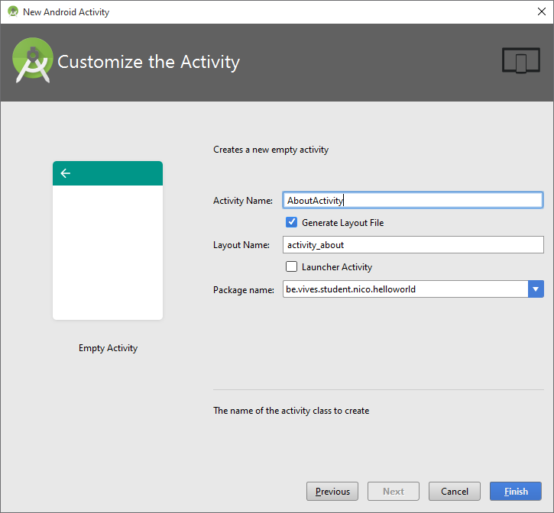
Creating a new Activity

Slide 6
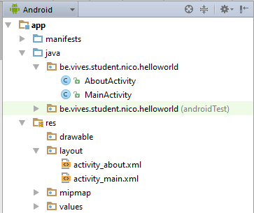
Creating a new Activity
Android Studio will automatically create a Java source code file and Layout markup file for you
Java activity source code file
Layout markup file (XML)

Slide 7
Android Development Chapter 3 – Getting to know the Android User Interface
Application and Activity Templates

Slide 8
Application Templates
Application templates create basic Android applications that you can immediately run and test on your Android device.
These templates are available when you create a new Android project
When you add new activities to an existing project you are also able to select an activity template
Some pre-generated code to get you started
We will mostly create an application based on the "Blank Activity" template

Slide 9
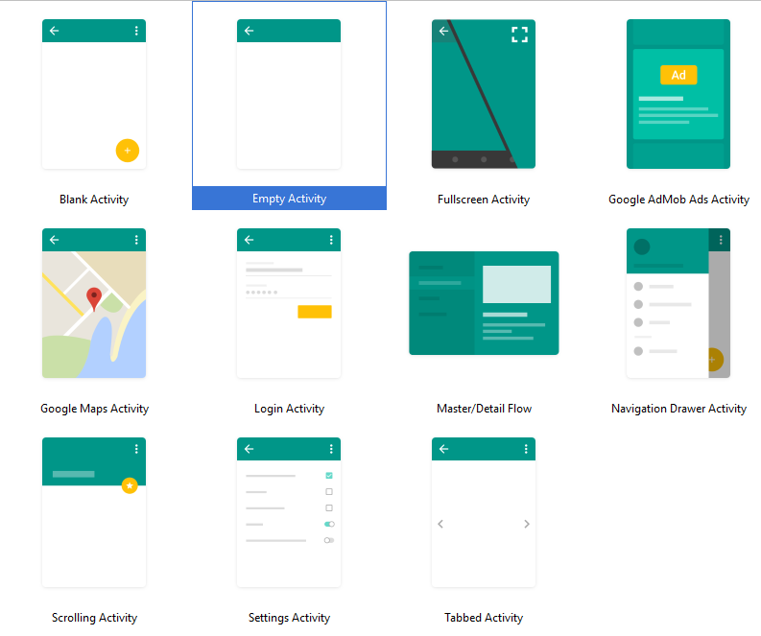
Application Templates

Slide 10
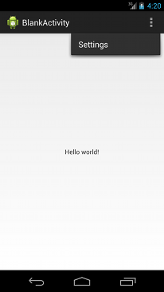
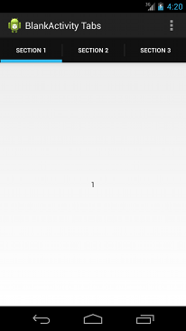
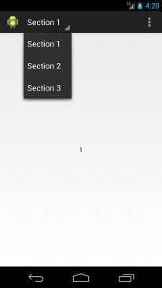
Blank Activity Template
The Blank Activity template creates a simple application that follows the Android Design guidelines.
http://developer.android.com/design/index.html
Use this template to create a basic app as a starting point for your project.

Slide 11

Full Screen Activity Template
This template provides an implementation of an activity which alternates between a primary, full screen view and a view with standard user interface controls, including the notification bar and application title bar.
The full screen view is the default and a user can activate the standard view by touching the device screen.

Slide 12
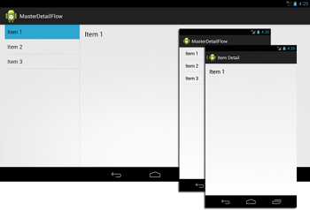
Master Detail Flow Template
This template creates an adaptive layout for a set of items and associated details.
On a tablet device, the item list and item details are displayed on the same screen.
On a smaller device, the list and details are displayed on separate screens.

Slide 13
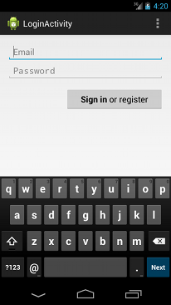
Login Activity Template
The Login Activity template provides input fields and a sample implementation of an AsyncTask that asks users to login or register with their credentials.
In this case the implementation of AsyncTask handles network operations separately from the main user interface thread
Keeps the UI responsive

Slide 14
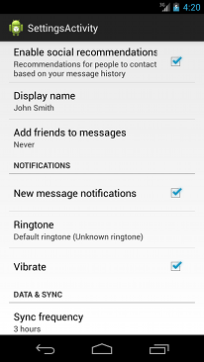
Settings Activity Template
The Settings Activity template extends the PreferenceActivity class and uses an XML file to create preference settings.
This template also demonstrates how to implement several data types for settings.

Slide 15
Android Development Chapter 2 – Activities, Fragments and Intents
Blank Activity Boilerplate Code

Slide 16
Boilerplate Code
When creating a new activity most of the start code is generated by the IDE
Almost all activities interact with the user, so the Activity class takes care of creating a window for you in which you can place your UI with setContentView(View).
The activity loads its UI component from the XML layout files
package be.vives.android.nico.testapp1; import ... public class MainActivity extends AppCompatActivity { @Override protected void onCreate(Bundle savedInstanceState) { super.onCreate(savedInstanceState); setContentView(R.layout.activity_main); // ... } }

Slide 17
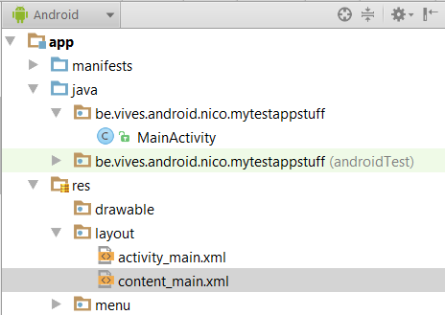
Boilerplate Code
The Layout can be found as two files under res/layout
content_main.xml
Which contains our actual layout we want to display to the user
activity_main.xml
Which acts a container for the content and some other things like a toolbar
It also defines the general layout of the activity

Slide 18
Boilerplate Code content_main.xml
In the content_main.xml layout XML file you will find the following starting code
It shows a TextView component inside a Layout container
More on layout containers later …
<?xml version="1.0" encoding="utf-8"?> <RelativeLayout xmlns:android="http://schemas.android.com/apk/res/android" xmlns:tools="http://schemas.android.com/tools" xmlns:app="http://schemas.android.com/apk/res-auto" android:layout_width="match_parent" android:layout_height="match_parent" android:paddingLeft="@dimen/activity_horizontal_margin" android:paddingRight="@dimen/activity_horizontal_margin" android:paddingTop="@dimen/activity_vertical_margin" android:paddingBottom="@dimen/activity_vertical_margin" app:layout_behavior="@string/appbar_scrolling_view_behavior" tools:showIn="@layout/activity_main" tools:context=".MainActivity"> <TextView android:text="Hello World!" android:layout_width="wrap_content" android:layout_height="wrap_content" /> </RelativeLayout>

Slide 19
Boilerplate Code activity_main.xml
activity_main.xml acts as a container for the content and some other things like a toolbar
For the moment this is less important for us
<?xml version="1.0" encoding="utf-8"?> <android.support.design.widget.CoordinatorLayout xmlns:android="http://schemas.android.com/apk/res/android" xmlns:app="http://schemas.android.com/apk/res-auto" xmlns:tools="http://schemas.android.com/tools" android:layout_width="match_parent" android:layout_height="match_parent" android:fitsSystemWindows="true" tools:context=".MainActivity"> <android.support.design.widget.AppBarLayout ... > <android.support.v7.widget.Toolbar ... /> </android.support.design.widget.AppBarLayout> <include layout="@layout/content_main" /> <android.support.design.widget.FloatingActionButton ... /> </android.support.design.widget.CoordinatorLayout>

Slide 20
Boilerplate Code AndroidManifest.xml
The activity also needs to be defined as an XML node inside the Manifest file
<?xml version="1.0" encoding="utf-8"?> <manifest xmlns:android="http://schemas.android.com/apk/res/android" package="be.vives.android.nico.mytestappstuff" > <application ... > <activity android:name=".MainActivity" android:label="@string/app_name" android:theme="@style/AppTheme.NoActionBar" > <intent-filter> <action android:name="android.intent.action.MAIN" /> <category android:name="android.intent.category.LAUNCHER" /> </intent-filter> </activity> </application> </manifest>
The name of the class that implements the activity, a subclass of Activity. The attribute value should be a fully qualified class name (such as, "com.example.project.MyActivity"). However, as a shorthand, if the first character of the name is a period (for example, ".MyActivity"), it is appended to the package name specified in the <manifest>.

Slide 21
Boilerplate Code AndroidManifest.xml
Notice the @string/app_name reference
This mechanism allows us to put ALL strings inside an XML file
Can be found in res/values/strings.xml
Easy to change and reuse text
Also faster and easier to translate application
<?xml version="1.0" encoding="utf-8"?> <manifest xmlns:android="http://schemas.android.com/apk/res/android" package="be.vives.android.nico.mytestappstuff" > <application ... > <activity android:name=".MainActivity" android:label="@string/app_name" android:theme="@style/AppTheme.NoActionBar" > <intent-filter> ... </intent-filter> </activity> </application> </manifest>

Slide 22

Let's Try It Out
Let's create a new application called "CoolBrowser" based on the "Blank Activity" template
Create a new activity called "AboutActivity" (also based on the "Blank Activity" template)
Let's add an about title to it
Make sure to use a string-value reference
Let's also add a small text giving some general info about our app

Slide 23
Android Development Chapter 2 – Activities, Fragments and Intents
Activity’s lifecycle

Slide 24
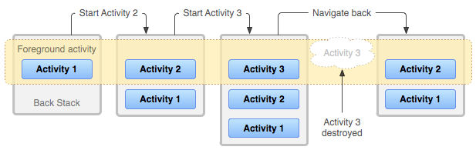
Activity’s lifecycle
Activities in the system are managed as an activity stack.
When a new activity is started, it is placed on the top of the stack and becomes the running activity
The previous activity remains below it in the stack
It will not come to the foreground again until the new activity exits
When you press the back button the current activity is destroyed
The stack's top activity is shown

Slide 25
Activity’s lifecycle
An activity has essentially four states
If an activity in the foreground of the screen (at the top of the stack), it is active or running.
In this example "Activity 1" is running / alive
Back Stack
Foreground activity
Activity 1
Activity 2

Slide 26
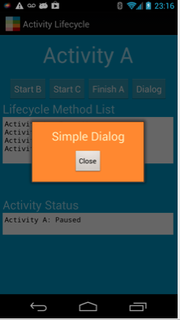
Activity’s lifecycle
An activity has essentially four states
If an activity has lost focus but is still visible (that is, a new non-full-sized or transparent activity has focus on top of your activity), it is paused.
A paused activity is completely alive (it maintains all state and member information and remains attached to the window manager)
However it can be killed by the system in extreme low memory situations.

Slide 27
Activity’s lifecycle
An activity has essentially four states
If an activity is completely obscured by another activity, it is stopped.
It still retains all state and member information, however, it is no longer visible to the user so its window is hidden and it will often be killed by the system when memory is needed elsewhere.
In this example "Activity 2" is stopped
Back Stack
Foreground activity
Activity 1
Activity 2

Slide 28
Activity’s lifecycle
If an activity is paused or stopped, the system can drop the activity from memory by either asking it to finish, or simply killing its process.
When it is displayed again to the user, it must be completely restarted and restored to its previous state.
It is your task as a programmer to save the state of the activity before it is killed
Android provides callback methods which can be used for this purpose

Slide 29
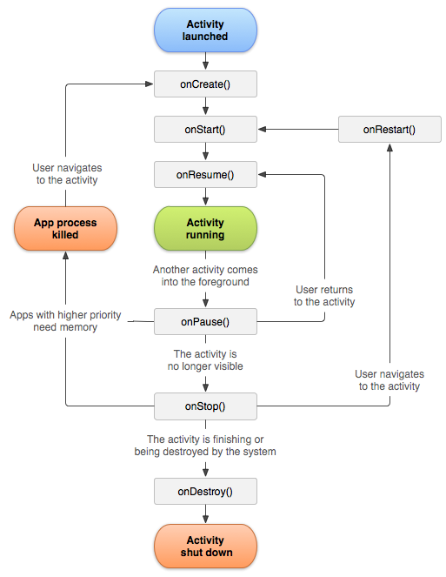
State Paths of an Activity
The square rectangles represent callback methods you can implement to perform operations when the Activity moves between states.
The colored ovals are major states the Activity can be in.

Slide 30

State Paths of an Activity
A simple application to learn to know all the stages of an activity’s lifecycle is just overriding all the lifecycle methods and outputting a message to the log
We will do this in the lab
When using Android Studio as an IDE just go to the activities java file and type the name of the method (onStop for example)
Code completion will suggest to override the base method
Select the correct one and hit TAB or ENTER to insert the snippet
If code completion is lost or does not kick in try to instantiate it using the CTRL-SPACE

Slide 31
Activity’s lifecycle
Crucial to know is that an Activity can be destroyed by the OS or the user at any time the activity loses focus
Hence you will need to provide the necessary code to save the state of your application when it is destroyed.
General guidelines
Use onCreate() to create and instantiate objects that your application will be using
Use onResume() to start any services or code that needs to run while your activity is in the foreground
Use onPause() to stop any services or code that does not need to run when your application is in the background
Use onDestroy() to free up resources before your activity is destroyed

Slide 32
Let's Try It Out
Let's add a console message to the onCreate() method of our MainActivity of CoolBrowser
Create filter to catch the messages with our tag
Override the onPause() method and also log message to console
Try messing around with the app and check when the onPause() and onCreate() methods are called
Log.v("TAG", "My message"); // Verbose Log.w("TAG", "My message"); // Warning Log.e("TAG", "My message"); // Error Log.d("TAG", "My message"); // Debug

Slide 33
Android Development Chapter 2 – Activities, Fragments and Intents
Event Handlers

Slide 34
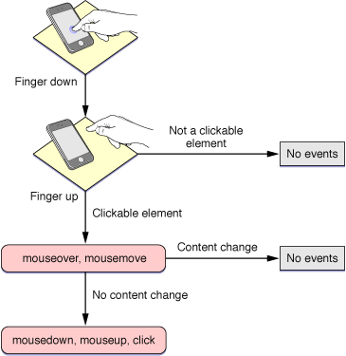
Event Handlers
An event handler is method that is called when a particular event takes place
Most typical example is the method that is called when a certain button is pressed

Slide 35
Event Handlers
An example of a button click event handler could be a Toast (small message)
This code will show a small message at the bottom (called a Toast in Android) when the button is clicked.
This is also called an event handler
Note the argument which is the View (graphical element) that caused the event handler to be fired
Always public and void (no return value)
You can use the ALT-ENTER shortcut key to import libraries when necessary
public void onAboutClick(View view) { Toast.makeText(this, "Should launch the about Activity", Toast.LENGTH_SHORT).show(); }

Slide 36
Event Handlers
While we did create a method with code to be executed when the button is pressed there is no connection between the method and the actual button
This needs to be done in the markup code of the button (in the XML file)
We call this registering an event handler
Notice that we need to specify the name of the method for the "onClick" property (case sensitive !)
Tab completion will be your best friend if you allow it to be !!!!
<Button android:layout_width="wrap_content" android:layout_height="wrap_content" android:text="About" android:id="@+id/btnAbout" android:layout_alignParentBottom="true" android:layout_centerHorizontal="true" android:onClick="onAboutClick"/>

Slide 37
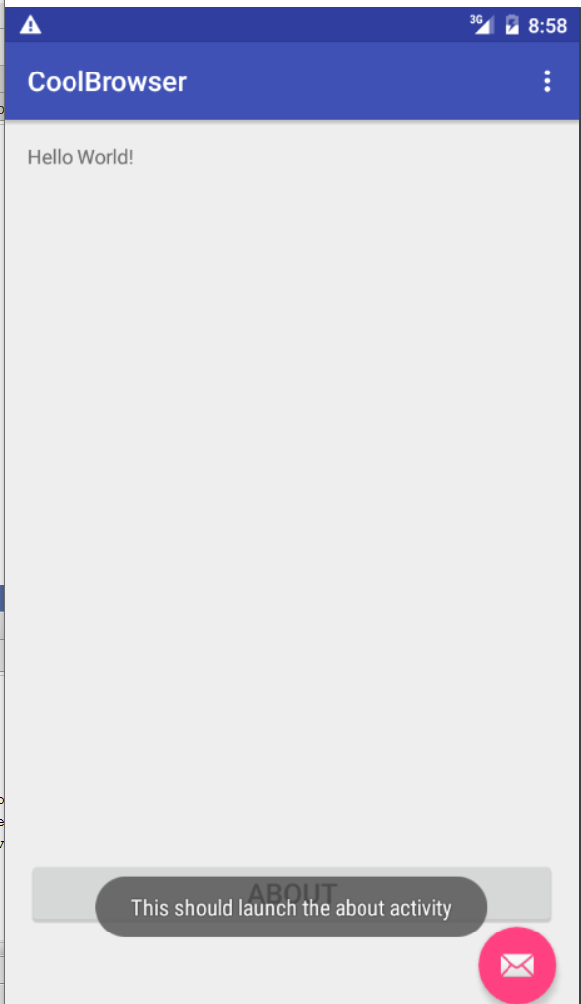
Let's Try It Out
Add a button to the Main Activity of the application with the text "About"
Add an event handler to show a toast message
Register the event handler with the about button on the main activity

Slide 38
Android Development Chapter 2 – Activities, Fragments and Intents
Intents

Slide 39
Intents
An Intent is a messaging object you can use to request an action from another app component.
There are three fundamental use-cases
To start an activity:
An Activity represents a single screen in an app. You can start a new instance of an Activity by passing an Intent to startActivity().
The Intent describes the activity to start and carries any necessary data.
Notes:
Source: http://developer.android.com/guide/components/intents-filters.html

Slide 40
Intents
To start a service:
A Service is a component that performs operations in the background without a user interface.
You can start a service to perform a one-time operation (such as download a file) by passing an Intent to startService().
The Intent describes the service to start and carries any necessary data.
To deliver a broadcast:
A broadcast is a message that any app can receive.
The system delivers various broadcasts for system events, such as when the system boots up or the device starts charging.
You can deliver a broadcast to other apps by passing an Intent to sendBroadcast(), sendOrderedBroadcast(), or sendStickyBroadcast().
Notes:
Source: http://developer.android.com/guide/components/intents-filters.html

Slide 41
Intent Types
There are two types of intents:
Explicit intents
Specify the component to start by name (the fully-qualified class name).
You'll typically use an explicit intent to start a component in your own app, because you know the class name of the activity or service you want to start.
When you create an explicit intent to start an activity or service, the system immediately starts the app component specified in the Intent object.
Implicit intents
Do not name a specific component, but instead declare a general action to perform, which allows a component from another app to handle it.
For example, if you want to show the user a location on a map, you can use an implicit intent to request that another capable app show a specified location on a map.

Slide 42
Intent Types
Implicit intents
When you create an implicit intent, the Android system finds the appropriate component to start by comparing the contents of the intent to the intent filters declared in the manifest file of other apps on the device.
If the intent matches an intent filter, the system starts that component and delivers it the Intent object.
If multiple intent filters are compatible, the system displays a dialog so the user can pick which app to use.

Slide 43
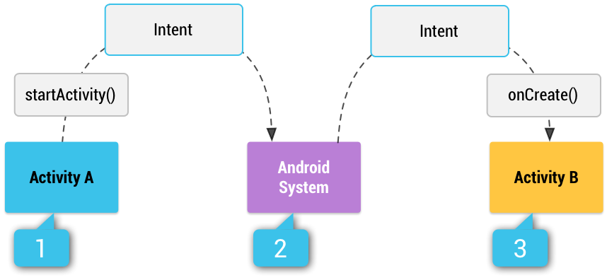
Intent Types – Implicit Intents
Example
Activity A creates an Intent with an action description and passes it to startActivity().
The Android System searches all apps for an intent filter that matches the intent.
When a match is found, the system starts the matching activity (Activity B) by invoking its onCreate() method and passing it the Intent.

Slide 44
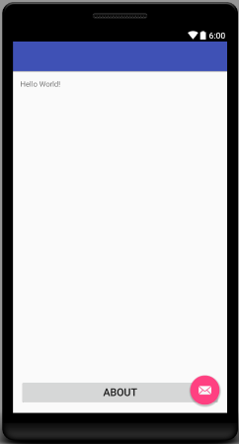
Linking Activities using Intents
An android device can have any number of activities.
When your application has more than one, you most likely want to navigate from one activity to another.
This can be achieved using intents.
Suppose a simple application with a MainActivity and an AboutActivity
Let's say we have an about button
<Button android:layout_width="wrap_content" android:layout_height="wrap_content" android:text="About" android:id="@+id/btnAbout" android:layout_alignParentBottom="true" android:layout_centerHorizontal="true" android:onClick="onAboutClick"/>
Method name of event handler

Slide 45
Linking Activities using Intents
If you do not specify any intent filters for your activity then it cannot be invoked using implicit intents
In this case you will need to use explicit intents to start the activity inside your own application
As the about activity should only be launched from inside our application we do not need to create an intent filter
To start the activity we use the startActivity(Intent intent) method
// Launch activity by creating an explicit intent Intent about = new Intent(this, AboutActivity.class); startActivity(about);

Slide 46
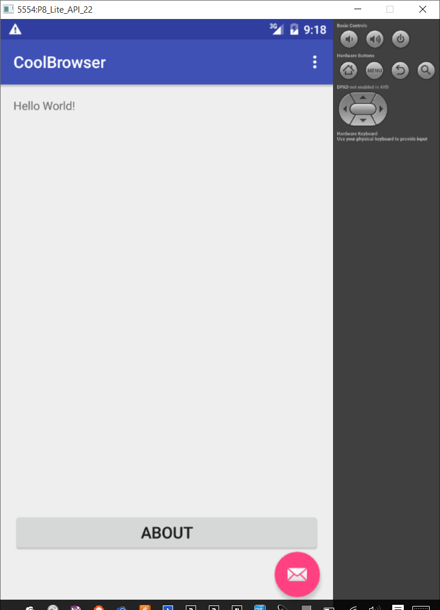
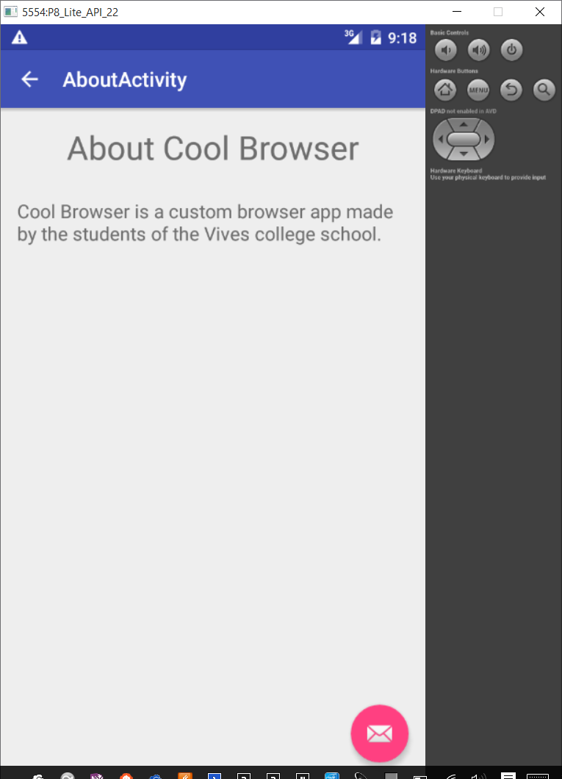
Let's Try It Out
Launch the AboutActivity when the user presses the about button

Slide 47
Android Development Chapter 2 – Activities, Fragments and Intents
Responding to Implicit Intents

Slide 48
Responding to Implicit Intents
Earlier, you saw how an activity can invoke another activity using the Intent object.
In order for other activities to invoke your activity, you need to specify the action and category within the <intent-filter> element in the AndroidManifest.xml file
Let’s create a new application and add the following intent filter to the MainActivity in the manifest file
<activity android:name=".MainActivity" android:label="@string/app_name" android:theme="@style/AppTheme.NoActionBar" > <intent-filter> <action android:name="android.intent.action.MAIN" /> <category android:name="android.intent.category.LAUNCHER" /> </intent-filter> <intent-filter> <action android:name="android.intent.action.VIEW" /> <category android:name="android.intent.category.DEFAULT" /> <data android:scheme="http" /> </intent-filter> </activity>

Slide 49
Responding to Implicit Intents
An intent filter is an expression in an app's manifest file that specifies the type of intents that the component would like to receive.
For instance, by declaring an intent filter for an activity, you make it possible for other apps to directly start your activity with a certain kind of intent.
Likewise, if you do not declare any intent filters for an activity, then it can be started only with an explicit intent

Slide 50
Responding to Implicit Intents
The following allows your activity to respond to a general ACTION_VIEW intent
The data node states that the intent data should adhere to the http-scheme
In other words, the data attached to the intent object should start with “http://”
To allow this to work we need to give the application permission to access the internet
Place the following permission node on the same level as the application node in the manifest file
<action android:name="android.intent.action.VIEW" />
<category android:name="android.intent.category.DEFAULT" />
<data android:scheme="http" />
<uses-permission android:name="android.permission.INTERNET"/>

Slide 51
Responding to Implicit Intents
Add a Webview component to the MainActivity GUI
<WebView android:layout_width="wrap_content" android:layout_height="wrap_content" android:id="@+id/webView" android:layout_alignParentTop="true" android:layout_alignParentStart="true" android:layout_alignParentEnd="true" />

Slide 52
Responding to Implicit Intents
We also need to extend the WebViewClient class and override the shouldOverrideUrlLoading() method
This is a private inner class inside MainActivity
public class MainActivity extends AppCompatActivity { private class WebViewCallback extends WebViewClient { @Override public boolean shouldOverrideUrlLoading(WebView view, String url) { // Allows the app to interfere with loading of a url return false; // return true means the host application handles the url // return false means the current WebView handles the url } } ...
Notes:
If we specify a webclient ourselfes (see next slide) we can return true here to handle a url by the app itself (not opening the url with the webview) or return false if we want the url to be loaded by the webview.
If we do not specify a webclient then the url will be loaded by another application that listens to the action_view intent filter.

Slide 53
Responding to Implicit Intents
In the onCreate() method of MainActivity we need to get the data (the url of the site) from the intent
@Override protected void onCreate(Bundle savedInstanceState) { super.onCreate(savedInstanceState); setContentView(R.layout.activity_main);
// ... if (getIntent().getData() != null){ // Get the URL Uri url = getIntent().getData(); // Get the WebView WebView webview = (WebView)findViewById(R.id.webView); // Specify a WebViewClient webview.setWebViewClient(new WebViewCallback()); // Load up the URL webview.loadUrl(url.toString()); } else {

Slide 54
Responding to Implicit Intents
public class MainActivity extends AppCompatActivity { private TextView info;
// ...
} else { // Else we create TextView at runtime with message to user info = new TextView(this); info.setText("No URL was specified to load."); info.setTextSize(18); RelativeLayout.LayoutParams lp = new RelativeLayout.LayoutParams( RelativeLayout.LayoutParams.FILL_PARENT, RelativeLayout.LayoutParams.WRAP_CONTENT); lp.addRule(RelativeLayout.ALIGN_PARENT_BOTTOM); ((ViewGroup)((WebView)findViewById(R.id.webView)).getParent()) .addView(info, lp); } }
More info on http://developer.android.com/reference/android/webkit/WebViewClient.html

Slide 55
Let's Try It Out
Create a blank activity called BrowserActivity
Add an intent filter to the BrowserActivity in the manifest file
Also add permission for internet use to the manifest file (same level as application)
Add a webview client to the GUI
Create inner class for callback
When the browser activity is created we need to fetch the url from the intent and give it to the webview

Slide 56

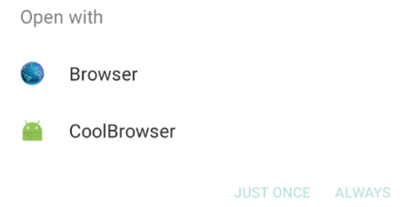
Let's Try It Out
Now how do we test this ??
Quickest solution is to open the notepad application and enter a url

Slide 57
Android Development Chapter 2 – Activities, Fragments and Intents
Passing Data to an Activity using an Intent Object
&
Sending an Implicit Intent

Slide 58
Passing Data using an Intent Object and Generating an Implicit Intent
It is common to pass data to an activity.
This can be done by using the Intent object to pass the data to the target activity.
Very similar to the way we pass data back from an Activity
Data can also be added and retrieved from an intent using the setData() and getData() methods
// Create the Intent object String url = "http://www.google.be"; Intent intent = new Intent(Intent.ACTION_VIEW); intent.setData(Uri.parse(url)); // Verify that the intent will resolve to an activity if (intent.resolveActivity(getPackageManager()) != null) { startActivity(intent); }

Slide 59

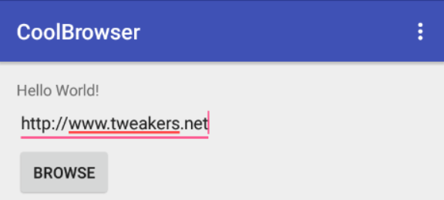
Let's Try It Out
Add a Plain Text element to an Activity UI
Add a Button element to an Activity UI
Create an event handler for the button and register it with the UI element
Get the URL from the Plain Text
Create intent
Add URL to intent
Start the activity

Slide 60
Android Development Chapter 2 – Activities, Fragments and Intents
Returning Results from an Activity

Slide 61
Returning Results from an Activity
Starting another activity doesn't have to be one-way. You can also start another activity and receive a result back. To receive a result, call startActivityForResult() (instead of startActivity()).
For example, your app can start a camera app and receive the captured photo as a result. Or, you might start the People app in order for the user to select a contact and you'll receive the contact details as a result.
Of course, the activity that responds must be designed to return a result.
When it does, it sends the result as another Intent object.
Your activity receives it in the onActivityResult() callback.

Slide 62
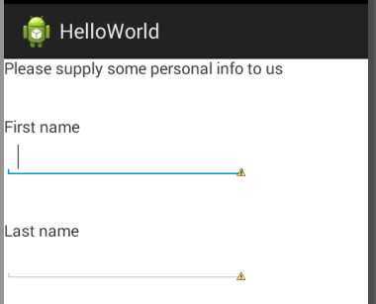
The Activity that will Return the Result
Let’s suppose we have an activity called AskPersonalInfoActivity which asks the user for some personal info
<LinearLayout
android:layout_width="wrap_content"
android:layout_height="wrap_content"
android:layout_alignBaseline="@+id/textView2"
android:layout_marginTop="56dp"
android:orientation="vertical" >
<TextView
android:id="@+id/txtFirstname"
android:layout_width="wrap_content"
android:layout_height="wrap_content"
android:layout_marginTop="38dp"
android:text="@string/firstname" />
<EditText
android:id="@+id/txtInputFirstname"
android:layout_width="wrap_content"
android:layout_height="wrap_content"
android:ems="10" >
<requestFocus />
</EditText>
...
....
<TextView
android:id="@+id/txtLastname"
android:layout_width="wrap_content"
android:layout_height="wrap_content"
android:layout_marginTop="38dp"
android:text="@string/lastname" />
<EditText
android:id="@+id/txtInputLastname"
android:layout_width="wrap_content"
android:layout_height="wrap_content"
android:ems="10" />
</LinearLayout>

Slide 63
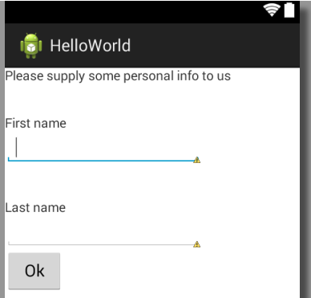
The Activity that will Return the Result
We also add an “Ok” button so we can confirm the input and return to the main activity
The handler is configured as onClick="onPersonalInfoOk“
In the manifest file an intent filter
<Button
android:id="@+id/btnOk"
android:layout_width="wrap_content"
android:layout_height="wrap_content"
android:text="@string/button_ok"
android:onClick="onPersonalInfoOk" />
<activity
android:name=".AskPersonalInfoActivity"
android:label="@string/title_activity_ask_personal_info" >
<intent-filter>
<action android:name="be.vives.nico.AskPersonalInfo" />
<category android:name="android.intent.category.DEFAULT" />
</intent-filter>
</activity>

Slide 64
Starting the Activity that will Generate the Result
The MainActivity has a button which has an onClick=“onPersonalInfo” handler set
There's nothing special about the Intent object you use when starting an activity for a result, but you do need to pass an additional integer argument to the startActivityForResult() method.
The integer argument is a "request code" that identifies your request. When you receive the result Intent, the callback provides the same request code so that your app can properly identify the result and determine how to handle it.
static final int ASK_PERSONAL_INFO = 1; // The request code
// ....
public void onPersonalInfo(View v) {
startActivityForResult(new Intent("be.vives.nico.AskPersonalInfo"), ASK_PERSONAL_INFO);
}

Slide 65
Creating the Result
As a result we want to return the values of the two TextViews (txtInputFirstname and txtInputlastname)
Need to be done inside the event handler of the Ok button
public void onPersonalInfoOk(View v) {
Intent intent = new Intent();
// Get EditText components
EditText fn = (EditText)findViewById(R.id.txtInputFirstname);
EditText ln = (EditText)findViewById(R.id.txtInputLastname);
// Get content of EditText
String firstname = fn.getText().toString();
String lastname = ln.getText().toString();
// Add to the data object
intent.putExtra("firstname", firstname);
intent.putExtra("lastname", lastname);
// Indicate all went well and add intent Object
setResult(RESULT_OK, intent);
// Kill the current activity
finish();
}
Key (as used with a HashMap)

Slide 66
Receiving the Result
When the user is done with the subsequent activity and returns, the system calls your activity's onActivityResult() method.
This method includes three arguments:
The request code you passed to startActivityForResult().
A result code specified by the second activity.
This is either RESULT_OK if the operation was successful or RESULT_CANCELED if the user backed out or the operation failed for some reason.
An Intent that carries the result data.

Slide 67
Receiving the Result
So inside our MainActivity we define the following callback method
@Override
protected void onActivityResult(int requestCode, int resultCode, Intent data) {
// Check which request we're responding to
if (requestCode == ASK_PERSONAL_INFO) {
// Make sure the request was successful
if (resultCode == RESULT_OK) {
String firstname = data.getStringExtra("firstname");
String lastname = data.getStringExtra("lastname");
Toast.makeText(this , "Hello " + firstname + " "
+ lastname, Toast.LENGTH_SHORT).show();
}
}
}
We need to use the method that corresponds to the actual object type
A toast provides simple feedback about an operation in a small popup. It only fills the amount of space required for the message and the current activity remains visible and interactive.

Slide 68
Returning Results from an Activity
Besides using the putExtra() method, you can also create a Bundle object and then attach it using the putExtras() method.
Think of a Bundle object as a dictionary object — it contains a set of name/value pairs.
The following statements create a Bundle object and then add two name/value pairs to it. It is then attached to the Intent object:
// use a Bundle object to add new name/values pairs
Bundle extras = new Bundle();
extras.putString("name", "Nico De Witte");
extras.putInt("age", 28);
// attach the Bundle object to the Intent object
Intent intent = new Intent();
intent.putExtras(extras);
// Retrieving the bundle
Bundle bundle = getIntent().getExtras();
See book page 67 and 68

Slide 69
Android Development Chapter 2 – Activities, Fragments and Intents
Fragments

Slide 70
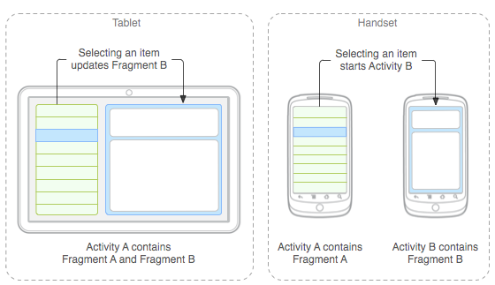
Fragments
Check out https://www.airpair.com/android/fragments-android-studio
Has some good images

