Slide 1

Android Development
Chapter 6 – Data Persistence

Slide 2
Android Development Chapter 6 – Data Persistence
Data Persistence

Slide 3
Data Persistence
Persisting data is an important topic in application development
Users typically expect to reuse data in the future
Example
User information
Configuration settings (preferences)
Application data
Logs
...

Slide 4
Data Persistence
Android provides several options for you to save persistent application data.
The solution you choose depends on your specific needs, such as whether the data should be private to your application or accessible to other applications (and the user) and how much space your data requires.
Your data storage options are
Shared Preferences
Store private primitive data in key-value pairs
Internal Storage
Store private data on the device memory
External Storage
Store public data on the shared external storage
SQLite Databases
Store structured data in a private database
Network Connection
Store data on the web with your own network server

Slide 5
Android SQLite
Saving data to a database is ideal for repeating or structured data
Ex.: contact information.
Using a database is much more efficient for storing this type of data.
Easy to use and allows selection based on database queries
Moreover, using databases enables you to enforce data integrity by specifying the relationships between different sets of data.
Android uses the SQLite database system.
The database that you create for an application is only accessible to itself; other applications will not be able to access it.

Slide 6
Android Development Chapter 6 – Data Persistence
User Preferences

Slide 7
Saving and Loading User Preferences
Android provides the SharedPreferences object to help you save simple application data.
For example
Your application may have an option that enables users to specify the font size of the text displayed in your application.
In this case, your application needs to remember the size set by the user so that the next time he or she uses the application again, it can set the size appropriately.
In order to do so, you have several options.
You can save the data to a file, but you have to perform some file management routines, such as writing the data to the file, indicating how many characters to read from it, and so on.
Also, if you have several pieces of information to save, such as text size, font name, preferred background color, and so on, then the task of writing to a file becomes more onerous.
Notes:
http://developer.android.com/guide/topics/ui/settings.html

Slide 8
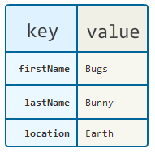
Saving and Loading User Preferences
An alternative to writing to a text file is to use a database
However saving simple data to a database is a bit overkill
Both from a developer’s point of view and in terms of the application’s run-time performance.
Using the SharedPreferences object, however, you save the data you want through the use of name/value pairs
Can also be used to save small chunks of general data
Specify a name for the data you want to save, and then both it and its value will be saved automatically to an XML file for you.
Notes:
http://developer.android.com/guide/topics/ui/settings.html

Slide 9
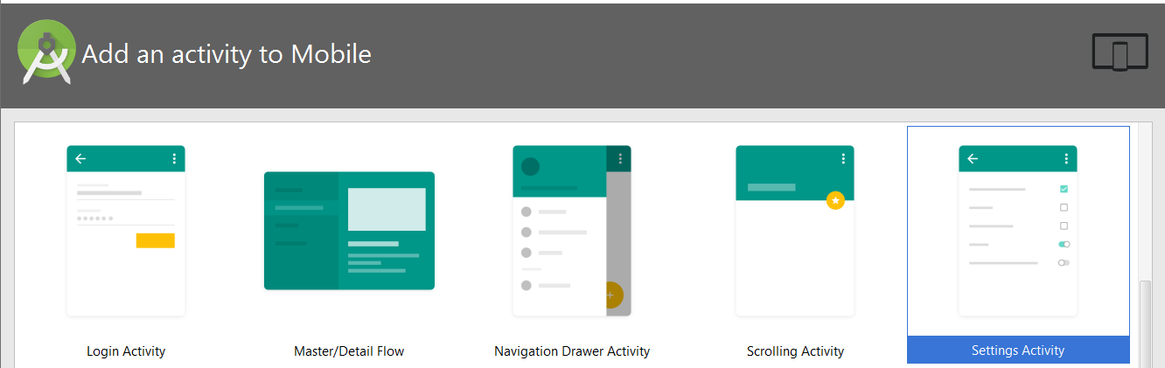
Saving and Loading User Preferences
Android Studio makes it extremely easy for us to create a nice looking and user friendly Preferences activity
Just create a new activity based on the Settings template
Notes:
http://developer.android.com/guide/topics/ui/settings.html

Slide 10

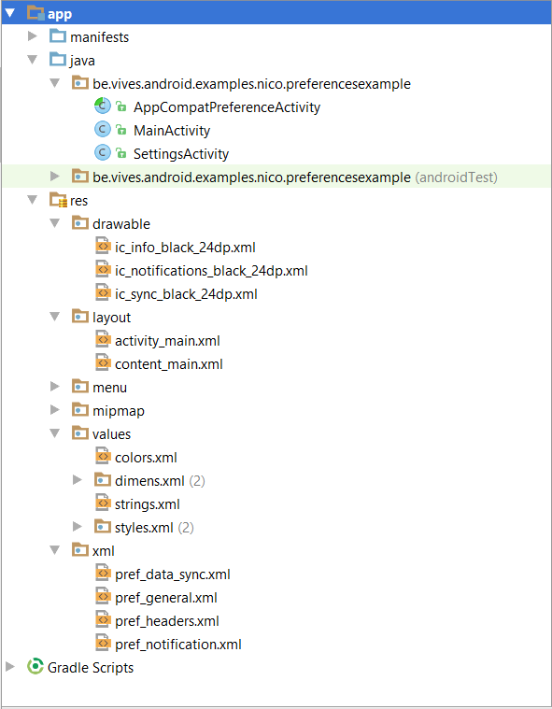
The Settings Activity Template
This template generates a fair amount of files for you
Can be a bit overwhelming
Take a deep breath and dive in
SettingsActivity is the Java file that contains the code to setup the actions bar, render the view of the settings and also fix some compatibility issues for older versions
May need some changes when adding or changing preferences !
Drawable contains some cool looking icons that will be drawn next to the categories of settings
To bad that breaks our program ☺
Notes:
http://developer.android.com/guide/topics/ui/settings.html

Slide 11
The Settings Activity Template
To fix the drawable "ic_sync_black_24dp.xml" go to https://github.com/google/material-design-icons/blob/master/notification/drawable-anydpi-v21/ic_sync_black_24dp.xml
Take note that not layout files are generated.
The full view is build dynamically based on the settings that are defined
Values/strings.xml contains some new entries such as the category titles and preference labels
Good practice, do the same !!
Notes:
http://developer.android.com/guide/topics/ui/settings.html

Slide 12
The Settings Activity Template
Xml
pref_data_sync.xml
pref_general.xml
pref_notification.xml
These contain the actual settings for the categories
Data & sync
General
Notifications
Notes:
http://developer.android.com/guide/topics/ui/settings.html

Slide 13
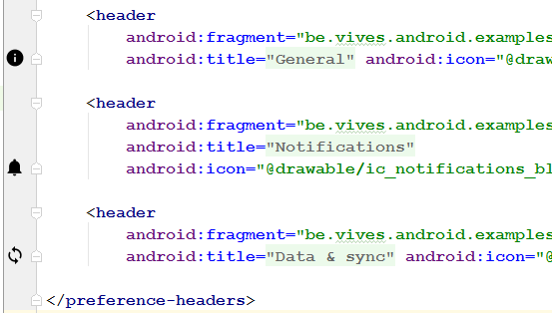
The Settings Activity Template
Xml
pref_headers.xml contains the header view when the settings activity is opened.
Allows us to easily group our settings in different groups
Checkout the icons that are shown on the left
Notes:
http://developer.android.com/guide/topics/ui/settings.html

Slide 15

Let's Hack @ it

Slide 16
Accessing the User's Preferences
Now that we got our settings defined we need to access the values of the preferences
To make life easier we are first going to declare a static string for each setting key inside the Settings Activity class
The actual string name contains the key of the setting defined in the xml file
public class SettingsActivity extends AppCompatPreferenceActivity { // Setting Keys public static final String PREF_DISPLAY_NAME = "display_name"; @Override protected void onCreate(Bundle savedInstanceState) { super.onCreate(savedInstanceState); setupActionBar(); }
...

Slide 17
Accessing the User's Preferences
Now we can access the settings inside any activity as follows
SharedPreferences sharedPref = PreferenceManager.getDefaultSharedPreferences(this); String name = sharedPref.getString(SettingsActivity.PREF_DISPLAY_NAME, "John Doe");
Default value if key was empty or not found

Slide 18

Would You Like to Know More ?
http://developer.android.com/guide/topics/ui/settings.html

