Slide 1

Android Development
Chapter 6 – Data Persistence

Slide 2
Android Development Chapter 6 – Data Persistence
Data Persistence

Slide 3
Data Persistence
Persisting data is an important topic in application development
Users typically expect to reuse data in the future
Example
User information
Configuration settings (preferences)
Application data
Logs
...

Slide 4
Data Persistence
Android provides several options for you to save persistent application data.
The solution you choose depends on your specific needs, such as whether the data should be private to your application or accessible to other applications (and the user) and how much space your data requires.
Your data storage options are
Shared Preferences
Store private primitive data in key-value pairs
Internal Storage
Store private data on the device memory
External Storage
Store public data on the shared external storage
SQLite Databases
Store structured data in a private database
Network Connection
Store data on the web with your own network server

Slide 5
Android Development Chapter 6 – Data Persistence
Creating and Using Databases

Slide 6
Android SQLite
Saving data to a database is ideal for repeating or structured data
Ex.: contact information.
Using a database is much more efficient for storing this type of data.
Easy to use and allows selection based on database queries
Moreover, using databases enables you to enforce data integrity by specifying the relationships between different sets of data.
Android uses the SQLite database system.
The database that you create for an application is only accessible to itself; other applications will not be able to access it.

Slide 7
Defining a Schema
One of the main principles of SQL databases is the schema
A formal declaration of how the database is organized
The schema is reflected in the SQL statements that you use to create your database.
You may find it helpful to create a companion class, known as a contract class, which explicitly specifies the layout of your schema in a systematic and self-documenting way.
A contract class is a container for constants that define names for URIs, tables, and columns.
It allows you to use the same constants across all the other classes in the same package.
A good way to organize a contract class is to put definitions that are global to your whole database in the root level of the class.
Then create an inner class for each table that enumerates its columns.

Slide 8
The Target Class
The Target class is the representation of our object of interest
public class Target {
private long id; // For database
private String uri; // Uri can be IP address, host name, ...
private int successes;
private int fails;
private int subsequentFails;
private ArrayList<String> history_log;
// ....
}

Slide 9
The Contract Class - DbContract
public final class DbContract {
// Global db definitions
public static final String DATABASE_NAME = "ServerStatus.db";
// To prevent someone from accidentally instantiating the contract class,
// give it an empty constructor.
public DbContract() {}
/* Inner class that defines the table contents */
public static abstract class TargetEntry implements BaseColumns {
public static final String TABLE_NAME = "targets";
public static final String COLUMN_NAME_ID = TargetEntry._ID;
public static final String COLUMN_NAME_URI = "uri";
public static final String COLUMN_NAME_SUCCESSES = "successes";
public static final String COLUMN_NAME_FAILS = "fails";
public static final String COLUMN_NAME_SUBSEQUENT_FAILS = "subsequent_fails";
public static final String[] ALL_COLUMNS = {
TargetEntry.COLUMN_NAME_ID,
TargetEntry.COLUMN_NAME_URI,
TargetEntry.COLUMN_NAME_SUCCESSES,
TargetEntry.COLUMN_NAME_FAILS,
TargetEntry.COLUMN_NAME_SUBSEQUENT_FAILS
};
}
}

Slide 10
The Database Helper Class - SQLiteOpenHelper
Once you have defined how your database looks, you should implement methods that create and maintain the database and tables.
A useful set of APIs is available in the SQLiteOpenHelper class.
When you use this class to obtain references to your database, the system performs the potentially long-running operations of creating and updating the database only when needed and not during app startup.
All you need to do is call getWritableDatabase() or getReadableDatabase().
Because they can be long-running, be sure that you call getWritableDatabase() or getReadableDatabase() in a background thread, such as with AsyncTask or IntentService.
To use SQLiteOpenHelper, create a subclass that overrides the onCreate() and onUpgrade() callback methods.
You may also want to implement onDowngrade() and onOpen(), but it's not required.

Slide 11
The Database Helper Class - SQLiteOpenHelper
public class DbHelper extends SQLiteOpenHelper {
private static final String TAG = "DbHelper";
// If you change the database schema, you must increment the database version.
private static final int DATABASE_VERSION = 1;
// Some helping constants
private static final String TEXT_TYPE = " TEXT";
private static final String INTEGER_TYPE = " INTEGER";
private static final String COMMA_SEP = ",";
// SQL statement for creating tables
private static final String SQL_CREATE_TARGETS_TABLE =
"CREATE TABLE " + TargetEntry.TABLE_NAME + " (" +
TargetEntry._ID + " INTEGER PRIMARY KEY," +
TargetEntry.COLUMN_NAME_URI + TEXT_TYPE + COMMA_SEP +
TargetEntry.COLUMN_NAME_SUCCESSES + INTEGER_TYPE + COMMA_SEP +
TargetEntry.COLUMN_NAME_FAILS + INTEGER_TYPE + COMMA_SEP +
TargetEntry.COLUMN_NAME_SUBSEQUENT_FAILS + INTEGER_TYPE +
" )";
// SQL statement for deleting tables
private static final String SQL_DELETE_TARGETS_TABLE =
"DROP TABLE IF EXISTS " + TargetEntry.TABLE_NAME;
public DbHelper(Context context) {
super(context, DbContract.DATABASE_NAME, null, DATABASE_VERSION);
}
// ......

Slide 12
The Database Helper Class - SQLiteOpenHelper
// ......
// Create the necessary tables
public void onCreate(SQLiteDatabase db) {
db.execSQL(SQL_CREATE_TARGETS_TABLE);
}
// Upgrade the database to the newer version
public void onUpgrade(SQLiteDatabase db, int oldVersion, int newVersion) {
// This database is only a cache for online data, so its upgrade policy is
// to simply to discard the data and start over
Log.w(TAG, "Upgrading db from " + oldVersion + " to “
+ newVersion + " which deletes all data");
db.execSQL(SQL_DELETE_TARGETS_TABLE);
onCreate(db);
}
}

Slide 13
The Data Source Class - TargetDataSource
A good practice for dealing with databases is to create a data source class to encapsulate all the complexities of accessing your data so that it is transparent to the calling code.
public class TargetsDataSource {
// Database and Helper
private SQLiteDatabase database;
private DbHelper dbHelper;
public TargetsDataSource(Context context) {
dbHelper = new DbHelper(context);
}
// Open the db connection
public void open() throws SQLException {
database = dbHelper.getWritableDatabase();
}
public void close() {
dbHelper.close();
}
// ...

Slide 14
The Data Source Class - TargetDataSource
// ......
public Target insertTarget(Target target) {
// Add fields of target to content values
ContentValues values = new ContentValues();
values.put(TargetEntry.COLUMN_NAME_URI, target.getUri());
values.put(TargetEntry.COLUMN_NAME_SUCCESSES, target.getSuccesses());
values.put(TargetEntry.COLUMN_NAME_FAILS, target.getFails());
values.put(TargetEntry.COLUMN_NAME_SUBSEQUENT_FAILS, target.getSubsequentFails());
// Insert the new row, returning the primary key value of the new row
long insertId = database.insert(
TargetEntry.TABLE_NAME,
null, // Column that can be null
values);
Log.v("Database", "Created new target " + target + " with id: " + insertId);
// Get the new target from the db
return this.getTarget(insertId);
}
// ......

Slide 15
The Data Source Class - TargetDataSource
public Target getTarget(long id) {
// Do the query
Cursor cursor = database.query(
TargetEntry.TABLE_NAME, // The table to query
TargetEntry.ALL_COLUMNS, // The columns to return
TargetEntry.COLUMN_NAME_ID + " = " + id, // The columns for the WHERE clause
null, // The values for the WHERE clause
null, // don't group the rows
null, // don't filter by row groups
null // The sort order
);
cursor.moveToFirst();
// Get the target from the db
Target target = null;
try {
target = cursorToTarget(cursor);
} catch (Exception e) {
Log.d("Database", e.getMessage());
target = null;
} finally {
cursor.close();
}
return target;
}

Slide 16
The Data Source Class - TargetDataSource
private Target cursorToTarget(Cursor cursor) throws Exception {
// Create new target
Target target = new Target(cursor.getString(cursor.getColumnIndex(TargetEntry.COLUMN_NAME_URI)));
target.setId(cursor.getLong(cursor.getColumnIndex(TargetEntry.COLUMN_NAME_ID)));
target.setStats(
cursor.getInt(cursor.getColumnIndex(TargetEntry.COLUMN_NAME_SUCCESSES)),
cursor.getInt(cursor.getColumnIndex(TargetEntry.COLUMN_NAME_FAILS)),
cursor.getInt(cursor.getColumnIndex(TargetEntry.COLUMN_NAME_SUBSEQUENT_FAILS)));
return target;
}
public void deleteTarget(Target target) {
long id = target.getId();
database.delete(TargetEntry.TABLE_NAME, TargetEntry.COLUMN_NAME_ID + " = " + id, null);
Log.v("Database", "Target deleted with id: " + id);
}

Slide 17
The Data Source Class - TargetDataSource
public ArrayList<Target> getAllTargets() {
ArrayList<Target> targets = new ArrayList<Target>();
// Get all target records and add them to the list
Cursor cursor = database.query(
TargetEntry.TABLE_NAME, // The table to query
TargetEntry.ALL_COLUMNS, // The columns to return
null, // The columns for the WHERE clause
null, // The values for the WHERE clause
null, // don't group the rows
null, // don't filter by row groups
null // The sort order
);
cursor.moveToFirst();
while (!cursor.isAfterLast()) {
try {
Target target = cursorToTarget(cursor);
targets.add(target);
} catch (Exception e) {
Log.d("Database", e.getMessage());
}
cursor.moveToNext();
}
// Make sure to close the cursor
cursor.close();
return targets;
}

Slide 18
Checkout Toledo
Database DEMO

Slide 19
Android Development Chapter 6 – Data Persistence
Saving and Loading User Preferences

Slide 20
Saving and Loading User Preferences
Android provides the SharedPreferences object to help you save simple application data.
For example
Your application may have an option that enables users to specify the font size of the text displayed in your application.
In this case, your application needs to remember the size set by the user so that the next time he or she uses the application again, it can set the size appropriately.
In order to do so, you have several options.
You can save the data to a file, but you have to perform some file management routines, such as writing the data to the file, indicating how many characters to read from it, and so on.
Also, if you have several pieces of information to save, such as text size, font name, preferred background color, and so on, then the task of writing to a file becomes more onerous.

Slide 21
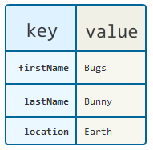
Saving and Loading User Preferences
An alternative to writing to a text file is to use a database
However saving simple data to a database is a bit overkill
Both from a developer’s point of view and in terms of the application’s run-time performance.
Using the SharedPreferences object, however, you save the data you want through the use of name/value pairs
Can also be used to save small chunks of general data
Specify a name for the data you want to save, and then both it and its value will be saved automatically to an XML file for you.

Slide 22
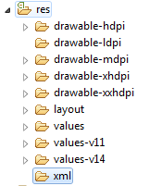
Creating a Preferences XML file
Step 1 – Start by creating an xml folder inside the res folder

Slide 23
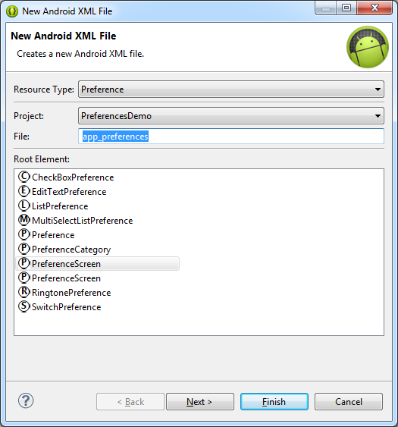
Creating a Preferences XML file
Step 2 – Right click the xml folder and select “New XML file”
Set the resource type to Preferences and select PreferenceScreen as the root element
Give the file a name

Slide 24
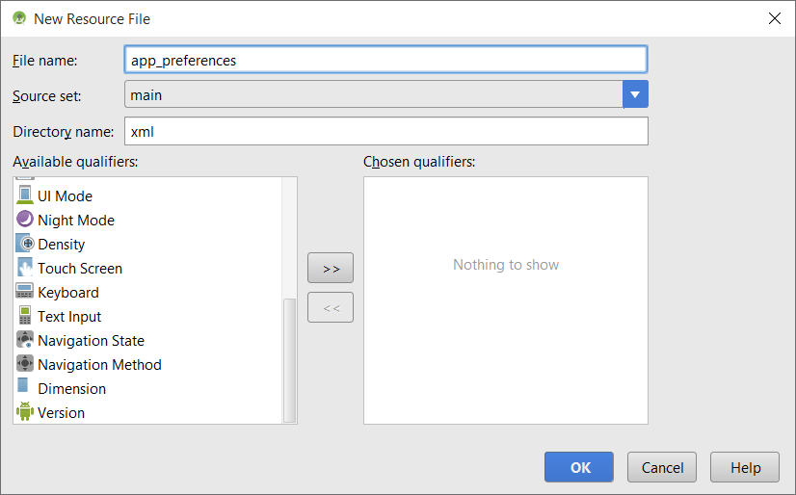

Slide 25
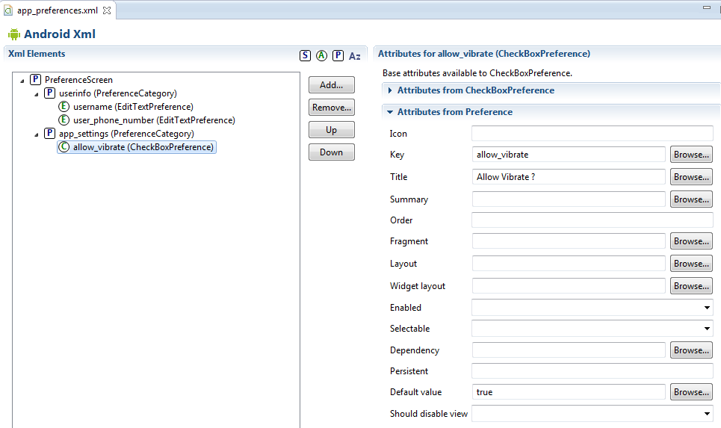
Building the Preferences Structure
Step 3 – The preference options and hierarchy can be easily build using the visual editor in Eclipse

Slide 26
Creating an Activity to Display the Preferences
Step 4 – Create a new Activity called AppPreferenceActivity and remove the layout file
Step 5 - Let the activity inherit from PreferenceActivity and load the preferences from the XML file in the onCreate() method
May give a deprecated warning but can be ignored for the moment
public class AppPreferenceActivity extends PreferenceActivity {
@Override
protected void onCreate(Bundle savedInstanceState) {
super.onCreate(savedInstanceState);
//setContentView(R.layout.activity_app_preference);
// Load the preferences from the xml file
addPreferencesFromResource(R.xml.app_preferences);
}
}

Slide 27
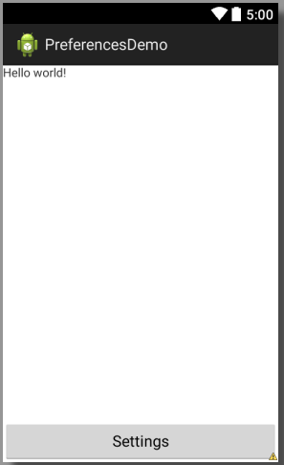
Access to the Preferences Activity
Step 6 – Add a way to launch your preferences activity
public void onSettings(View v) {
// Launch settings activity
startActivity(new Intent(this,
AppPreferenceActivity.class));
}

Slide 28
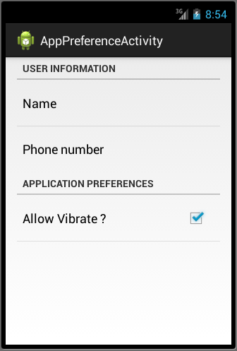
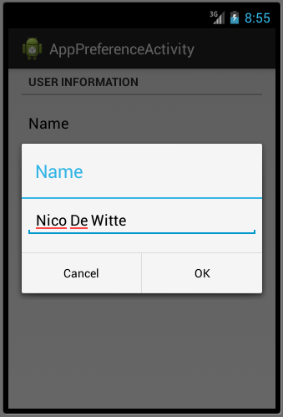
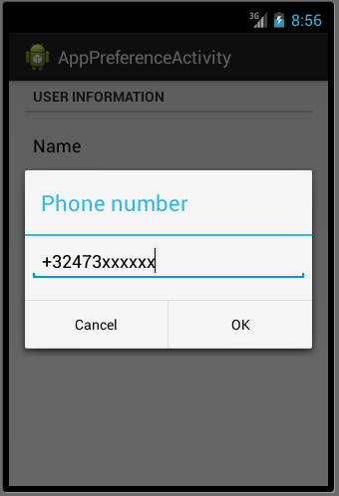
The End Result

Slide 29
The End Result
You can actually download the written XML file from the emulator (and from some phones)
Open the DDMS perspective (Window => Open Perspective => DDMS)
Open the File Explorer tab and make sure you select the correct device on the left
Navigate to /data/data/<your_package_path/shared_prefs/<your_file.xml>
Pull it from the device (top right of the DDMS)
<?xml version='1.0' encoding='utf-8' standalone='yes' ?>
<map>
<string name="user_phone_number">+32473xxxxxx</string>
<string name="username">Nico De Witte</string>
<boolean name="allow_vibrate" value="false" />
</map>

Slide 30
How to retrieve the preferences
First we need to get the SharedPreferences object for our app
"be.vives.nico.serverstatus_preferences“ is the name of the actual preferences file
Consist of your package name, application name and “_preferences”
Now we can access the preference elements
Second parameter is default value in case the preference is not found
SharedPreferences appPrefs =
getSharedPreferences("be.vives.nico.serverstatus_preferences",
MODE_PRIVATE);
boolean alarm_dovibrate = appPrefs.getBoolean("allow_vibrate", false);
String username = appPrefs.getString("username", "Anonymnous");
String alarm_phonenumber = appPrefs.getString("user_phone_number", "");

