Slide 1

Android Development
Chapter 3 – Getting to know the Android User Interface
Notes:
https://www.google.com/design/spec/material-design/

Slide 2
Android Development Chapter 3 – Getting to know the Android User Interface
The User Interface

Slide 3
The User Interface
All user interface elements in an Android app are built using View and ViewGroup objects.
A View is an object that draws something on the screen that the user can interact with.
A ViewGroup is an object that holds other View (and ViewGroup) objects in order to define the layout of the interface.
Android provides a collection of both View and ViewGroup subclasses that offer you common input controls (such as buttons and text fields) and various layout models (such as a linear or relative layout).

Slide 4
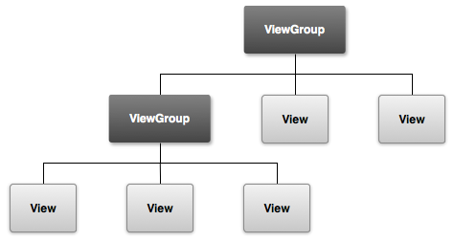
User Interface Layout
The user interface for each component of your app is defined using a hierarchy of View and ViewGroup objects.
Each view group is an invisible container that organizes child views
The child views may be input controls or other widgets that draw parts of the UI
This hierarchy tree can be as simple or complex as you need it to be
Simplicity is best for performance
When you load a layout resource in your app, Android initializes each node of the layout into a runtime object
Can be used to define additional behaviors, query the object state or modify the layout

Slide 5
Android Development Chapter 3 – Getting to know the Android User Interface
Layouts

Slide 6
Layouts
A layout defines the visual structure for a user interface, such as the UI for an activity or app widget.
You can declare a layout in two ways:
Declare UI elements in XML
Android provides a straightforward XML vocabulary that corresponds to the View classes and subclasses, such as those for widgets and layouts.
Instantiate layout elements at runtime.
Your application can create View and ViewGroup objects (and manipulate their properties) programmatically.
The Android framework gives you the flexibility to use either or both of these methods for declaring and managing your application's UI.

Slide 7
XML
Each layout file must contain exactly one root element, which must be a View or ViewGroup object.
Once you've defined the root element, you can add additional layout objects or widgets as child elements to gradually build a View hierarchy that defines your layout.
<?xml version="1.0" encoding="utf-8"?>
<LinearLayout xmlns:android="http://schemas.android.com/apk/res/android"
android:layout_width="match_parent"
android:layout_height="match_parent"
android:orientation="vertical" >
<TextView android:id="@+id/text"
android:layout_width="wrap_content"
android:layout_height="wrap_content"
android:text="Hello, I am a TextView" />
<Button android:id="@+id/button"
android:layout_width="wrap_content"
android:layout_height="wrap_content"
android:text="Hello, I am a Button" />
</LinearLayout>
Notes:
wrap_content tells your view to size itself to the dimensions required by its content.
match_parent (named fill_parent before API Level 8) tells your view to become as big as its parent view group will allow.

Slide 8

Instantiate layout elements at runtime
Create View dynamically
You should probable save it as an attribute of the class
Set properties of the view
Set layout parameters
Add it to the necessary container

Slide 9
Instantiate layout elements at runtime SOLUTION be.vives.android.examples.nico.runtimecomponentsexample;
Class attribute
onCreate()
This approach expects a View with id already present
private Button btnRuntime;
btnRuntime = new Button(this); btnRuntime.setText("Click me"); btnRuntime.setOnClickListener(new Button.OnClickListener() { @Override public void onClick(View v) { Toast.makeText(getApplicationContext(), "Dude you totally clicked me", Toast.LENGTH_SHORT).show(); } }); RelativeLayout.LayoutParams lp = new RelativeLayout.LayoutParams(RelativeLayout.LayoutParams.FILL_PARENT, RelativeLayout.LayoutParams.WRAP_CONTENT); lp.addRule(RelativeLayout.ALIGN_PARENT_BOTTOM); ((ViewGroup)((TextView)findViewById(R.id.txtHello)).getParent())
.addView(btnRuntime, lp);

Slide 10
Absolute and Relative Measurements
In general, specifying a layout width and height using absolute units such as pixels is not recommended.
Instead, using relative measurements such as density-independent pixel units (dp), wrap_content, or match_parent, is a better approach, because it helps ensure that your application will display properly across a variety of device screen sizes.
Absolute measurements
px (Pixels)
Corresponds to actual pixels on the screen.
in (Inches)
Based on the physical size of the screen.
mm (Millimeters)
Based on the physical size of the screen.
pt (Points)
1/72 of an inch based on the physical size of the screen.

Slide 11
Absolute and Relative Measurements
Relative measurements
dp (Density-independent Pixels)
An abstract unit that is based on the physical density of the screen. These units are relative to a 160 dpi screen, so one dp is one pixel on a 160 dpi screen.
The ratio of dp-to-pixel will change with the screen density, but not necessarily in direct proportion.
Note: The compiler accepts both "dip" and "dp", though "dp" is more consistent with "sp".
sp (Scale-independent Pixels)
This is like the dp unit, but it is also scaled by the user's font size preference.
It is recommend you use this unit when specifying font sizes, so they will be adjusted for both the screen density and user's preference.

Slide 12
Density Support
Example
Using px for dimensions (bad practice)
80 x 160 px
80 x 160 px
800 x 1600
160 dpi
1600 x 3200
320 dpi

Slide 13
Density Support
Example
Using dp for dimensions (good practice)
Translates to 160 x 320 px
80 x 160 dp
80 x 160 dp
800 x 1600
160 dpi
1600 x 3200
320 dpi

Slide 14
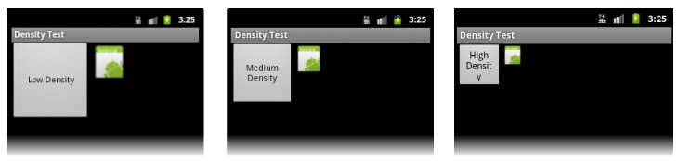
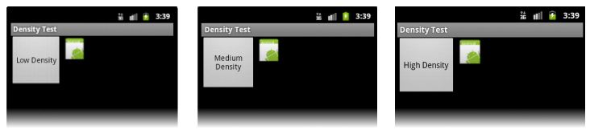
Density Support
Bad:
Good:

Slide 15
Best Practices
Use wrap_content, fill_parent, or the dp unit for layout dimensions
Do not use hard-coded pixel values in your application code
Do not use AbsoluteLayout
Deprecated
Use size and density-specific resources
res/drawable-mdpi/icon.png //for medium-density screens
res/drawable-hdpi/icon.png //for high-density screens

Slide 16
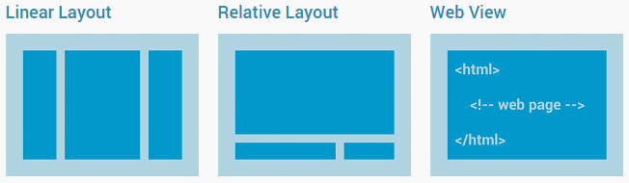
Some Common Layouts
Although you can nest one or more layouts within another layout to achieve your UI design, you should strive to keep your layout hierarchy as shallow as possible.
Your layout draws faster if it has fewer nested layouts (a wide view hierarchy is better than a deep view hierarchy).

Slide 17
Linear Layout
A layout that organizes its children into a single horizontal or vertical row.
It creates a scrollbar if the length of the window exceeds the length of the screen.
You can specify the layout direction with the android:orientation attribute.
All children of a LinearLayout are stacked one after the other
so a vertical list will only have one child per row, no matter how wide they are
a horizontal list will only be one row high (the height of the tallest child, plus padding).
A LinearLayout respects margins between children and the gravity (right, center, or left alignment) of each child.

Slide 18
The Weight Attribute
LinearLayout also supports assigning a weight to individual children with the android:layout_weight attribute.
This attribute assigns an "importance" value to a view in terms of how much space it should occupy on the screen.
A larger weight value allows it to expand to fill any remaining space in the parent
Child views can specify a weight value, and then any remaining space in the view group is assigned to children in the proportion of their declared weight.
Default weight is zero.
Example:
You have a MapView and a Table which should show some additional information to the map. The map should use 3/4 of the screen and table should use 1/4 of the screen. Then you will set the layout_weight of the map to 3 and the layout_weight of the table to 1.
To get it work you also have to set the height or width (depending on your orientation) to 0px.

Slide 19
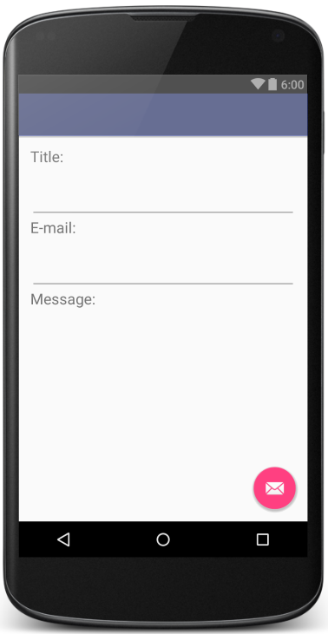
Example
<LinearLayout android:orientation="vertical" android:layout_width="match_parent" android:layout_height="match_parent"> <TextView android:layout_width="wrap_content" android:layout_height="wrap_content" android:text="Title:" android:textSize="20sp" android:paddingEnd="8dp"/> <EditText android:layout_width="match_parent" android:layout_height="wrap_content" android:layout_weight="1" /> <TextView android:layout_width="wrap_content" android:layout_height="wrap_content" android:text="E-mail:" android:textSize="20sp" android:paddingEnd="8dp" /> <EditText android:layout_width="match_parent" android:layout_height="wrap_content" android:layout_weight="1" /> <TextView android:layout_width="wrap_content" android:layout_height="wrap_content" android:text="Message:" android:textSize="20sp" android:paddingEnd="8dp" /> <EditText android:layout_width="match_parent" android:layout_height="wrap_content" android:inputType="textMultiLine" android:ems="10" android:layout_weight="10" /> </LinearLayout>

Slide 20
Relative Layout
Enables you to specify the location of child objects relative to each other (specified by ID) or to the parent (aligned to the top of the parent).
A RelativeLayout is a very powerful utility for designing a user interface because it can eliminate nested view groups and keep your layout hierarchy flat, which improves performance.
If you find yourself using several nested LinearLayout groups, you may be able to replace them with a single RelativeLayout.

Slide 21
Relative Layout
Some of the many layout properties available to views in a RelativeLayout include:
android:layout_alignParentTop
If "true", makes the top edge of this view match the top edge of the parent.
android:layout_centerVertical
If "true", centers this child vertically within its parent.
android:layout_below
Positions the top edge of this view below the view specified with a resource ID.
android:layout_toRightOf
Positions the left edge of this view to the right of the view specified with a resource ID.
The value for each layout property is either a boolean to enable a layout position relative to the parent RelativeLayout or an ID that references another view in the layout against which the view should be positioned.

Slide 22
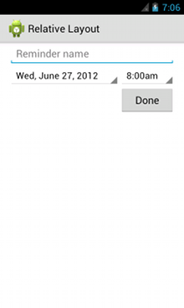
Example
<?xml version="1.0" encoding="utf-8"?>
<RelativeLayout xmlns:android="http://schemas.android.com/apk/res/android"
android:layout_width="match_parent"
android:layout_height="match_parent"
android:paddingLeft="16dp"
android:paddingRight="16dp" >
<EditText
android:id="@+id/name"
android:layout_width="match_parent"
android:layout_height="wrap_content"
android:hint="@string/reminder" />
<Spinner
android:id="@+id/dates"
android:layout_width="0dp"
android:layout_height="wrap_content"
android:layout_below="@id/name"
android:layout_alignParentLeft="true"
android:layout_toLeftOf="@+id/times" />
<Spinner
android:id="@id/times"
android:layout_width="96dp"
android:layout_height="wrap_content"
android:layout_below="@id/name"
android:layout_alignParentRight="true" />
<Button
android:layout_width="96dp"
android:layout_height="wrap_content"
android:layout_below="@id/times"
android:layout_alignParentRight="true"
android:text="@string/done" />
</RelativeLayout>
Most of this can be achieved relatively easily by using the design editor

Slide 23
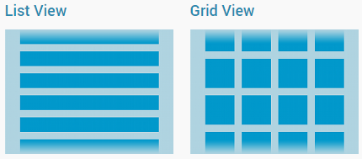
Building Layouts with an Adapter
When the content for your layout is dynamic or not pre-determined, you can use a layout that subclasses AdapterView to populate the layout with views at runtime.
A subclass of the AdapterView class uses an Adapter to bind data to its layout.
The Adapter behaves as a middleman between the data source and the AdapterView layout
The Adapter retrieves the data (from a source such as an array or a database query) and converts each entry into a view that can be added into the AdapterView layout

Slide 24
Android Development Chapter 3 – Getting to know the Android User Interface
Adapting to Display Orientation

Slide 25
Display Orientation
One of the key features of modern smartphones is their ability to switch screen orientation, and Android is no exception.
Android supports two screen orientations: portrait and landscape
By default, when you change the display orientation of your Android device, the current activity that is displayed automatically redraws its content in the new orientation.
This is because the onCreate() method of the activity is fired whenever there is a change in display orientation.
When you change the orientation of your Android device, your current activity is actually destroyed and then recreated.
You can change the emulator orientation by pressing CTRL-F11

Slide 26
Adapting to Display Orientation
In general, you can employ two techniques to handle changes in screen orientation:
Anchoring
The easiest way is to anchor your views to the four edges of the screen. When the screen orientation changes, the views can anchor neatly to the edges.
Anchoring can be easily achieved by using RelativeLayout .
Resizing and repositioning
Whereas anchoring and centralizing are simple techniques to ensure that views can handle changes in screen orientation, the ultimate technique is resizing each and every view according to the current screen orientation.

Slide 27
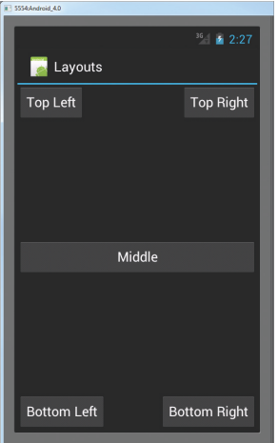
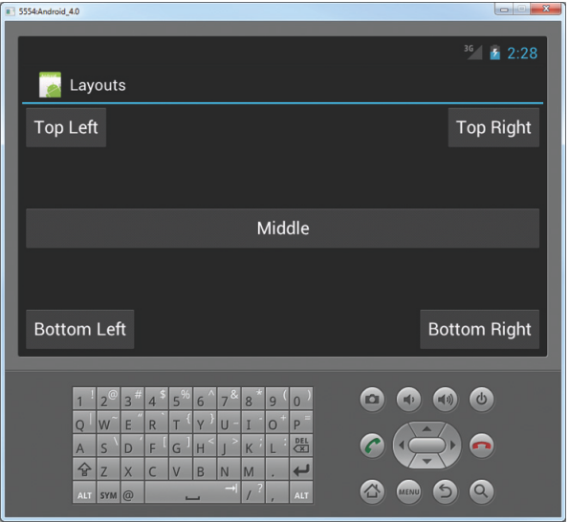
Anchoring Views
<RelativeLayout xmlns:android="http://schemas.android.com/apk/res/android"
xmlns:tools="http://schemas.android.com/tools"
android:layout_width="fill_parent"
android:layout_height="fill_parent"
tools:context="${relativePackage}.${activityClass}" >
<Button
android:id="@+id/button1"
android:layout_width="wrap_content"
android:layout_height="wrap_content"
android:text="Top Left"
android:layout_alignParentLeft="true"
android:layout_alignParentTop="true" />
<Button
android:id="@+id/button2"
android:layout_width="wrap_content"
android:layout_height="wrap_content"
android:text="Top Right"
android:layout_alignParentTop="true"
android:layout_alignParentRight="true" />
<Button
android:id="@+id/button3"
android:layout_width="wrap_content"
android:layout_height="wrap_content"
android:text="Bottom Left"
android:layout_alignParentLeft="true"
android:layout_alignParentBottom="true" />
<Button
android:id="@+id/button4"
android:layout_width="wrap_content"
android:layout_height="wrap_content"
android:text="Bottom Right"
android:layout_alignParentRight="true"
android:layout_alignParentBottom="true" />
<Button
android:id="@+id/button5"
android:layout_width="fill_parent"
android:layout_height="wrap_content"
android:text="Middle"
android:layout_centerVertical="true"
android:layout_centerHorizontal="true" />
</RelativeLayout>

Slide 28
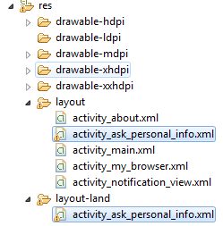
Resizing and Repositioning
Apart from anchoring your views to the four edges of the screen, an easier way to customize the UI based on screen orientation is to create a separate res/layout folder containing the XML files for the UI of each orientation.
To support landscape mode, you can create a new folder in the res folder and name it as layout-land (representing landscape).
Basically, the xml file contained within the layout folder defines the UI for the activity in portrait mode, whereas the xml file in the layout-land folder defines the UI in landscape mode.

Slide 29
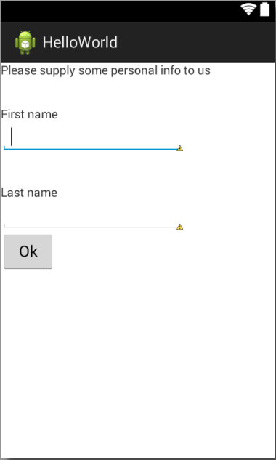
Resizing and Repositioning - Portrait
<RelativeLayout xmlns:android="http://schemas.android.com/apk/res/android"
xmlns:tools="http://schemas.android.com/tools"
android:layout_width="match_parent"
android:layout_height="match_parent"
tools:context="${relativePackage}.${activityClass}" >
<TextView
android:id="@+id/textView2"
android:layout_width="wrap_content"
android:layout_height="wrap_content"
android:text="@string/ask_info" />
<LinearLayout
android:id="@+id/linearLayout1"
android:layout_width="wrap_content"
android:layout_height="wrap_content"
android:layout_alignBaseline="@+id/textView2"
android:layout_marginTop="56dp"
android:orientation="vertical" >
<TextView
android:id="@+id/txtFirstname"
android:layout_width="wrap_content"
android:layout_height="wrap_content"
android:layout_marginTop="38dp"
android:text="@string/firstname" />
<EditText
android:id="@+id/txtInputFirstname"
android:layout_width="wrap_content"
android:layout_height="wrap_content"
android:ems="10" >
<requestFocus />
</EditText>
...
...
<TextView
android:id="@+id/txtLastname"
android:layout_width="wrap_content"
android:layout_height="wrap_content"
android:layout_marginTop="38dp"
android:text="@string/lastname" />
<EditText
android:id="@+id/txtInputLastname"
android:layout_width="wrap_content"
android:layout_height="wrap_content"
android:ems="10" />
<Button
android:id="@+id/btnOk"
android:layout_width="wrap_content"
android:layout_height="wrap_content"
android:text="@string/button_ok"
android:onClick="onPersonalInfoOk" />
</LinearLayout>
</RelativeLayout>

Slide 30
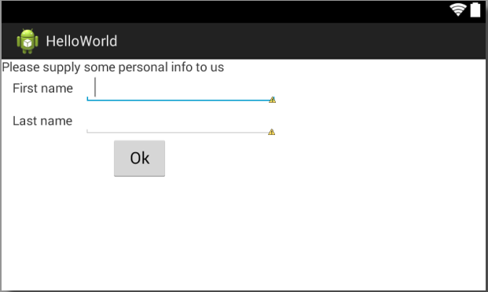
Resizing and Repositioning - Landscape
...
<LinearLayout
android:id="@+id/linearLayout3"
android:layout_width="wrap_content"
android:layout_height="wrap_content"
android:orientation="horizontal" >
<TextView
android:id="@+id/txtLastname"
android:layout_width="wrap_content"
android:layout_height="wrap_content"
android:layout_marginLeft="12dp"
android:layout_marginRight="12dp"
android:text="@string/lastname" />
<EditText
android:id="@+id/txtInputLastname"
android:layout_width="wrap_content"
android:layout_height="wrap_content"
android:ems="10" />
</LinearLayout>
<Button
android:id="@+id/btnOk"
android:layout_width="wrap_content"
android:layout_height="wrap_content"
android:layout_gravity="center"
android:text="@string/button_ok"
android:onClick="onPersonalInfoOk" />
</LinearLayout>
</RelativeLayout>
<RelativeLayout xmlns:android="http://schemas.android.com/apk/res/android"
xmlns:tools="http://schemas.android.com/tools"
android:layout_width="match_parent"
android:layout_height="match_parent"
tools:context="${relativePackage}.${activityClass}" >
<TextView
android:id="@+id/textView2"
android:layout_width="wrap_content"
android:layout_height="wrap_content"
android:text="@string/ask_info" />
<LinearLayout
android:id="@+id/linearLayout1"
android:layout_width="wrap_content"
android:layout_height="wrap_content"
android:layout_alignBaseline="@+id/textView2"
android:layout_marginTop="56dp"
android:orientation="vertical" >
<LinearLayout
android:id="@+id/linearLayout2"
android:layout_width="wrap_content"
android:layout_height="wrap_content"
android:orientation="horizontal" >
<TextView
android:id="@+id/txtFirstname"
android:layout_width="wrap_content"
android:layout_height="wrap_content"
android:layout_marginLeft="12dp"
android:layout_marginRight="12dp"
android:text="@string/firstname" />
<EditText
android:id="@+id/txtInputFirstname"
android:layout_width="wrap_content"
android:layout_height="wrap_content"
android:ems="10" >
<requestFocus />
</EditText>
</LinearLayout>
...

Slide 31
Managing changes to screen orientation
For any activity you should save whatever state you need to save in the onPause() method
fired every time the screen changes orientation
Important to understand
only views that are named (via android:id attribute_ will have their state persisted

