Slide 1
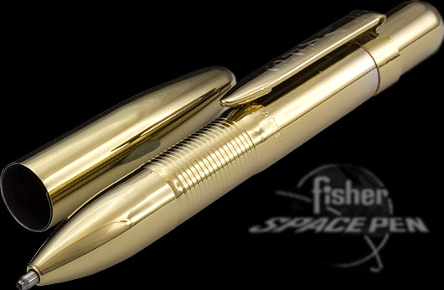
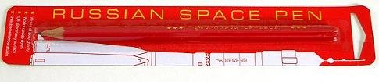
Problem Space
A customer problem, need, or benefit that the product should address
A product requirement
Example
Ability to write in space (zero gravity)
Solution Space
A specific implementation to address the need or product requirement
Example
NASA space pen
$1 M R&D costs
Russian pencil

