Slide 1
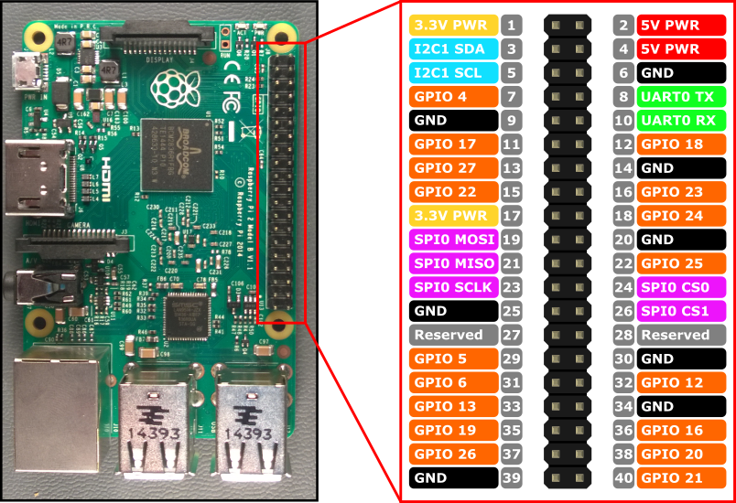

Slide 2
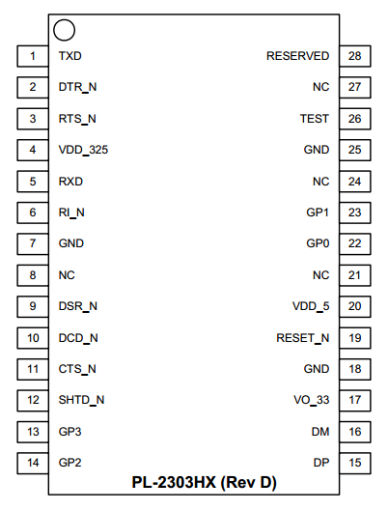

Slide 3
Human readable source code
main.cpp
❶
Pre-processor
#include header files
Expanded source code
main.ii
❷
Compiler
Assembler code
main.s
❸
Assembler
Object code
main.o
❹
Linker
Object code of Libraries
Executable Program
Hello

