Slide 1
Multimedia Technieken 2015 – 2016
Controlling an I2C Slave Device from User Space

Slide 2
Controlling an I2C Slave Device from User Space
I2C in a Nutshell

Slide 3
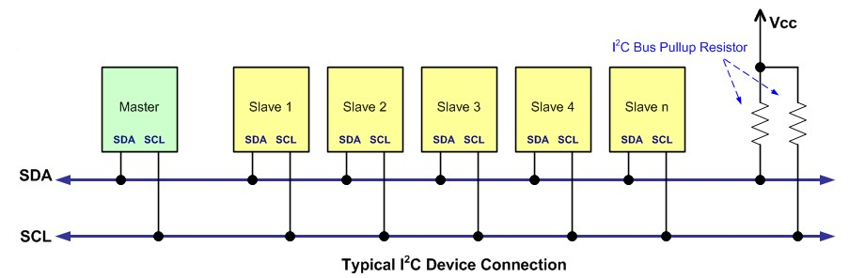
I2C in a Nutshell
Why I2C is commonly used to control external devices
Its a common standard
Its "fast" for low-speed devices
Bus architecture (multiple devices can be connected)
Easy to use
Wide support (most uC’s and processors have build in I2C peripheral)
Only 2 communication lines needed (SDA and SCL)

Slide 4
The Physical Bus
The bus consists of just two wires, called SCL and SDA, and a ground
SCL is the clock line.
It is used to synchronize all data transfers over the I2C bus.
SDA is the data line.
The SCL and SDA lines are connected to all devices on the I2C bus.
There does need to be a third wire which is the ground

Slide 5
The Physical Bus
Both SCL and SDA lines are "open drain" drivers.
What this means is that the chip can drive its output low, but it cannot drive it high.
For the line to be able to go high you must provide pull-up resistors to Vcc
There should be a resistor from the SCL line to Vcc and another from the SDA line to Vcc.
You only need one set of pull-up resistors for the whole I2C bus, not for each device.
Vcc depends on the devices used. Typically 5V or 3V3

Slide 6
Masters and Slaves
The devices on the I2C bus are either masters or slaves.
The master is always the device that drives the SCL clock line
The slaves are the devices that respond to the master.
A slave cannot initiate a transfer over the I2C bus, only a master can do that.
There can be, and usually are, multiple slaves on the I2C bus, however there is normally only one master.
It is possible to have multiple masters, but it is unusual.
Slaves will never initiate a transfer.
Both master and slave can transfer data over the I2C bus, but that transfer is always controlled by the master.

Slide 7
Controlling an I2C Slave Device from User Space
Our Goal

Slide 8
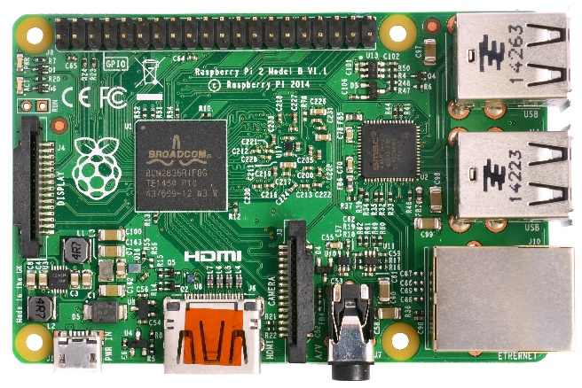
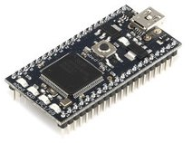
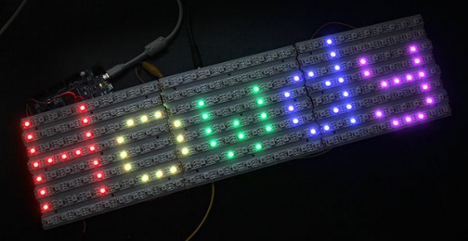
Our Goal
Connect the Raspberry Pi 2 to the mBed i2c NeoPixel driver
Write a user space application and let it communicate with the slave device
We will need to cross-compile the source to the ARM architecture
In this setup the Raspberry Pi will act as a master while the mbed NeoPixel driver is the slave

Slide 9
Controlling an I2C Slave Device from User Space
Enabling I2C on the Raspberry Pi 2

Slide 10
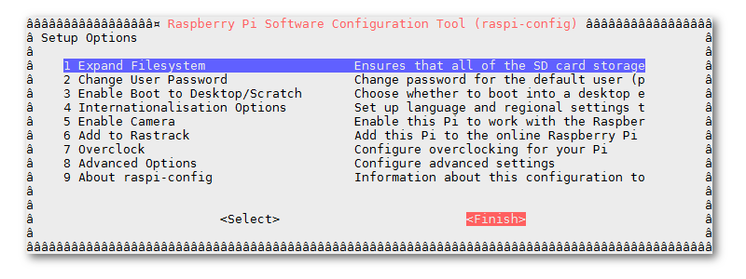
Step 1 - Enable i2c
Use the raspi-config utility to enable i2c
Select ‘Advanced Options’ => ‘I2C’ => ‘Enable’
pi@raspberrypi ~ $ sudo raspi-config

Slide 11
Step 2 - Edit Module File
Open the modules file
And add the following to it
This will make sure the i2c device modules are loaded when the kernel is booted
pi@raspberrypi ~ $ sudo nano /etc/modules
i2c-bcm2708
i2c-dev

Slide 12
Step 3 - Install Utilities
Install i2c-tools which has a bus discovery tool which is really handy
Shutdown the Raspberry Pi
Disconnect the power adapter and connect your i2c device
pi@raspberrypi ~ $ sudo apt-get update
pi@raspberrypi ~ $ sudo apt-get install i2c-tools
pi@raspberrypi ~ $ sudo halt

Slide 13
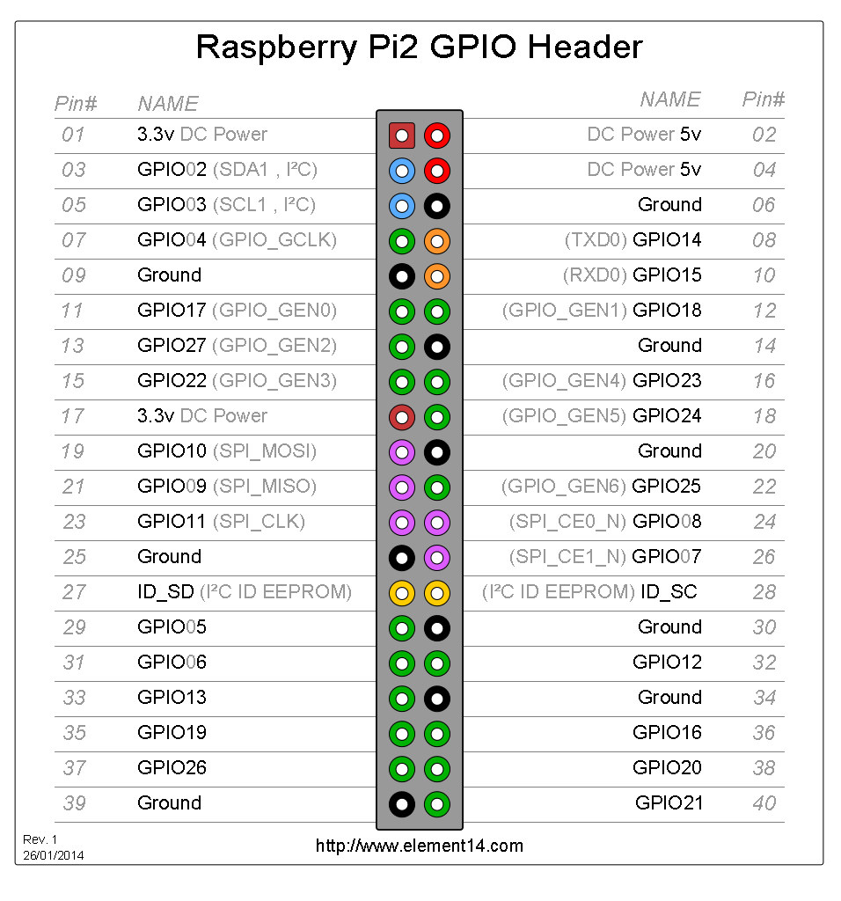
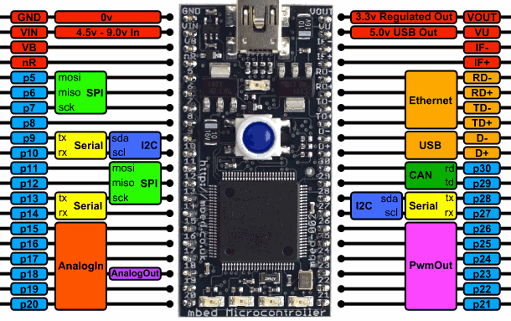
Step 4 - Connecting the i2c of mBed to the Raspberry Pi 2
Raspberry Pi runs at 3.3V
mBed runs at 3.3V
So no level shifting is required
We do not need to add pull-up resistors because the Raspberry Pi 2 already has pull-ups of 1k8 on each i2c line

Slide 14
Step 5 - Scanning the bus using i2cdetect
Once the two embedded boards are connected using i2c you can use the i2cdetect tool to scan the bus for slave devices
For we need to check "/dev" for available i2c busses
Look for "i2c-x" where x is a number
Use the i2cdetect tool to scan the bus and replace x with the number of the actual device bus
pi@raspberrypi ~ $ cd /dev
pi@raspberrypi ~ $ ls i2c-*
pi@raspberrypi ~ $ i2cdetect –r x

Slide 15
Step 5 - Scanning the bus using i2cdetect
Example
You should get similar output when the mBed is connected
0x40 is the NeoPixel slave. Can you explain the other two devices ?
pi@raspberrypi ~ $ sudo i2cdetect –r 1
0 1 2 3 4 5 6 7 8 9 a b c d e f
00: -- -- -- -- -- -- -- -- -- -- -- -- --
10: -- -- -- -- -- -- -- -- -- -- -- -- -- -- -- --
20: -- -- -- -- -- -- -- -- -- -- -- -- -- -- -- --
30: -- -- -- -- -- -- -- -- -- -- -- -- -- -- -- --
40: 40 -- -- -- -- -- -- -- 48 -- -- -- 4C -- -- --
50: -- -- -- -- -- -- -- -- -- -- -- -- -- -- -- --
60: -- -- -- -- -- -- -- -- -- -- -- -- -- -- -- --
70: -- -- -- -- -- -- -- --

Slide 16
7-bit or 8-bit address ?
Also notice that the mBed uses the 8-bit address (R/W) LSB included while Linux uses the 7-bit address
You will need to use the 7-bit address in you C++ program !
Part from the mBed slave code:
0 1 2 3 4 5 6 7 8 9 a b c d e f
00: -- -- -- -- -- -- -- -- -- -- -- -- --
10: -- -- -- -- -- -- -- -- -- -- -- -- -- -- -- --
20: -- -- -- -- -- -- -- -- -- -- -- -- -- -- -- --
30: -- -- -- -- -- -- -- -- -- -- -- -- -- -- -- --
40: 40 -- -- -- -- -- -- -- 48 -- -- -- 4C -- -- --
50: -- -- -- -- -- -- -- -- -- -- -- -- -- -- -- --
60: -- -- -- -- -- -- -- -- -- -- -- -- -- -- -- --
70: -- -- -- -- -- -- -- --
I2cSettings settings;
settings.frequency = 100000;
settings.address = 0x80;

Slide 17
Controlling an I2C Slave Device from User Space
The mBed NeoPixel Driver Slave

Slide 18
The mBed NeoPixel Driver Slave
The mBed controls a NeoPixel string of RGB LED's
The size of a string and number of strings can be configured in the slave code
A string is a continuous connection of NeoPixel LED's
Slave code is available on mBed as library
Import the library 'NeoPixelI2cDriver'
Search for 'neopixel'

Slide 19
The mBed NeoPixel Driver Slave
The NeoPixel data line needs to be connected to the SPI pin (pin 5) on the mBed
Everything can be tested without NeoPixel string (debug info is outputted to console)
To get some console output from the slave device you can use a terminal program such as Putty to connect to the serial interface over USB at a speed of 115200 baud.
The slave device also has an alive LED which will blink periodically as long as the device is operational and responsive.
The I2C bus operates at 100kHz and the slave device address is 0x80 (0x40 7-bit).

Slide 20
The mBed NeoPixel Driver Slave - main.cpp https://developer.mbed.org/users/dwini/code/NeoPixelI2cSlave/
#include "mbed.h"
#include "neopixel_string.h"
#include "i2c_device.h"
#include "neopixel_string_factory.h"
#include "neopixel_i2c_daemon.h"
// This must be an SPI MOSI pin.
#define DATA_PIN p5
#define STRING_SIZE 8
#define DEBUG_MODE 1
#include "log.h"
Serial pc(USBTX, USBRX); // tx, rx

Slide 21
The mBed NeoPixel Driver Slave - main.cpp https://developer.mbed.org/users/dwini/code/NeoPixelI2cSlave/
int main() {
pc.baud(115200);
SimplyLog::Log::i("Neopixel driver loading\r\n");
I2cSettings settings;
settings.frequency = 100000;
settings.address = 0x80;
SimplyLog::Log::i("Slave is working @ %dHz\r\n", settings.frequency);
SimplyLog::Log::i("Slave is working @ SLAVE_ADDRESS = 0x%x\r\n", settings.address);
SimplyLog::Log::i("Creating NeoPixel String\r\n");
NeoPixelString * first_string = NeoPixelStringFactory::createNeoPixelString(DATA_PIN, STRING_SIZE);
SimplyLog::Log::i("Creating I2cDevice\r\n");
I2cDevice i2c(p28, p27, &settings);
SimplyLog::Log::i("Creating NeoPixel I2c Daemon\r\n");
NeoPixelI2cDaemon neo(&i2c, LED1);
neo.attachPixelString(first_string);
SimplyLog::Log::i("Listening in blocking mode\r\n");
neo.listen(true);
while(1) { }
}

Slide 22
The mBed NeoPixel Driver Slave - Possible Transactions
@ the moment there are three commands that can be send to the slave
OFF (0x01) which will turn off all the LED's
DIAGNOSTIC (0x02) which will run a pre-programmed diagnostic routine
SINGLE_COLOR (0x03) which allows all LED's to be programmed with a given color
OFF and DIAGNOSTIC and single byte transactions
SINGLE_COLOR is a four-byte transactions
First byte is the command (0x03)
Following three bytes are the RGB values (0 - 255 or 0x00 to 0xFF)

Slide 23
The mBed NeoPixel Driver Slave - Possible Transactions
The master can also request some information from the slave by sending a read request
@ the moment the slave will answer with a single byte value, namely the number of strings attached to the mBed (which will be 1).

Slide 24
Controlling an I2C Slave Device from User Space
Raspberry Pi 2 User Space Master Program

Slide 25
Start from the Base
Some decent information can be found @ http://elinux.org/Interfacing_with_I2C_Devices
You can start from the example program that I created
Not very OOP, that is YOUR task
See GitHub:
https://github.com/BioBoost/pi_i2c_master_neopixel_driver.git

Slide 26
Controlling an I2C Slave Device from User Space
Assignment

Slide 27
Assignment
Create a C++ program to control the mBed slave device from User Space
Use OOP !!
No single class or 400 lines main function programs
This will get you flunked !
Prove what you have learned and what you are capable off !
This needs to be incorporated in the final program of the group
Requirements
Fading (from bright to dark and vice versa) or Stroboscope (with adjustable timings)
Set colors (per LED not just one color for the whole string)
You can extend the slave program as you seem fit

