Slide 1
Multimedia Technieken
Introduction to Linux

Slide 2
Introduction

Slide 3
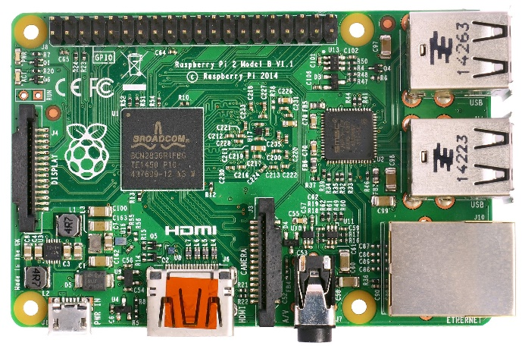
Introduction
The Raspberry PI 2 embedded system
A 900MHz quad-core ARM Cortex-A7 CPU
1GB RAM
4 USB ports
40 GPIO pins
Full HDMI port
Ethernet port
Combined 3.5mm audio jack and composite video
Camera interface (CSI)
Display interface (DSI)
Micro SD card slot
VideoCore IV 3D graphics core
How to use all these complex features ?

Slide 4
Introduction
How to use all these complex features ?
Typically by installing an Operating System (OS) which provides access to the hardware as a service
You can actually write programs for the Pi without using an OS but this is very complex
These are also called Bare-metal applications
But which one ?
User Application
OS
Hardware

Slide 5
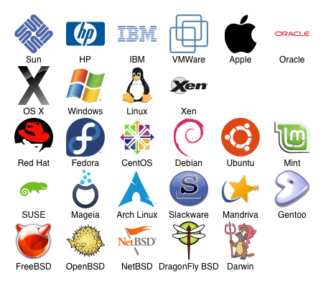
Introduction
What OS can we use ?
The ones that support the Raspberry Pi 2
Guess what, it’s a short list
Linux based
Raspbian
Ubuntu Mate
OSMC and OpenElec (Media Centers)
Windows based
Windows 10 IoT core
Other
Risc OS (Real-time OS)
Initially we will use the Raspbian linux distribution
Notes:
Raspbian is the Foundation’s official supported operating system.

Slide 6
Linux and it’s kernel

Slide 7

Linux Distribution
Linux was originally developed by as a free operating system for personal computers based on the Intel x86 architecture, but has since been ported to more computer hardware platforms than any other operating system.
Desktop PC’s, servers, mainframe’s, supercomputers, smart phones, tablets, TV’s, embedded systems, …
Linux = Linux distribution (distro)
Linux distro = Linux kernel + libraries + system utils
Linux kernel
Created in 1991 by Finnish computer science student Linus Torvalds
Unix-like
Free and open-source
Received contributions from nearly 12,000 programmers

Slide 8
Linux, kernel, distro, …
Linux kernel
+ libraries and system utils
Small embedded system
+ package manager
General public embedded system
+ user applications
+ games
+ windows manager
+ desktop environment
…
+ server applications
Desktop PC
Desktop PC

Slide 9
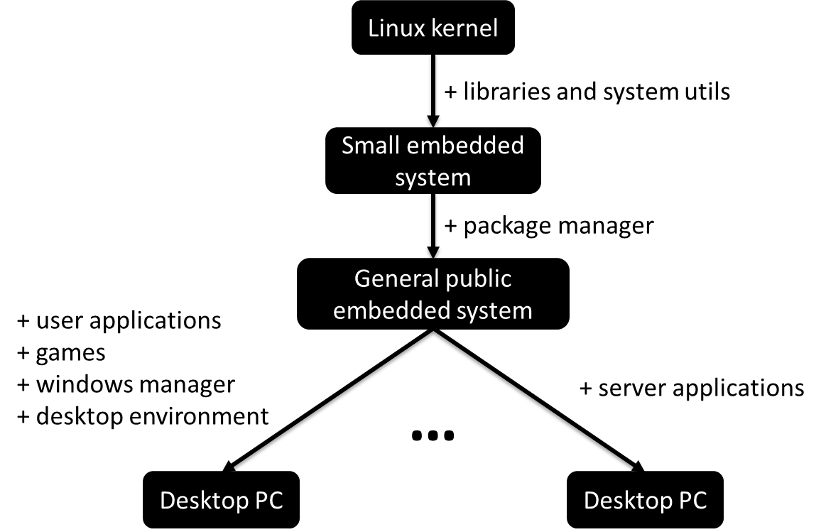
Linux, kernel, distro, …
When we are talking about embedded Linux we actually are talking about the same kernel code running on millions of other systems.
There is no separate code base for embedded systems.
When we however build a Linux system for an embedded target we do exclude features we won’t be using
We are also cross-compiling the kernel to binary code that can run on the target system.

Slide 10
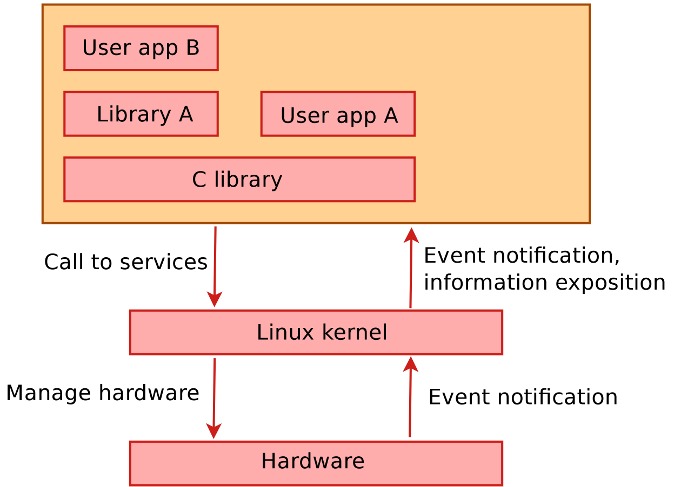
The keThe Linux Kernelrnel
The Linux kernel provides the core system facilities required for any system based upon Linux to operate correctly.
It has complete control over everything that occurs in the system.
Application software relies upon specific features of the Linux kernel such as its handling of hardware devices and its provision of many fundamental abstractions such as virtual memory, sockets, tasks (known as processes), files and many others.

Slide 11
The Linux Kernel
The main roles of the kernel are
Manage all the hardware resources
CPU, memory, I/O.
Provide a set of portable, architecture - and hardware independent APIs (Application Programmable Interface) to allow user space applications and libraries to use the hardware resources.
Handle concurrent accesses and usage of hardware resources from diﬀerent applications.
Example: a single network interface is used by multiple user space applications through various network connections. The kernel is responsible for "multiplexing" the hardware resource.

Slide 12
The Linux Kernel
The main interface between the kernel and user space is the set of system calls that are provided by the kernel (about 300 system calls that provide the main kernel services).
These services include
file and device operations
networking operations
inter-process communication
process management
memory mapping
timers
threads
synchronization primitives
…

Slide 13
The Linux Kernel
Some key features of the kernel are
Portability and hardware support
It runs on most architectures.
Scalability
Linux can run on super computers as well as on tiny devices (4 MB of RAM is enough).
Compliance to standards and interoperability
Exhaustive networking support
Security
It can't hide its ﬂaws. Its code is reviewed by many experts.
Stability and reliability
Modularity
Can include only what a system needs even at run time.
Easy to program
You can learn from existing code. Many useful resources on the net.

Slide 14
The Linux Kernel
Very important to know is that the kernel interface is stable over time.
This basically means that only new system calls can be added by the kernel developers and no old calls can be removed.
This means that applications running on an older kernel version should always work on a newer one.
The system call interface is actually wrapped by the C library and user space applications usually never make a system call directly but rather use the corresponding C library functions.

Slide 15
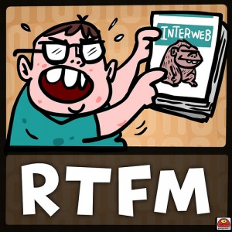
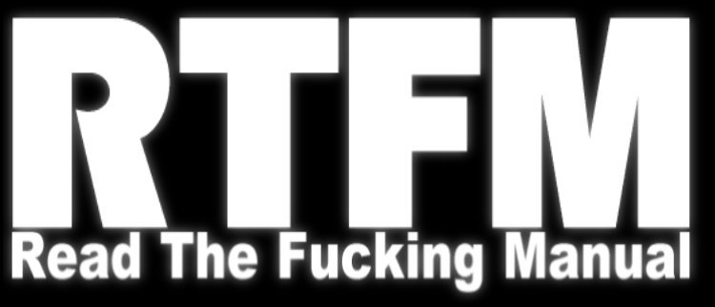
Linux Basics
The Man Pages
While the information and examples presented here will be valid for most Linux distro’s, some information and commands may only work for Debian based distro’s.

Slide 16
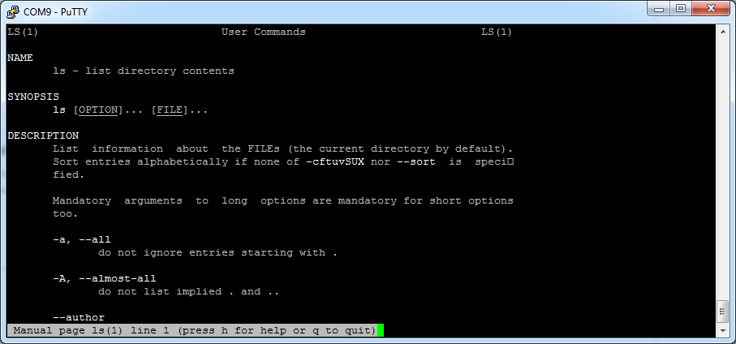
The Man Pages
The most important command you need to know is the "man" command,
Provides an interface to the reference manuals.
By adding a command after the man command you can consult the man-pages for the particular command.
Example:
$ man ls

Slide 17
The Man Pages
You can scroll through the man-pages using the arrow keys.
Searching the current man-page can be done by first typing a slash ("/"), followed by your search term.
Jumping to the next hit can be done by hitting the "n" key, while jumping back is done with "SHIFT-n".
Exiting the man-pages is achieved using the "CTRL-c" combination.
Some exercises:
What does the "cat" command do ? How can it be used to output the content of a file ? Try to read the file "/proc/cpuinfo"
What does the "dmesg" command do ?
The "free" command shows system memory usage.How can you make the numbers "human readable" ?

Slide 18
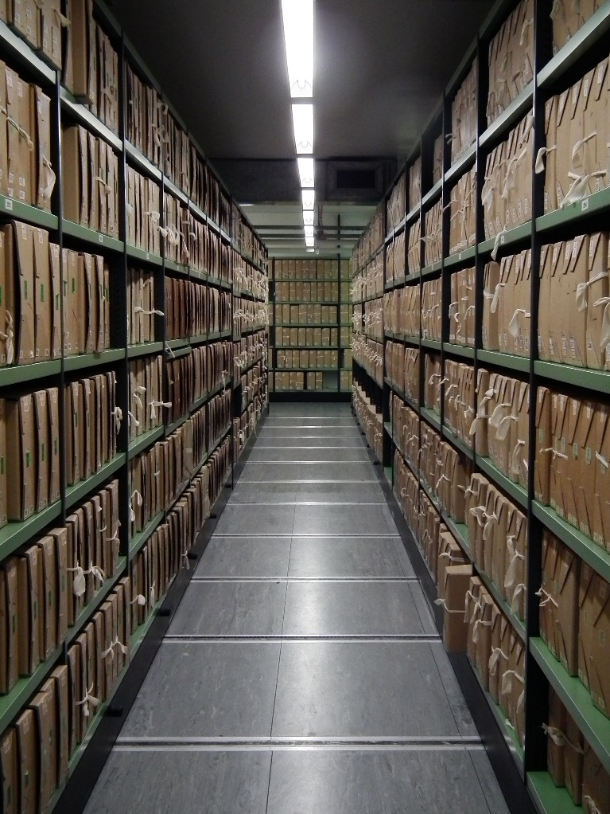
Linux Basics
The Linux File System
While the information and examples presented here will be valid for most Linux distro’s, some information and commands may only work for Debian based distro’s.

Slide 19
Some History
Linux inherits many of its concepts of filesystem organization from its Unix predecessors.
As far back as 1979, Unix was establishing standards to control how compliant systems would organize their files.
The Linux Filesystem Hierarchy Standard or FHS for short
One important thing to mention when dealing with these systems is that Linux implements just about everything as a file.
This means that a text file is a file
a directory is a file (simply a list of other files)
a printer is represented by a file (the device drivers can send anything written to the printer file to the physical printer)
…
Although this is in some cases an oversimplification

Slide 20
Exploring the File System
Where are thou ?
Use the "pwd" (print working dir) command
This simply returns the directory you are currently located in.
List the content of a directory using the "ls" command
This will tell you all directories and files in your current directory.
bioboost@NDWMINT ~ $ pwd
/home/bioboost
bioboost@NDWMINT / $ ls
bin dev initrd.img lost+found opt run sys var
boot etc lib media proc sbin tmp vmlinuz
cdrom home lib64 mnt root srv usr

Slide 21
Exploring the File System
The two most common used flags of "ls" are probable -l and -a.
The "-l" forces the command to output information in long-form
The very first character tells us what kind of file it is. The three most common types are:
-: Regular file
d: Directory (a file of a specific format that lists other files)
l: A hard or soft link (basically a shortcut to another file)
bioboost@NDWMINT ~ $ ls -l
total 88
...
drwxr-xr-x 3 root root 4096 Jun 20 07:48 home
-rw-r--r-- 1 root root 0 Sep 24 13:37 log.txt
drwx------ 2 root root 16384 Jun 20 07:34 lost+found
...

Slide 22
Exploring the File System
The two most common used flags of "ls" are probable -l and -a.
The "-a" flag lists all files, including hidden files.
In Linux, files are hidden automatically if they begin with a dot
The first two entries, . and .. are special
The . directory is a shortcut that means "the current directory"
The .. directory is a shortcut that means "the current directory's parent directory"
bioboost@NDWMINT ~ $ bioboost@NDWMINT ~ $ ls -al
total 124
drwxr-xr-x 18 bioboost bioboost 4096 Sep 24 13:04 .
drwxr-xr-x 3 root root 4096 Sep 21 12:35 ..
drwx------ 4 bioboost bioboost 4096 Sep 21 12:40 .cache
drwxr-xr-x 12 bioboost bioboost 4096 Sep 21 12:41 .config
drwxr-xr-x 2 bioboost bioboost 4096 Sep 21 12:40 Documents
...

Slide 23
Traversing the File System
To change to a different directory, you issue the "cd" command
It stands for "change directory"
You can follow the "cd" command with either an absolute or a relative pathname
An absolute path is a file path that specifies the location of a directory from at the top of the directory tree
Absolute paths begin with a "/"
A relative path is a file path that is relative to the current working directory.
This means that instead of defining a location from the top of the directory structure, it defines the location in relation to where you currently are.

Slide 24
Traversing the File System
Let's traverse to the absolute path "/home"
It doesn't matter what our current working dir is
bioboost@NDWMINT ~ $ pwd
/home/bioboost
bioboost@NDWMINT ~ $ cd /home
bioboost@NDWMINT /home $ pwd
/home

Slide 25
Traversing the File System
The lack of the "/" from the beginning tells to use the current directory as the base for looking for the path
bioboost@NDWMINT ~ $ ls
Desktop Documents Downloads Music Pictures Public Templates Videos
bioboost@NDWMINT ~ $ pwd
/home/bioboost
bioboost@NDWMINT ~ $ cd Downloads
bioboost@NDWMINT ~/Downloads $ pwd
/home/bioboost/Downloads

Slide 26
Traversing the File System
This is where the ".." directory entry comes in handy.
It can be used as a shortcut to move to the parent directory of the current dir
The "." directory represents the current working dir.
So changing to "." has no effect
Try this for yourself
bioboost@NDWMINT ~ $ pwd
/home/bioboost
bioboost@NDWMINT ~ $ cd ..
bioboost@NDWMINT /home $ pwd
/home

Slide 27
Traversing the File System
You can immediately jump to your personal home directory by using the "~" as destination
bioboost@NDWMINT / $ pwd
/
bioboost@NDWMINT / $ cd ~
bioboost@NDWMINT ~ $ pwd
/home/bioboost

Slide 28
The Linux File System Layout
The file system is contained within a single tree
Regardless of how many devices are incorporated.
What this means is that all components accessible to the operating system are represented somewhere in the main file system.
In Windows, each hard drive or storage space is represented as its own file system, which are labeled with letter designations
In Linux, every file and device on the system resides under the "root" directory, which is denoted by a starting "/".
Thus, if we want to go to the top-level directory of the entire operating system and see what is there, we can type
Every file, device, directory, or application is located under this one directory.
bioboost@NDWMINT ~ $ cd /
bioboost@NDWMINT / $

Slide 29
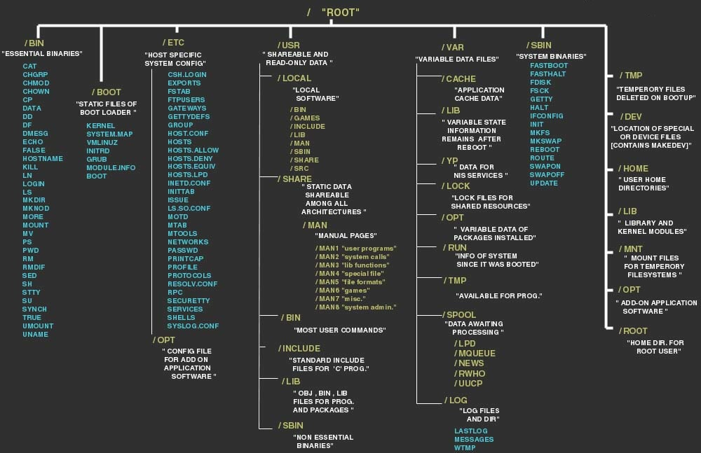
The Linux File System Layout

Slide 30
The /proc directory
The "/proc" directory is actually a pseudo-file system of its own that is mounted to that directory.
The proc file system does not contain real files, but is instead dynamically generated to reflect the internal state of the Linux kernel.
This means that we can check and modify different information from the kernel itself in real time.
For instance, you can get detailed information about the processor and its cores by typing
bioboost@NDWMINT ~ $ cat /proc/cpuinfo
processor : 0
model name : ARMv6-compatible processor rev 7 (v6l)
Features : swp half thumb fastmult vfp edsp java tls
CPU implementer : 0x41
CPU architecture: 7

Slide 31
Manipulating the File System
A file can be created using the "touch" command
You can remove a file using the "rm" command
Add "-r" (recursive) to remove a directory and its content
You can move a file using the "mv" file
Also applicable for directory
Can also be used for renaming a file or directory
To copy a file use "cp"
Add "-r" (recursive) to copy a directory and its content
A text editor such as "nano" can be used to manipulate the content of text file

Slide 32

Linux Basics
Linux Permissions and Ownership
While the information and examples presented here will be valid for most Linux distro’s, some information and commands may only work for Debian based distro’s.

Slide 33
Users
Linux is a multi-user system.
Basic understanding of users and groups is required before ownership and permissions can be discussed
They are the entities that the ownership and permissions apply to.
There are two types of users
system users - which are used to run non-interactive or background processes on a system
regular users - which are used for logging in and running processes interactively.
An easy way to view all of the users on a system is to look at the contents of the "/etc/passwd" file.
Each line in this file contains information about a single user, starting with its user name (the name before the first :).

Slide 34
Users
bioboost@NDWMINT ~ $ cat /etc/passwd
root:x:0:0:root:/root:/bin/bash
daemon:x:1:1:daemon:/usr/sbin:/usr/sbin/nologin
bin:x:2:2:bin:/bin:/usr/sbin/nologin
...
www-data:x:33:33:www-data:/var/www:/usr/sbin/nologin
nobody:x:65534:65534:nobody:/nonexistent:/usr/sbin/nologin
libuuid:x:100:101::/var/lib/libuuid:
...
syslog:x:101:104::/home/syslog:/bin/false
kernoops:x:106:65534:Kernel Oops Tracking
bioboost:x:1000:1000:Nico De Witte,,,:/home/bioboost:/bin/bash
vboxadd:x:999:1::/var/run/vboxadd:/bin/false

Slide 35
Superuser
In addition to the two user types, there is the superuser, or root user, that has the ability to override any file ownership and permission restrictions.
In practice, this means that the superuser has the rights to access anything on its own server.
This user is used to make system-wide changes, and must be kept secure.
It is also possible to configure other user accounts with the ability to assume "superuser rights".
Allowing the user to execute "sudo" commands
More on this later

Slide 36
Viewing Ownership and Permissions
In Linux, each and every file is owned by a single user and a single group, and has its own access permissions.
The most common way to view the permissions of a file is to use "ls" with the long listing option
If you want to view the permissions of all of the files in your current directory, run the command without an argument
bioboost@NDWMINT ~ $ ls -l <somefile>
bioboost@NDWMINT ~ $ ls

Slide 37
Viewing Ownership and Permissions
Example
bioboost@NDWMINT ~ $ ls -l
total 36
drwxr-xr-x 2 bioboost bioboost 4096 Sep 21 12:40 Desktop
-rw-r--r-- 1 bioboost bioboost 78 Sep 24 15:24 hello_world.rb
drwxr-xr-x 2 bioboost bioboost 4096 Sep 21 12:40 Music
drwxr-xr-x 2 bioboost bioboost 4096 Sep 21 12:40 Pictures
-rw------- 1 bioboost bioboost 0 Sep 24 16:49 private.txt
-rw-rw-rw- 1 bioboost bioboost 0 Sep 24 16:50 public.txt
drwxr-xr-x 2 bioboost bioboost 4096 Sep 21 12:40 Videos
...
Filemode
User
(owner)
Group

Slide 38
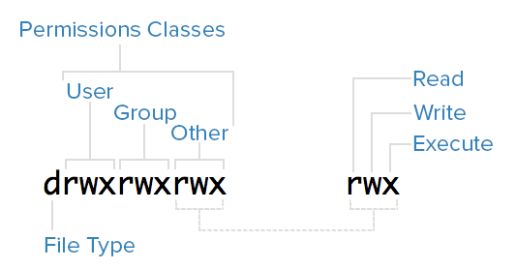
The Filemode
First character is the file type
-: regular file
d: directory (a file of a specific format that lists other files)
l: a hard or soft link (basically a shortcut to another file)
c: a character device file
b: a block device file
p: a pipe file
s: a socket file

Slide 39
Permission Classes
The next 9 characters make up the permission classes, namely
User: The owner of a file belongs to this class
Group: The members of the file's group belong to this class
Other: Any users that are not part of the user or group classes belong to this class.
The order of the classes is consistent across all Linux distributions.

Slide 40
Symbolic Permissions
The next thing to pay attention to are the sets of three characters, or triads, as they denote the permissions, in symbolic form, that each class has for a given file.
In each triad, read, write, and execute permissions are represented in the following way:
Read: Indicated by an r in the first position
Write: Indicated by a w in the second position
Execute: Indicated by an x in the third position. In some special cases, there may be a different character here.
A hyphen (-) in the place of one of these characters indicates that the respective permission is not available for the respective class.

Slide 41
Read, Write and Execute
Read
Normal file: allows a user to view the contents of the file.
Directory: allows a user to view the names of the file in the directory.
Write
Normal file: allows a user to modify and delete the file.
Directory: allows a user to delete the directory, modify its contents (create, delete, and rename files in it), and modify the contents of files that the user can read.
Execute
Normal file: allows a user to execute a file (the user must also have read permission). As such, execute permissions must be set for executable programs and shell scripts before a user can run them.
Directory: allows a user to access, or traverse, into (i.e. cd) and access metadata about files in the directory (the information that is listed in an ls -l).

Slide 42
Examples
-rw------- | mark | customers | Mark (the owner) can read the file and can write to it. The customers group and others have no permissions.
-rwxr-x--- | mark | customers | Mark (the owner) has full file control (including execution). The users of the group customers can read and execute the file. Others have no permissions.
drwxr-x--- | mark | www-data | Mark (the owner) of the directory has full control. The www-data group users can read and traverse the directory. Other can not.
drwx--x--- | mark | customers | Mark (the owner) of the directory has full control. The customers can 'cd' into the directory but cannot 'ls' to show the content.
drwx-wx--- | mark | customers | Mark (the owner) of the directory has full control. The customers can 'cd' into the directory but cannot 'ls' to show the content. They can however create and delete files in the directory. Customer can even delete files he does not have read or write access too as long as he knows the name of the file.
drwxrw---- | mark | customers | Customers can list the directory content but cannot cd into the dir or access any of the files.

Slide 43
Linux Basics
Debian Package Manager
While the information and examples presented here will be valid for most Linux distro’s, some information and commands may only work for Debian based distro’s.

Slide 44
A Repository of Packages
Every Linux distribution is different in terms of how software is installed.
Linux distributions use different installation file types, package managers, and commands for installation.
Even within a single form of Linux, there are different types of package managers.
A package manager is software used to handle the installation, removal, configuration, and updating of programs and drivers.
Debian files are usually downloaded by package managers from a software repository.
A repository is a collection of Debian files that typically comes from a server
Debian files are not required to come from a repository, although most do.
Can be manually downloaded too

Slide 45
Debian and it's Packages
Packages generally contain all of the files necessary to implement a set of related commands or features.
Two types of Debian packages
Binary packages
Contain executables, configuration files, man/info pages, copyright information, and other documentation.
Distributed in a Debian-specific archive format (.deb file)
Source packages
consist of a .dsc file describing the source package
a .orig.tar.gz with original unmodified source
usually a .diff.gz file that contains the Debian-specific changes to the original source

Slide 46
Debian and it's Packages
Installation of software by the package system uses "dependencies" which are carefully designed by the package maintainers.
Example
GNU C compiler (gcc) "depends" on the package binutils which includes the linker and assembler.
If a user attempts to install gcc without having first installed binutils, the package management system (dpkg) will send an error message that it also needs binutils, and stop installing gcc.
Multiple tools exist to manage Debian packages
From graphic or text-based interfaces to the low level tools used to install packages.
dpkg, APT, aptitude, dselect, …

Slide 47
Advanced Package Tool
dpkg is the main package management program
Low level
APT is the Advanced Package Tool and provides the apt-get program.
apt-get provides a simple way to retrieve and install packages from multiple sources using the command line.
Unlike dpkg, apt-get does not understand .deb files, it works with the packages proper name and can only install .deb archives from a source specified in /etc/apt/sources.list.
apt-get will call dpkg directly after downloading the .deb archives from the configured sources.

Slide 48
Using APT to Manage Your Packages
To update the list of package known by your system, you can run
Always run this command before installing packages to make sure you are using latest versions
To upgrade all the packages on your system (without installing extra packages or removing packages), run
These commands must be run with root privileges, so use 'sudo'
bioboost@NDWMINT ~ $ apt-get update
bioboost@NDWMINT ~ $ apt-get upgrade

Slide 49
Using APT to Manage Your Packages
To install a package you can use
This will also install the dependencies of the package
To remove the foo package from your system, run
To remove the foo package and its configuration files from your system, run
bioboost@NDWMINT ~ $ apt-get install <packagename>
bioboost@NDWMINT ~ $ apt-get remove <packagename>
bioboost@NDWMINT ~ $ apt-get --purge remove <packagename>

Slide 50
Using APT to Manage Your Packages
To upgrade all the packages on your system, and, if needed for a package upgrade, installing extra packages or removing packages, run
Some exercises
Install git
Install aptitude
Install ruby
bioboost@NDWMINT ~ $ apt-get dist-upgrade

Slide 51
Aptitude
Aptitude is a package manager for Debian GNU/Linux systems that provides a frontend to the apt package management infrastructure.
Aptitude is a text-based interface using the curses library
Easy access to all versions of a package.
easy to keep track of obsolete software by listing it under "Obsolete and Locally Created Packages".
fairly powerful system for searching particular packages and limiting the package display
can be used to install the predefined tasks
Aptitude in full screen mode has su functionality embedded and can be run by a normal user.
It will call su (and ask for the root password, if any) when you really need administrative privileges

Slide 52
Aptitude
We will mainly use it for searching for packages
Assignment
Install the apache package and find out where the webpages are stored. Make sure you can view your website from your host machine. Change the index.html page (you can use the nano editor for this) and add some cool things to it.
bioboost@NDWMINT ~ $ aptitude search <searchterm>

Slide 53

Would you like to know more ?
Well then

Slide 54
Booting the Raspberry Pi

Slide 55
When we are talking about embedded Linux we actually are talking about the same kernel code running on millions of other systems. There is no separate code base for embedded systems. When we however build a Linux system for an embedded target we do exclude features we won’t be using and we are also cross-compiling the kernel to binary code that can run on the target system.

Slide 56
Setting up an Embedded System
To setup an embedded Linux system we have multiple choices:
Use a pre-built binary distribution such as Raspbian, Ubuntu or Fedora
Quick to set up, but not very flexible: support for only a few architectures, no flexibility on package configuration, no easy way to rebuild the entire system automatically.
Build all system components manually
Highly flexible, but painful and inefficient: need to handle complex cross-compilation issues, understand inter-package dependencies, not reproducible.
Use an automated build system, that builds the entire system from source
Automated, flexible, handle most cross-compilation issues
Examples: Buildroot, OpenWRT, PTXdist, OpenBricks, OpenEmbedded, Yocto, etc.

