Slide 1
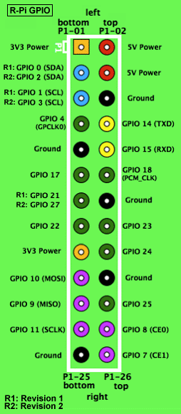
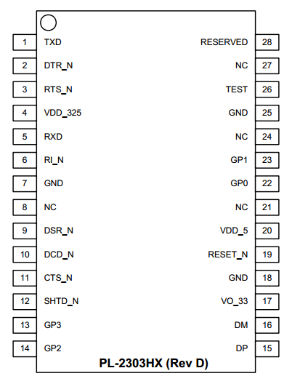

Slide 2
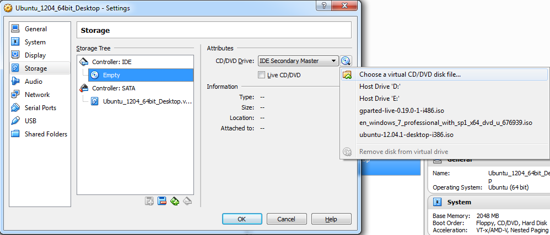
❷
❶
❸

Slide 3
❶
Binutils source
C standard libraries
Compiler, assembler and linker
binutils
x86
x86
x86
❷
Cross-compiler source
C standard libraries
Compiler, assembler and linker
Bootstrap compiler
x86
x86
x86
❸
C library source
Linux kernel headers
Bootstrap compiler
glibc or uClibc
x86
ARM

Slide 4
❹
Cross-compiler source
glibc or uClibc
Compiler, assembler and linker
Cross-compiler
ARM
x86
x86
❺
Linux kernel source
glibc or uClibc
Cross-compiler and binutils
Linux kernel
ARM
x86
ARM
❻
Application source
glibc or uClibc
Cross-compiler and binutils
Application
ARM
x86
ARM

