Slide 1
Multimedia Technieken
Buildroot

Slide 2
Building Embedded Linux Systems
To create an embedded Linux system we have multiple choices:
Use a pre-built binary distribution such as Debian, Ubuntu or Fedora
Quick to set up, but not very flexible: support for only a few architectures, no flexibility on package configuration, no easy way to rebuild the entire system automatically.
Build all system components manually
Highly flexible, but painful and inefficient: need to handle complex cross-compilation issues, understand inter-package dependencies, not reproducible.
Use an automated build system, that builds the entire system from source
Automated, flexible, handle most cross-compilation issues
Examples: Buildroot, OpenWRT, PTXdist, OpenBricks, OpenEmbedded, Yocto, etc.

Slide 3
Buildroot Main Characteristics
Based on well-known technologies:
kconfig for the configuration interface and language
make for the build logic
These technologies are familiar to all embedded Linux developers.
Very simple to use, and easily hackable code base. The core infrastructure is a few hundred lines of make code.
Fast. It does really build only what’s necessary. The base system, composed only of BusyBox, takes less than 3 minutes to build with an external toolchain.
Designed for small to medium sized embedded systems. There is no runtime package management system (dpkg, rpm). Complete rebuilds are often required. Well-suited for systems with a limited number of components.

Slide 4
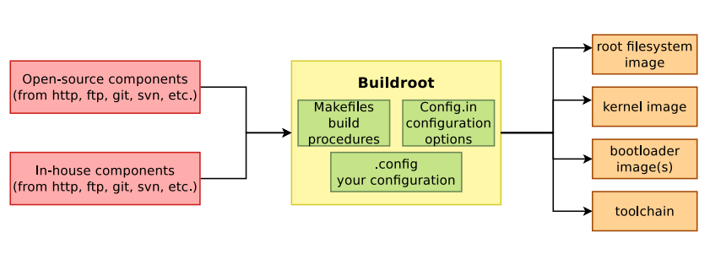
General Principle

Slide 5
Buildroot
Getting the Latest Buildroot

Slide 6
Getting the Latest Buildroot
Latest stable release:
Download the latest tar-bal from http://buildroot.uclibc.org/download.html
Latest development repository
$ tar -xvzf buildroot-2014.08.tar.gz
# x indicates an extraction
# v gives extra output (verbose)
# z is for a gz compressed archive
# f is a file specifier
git clone git://git.buildroot.net/buildroot

Slide 7
Buildroot
Building it all

Slide 8
Host System Requirements
Your host system will need some libraries, tools and packages before we can use Buildroot
Buildroot will generate errors when dependencies are not met
Luckily you can always continue the build process after installing missing dependencies
Following packages are mandatory
$ sudo apt-get install git git-core libncurses5 libncurses5-dev build-essential

Slide 9
Buildroot and Raspberry Pi
Buildroot comes with predefined configuration files for many popular embedded systems
Check out buildroot/config/ directory for available configurations
Select configuration using the make command as followed
Creates a configuration file in buildroot/ with the name .config
$ make raspberrypi_defconfig

Slide 10
Building it all
Once the configuration is defined and saved in .config, the compilation process is started by using the make command
This will take a while the first time
Buildroot will automatically download, extract, patch, configure, compile and install the selected components, taking care of the necessary dependencies.
Never run this as root ! (no need)
Very limited set of dependencies:
a native compiler, and basic utilities like awk, bison, patch, gzip, tar, wget, etc.
$ make

Slide 11
Building it all - Result
Check buildroot/output/images for the generated files for your target system
rootfs.tar
This is your rout filesystem. It still needs to be extracted to its own partition on an SD card
rpi-firmware (bootcode.bin, cmdline.txt, config.txt, fixup.dat, startup.elf)
These are the bootloaders and configuration files for booting your Pi
zImage
The kernel image
├── rootfs.tar
├── rpi-firmware
│ ├── bootcode.bin
│ ├── cmdline.txt
│ ├── config.txt
│ ├── fixup.dat
│ └── start.elf
└── zImage

Slide 12
Buildroot
Booting the Raspberry Pi

Slide 13
Preparing the SD card
Instructions can be found under board/raspberrypi/readme.txt
It states that we need two partitions
FAT32 boot partition
EXT3 / EXT4 root filesystem partition
At the root of the boot partition, the RaspberryPi must find the following files:
bootcode.bin
config.txt
fixup.dat
start.elf
zImage
The kernel image file name is defined in config.txt like “kernel=zImage”.
Can be changed if you wish
$ cat buildroot/board/raspberrypi/readme.txt

Slide 14
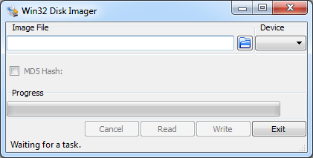
Preparing the SD card
Would be really easy when we had RAW access to SD card from virtual machine
Solution:
Creating our own image file and use Win32 Disk Imager to write the image to the SD card

Slide 15
Preparing the SD card – Solution outline
Create an image file (50MB)
Create both partitions using the fdisk tool
$ cd ~
$ dd if=/dev/zero of=minimal_pi.img bs=1M count=50
$ fdisk minimal_pi.img
Disk minimal_pi.img: 52 MB, 52428800 bytes
255 heads, 63 sectors/track, 6 cylinders, total 102400 sectors
Units = sectors of 1 * 512 = 512 bytes
Sector size (logical/physical): 512 bytes / 512 bytes
I/O size (minimum/optimal): 512 bytes / 512 bytes
Disk identifier: 0xef02b601
Device Boot Start End Blocks Id System
minimal_pi.img1 2048 22527 10240 4 FAT16 <32M
minimal_pi.img2 22528 102399 39936 83 Linux

Slide 16
Preparing the SD card – Solution outline
Use the kpartx tool to map both paritions to a loop device
A loop device allows us to access a file as a block device (example of a block device is HDD)
Both partitions can now be accessed via
/dev/mapper/loop0p1
/dev/mapper/loop0p2
Now the partitions can be formatted with a filesystem
$ kpartx –a minimal_pi.img
$ sudo mkfs.vfat -F 16 -n boot /dev/mapper/loop0p1
$ sudo mkfs.ext4 -L rootfs /dev/mapper/loop0p2

Slide 17
Preparing the SD card – Solution outline
Next we mount the newly formatted partitions so we can add the necessary files to them
Copy the files to the partitions
$ sudo mkdir -p /mnt/boot
$ sudo mkdir -p /mnt/rootfs
$ sudo mount -o rw,sync /dev/mapper/loop0p1 /mnt/boot
$ sudo mount -o rw,sync /dev/mapper/loop0p2 /mnt/rootfs
$ sudo cp buildroot/output/images/zImage /mnt/boot
$ sudo cp buildroot/output/images/rpi-firmware/* /mnt/boot
$ sudo tar -xpsf buildroot/output/images/rootfs.tar -C /mnt/rootfs

Slide 18
Preparing the SD card – Solution outline
The cmdline.txt also need to be changed a bit. Open it using nano:
Make sure the content reads:
Unmount both partitions and detach the loop device with kpartx
Also copy the image to your share
$ sudo nano /mnt/boot/cmdline.txt
dwc_otg.fiq_fix_enable=1 sdhci-bcm2708.sync_after_dma=0 dwc_otg.lpm_enable=0 console=ttyAMA0,115200 root=/dev/mmcblk0p2 rootfstype=ext4 rootwait
$ sudo umount /mnt/boot
$ sudo umount /mnt/rootfs
$ sudo kpartx –d minimal_pi.img
$ cp minimal_pi.img /media/sf_VMShare

Slide 19
Preparing the SD card - Automated
All these steps have been automated using a shell script called ‘sdcard.sh’. Copy it to your homedir and make sure it is executable
Change the location of buildroot inside the script using nano
Run the script
$ sudo chmod +x sdcard.sh
$ nano sdcard.sh
$ cd ~
$ ./sdcard.sh

Slide 20
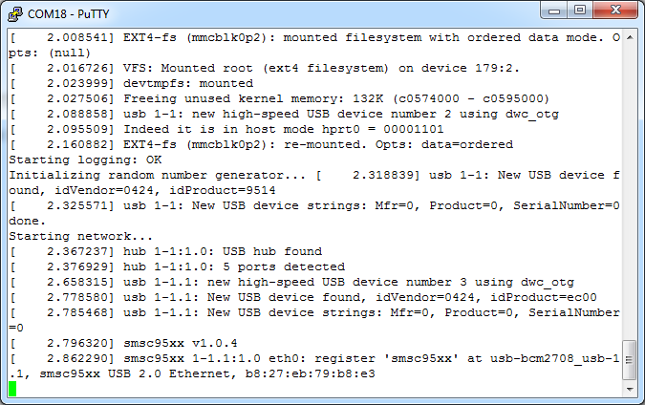
Success
This perfectly boots.
Attaching a serial to USB would show you the kernel message
However the actual login prompt is not displayed
It is actually available through HDMI

Slide 21
Buildroot
Configuring your system

Slide 22
Needs more configuration
Some things we still need to configure
Custom root file system
Setup the network interface
Remote access via SSH
Spawning a getty on the serial line

Slide 23
Custom Root File System
Before we can continue we will need a way to add our own files to the file system and make changes to existing files
Buildroot implements a simple way of doing this
The first step is to create the following directory structure inside your home folder
“Config.in” and “external.mk” are empty files that are mandatory
$ tree pi_buildroot_custom/
pi_buildroot_custom/
├── board
│ └── raspberrypi
│ └── rootfs_overlay
├── Config.in
└── external.mk
3 directories, 2 files

Slide 24
Custom Root File System
Next we need to tell Buildroot where this directory can be found
This only needs to be done once !
Make sure to specify the absolute path of your customizations directory
This is automatically saved in “output/.br-external”
$ make BR2_EXTERNAL=/home/nico/pi_buildroot_custom

Slide 25
Custom Root File System
Now we need to tell Buildroot to use “/home/nico/pi_buildroot_custom/board/raspberrypi/rootfs_overlay/” as a root filesystem overlay
Issue
Navigate to
and change “Root filesystem overlay directories” to
Save and exit
$ make menuconfig
System configuration
$(BR2_EXTERNAL)/board/raspberrypi/rootfs_overlay

Slide 26
Custom Root File System
Just create a new file called info in “/home/nico/pi_buildroot_custom/board/raspberrypi/rootfs_overlay/”
Just add some text identifying this as being your system
$ nano /home/nico/pi_buildroot_custom/board/raspberrypi/rootfs_overlay/info

Slide 27
Setup the network interface
For the moment all we need to do is activate the network interface.
We just added our own filesystem overlay so this is easy
Create a file called “interfaces” in “etc/network”
And copy the following content to the file
$ cd ~/pi_buildroot_custom/board/raspberrypi/rootfs_overlay/
$ mkdir –p etc/network
$ cd etc/network
$ touch interfaces
auto lo
iface lo inet loopback
auto eth0
iface eth0 inet dhcp

Slide 28
Setup the network interface
Apparently sometimes it happens that the network controller is not yet operational and Linux already tries to bring up the interface
In this the network interfaces never comes up and the interface also receives no IP address
To fix this we need to add a delay to the script that brings up the network interfaces
The script that brings up the interfaces can be found at “/buildroot/output/target/etc/init.d/S40network”
We can copy this to our root file system overlay and modify it
$ mkdir –p ~/pi_buildroot_custom/board/raspberrypi/rootfs_overlay/etc/init.d
$ cp –a ~/buildroot/output/target/etc/init.d/S40network ~/pi_buildroot_custom/board/raspberrypi/rootfs_overlay/etc/init.d/

Slide 29
Setup the network interface
Next we need to add a “sleep 2” before the “ifup” command
With the end result being
$ cd ~/pi_buildroot_custom/board/raspberrypi/rootfs_overlay/etc/init.d/
$ nano S40network
#!/bin/sh
#
# Start the network....
#
case "$1" in
start)
echo "Starting network..."
sleep 2
/sbin/ifup -a
;;
stop)
echo -n "Stopping network..."
/sbin/ifdown -a
;;
restart|reload)
"$0" stop
"$0" start
;;
*)
echo "Usage: $0 {start|stop|restart}"
exit 1
esac
exit $?

Slide 30
Adding an SSH daemon
First of all we need to configure the system with an SSH daemon so we can login remotely
The perfect candidate for this is dropbear which can be retrieved from https://matt.ucc.asn.au/dropbear/dropbear.html
However since this is a requirement almost every embedded system needs it was added to Buildroot
To configure Buildroot to add the dropbear ssh daemon start the buildroot menu config
This allows you to configure the overall Buildroot system
$ cd ~/buildroot
$ make menuconfig

Slide 31

Adding an SSH daemon
Navigate to
and check
How could you ever have found this yourself ?
Google
menuconfig + search (/)
Target packages => Networking applications
dropbear

Slide 32
Adding an SSH daemon
Dropbear will not allow a user to login with a user account which does not have a password
The root account does not have a password default
Navigate to
and set a “Root password”
System Configuration

Slide 33
Adding an SSH daemon
Save the configuration and issue a make command
Execute the sdcard.sh shell script
Write the image to the SD card and reboot the Pi
$ make
$ ~/sdcard.sh

Slide 34

Spawning a getty on the serial line
To spawn a console to the serial line (necessary for debugging) you need to configure Buildroot
Navigate to
and change the “TTY port” to
which is the name of the serial port on the Raspberry Pi
$ make menuconfig
System configuration => Run a getty (login prompt) after => getty options
ttyAMA0

Slide 35

Problems ?
Step 1: Keep calm
Step 2: Retrace your steps and make sure you did not mess anything up
Step 3: Panic
Step 4: Ask for a Serial to USB converter and debug

Slide 36
Buildroot
Room for improvements

Slide 37
System in Development
Is this a manageable setup for a system in development ?
Real world development setup would for example use a boot loader which could fetch the kernel and root file system from a network drive
This would allow you to omit the SD card write step
Much faster for testing
More complex to setup
Requires a working network interface

