Slide 1
Multimedia Technieken
Raspberry Pi Basic I2C Memory Master

Slide 2
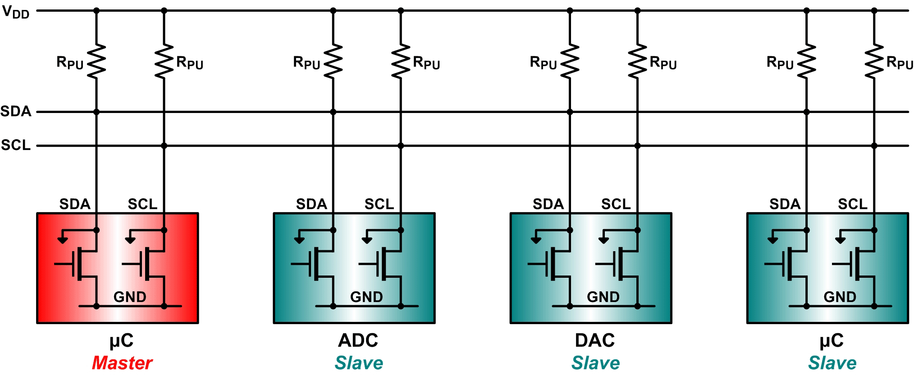
Why I2C ?
Because
Its a common standard
Its “fast” for low-speed devices
Bus (multiple devices can be connected)
Easy to use
Wide support
Only 2 communication lines needed (SDA and SCL)

Slide 3
Raspberry Pi Basic I2C Memory Master
Our Goal

Slide 4
Our Goal
Connect the Raspberry Pi to the mbed I2C memory emulator
Write a user space application (diagnostic) and let it communicate with the slave device
We will need to cross-compile the source to the ARM architecture
In this setup the Raspberry Pi will act as a master while the mbed memory emulator is the slave
The characteristics of the setup are
100kHz bus frequency
Slave is at address 0x84
See mbed slave description for more info

Slide 5
Raspberry Pi Basic I2C Memory Master
Connecting the Pi and the mbed

Slide 6

Voltage Levels
Raspberry Pi runs at 3.3V
mbed runs at 3.3V
So no level shifting is required
We do need to add pull-up resistors of 3k3 to both the SDA and SCL lines

Slide 7
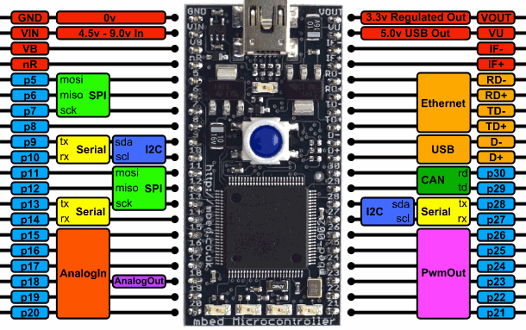
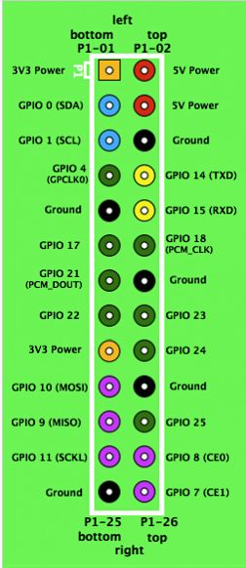
Connections
3v3
3k3
3k3

Slide 8
Raspberry Pi Basic I2C Memory Master
Enabling Linux kernel I2C support

Slide 9
Enabling Linux kernel I2C support
Before we can continue we need to enable i2c support in the Linux kernel
Do a “make linux-menuconfig” and enable
Next go down into I2C support and enable
Under I2C Hardware Bus support enable
Device drivers => I2C support
* I2C device interface
* I2C Core debugging messages
* I2C Bus debugging messages
* BCM2708 BSC
M GPIO-based bitbanging I2C

Slide 10
Add i2c-tools
i2c-tools is a useful package that allows us to scan the I2C bus for devices
Very useful for debugging and testing
Do a “make menuconfig” and navigate to
Enable
Save and make the system
You can download this image from Toledo
Target packages => Hardware handling
* i2c-tools

Slide 11
Raspberry Pi Basic I2C Memory Master
i2cdetect

Slide 12
i2cdetect
Once the two embedded boards are connected using i2c you can use the i2cdetect tool to scan the bus for slave devices
For we need to check “/dev” for available i2c busses
Look for “i2c-x” where x is a number
Use the i2cdetect tool to scan the bus and replace x with the number of the actual device bus
$ cd /dev
$ ls
$ i2cdetect –r x
example
$ i2cdetect –r 1

Slide 13
i2cdetect
You should get output similar to the one shown below
Notice that i2cdetect (and Linux) sees the device @ 0x42 instead of 0x84. This is normal as Linux uses a 7bit address and mbed an 8bit address.
# i2cdetect -r 1
WARNING! This program can confuse your I2C bus, cause data loss and worse!
I will probe file /dev/i2c-1 using read byte commands.
I will probe address range 0x03-0x77.
Continue? [Y/n]
0 1 2 3 4 5 6 7 8 9 a b c d e f
00: -- -- -- -- -- -- -- -- -- -- -- -- --
10: -- -- -- -- -- -- -- -- -- -- -- -- -- -- -- --
20: -- -- -- -- -- -- -- -- -- -- -- -- -- -- -- --
30: -- -- -- -- -- -- -- -- -- -- -- -- -- -- -- --
40: -- -- 42 -- -- -- -- -- -- -- -- -- -- -- -- --
50: -- -- -- -- -- -- -- -- -- -- -- -- -- -- -- --
60: -- -- -- -- -- -- -- -- -- -- -- -- -- -- -- --
70: -- -- -- -- -- -- -- --

Slide 14
Raspberry Pi Basic I2C Memory Master
Cross-compiling

Slide 15

Compilation using Makefiles
Makefile(s) are text files written in a certain prescribed syntax.
Together with the Make utility, it helps build a software from its source files, a way to organize code, and its compilation and linking.
Start by creating a really simple C++ program in your home dir
Example:
Save it as main.cpp
#include <stdio.h>
int main(void)
{
printf("Hello world\r\n");
return 0;
}

Slide 16
Compilation using Makefiles
You can compile this program using the following command
Or we can make a really simple makefile
Save it as “Makefile”
$ gcc –o hello main.cpp
# The compiler
CC=g++
# Compiler flags
CFLAGS = -Wall
# -Wall turns on most, but not all, compiler warnings
hello: clean
$(CC) $(CFLAGS) -o hello main.cpp
clean:
rm -f hello

Slide 17
Compilation using Makefiles
Next you just execute the “make” command to generate your executable
Or “make clean” to clean your output files
Output:
Now you can run the program
$ ls
hello main.cpp Makefile
./hello
Hello world

Slide 18
Cross-compiling using Makefiles
Now we got a small program to compile on our host system but when we want to run this on the Pi we need to cross-compile it
Luckily the cross-compilation tool is ready-to-use because of buildroot
You just to find it
~/buildroot/output/host/usr/bin/

Slide 19
Cross-compiling using Makefiles
To make life easier you can use the following Makefile as a base for your work
You can download this from Toledo (make_hello)
# The compiler
BINPATH=/home/nico/buildroot/output/host/usr/bin/arm-buildroot-linux-uclibcgnueabi-
CC=$(BINPATH)g++
# Compiler flags
CFLAGS = -Wall
# -Wall turns on most, but not all, compiler warnings
hello: clean
$(CC) $(CFLAGS) -o hello main.cpp
clean:
rm -f hello

Slide 20
Raspberry Pi Basic I2C Memory Master
Secure Copy

Slide 21
Secure Copy
To copy the executable to the target system we can use the secure copy tool which has the following syntax
Scp allows us to copy files from one system to another over a secure SSH connection
Example:
This will copy the hello executable to the root of the target system
scp [[user@]host1:]source [[user@]host2:]destination
scp /home/nico/make_hello/hello root@172.180.35.10:/

Slide 22
Raspberry Pi Basic I2C Memory Master
Assignment

Slide 23
Assignment
Port the code of the I2C mbed master to the Raspberry Pi
You can find a lot of useful code on http://elinux.org/Interfacing_with_I2C_Devices
Start from the Skeleton project found at Toledo
This already included a working Makefile

