Slide 1
Multimedia Technieken
I2C TRex Motor Controller

Slide 2
Introduction
Communication using JSON strings
Webserver + PHP
TRex master control
(C++ app)
Address: 0x07
Speed: 100k
Raspberry Pi
TRex Motor Controller
i2c

Slide 3
I2C TRex Motor Controller
Web Application

Slide 4
Web Application
Pi Status
PHP as a server side language
Use a CSS framework for the layout (such as Twitter BootStrap or Foundation)
MAC Address
CPU temperature
Free memory
Free disk free
...

Slide 5
Web Application
TRex Status
PHP as a server side language
Use a CSS framework for the layout (such as Twitter BootStrap or Foundation)
Communication with TRex control application uses JSON strings
Use chart.js for displaying some information such as battery voltage
Errors flags
Battery voltage
Motor current
Encoder count
...

Slide 6
Web Application
TRex Control
PHP as a server side language
Use a CSS framework for the layout (such as Twitter BootStrap or Foundation)
Left Motor Speed
Right Motor Speed
PWM Frequency
Servo Position
...

Slide 7
Web Application
To use php with a web server you will need to cross-compile lighttpd and php to the arm platform
Check out http://samarthparikh.blogspot.be/2013/09/cross-compile-lighttpd-php-for-arm.html
While using pre-compiled file systems for armel such as ubuntu, debian, etc. there is an option of installing the required packages from their respective repositories.
However when the file system is created from scratch, which would usually based on busybox, one doesn't have the flexibility of installing packages from repos.
Rather the required package should be compiled and installed manually on to the file system being used.

Slide 8
I2C TRex Motor Controller
TRex C++ Control Application

Slide 9
TRex C++ Control Application
Skeleton code is available on GitHub
https://github.com/BioBoost/i2c_pi_trex_master_student
Abstract classes are provided from which you should inherit and create your own classes
For example you should call your class “MyTRex” which inherits from the abstract “TRex” class.
NO changes can be made to the abstract classes !
You will need to add the I2C code you have written for the Raspberry Pi Memory device to “MyI2C”
All methods and classes are documented using JavaDoc alike documentation

Slide 10
TRex C++ Control Application

Slide 11
TRex C++ Control Application

Slide 12
JSON (JavaScript Object Notation)
Communication using JSON strings
Webserver + PHP
TRex master control
(C++ app)
Address: 0x07
Speed: 100k
Raspberry Pi
TRex Motor Controller
i2c

Slide 13
JSON
JSON (JavaScript Object Notation) is a lightweight data-interchange format.
It is easy for humans to read and write.
It is easy for machines to parse and generate.
JSON is a text format that is completely language independent but uses conventions that are familiar to programmers of the C-family of languages, including C, C++, C#, Java, JavaScript, Perl, Python, and many others.
JSON is built on two structures:
A collection of name/value pairs
In various languages, this is realized as an object, record, struct, dictionary, hash table, keyed list, or associative array.
An ordered list of values.
In most languages, this is realized as an array, vector, list, or sequence.
These are universal data structures. Virtually all modern programming languages support them in one form or another. It makes sense that a data format that is interchangeable with programming languages also be based on these structures.

Slide 14

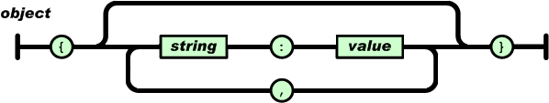
JSON
An object is an unordered set of name/value pairs.
An object begins with { (left brace) and ends with } (right brace).
Each name is followed by : (colon) and the name/value pairs are separated by , (comma).

Slide 15
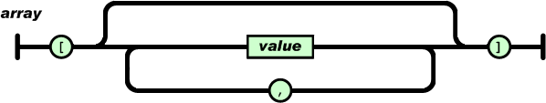
JSON
An array is an ordered collection of values.
An array begins with [ (left bracket) and ends with ] (right bracket). Values are separated by , (comma).

Slide 16
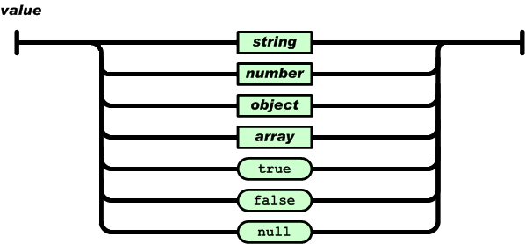
JSON
A value can be a string in double quotes, or a number, or true or false or null, or an object or an array. These structures can be nested.

Slide 17
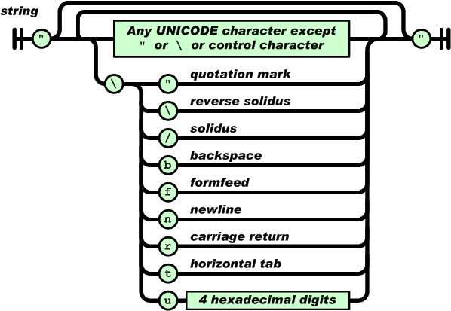
JSON
A string is a sequence of zero or more Unicode characters, wrapped in double quotes, using backslash escapes. A character is represented as a single character string. A string is very much like a C or Java string.

Slide 18
JSON Communication
When starting the C++ TRex Controller application should read a JSON string from the standard input stream (STDIN)
First situation
We want to request the status information from the TRex
A JSON string following this format needs to be send to the standard input stream of the C++ application
The C++ application needs to respond with a JSON string on the standard output stream (STDOUT) of the following format
{"device_path": "/dev/i2c-1", "i2c_address": 7}
{"device_path": "/dev/i2c-1", "i2c_address": 7, "errors": {"start_byte": false, "pwm_frequency": false, "motor_speed": false, "servo_position": false, "impact_sensitivity": false, "low_battery": false, "i2c_address": false, "i2c_speed": false}, "battery_voltage": 7.52, "motor_current": {"left": 2.15, "right": 5.71}, "encoder_count": {"left": 125, "right": 800}, "accelero_meter": [0, 125, 88], "impact": [0, 125, 88]}

Slide 19
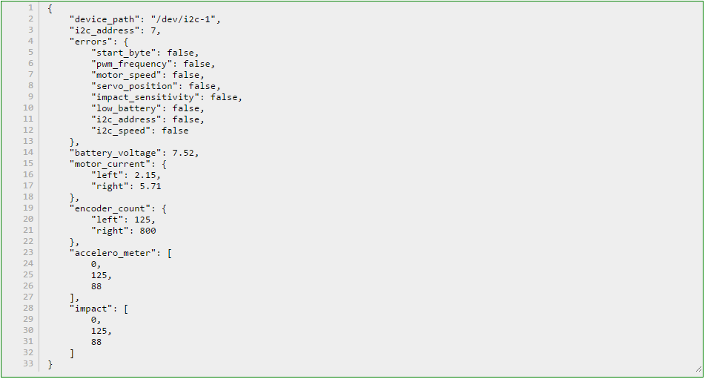

Slide 20
JSON Communication
Second situation
We want to send a command to the TRex
A JSON string following this format needs to be send to the standard input stream of the C++ application
The C++ application needs to respond with the same JSON string shown earlier (with the status information) on the standard output stream (STDOUT)
{"device_path": "/dev/i2c-1", "i2c_address": 7, "pwm_frequency": 6, "motor_speed": {"left": 128, "right": -55}, "brake": {"left": 0, "right": 0}, "servos": [128, 12, 13, 0, 0, 0], "accelero_meter_devibrate": 50, "impact_sensitivity": 50, "low_battery_voltage": 550, "i2c_slave_address": 7, "clock_frequency": 0}

Slide 21
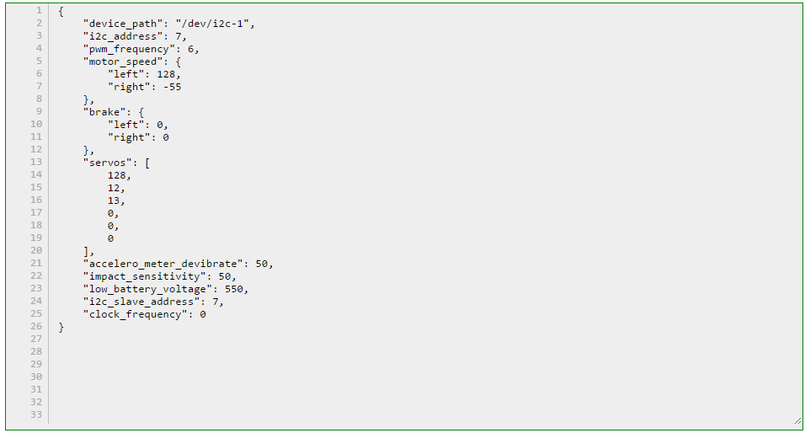

Slide 22
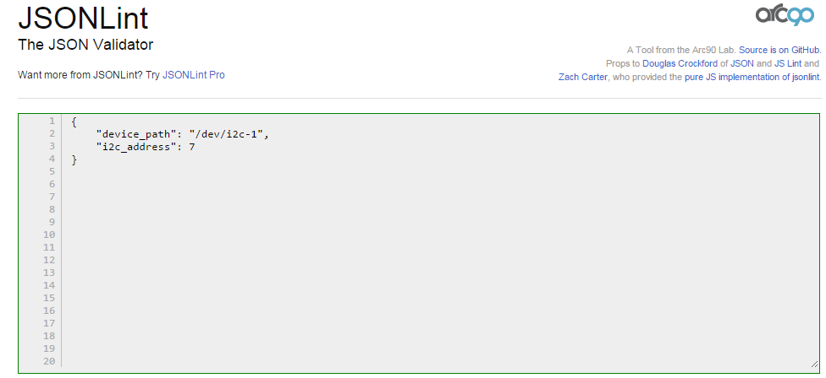
JSON Validator
You can use http://jsonlint.com/ to validate your output

Slide 23
I2C TRex Motor Controller
Forking the C++ Application

Slide 24
Forking and Cloning
Create your own GitHub account
Create a repository by forking from https://github.com/BioBoost/i2c_pi_trex_master_student
Forking a repository
A fork is a copy of a repository. Forking a repository allows you to freely experiment with changes without affecting the original project.
Most commonly, forks are used to either propose changes to someone else's project or to use someone else's project as a starting point for your own idea.

Slide 25
Forking and Cloning
Clone the remote repository to your local Ubuntu
Do your thing
Push your changes to your remote repository on GitHub
Next time you can just type
$ git clone https://github.com/<your_username>/i2c_pi_trex_master_student.git
$ git add ....
$ git commit .....
$ git push -u origin master
$ git push

Slide 26
Keeping Up to Date
Add a remote that points to the original repository
Fetch the branches and their respective commits from the upstream repository. Commits to master will be stored in a local branch, upstream/master.
$ git remote add upstream https://github.com/BioBoost/i2c_pi_trex_master_student.git
$ git remote –v
origin https://github.com/dewittenico/i2c_pi_trex_master_student.git (fetch)
origin https://github.com/dewittenico/i2c_pi_trex_master_student.git (push)
upstream https://github.com/BioBoost/i2c_pi_trex_master_student.git (fetch)
upstream https://github.com/BioBoost/i2c_pi_trex_master_student.git (push)
$ git fetch upstream
# remote: Counting objects: 75, done.
# remote: Compressing objects: 100% (53/53), done.
# remote: Total 62 (delta 27), reused 44 (delta 9)
# Unpacking objects: 100% (62/62), done.
# From https://github.com/ORIGINAL_OWNER/ORIGINAL_REPOSITORY
# * [new branch] master -> upstream/master

Slide 27
Keeping Up to Date
Check out your fork's local master branch.
Merge the changes from upstream/master into your local master branch. This brings your fork's master branch into sync with the upstream repository, without losing your local changes.
$ git checkout master
# Switched to branch 'master'
$ git merge upstream/master
# Updating a422352..5fdff0f
# Fast-forward
# README | 9 -------
# README.md | 7 ++++++
# 2 files changed, 7 insertions(+), 9 deletions(-)
# delete mode 100644 README
# create mode 100644 README.md

Slide 28
The mbed TRex slave emulator
The slave code can be found at http://developer.mbed.org/users/dwini/code/i2c_mbed_trex_emulator/
Import the program into your own online workspace
Check for updates from time to time

