Slide 1
Multimedia Technieken
I2C mbed memory slave device

Slide 2
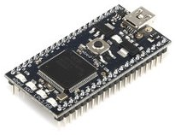
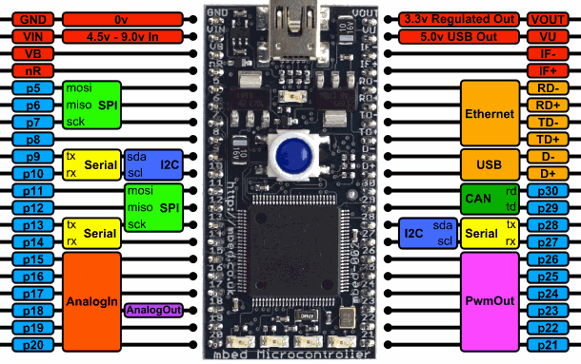
I2C mbed memory slave device
The I2C Memory Slave emulates a really small I2C memory device.
It allows you to store 32 integers (of 4 bytes) each and retrieve them.
To connect to the device you will need to attach an I2C master device to pin 27 (SCL) and pin 28 (SDA).
You will also need to add two pull-up resisters of 2k2.

Slide 3
I2C mbed memory slave device
To get some console output from the slave device you can use a terminal program such as Putty to connect to the serial interface over USB at a speed of 115200 baud.
The slave device also has an alive LED which will blink periodically as long as the device is operational and responsive.
The I2C bus operates at 100kHz and the slave device address is 0x84.

Slide 4
I2C mbed memory slave device
Below is an overview of the commands that can be send to slave device.
With the PUSH command you can write a value to the memory device. All you need to do is send 6 bytes to the device. The command byte, followed by the address of where the value should be stored and last the actual integer value consisting of 4 bytes.
Command value | Command name | Description | Example
0x00 | PUSH | Write a value to the specified address | Write: [0x00] [1 byte address] [4 bytes data]
0x01 | PULL | Set internal read pointer to specific address | Write: [0x01] [1 byte address]
0x02 | CLEAR | Reset the memory to all zeroes | Write: [0x02]
0x03 | PRINT | Print memory to slave console | Write: [0x03]

Slide 5
I2C mbed memory slave device
Below is an overview of the commands that can be send to slave device.
The PULL command allows you to set the internal read pointer of the slave. This pointer is used when reading from the device and should point to the memory location you want to read. Once set you can do a read from the slave device, which will send you 5 bytes. The first byte is the address of the internal read pointer. The following 4 bytes are the actual value stored in the memory at the given address.
Command value | Command name | Description | Example
0x00 | PUSH | Write a value to the specified address | Write: [0x00] [1 byte address] [4 bytes data]
0x01 | PULL | Set internal read pointer to specific address | Write: [0x01] [1 byte address]
0x02 | CLEAR | Reset the memory to all zeroes | Write: [0x02]
0x03 | PRINT | Print memory to slave console | Write: [0x03]

Slide 6
I2C mbed memory slave device
Below is an overview of the commands that can be send to slave device.
The CLEAR and PRINT commands are simple 1 byte commands which can be send to the device to respectively clear the memory and to print the content of the memory to the slave’s console.
Command value | Command name | Description | Example
0x00 | PUSH | Write a value to the specified address | Write: [0x00] [1 byte address] [4 bytes data]
0x01 | PULL | Set internal read pointer to specific address | Write: [0x01] [1 byte address]
0x02 | CLEAR | Reset the memory to all zeroes | Write: [0x02]
0x03 | PRINT | Print memory to slave console | Write: [0x03]

Slide 7
Slave code – memory.h
#ifndef MEMORY_HEADER
#define MEMORY_HEADER
class Memory {
public:
const static int MEMORY_SIZE = 32;
private:
int memory[MEMORY_SIZE];
public:
Memory();
void reset();
void set(int address, int value);
int get(int address);
void print();
};
#endif

Slide 8
Slave code – memory.cpp
#include "mbed.h"
#include "memory.h"
Memory::Memory()
{
reset();
}
/*
* Reset all memory locations to 0.
*/
void Memory::reset()
{
for (int i = 0; i < Memory::MEMORY_SIZE; i++) {
this->memory[i] = 0;
}
}

Slide 9
Slave code – memory.cpp
/*
* Store value in memory
*/
void Memory::set(int address, int value)
{
if (address < Memory::MEMORY_SIZE) {
this->memory[address] = value;
}
}
/*
* Retrieve value from memory
*/
int Memory::get(int address)
{
if (address < Memory::MEMORY_SIZE) {
return this->memory[address];
} else {
return 0;
}
}

Slide 10
Slave code – memory.cpp
/*
* Print current memory content to console
*/
void Memory::print()
{
int i = 0, c = 0;
while (i < Memory::MEMORY_SIZE) {
c = (c + 1) % 4;
printf("\t[%#04x]: %6d", i, this->memory[i]);
if (!c) {
printf("\r\n");
}
i++;
}
}

Slide 11
Slave code – main.cpp
#include "mbed.h"
#include "memory.h"
DigitalOut aLED(LED1);
Serial pc(USBTX, USBRX); // tx, rx
I2CSlave slave(p28, p27);
const int SLAVE_ADDRESS = 0x84;
const int I2C_FREQUENCY = 100000;
const int I2C_BUFFER_SIZE = 6;
enum COMMAND { PUSH, PULL, CLEAR, PRINT };
#define intToByte(pbytebuff,intval) (*((int*)(pbytebuff)) = intval)
#define byteToInt(pbytebuff,pintval) (*(pintval) = *((int*)(pbytebuff)))

Slide 12
Slave code – main.cpp
int main() {
pc.baud(115200);
pc.printf("Size of integer is %d bytes\r\n", sizeof(int));
// Alive LED
int cAlive = 0;
// Configure I2C
slave.frequency(I2C_FREQUENCY);
pc.printf("Slave is working @ %dHz\r\n", I2C_FREQUENCY);
slave.address(SLAVE_ADDRESS);
pc.printf("Slave is working @ SLAVE_ADDRESS = 0x%x\r\n", SLAVE_ADDRESS);
// Setup memory
Memory memory;
pc.printf("Size of memory buffer is %d elements\r\n", Memory::MEMORY_SIZE);
memory.print();
pc.printf("Awaiting commands from master ...\r\n");
// I2C buffer
char buffer[I2C_BUFFER_SIZE];
// Internal address pointer
int pointer = 0;

Slide 13
Slave code – main.cpp
while (1) {
int rec = slave.receive();
switch (rec) {
case I2CSlave::ReadAddressed:
{
int value = memory.get(pointer);
buffer[0] = pointer;
intToByte(buffer+1, value);
if (!slave.write(buffer, 5)) {
pc.printf("Retrieving and sending to master %d@%d\r\n", value, pointer);
} else {
pc.printf("Failed to send to master %d@%d\r\n", value, pointer);
}
break;
}

Slide 14
Slave code – main.cpp
case I2CSlave::WriteAddressed:
{
// First we read the command byte
int command = slave.read();
// Check the command
switch (command)
{
case PUSH:
// Expect 5 more bytes [address] [int value]
if(!slave.read(buffer, 5)) {
int address = buffer[0];
int value;
byteToInt(buffer+1, &value);
pc.printf("Storing %d@%d\r\n", value, address);
memory.set(address, value);
} else {
pc.printf("PUSH received with missing address/data\r\n");
}
break;

Slide 15
Slave code – main.cpp
case PULL:
// Expect 1 more byte [address]
if(!slave.read(buffer, 1)) {
int address = buffer[0];
pc.printf("Setting pointer to %d\r\n", address);
if (address < Memory::MEMORY_SIZE) {
pointer = address;
} else {
pc.printf("Address out of boundary\r\n");
}
} else {
pc.printf("PULL received with missing address\r\n");
}
break;
case CLEAR:
pc.printf("Clearing the memory\r\n");
memory.reset();
break;
case PRINT:
memory.print();
break;
default:
pc.printf("Unknown command byte\r\n");
}

Slide 16
Slave code – main.cpp
}
}
// Clear buffer
for (int i = 0; i < I2C_BUFFER_SIZE; i++) {
buffer[i] = 0;
}
// Alive LED
cAlive = (cAlive + 1) % 100000;
if (!cAlive) {
aLED = !aLED;
}
}
}

Slide 17
I2C mbed memory slave device
Assignment

Slide 18

Assignment
Create a simple master device using an mbed which demonstrates and tests the capabilities of the slave
Make sure to add a diagnostic function which writes and reads the full memory making sure both read and write operations are performed correctly.
Find a bug in the slave and earn an extra point ☺
Ready, set, GO

