Slide 1
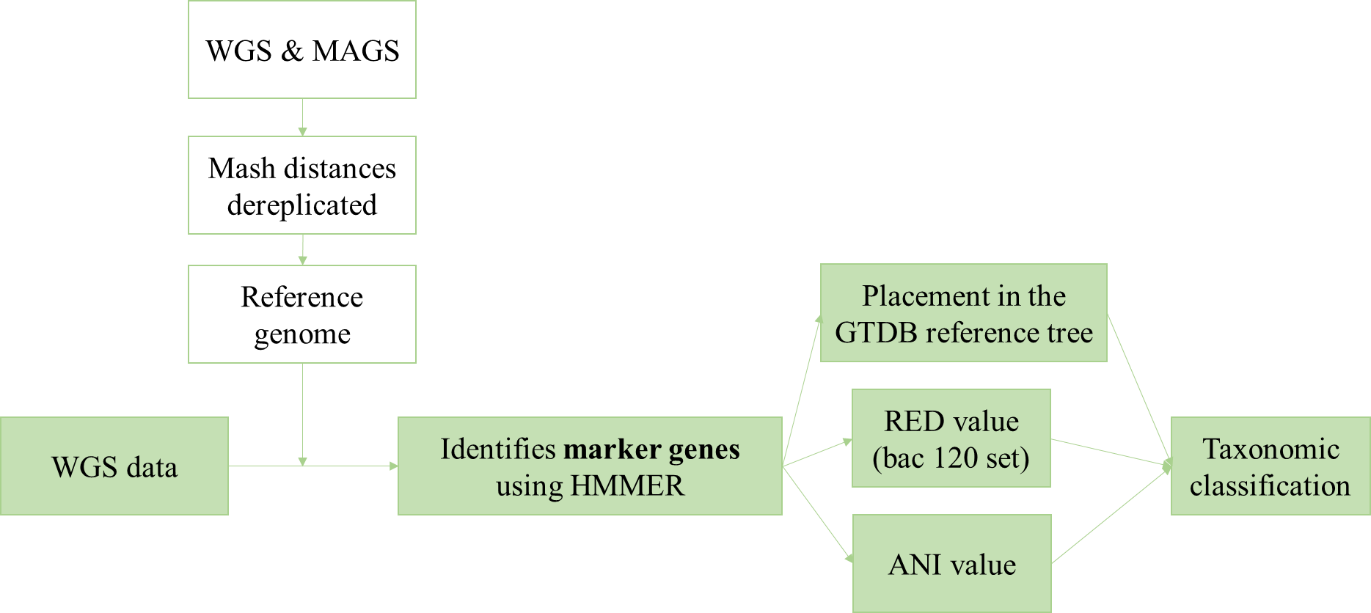
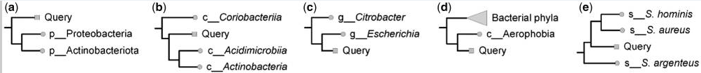
Saheb Kashaf, S., Almeida, A., Segre, J.A. et al. Recovering prokaryotic genomes from host-associated, short-read shotgun metagenomic sequencing data. Nat Protoc (2021)
Annotation
Taxonomy assignment：GTDB-tk as golden standard
Workflow
Example
Notes:
这一分类系统以细菌中普遍存在的120个单拷贝蛋白质（bac120）为基础；对多分组类别消歧后，根据相对演化散度标准化和分级，在大量氨基酸水平差异的基础上构建新的分类系统（命名为GTDB），大幅修正了现有的细菌生命之树。
RED values were calculated from the annotated bac120 tree with PhyloRank. PhyloRank performs a preorder tree traversal with the RED of the root defined to be zero and the RED of node n defined as p + (d/u)(1 – p), where p is the RED of the parent node, d is the branch length to the parent node, and u is the average branch length from the parent node to all extant taxa descendant from n. https://www.nature.com/articles/nbt.4229

