Slide 1
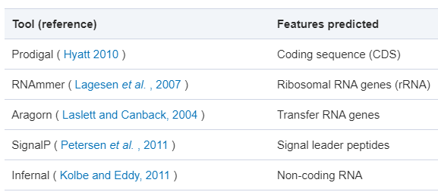
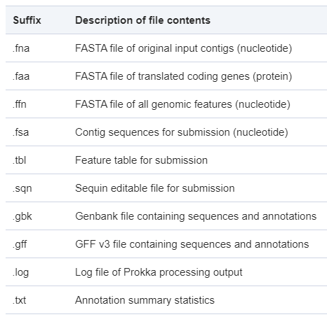
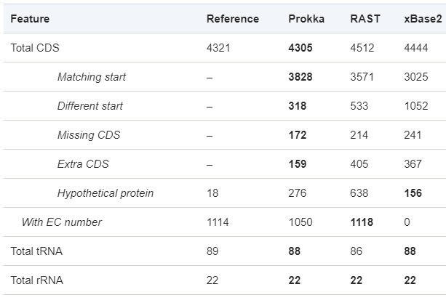
Saheb Kashaf, S., Almeida, A., Segre, J.A. et al. Recovering prokaryotic genomes from host-associated, short-read shotgun metagenomic sequencing data. Nat Protoc (2021)
Annotation
Prokka
Tools
OutPut
Comparison

Slide 2
Saheb Kashaf, S., Almeida, A., Segre, J.A. et al. Recovering prokaryotic genomes from host-associated, short-read shotgun metagenomic sequencing data. Nat Protoc (2021)
Annotation
Prokka：gff and tsv file （DO80）
Seq_ID | Source | Type | Start | End | Score | Strand | Phase | Attributes
1 | prokka | gene | 5116 | 5442 | . | - | . | ID=MHDHFPLE_00005_gene;locus_tag=MHDHFPLE_00005
1 | Prodigal:002006 | CDS | 5116 | 5442 | . | - | 0 | ID=MHDHFPLE_00005;Parent=MHDHFPLE_00005_gene;inference=ab initio prediction:Prodigal:002006;locus_tag=MHDHFPLE_00005;product=hypothetical protein
locus_tag | Type | length_bp | gene | EC_number | COG | product
MHDHFPLE_00003 | gene | 1500 | feaB
MHDHFPLE_00003 | CDS | 1500 | feaB | 1.2.1.39 | COG1012 | Phenylacetaldehyde dehydrogenase
MHDHFPLE_00005 | gene | 327
MHDHFPLE_00005 | CDS | 327 |  |  |  | hypothetical protein
MHDHFPLE_00184 | gene | 414 | hns
MHDHFPLE_00184 | CDS | 414 | hns |  | COG2916 | DNA-binding protein H-NS
Notes:
Phase：起始编码未知,仅CDS会注释，

