Slide 1
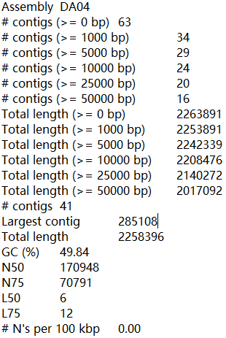
Saheb Kashaf, S., Almeida, A., Segre, J.A. et al. Recovering prokaryotic genomes from host-associated, short-read shotgun metagenomic sequencing data. Nat Protoc (2021)
Quality Evaluation
Assemble quality：QUAST
No reference genome
Contig sizes，GC (%)，N50，L50 …
N50: the length for which the collection of all contigs of that length or longer covers at least half an assembly
L50: the number of contigs equal to or longer than N50. In other words, L50, for example, is the minimal number of contigs that cover half the assembly.

Slide 2
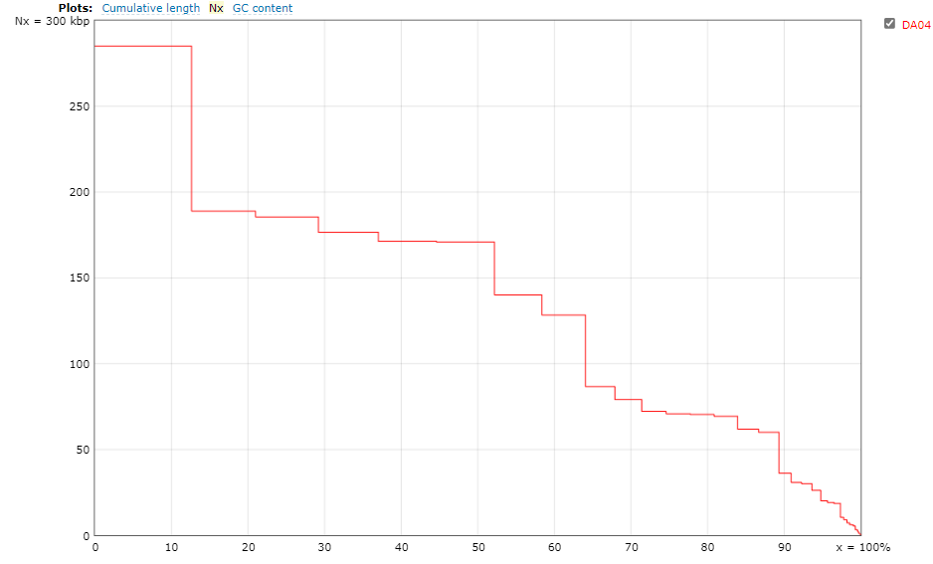
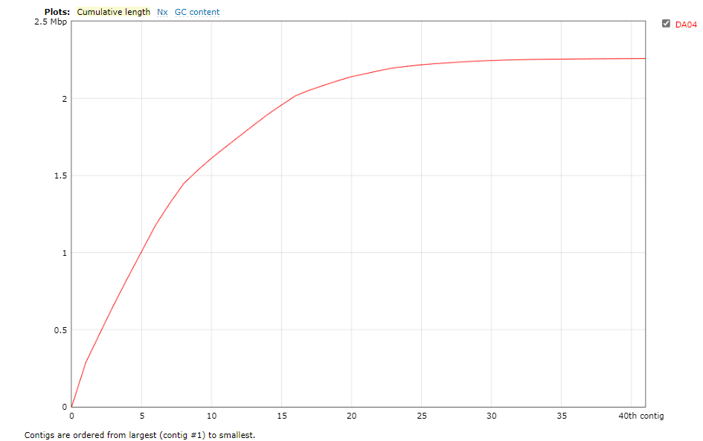
Saheb Kashaf, S., Almeida, A., Segre, J.A. et al. Recovering prokaryotic genomes from host-associated, short-read shotgun metagenomic sequencing data. Nat Protoc (2021)
Quality Evaluation
QUAST example
N50
L50
Contig size
Accumulated genome size
Percentage of genome
Sorted contig numbers

Slide 3
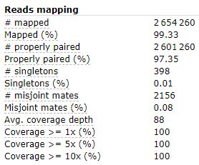
Saheb Kashaf, S., Almeida, A., Segre, J.A. et al. Recovering prokaryotic genomes from host-associated, short-read shotgun metagenomic sequencing data. Nat Protoc (2021)
Quality Evaluation
组装质量评估：QUAST
No reference genome
Metrics：Contig sizes，Duplication ratio，GC (%)，N50…
Reference genome & paired-end reads
Mis-assemblies and structural variations
Saheb Kashaf, et al. Recovering prokaryotic genomes from host-associated, short-read shotgun metagenomic sequencing data. Nat Protoc (2021)
Notes:
high completeness and low contamination MAGs might represent only a fraction of the entire metagenome²⁴
the minimum threshold of sequencing needed to retrieve medium- and high-quality MAGs varied between ~0.6 and ~6.1 Gb, but that the number of MAGs began to saturate with increasing sequencing effort²⁵
the depth of coverage required to recover MAGs depends on the diversity of the sample.
A study²⁶ comparing different assemblers demonstrated that ×10 coverage would be sufficient to recover the genomes of unique species in a sample, but much higher coverage (~×50) was required when there are closely related strains in the same sample.
fail to distinguish between contigs coming from different organisms, leading to the recovery of chimeric draft genomes (contaminated genomes)⁹
fail to correctly incorporate contigs from plasmids and other mobile genetic elements²⁷.

Slide 4
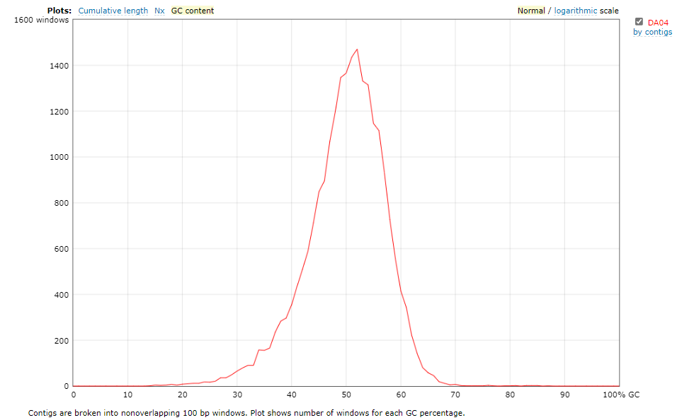
Saheb Kashaf, S., Almeida, A., Segre, J.A. et al. Recovering prokaryotic genomes from host-associated, short-read shotgun metagenomic sequencing data. Nat Protoc (2021)
Quality Evaluation
组装质量评估：QUAST
Genome size
N50
GC content
Saheb Kashaf, et al. Recovering prokaryotic genomes from host-associated, short-read shotgun metagenomic sequencing data. Nat Protoc (2021)
Notes:
high completeness and low contamination MAGs might represent only a fraction of the entire metagenome²⁴
the minimum threshold of sequencing needed to retrieve medium- and high-quality MAGs varied between ~0.6 and ~6.1 Gb, but that the number of MAGs began to saturate with increasing sequencing effort²⁵
the depth of coverage required to recover MAGs depends on the diversity of the sample.
A study²⁶ comparing different assemblers demonstrated that ×10 coverage would be sufficient to recover the genomes of unique species in a sample, but much higher coverage (~×50) was required when there are closely related strains in the same sample.
fail to distinguish between contigs coming from different organisms, leading to the recovery of chimeric draft genomes (contaminated genomes)⁹
fail to correctly incorporate contigs from plasmids and other mobile genetic elements²⁷.

