Slide 1
Saheb Kashaf, S., Almeida, A., Segre, J.A. et al. Recovering prokaryotic genomes from host-associated, short-read shotgun metagenomic sequencing data. Nat Protoc (2021)
Quality Evaluation
Estimate completeness and contamination from CheckM
Completeness: the number of marker sets present in a genome taking into account that only a portion of a marker set may be identified
Contamination: estimated from the number of multicopy marker genes identified in each marker set
Parks DH, et al. 2015. CheckM: assessing the quality of microbial genomes recovered from isolates, single cells, and metagenomes. Genome Research.

Slide 2
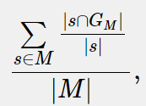
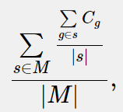
Saheb Kashaf, S., Almeida, A., Segre, J.A. et al. Recovering prokaryotic genomes from host-associated, short-read shotgun metagenomic sequencing data. Nat Protoc (2021)
Quality Evaluation
Estimate completeness and contamination from CheckM
Completeness: the number of marker sets present in a genome taking into account that only a portion of a marker set may be identified
s is a set of collocated marker genes;
M is the set of all collocated marker sets s;
G_{M} is the set of marker genes identified in a genome.
Contamination: estimated from the number of multicopy marker genes identified in each marker set
C_{g} is N − 1 for a gene g identified N ≥ 1 times
Parks DH, et al. 2015. CheckM: assessing the quality of microbial genomes recovered from isolates, single cells, and metagenomes. Genome Research.
Notes:
high completeness and low contamination MAGs might represent only a fraction of the entire metagenome²⁴
the minimum threshold of sequencing needed to retrieve medium- and high-quality MAGs varied between ~0.6 and ~6.1 Gb, but that the number of MAGs began to saturate with increasing sequencing effort²⁵
the depth of coverage required to recover MAGs depends on the diversity of the sample.
A study²⁶ comparing different assemblers demonstrated that ×10 coverage would be sufficient to recover the genomes of unique species in a sample, but much higher coverage (~×50) was required when there are closely related strains in the same sample.
fail to distinguish between contigs coming from different organisms, leading to the recovery of chimeric draft genomes (contaminated genomes)⁹
fail to correctly incorporate contigs from plasmids and other mobile genetic elements²⁷.

Slide 3
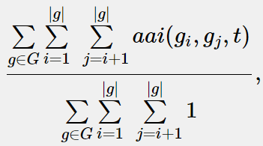
Saheb Kashaf, S., Almeida, A., Segre, J.A. et al. Recovering prokaryotic genomes from host-associated, short-read shotgun metagenomic sequencing data. Nat Protoc (2021)
Quality Evaluation
Estimate completeness and contamination from CheckM
strain heterogeneity index: calculated as the fraction of multicopy gene pairs above a specified amino acid identity (AAI) threshold
where g = {g₁,g₂,…,g_{N}} is the set of hits to a marker gene; G is the set of all marker genes; and aai is 1 if the AAI between g_{i} and g_{j} is greater than t (default = 0.9) and 0 otherwise
Parks DH, et al. 2015. CheckM: assessing the quality of microbial genomes recovered from isolates, single cells, and metagenomes. Genome Research.
Notes:
high completeness and low contamination MAGs might represent only a fraction of the entire metagenome²⁴
the minimum threshold of sequencing needed to retrieve medium- and high-quality MAGs varied between ~0.6 and ~6.1 Gb, but that the number of MAGs began to saturate with increasing sequencing effort²⁵
the depth of coverage required to recover MAGs depends on the diversity of the sample.
A study²⁶ comparing different assemblers demonstrated that ×10 coverage would be sufficient to recover the genomes of unique species in a sample, but much higher coverage (~×50) was required when there are closely related strains in the same sample.
fail to distinguish between contigs coming from different organisms, leading to the recovery of chimeric draft genomes (contaminated genomes)⁹
fail to correctly incorporate contigs from plasmids and other mobile genetic elements²⁷.

Slide 4
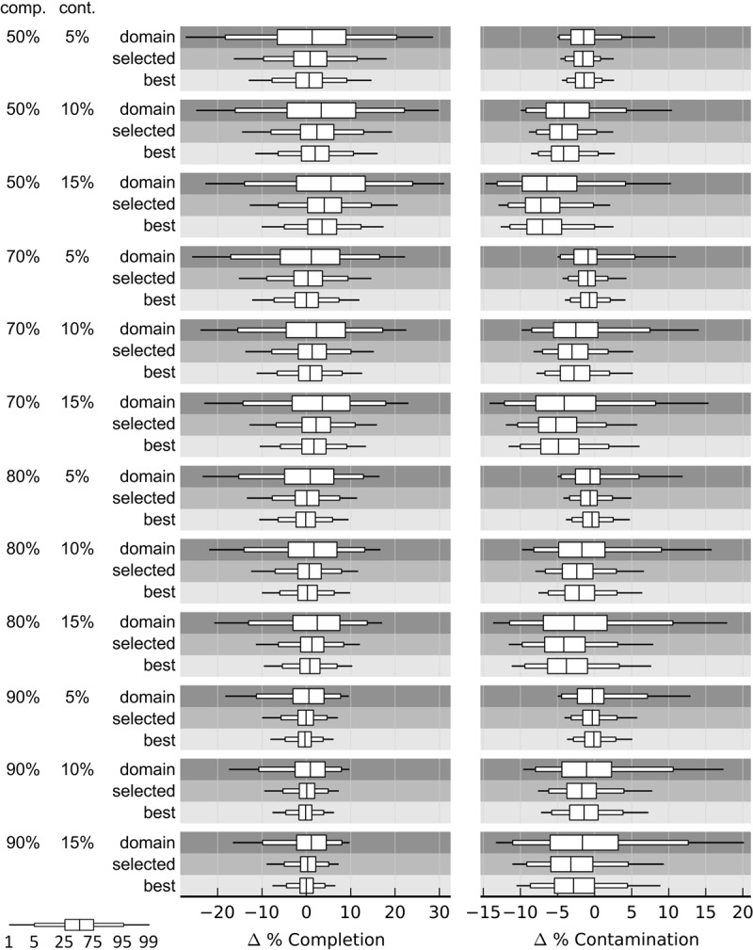
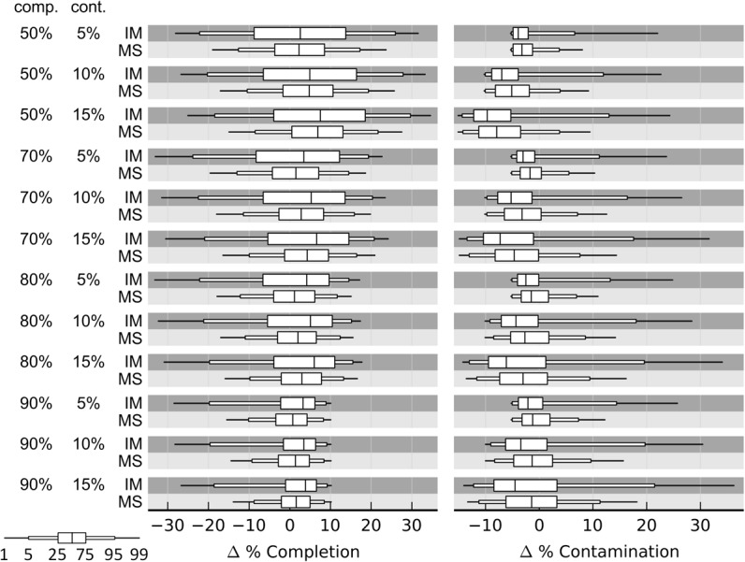
Quality Evaluation
Marker gene set selection of checkM
MS (collocated) better than IM (Individual)
Lineage selected better than domain (IM)
Parks DH, et al. 2015. CheckM: assessing the quality of microbial genomes recovered from isolates, single cells, and metagenomes. Genome Research.
Notes:
high completeness and low contamination MAGs might represent only a fraction of the entire metagenome²⁴
the minimum threshold of sequencing needed to retrieve medium- and high-quality MAGs varied between ~0.6 and ~6.1 Gb, but that the number of MAGs began to saturate with increasing sequencing effort²⁵
the depth of coverage required to recover MAGs depends on the diversity of the sample.
A study²⁶ comparing different assemblers demonstrated that ×10 coverage would be sufficient to recover the genomes of unique species in a sample, but much higher coverage (~×50) was required when there are closely related strains in the same sample.
fail to distinguish between contigs coming from different organisms, leading to the recovery of chimeric draft genomes (contaminated genomes)⁹
fail to correctly incorporate contigs from plasmids and other mobile genetic elements²⁷.

Slide 5
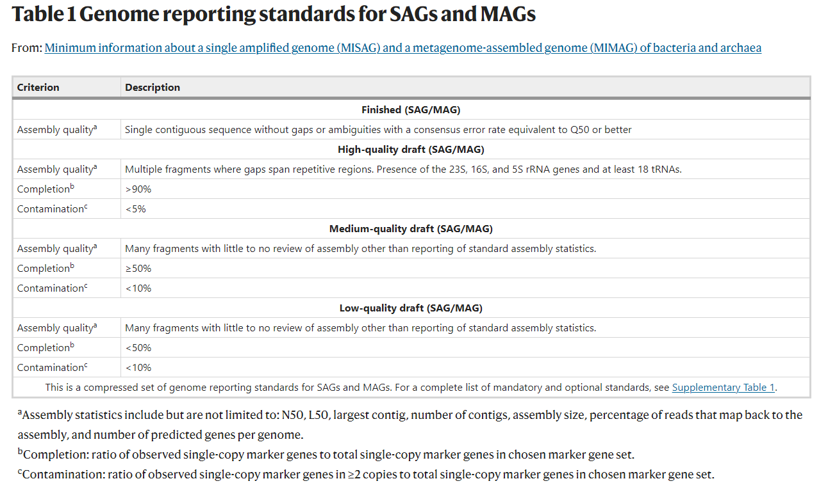
Saheb Kashaf, S., Almeida, A., Segre, J.A. et al. Recovering prokaryotic genomes from host-associated, short-read shotgun metagenomic sequencing data. Nat Protoc (2021)
Quality Evaluation
CheckM和QUAST的综合统计
BSC34

